Slide 1
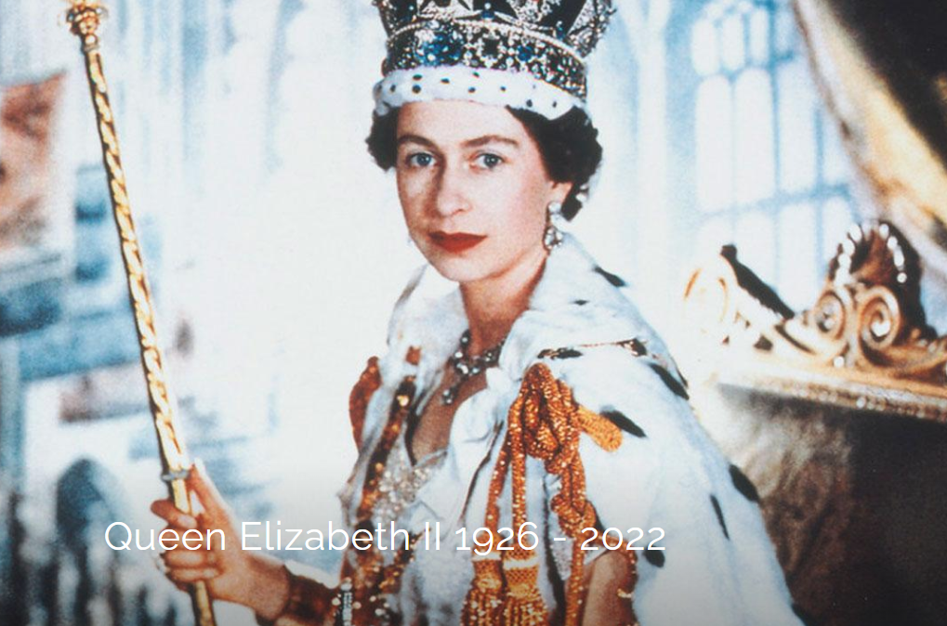

Slide 2
https://www.youtube.com/watch?v=ttFKYtK1jXM

Slide 3
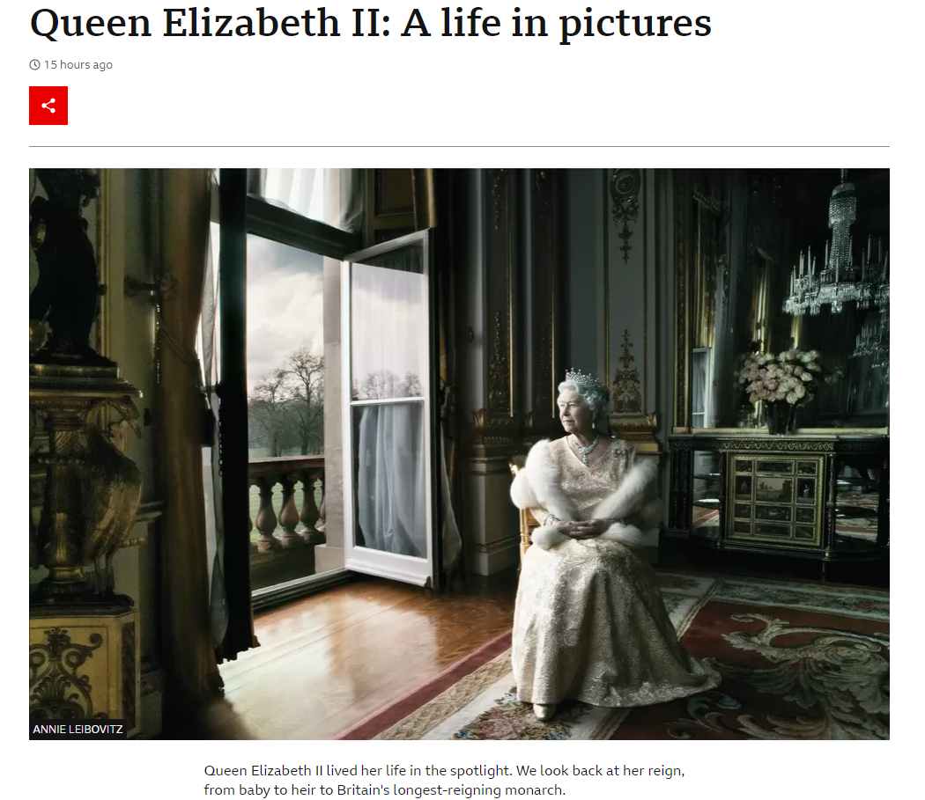
https://www.bbc.co.uk/news/in-pictures-61645231

Slide 4
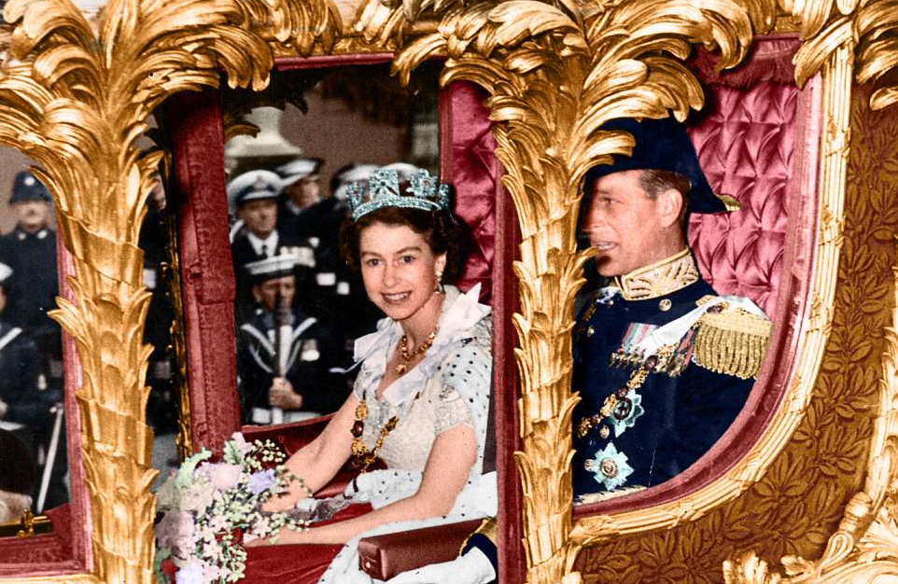
George V1 died February 1952 while Princess Elizabeth & Phillip were in Kenya, and she became Queen overnight
Elizabeth 11 Crowned Queen June 2 1953

Slide 5
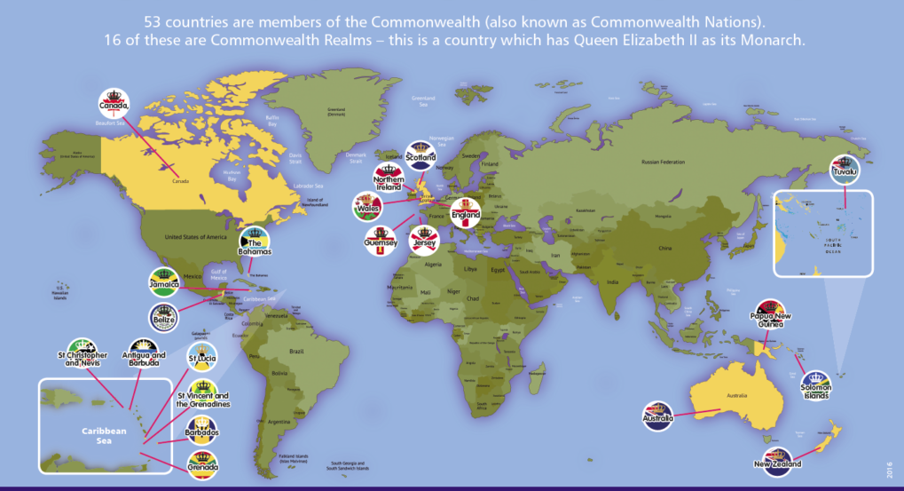
SOVEREIGN REALMS- QUEEN HEAD OF STATE.

Slide 6
In 2022, Her Majesty The Queen became the first British Monarch to celebrate a Platinum Jubilee after 70 years of service…we had a wonderful day at Russell

Slide 7
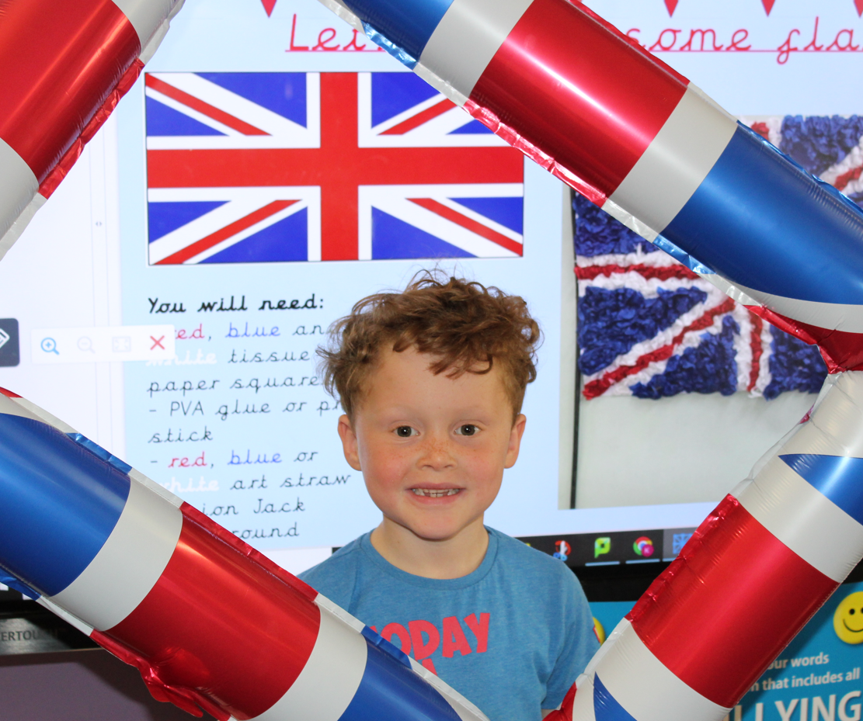
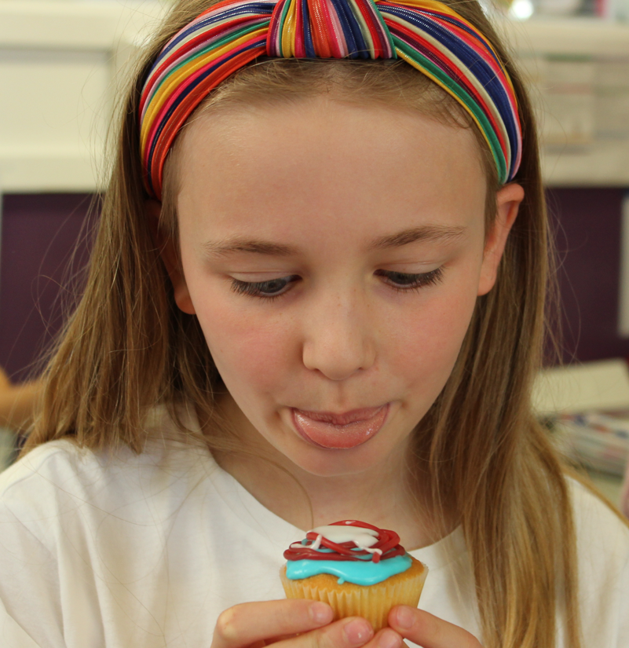
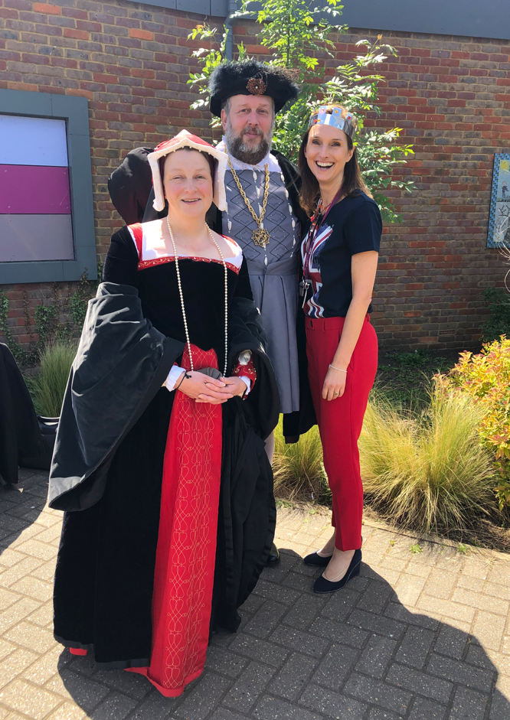
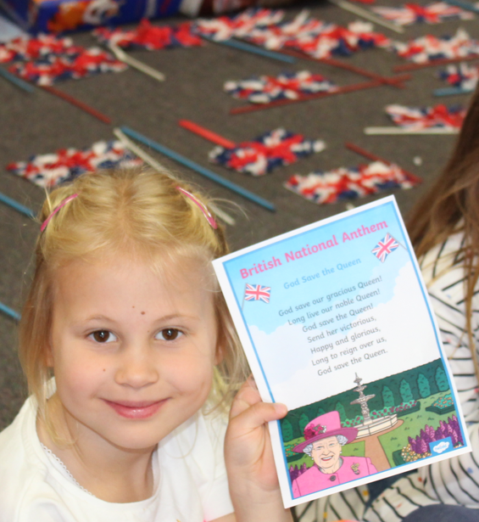
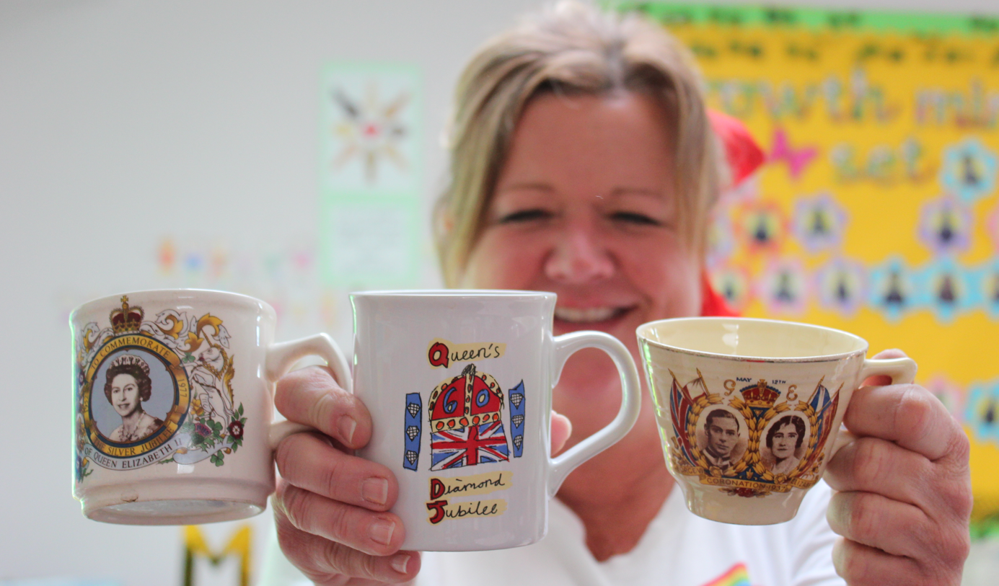

Slide 8
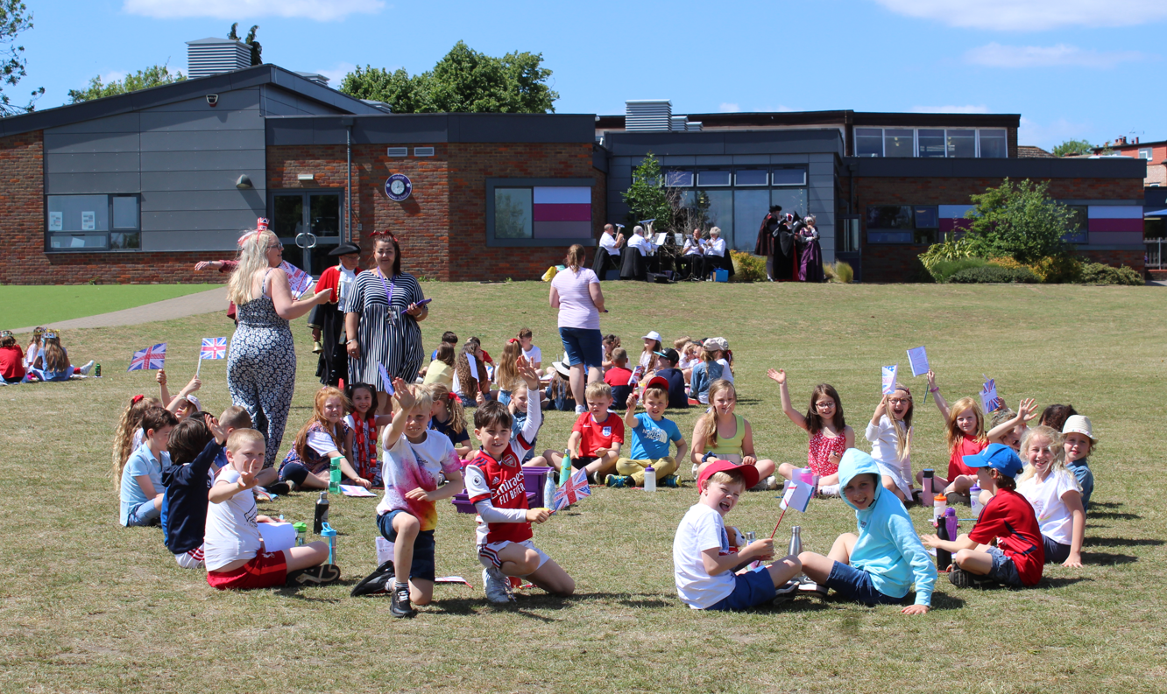

Slide 9
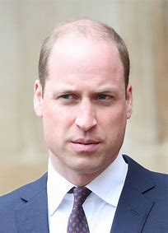
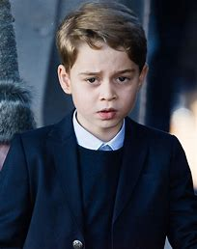
The Prince of Wales
Duke of Cambridge
Prince George
1st in Line to the Throne 2nd in Line 3rd in Line

Slide 10
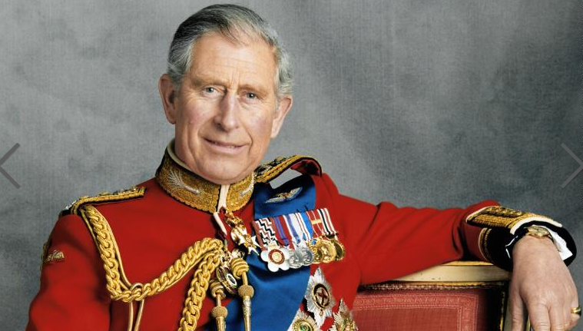
King Charles III – God save the King

Slide 11
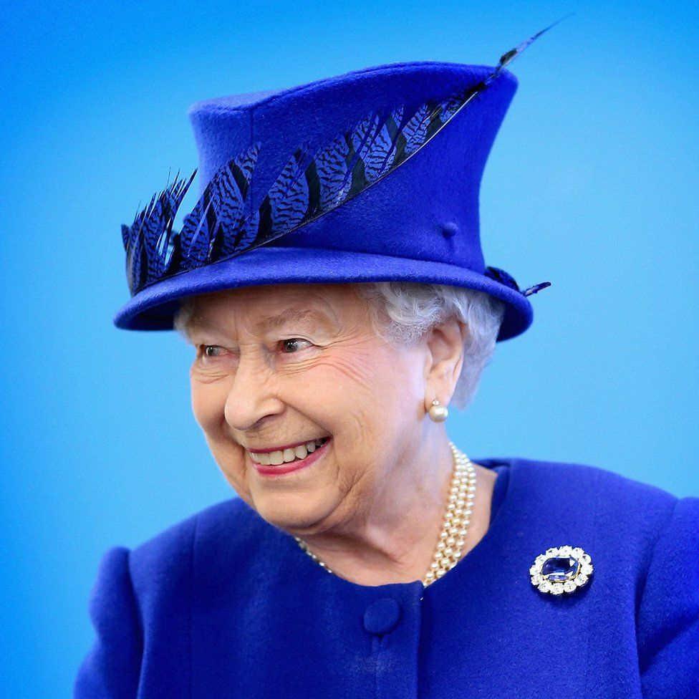
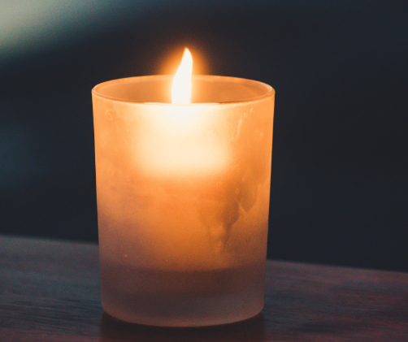
Mourning (morning)
Reflect - respect
DALAI LAMA IN A MESSAGE TO KING CHARLES
“Her reign, as Britain’s longest serving monarch, represented celebration, inspiration and a reassuring sense of continuity for so many people alive today.
Your mother lived a meaningful life with dignity, grace, a strong sense of service and a warm heart, qualities we all should treasure.”

Slide 12
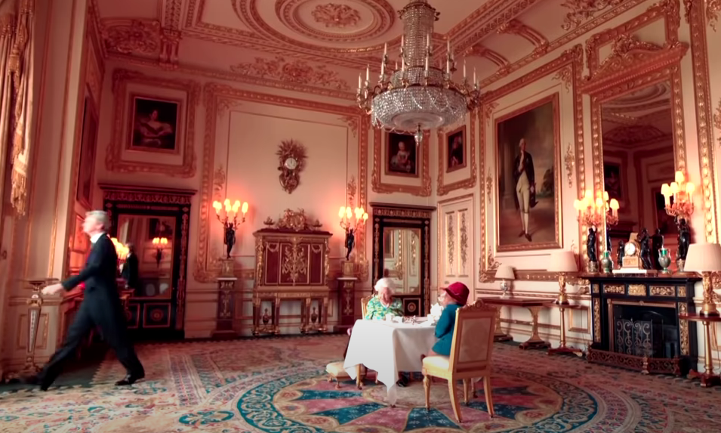
https://www.youtube.com/watch?v=ZZRP70zMHgo

