Slide 1
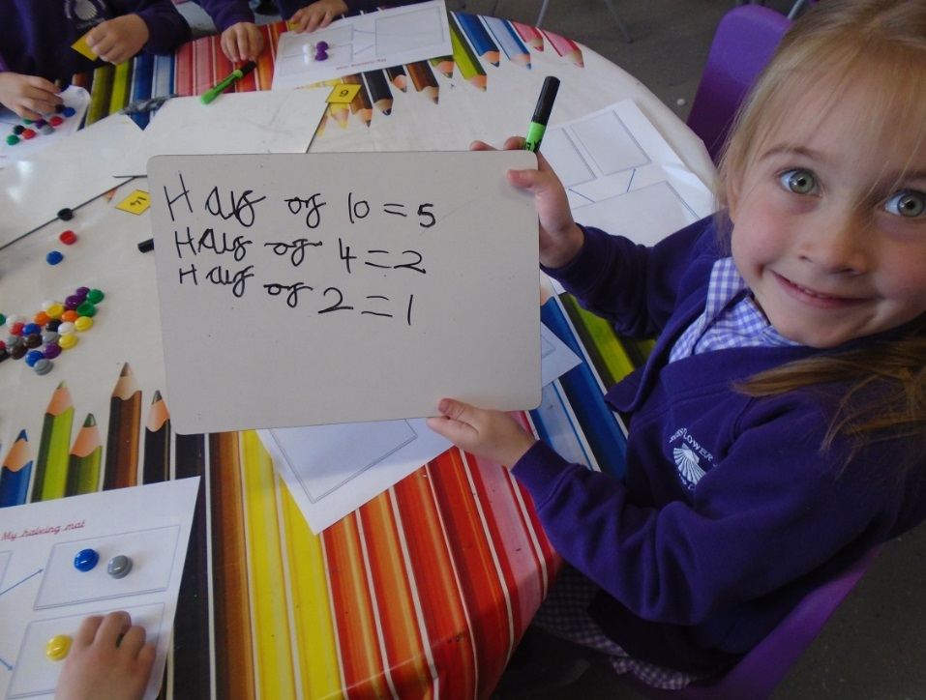
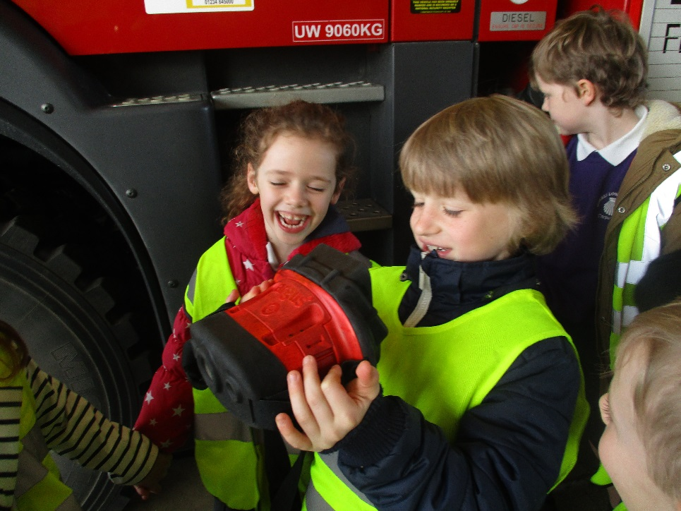
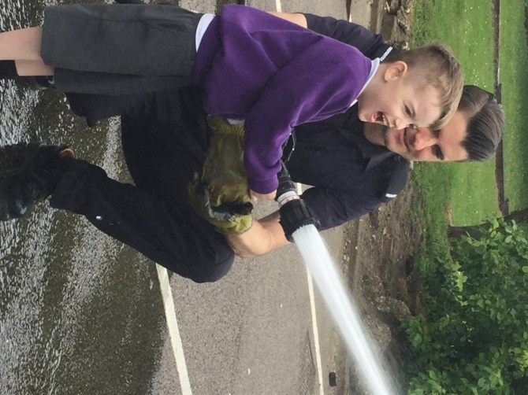
Welcome to Russell lower school…
New Intake 2023

Slide 2
…The Friendly school
We are very proud of our school, the pupils and all they achieve
We are a very happy school that achieves extremely high standards and believe that above all children and their development are paramount
We are passionate about enhancing each child’s knowledge, skills and understanding whist enabling them to become more confident, successful, independent, active and responsible
We believe that it is imperative that you are involved in every aspect of your child’s education and that we form a ‘team around the child’
We have a strong, caring ethos, where children and their successes really matter and are celebrated

Slide 3
The Foundation Teachers…there are currently also 5 teaching assistants that work across the 3 classes too

Slide 4
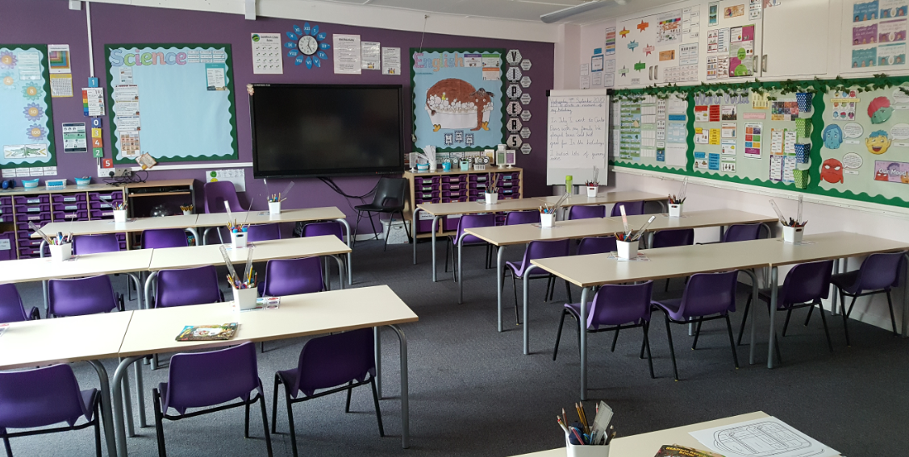
Welcome to our busy, bright, well-resourced classrooms
Year 3 Classroom
Foundation Stage Classroom

Slide 5
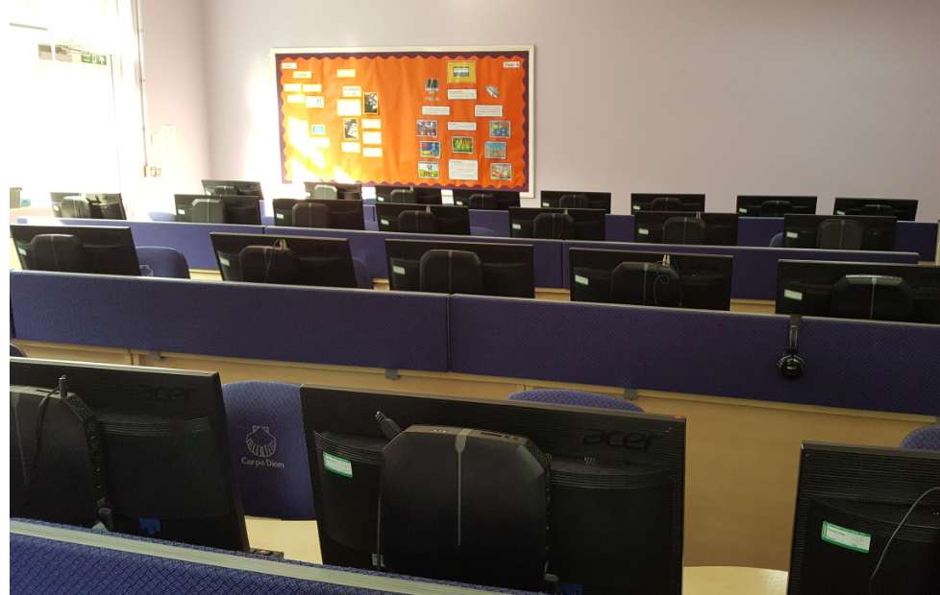
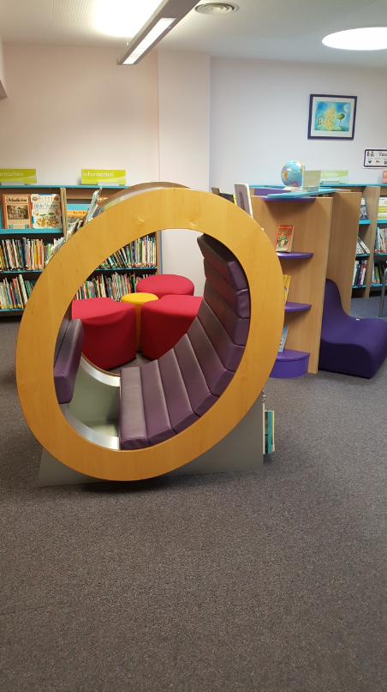
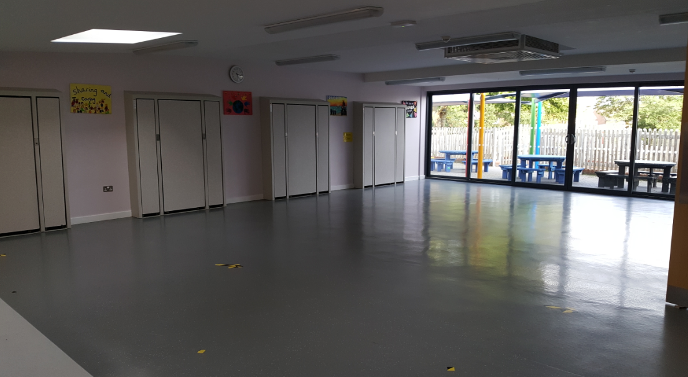
What does it look like inside?
Modern, bright and well resourced library, computer suite and two large halls

Slide 6
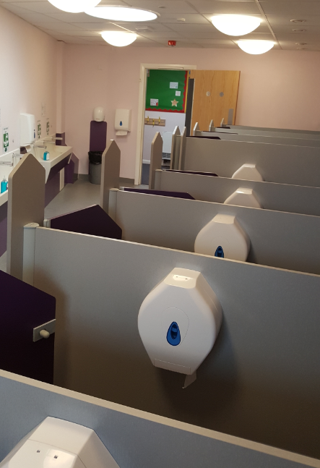
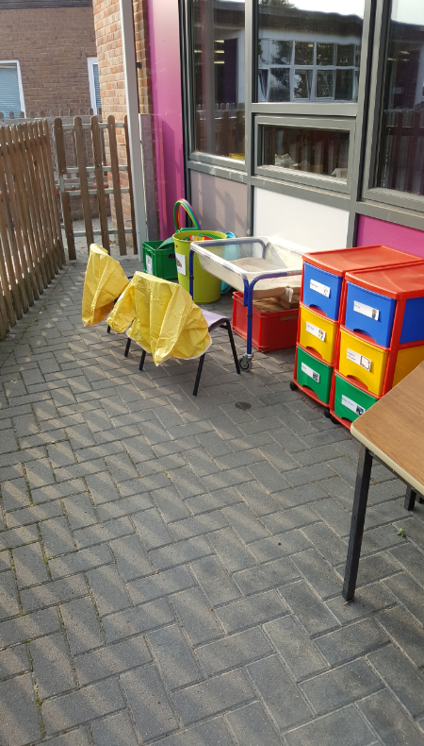
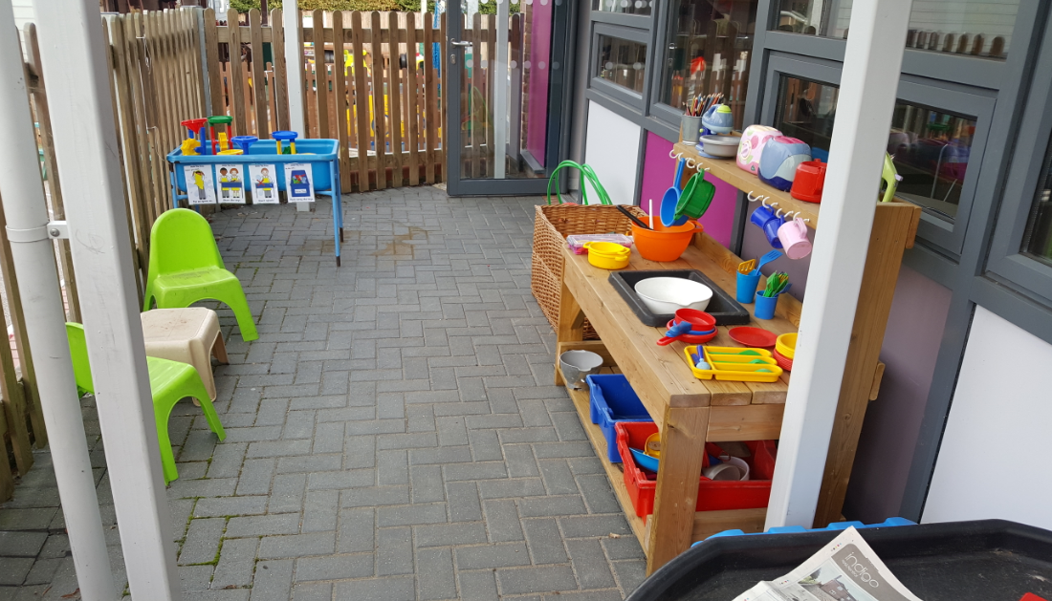
Foundation Stage corridor, toilets, and multiple terraces to take learning outside

Slide 7
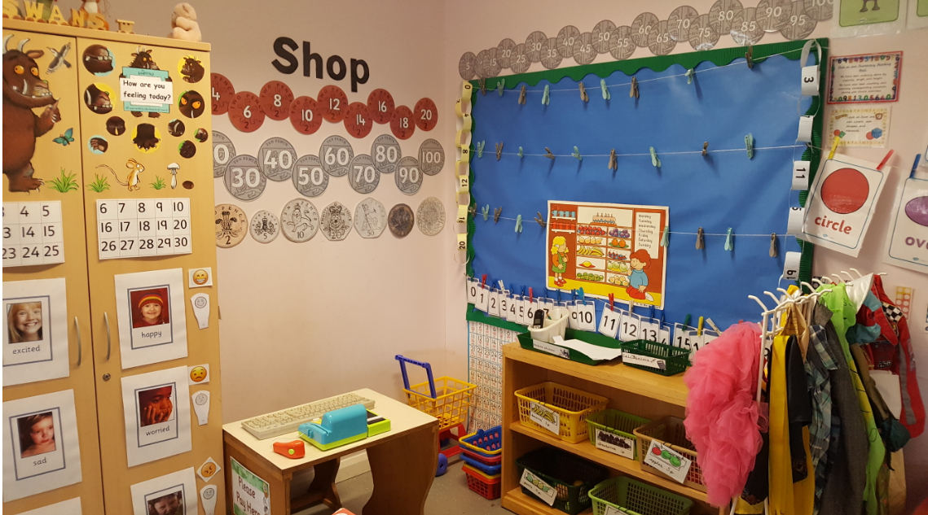
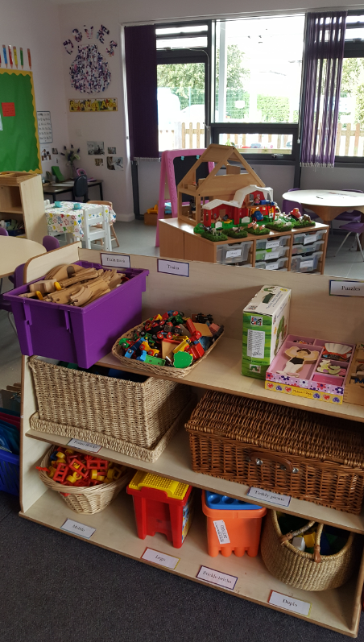
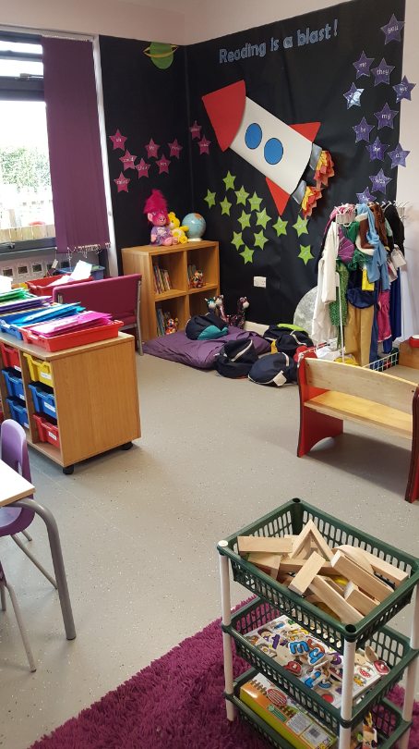
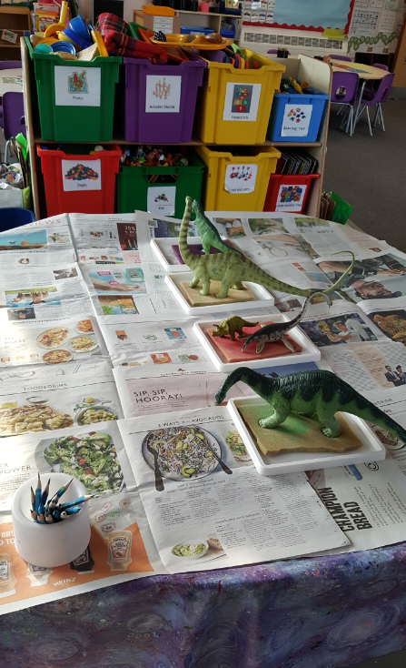
What does it look like inside?!

Slide 8
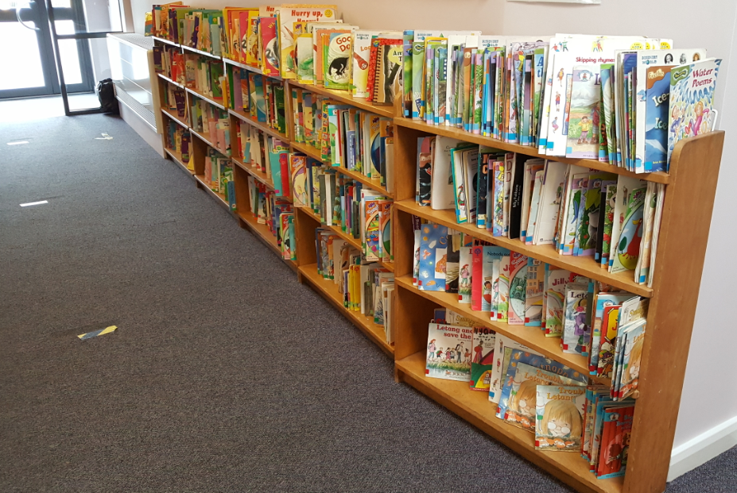
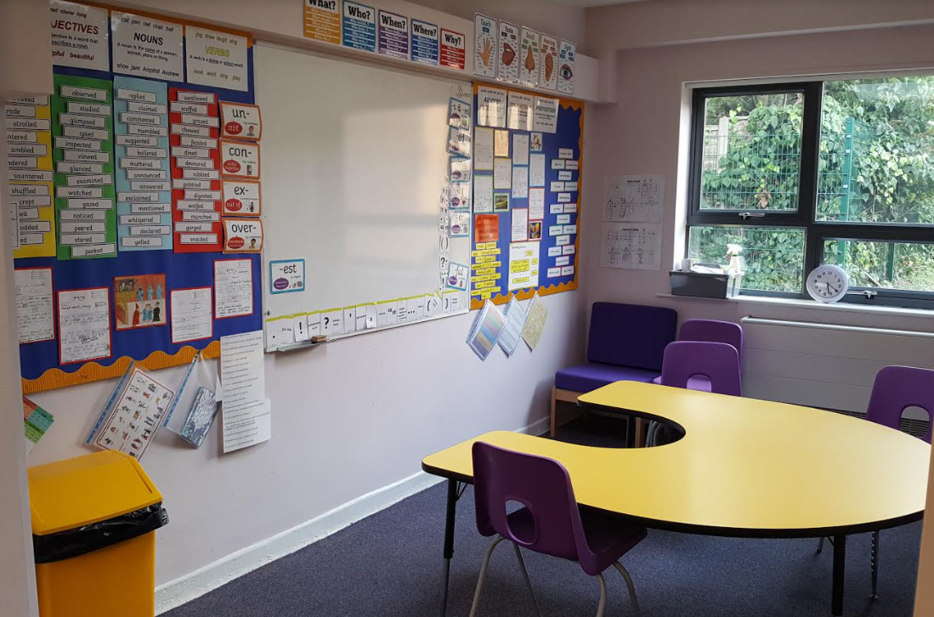
Reading resources and extra support or challenge

Slide 9
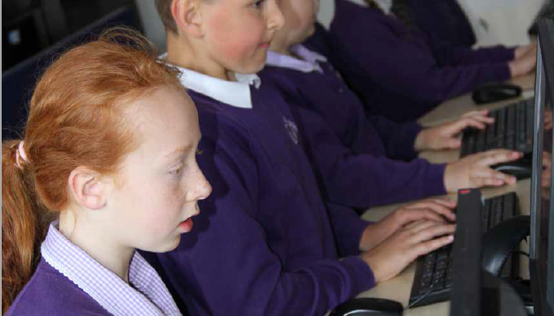
The learning journey
Children learn best when they are happy, secure and feel good about themselves
Learning should be fun – we aim to make it ‘irresistible’ through our rich creative curriculum which provides regular enrichment days, both in and out of school
Children are encouraged to explore, question, discuss and take ownership of their learning – striving to do better and to understand what they need to learn next in order to achieve their full potential
Our facilities are second-to-none in Bedfordshire, having undergone a £3.9m build in 2015, providing 7 new classrooms, two new school halls (one as a dining hall), a mini-ICT suite and a wonderful library. In addition, in 2016 we completely refurbished the ‘old’ parts of the school
All classrooms are equipped with the latest ‘Clevertouch’ boards and we have state-of-the-art ICT suite, three playgrounds all with trim trails and astro-turf areas, a wildlife garden and extensive field
We have a wide range of lunch-time and after-school activities, including football, netball, art, choir, gardening club, archery and multi-skills, as well as a thriving ‘Before and After School Club’ which provides care for our children between 7:45am and 6pm

Slide 10
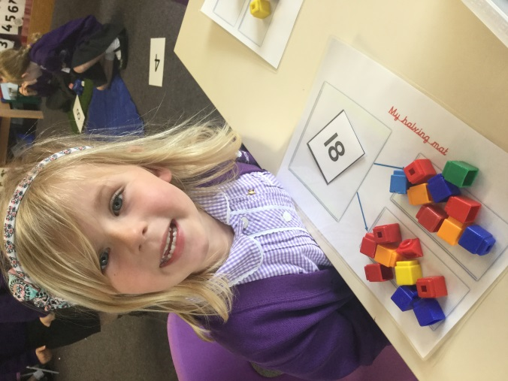
The Foundation Stage Curriculum
How do we teach Reading? Letters and Sounds, Jolly Phonics, daily sessions, target sight words, reading books and diaries
Writing? ‘Exciting Writing’ sessions continue to raise standards of writing at Russell. We use ‘Russell Writing’ which is a cursive script
And Maths? Taught sessions with the class teacher with follow
-up activities, including use of White Rose,
Numicon, practical activities and problem-solving
There is a new statutory EYFS Curriculum in place from
September 2021. It was already the way we worked.

Slide 11
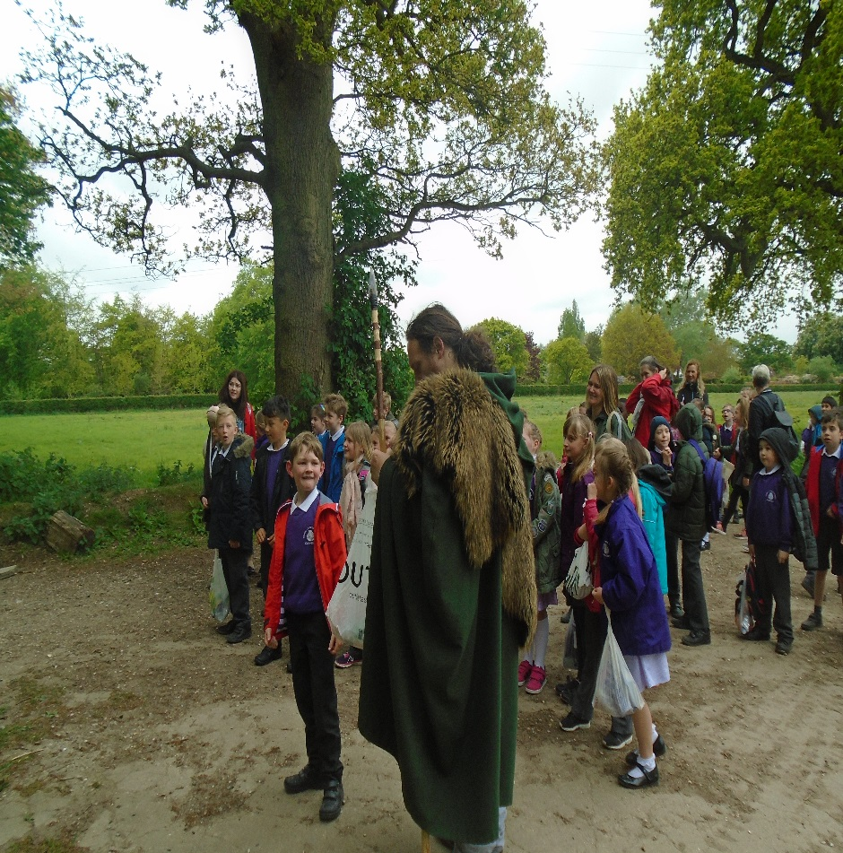
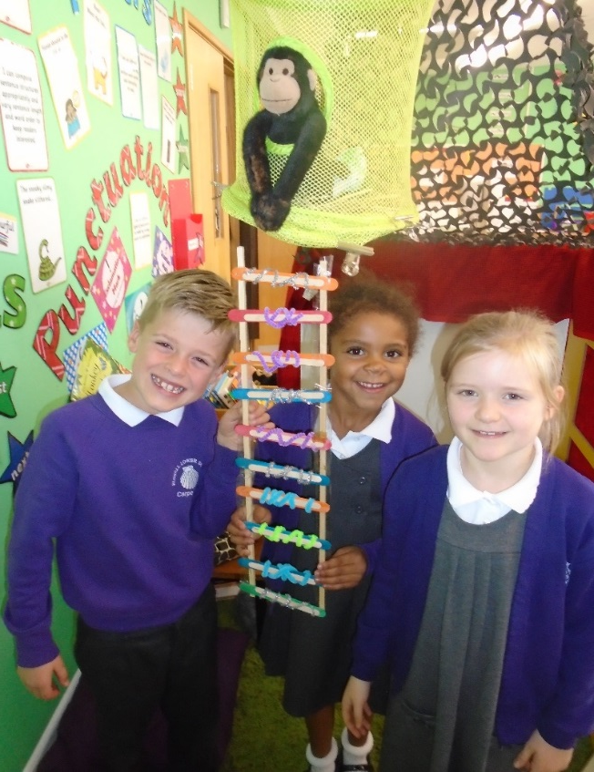
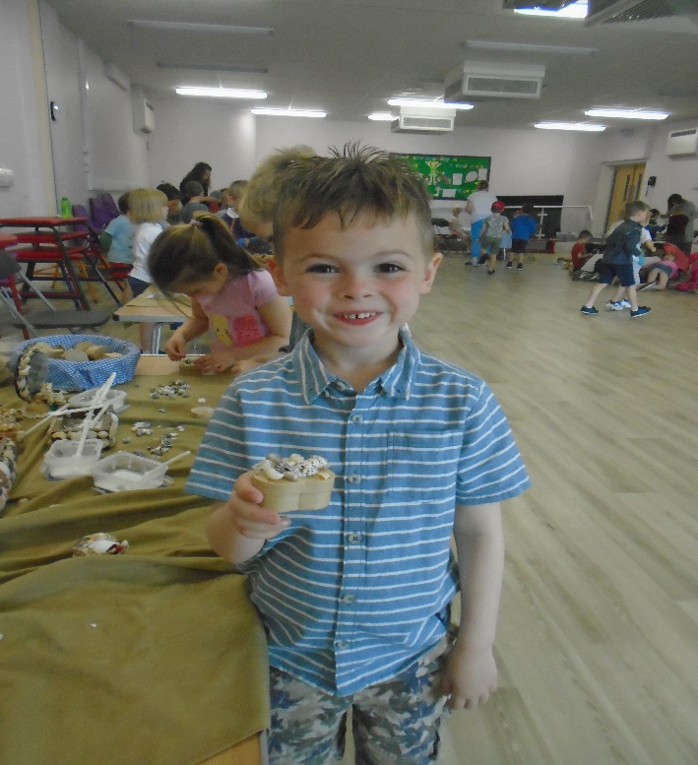
Our creative ‘themed’ curriculum

Slide 12
Keeping you informed with learning – half termly Theme webs, Learning Logs, Tapestry and show and tell

Slide 13
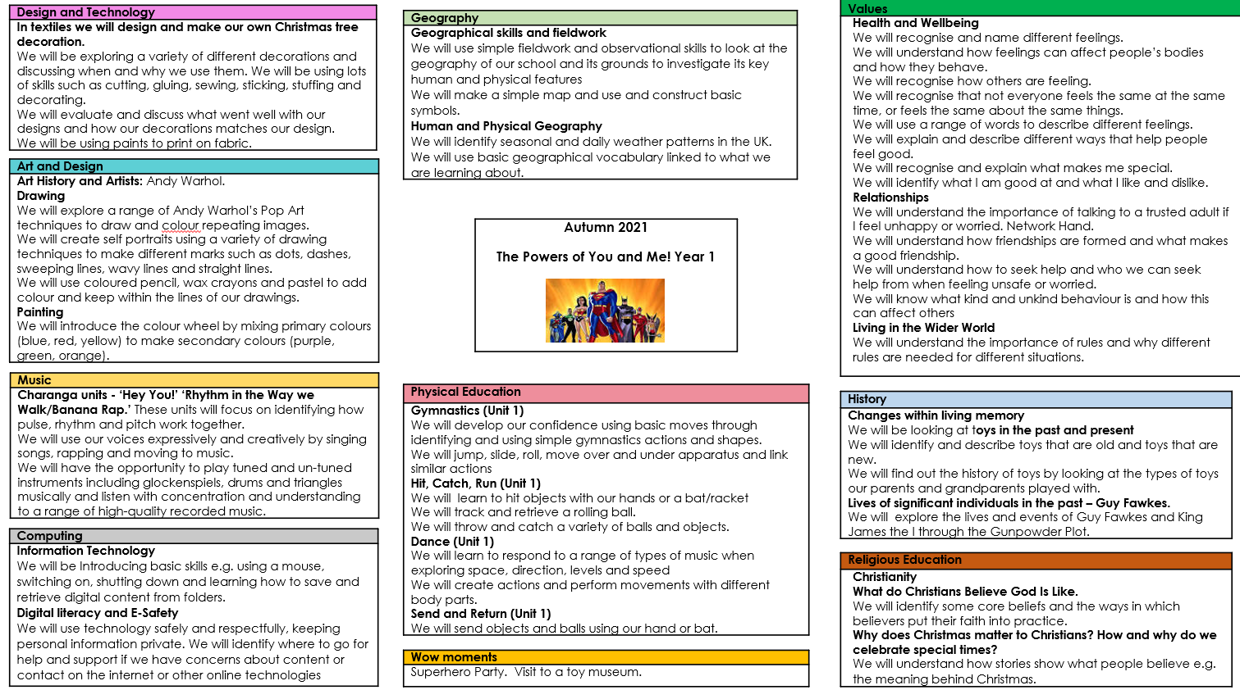

Slide 15
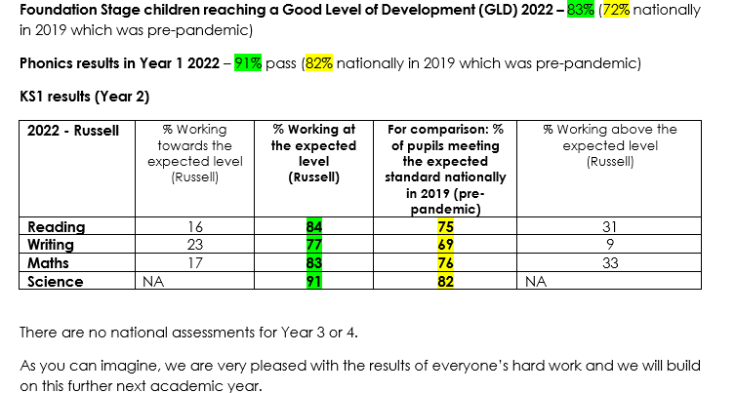
The standards
WHAT DO THE RESULTS SHOW? (and how do you compare pre-Covid?)
OFSTED Good November 2016 – with many areas commented upon as excellent, including the Foundation Stage
Foundation Stage, Key Stage One and Key Stage Two outcomes are strong

Slide 16
COMMUNITY LINKS
Very active PTA with everyone welcome – huge fundraiser for school
Use of the local environment – such as Ampthill Great Park, Waitrose, Houghton House and Kings Arms Gardens
Links with local churches (St Andrew’s/ABC), charities (Rotakids)and the Police and Fire Service
Strong links with pre-schools, particularly Ladybirds and Merry Poppets, but 60% of our children also come ‘out of catchment’
Close work with Sustrans for Bikeability, scooterbility, Dr Bike, Fun Maths and Science days, Santa Challenge etc.
Strong transition work with Middle Schools: Alameda and Woodlands and Upper School: Redborne
Strong ‘pyramid’ work with Redborne Schools Partnership involving all of Maulden, Ampthill and Flitwick working together

Slide 17
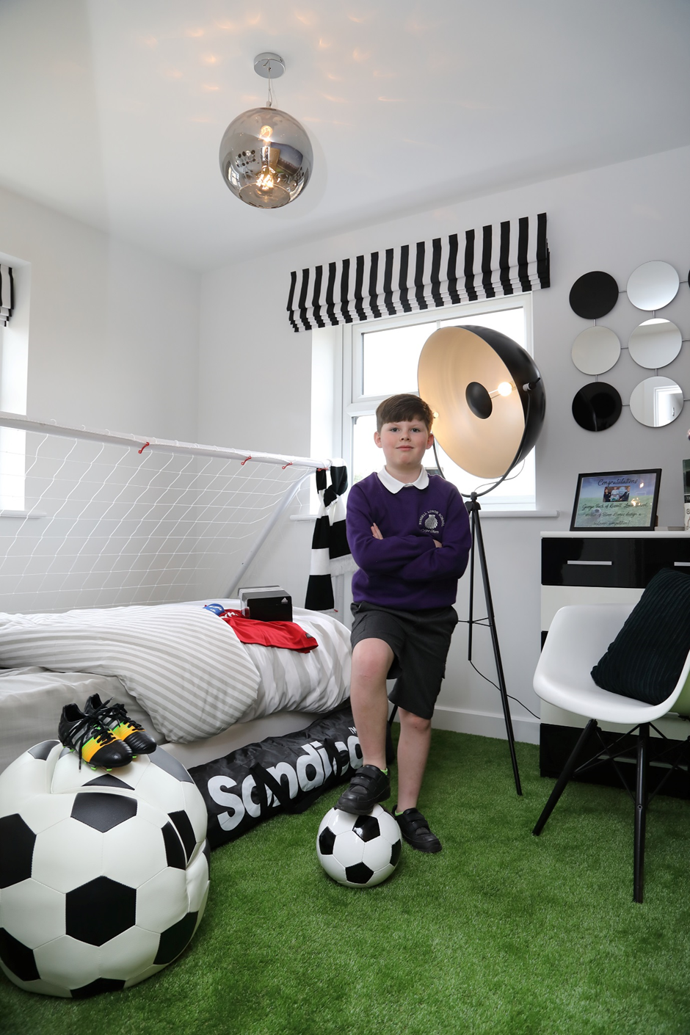
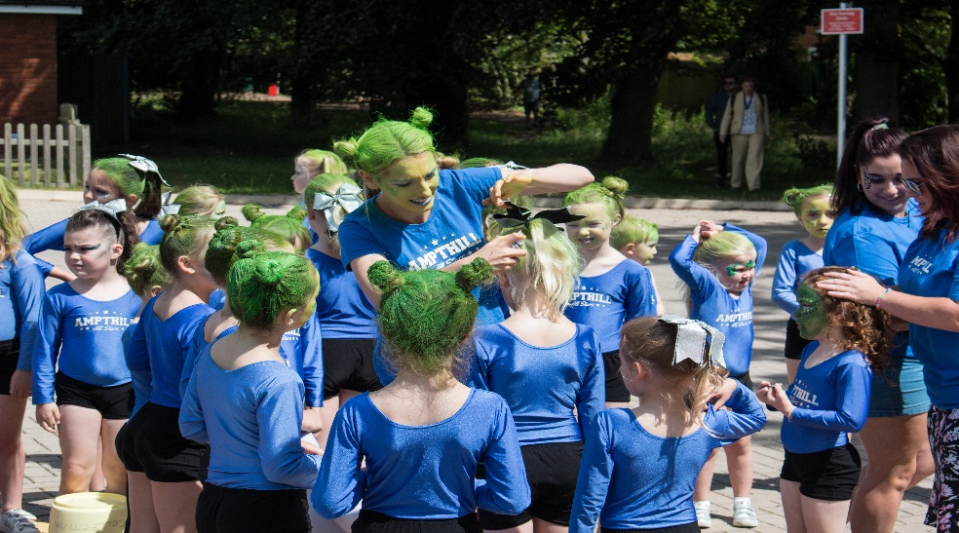
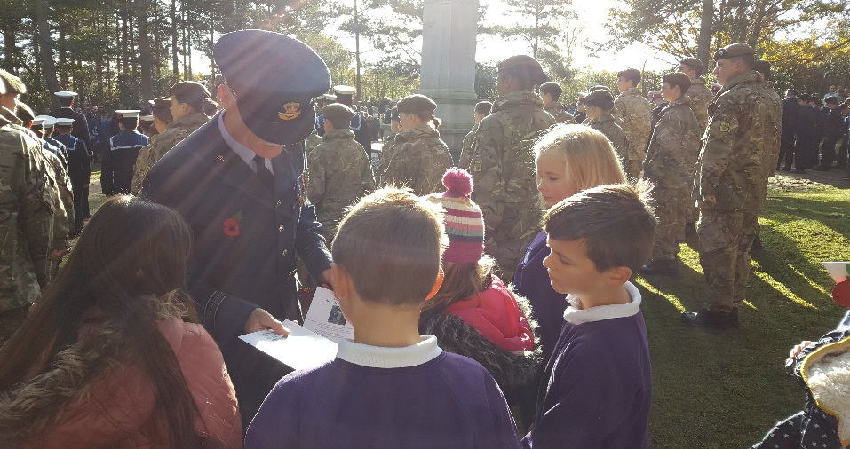
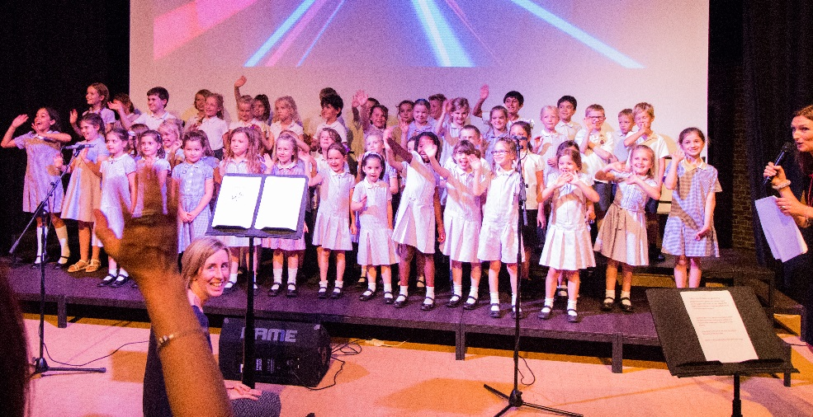
Community Links

Slide 18
What else can you offer?
Aviary Before and after school club
A range of extra-curricular clubs including sports and music
Strong, experienced teaching, Office and leadership teams
Dedicated Pastoral Support team and area in the school
PSHRE sessions/Sunshine Circles
5 Minutes Calm with mindfulness activities and yoga
Swimming in Year 3 and Year 4
Annual theatre trip or visit
Termly activity mornings or open afternoons to keep you in touch with the classroom
Parent workshops; E-Safety, Triple P, Volunteering in School, Phonics, Reading and Writing, Maths…just a few that often take place in the autumn term

Slide 20
What parents say – questionnaire – Feb 2021/FEB 2022
100% said they were happy with the remote learning offer and how Covid had been managed
100% of parents said their child is well looked after and well taught at Russell Lower School
100% of parents said their child is happy, feels safe and makes good progress at Russell Lower School
100% of parents said that the school ensures the pupils are well behaved at Russell Lower School
100% of parents said they would recommend the school to another parent
100% of parents said the school is well lead and managed
98% said school deals effectively with bullying with most parents reporting no experience of it at all
What can we do better?
Introduce a PE kit top so we look smarter in tournaments
Can we agree how often children should be heard read at home and at school so we know what to expect?
Can we have more reports on progress? (2018)
Source: Covid questionnaire Feb 2021, Full Questionnaire June 19

Slide 21
Even after a 3rd academic year of Covid?

Slide 22
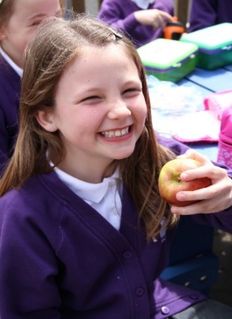
What parents said
“I cannot express in words how the staff have supported us over the years and the difference it has made to our lives.”
“I have been extremely impressed with Russell and I am very excited that the children are learning here.”
“My daughter loves Russell.” “We are very happy here.” “We LOVE the ‘open door’ policy.”
“Creative curriculum, ‘wow’ days and the trips are fantastic.”
“As parents of 3 children, we have been very pleased with their progress…motivational teachers have made learning fun and interesting.”
“Delighted with the school. The children are really happy…we are really glad
we chose this school!”
“I love the school ethos and my children have been really happy here”
“The PE is really good. Lots of different clubs and new skills. School is exciting!”
“The school could not have handled Covid any better. Communication is excellent and remote learning was 4 live lessons a day with their teacher!”
Source: Questionnaires 2018 – 22, and Ofsted Report

Slide 23
What ofsted said: 2016/17
“Pupils say they love school…they say teachers are good and fun, they get support if they need it, teachers encourage them to do high-level work and they learn a lot, everyone gets along and any bullying is dealt with very quickly.”
“Children’s behaviour and attitudes to learning are very good. Consequently they make good progress.”
“A rich curriculum and the wide range of extra-curricular activities bring learning to life.”
“Accurate tracking of pupils’ progress and robust monitoring of teaching ensure that most-able pupils are identified and challenged to achieve as much as possible.”
“Learning in the early years is exciting. Parents said their children were very happy, safe and thrilled to be at school. I can see why.”
“Parents, pupils and staff say that the best characteristics of this school are exemplified by ‘The Russell Way’ and ‘not-a- second-wasted’ approach through which everyone is valued and stimulated to make the school even better.”
“There is a well-managed buzz of excitement at the start of the day.”
“There are high expectations for conduct around the school.”
“Pupils are very proud of their school and keen to take on responsibilities. Their personal development is a strength.”

Slide 24
The admissions process
The deadline for admission is 15th January 2023 – we strongly advise applying before Christmas once you have made your choice as we had 98 first choice applications again this year (94 last year)!
Make your application to CBC Admissions – we do not handle our own admissions unfortunately
You will be offered a place via CBC
You accept/decline your place
You will be invited to a new intake meeting in June which begins the transition process from nursery and introduces you to school

Slide 25
More information
Our website has almost everything you could possibly need: www.russell-lower.co.uk
Email: office@russell-lower.co.uk
Ring: 01525 755664

Slide 26
Thank you for coming…tour and questions
Thank you for coming
We have another open day session if you feel you want to come again you would be very welcome
Any questions can be sent to office@russell-lower.co.uk and we will get back to you promptly
Tours

