Slide 1
Reporting progress and assessments to parents workshop – January 2016, 6:30 – 7:15pm

Slide 2
Why are things changing at Russell?
The Government has changed the way teachers assess children
The Government has changed the language we use around assessment
Parents felt (September Parent Questionnaire) that they were not as informed as they could be about children’s attainment and progress through the year. The end of year reports are ‘too late’

Slide 3
What assessments currently take place?
Daily assessments in class of what children can do – these are entered into our assessment and tracking system called Classroom Monitor
‘Summary’ assessments each term to check that children are ‘on track’ to achieve ARE (age related expectations) and make good progress from their starting points
Baseline Assessment of children as they enter school (First half term of Foundation Stage)
Early Years Profile – Reported at the end of Foundation Stage to report to parents if their child has made a Good Level of Development (GLD)
Year 1 Phonic Screening Test (with a re-test in Year 2 for any children not meeting the expected standard)
Statutory Assessment tests that used to be called SATS in Year 2. These are in Reading (2 papers), Maths (2 papers – Arithmetic and Reasoning), Grammar, Punctuation and Spelling (with a separate spelling test) and teacher assessed writing
There are no statutory assessments in Year 4 but we assess and report using Classroom Monitor

Slide 4
What has changed nationally?
A new national curriculum with raised expectations
Levels have gone – teachers previously reported level 1 (c,b,a), level 2 (c,b,a) etc. with level 2b being the ‘expected’ level at Year 2
‘Life after Levels’ – schools could decide their own system!
Some principles changed too – instead of ‘Best Fit’ teachers must now use ‘Secure’
The Government have published ‘Interim’ Teacher Assessment frameworks – this year Teacher Assessment will remain ‘king’ but in future it may be test based

Slide 5
What does this mean for us and our children?
In all Year groups, teachers will be reporting to you using the language of ‘Working Towards the Expected Standard’, ‘Working at the Expected Standard’ or ‘Exceeding the Expected Standard’.
In Year 2 the tests will give a result ‘score’ for each child, where the ‘Expected Standard’ score is 100. From this, parents will know that any score below 100 is ‘Working Towards’ and any score above 100 is ‘Above or Exceeding’ the ‘Expected’ standard

Slide 6
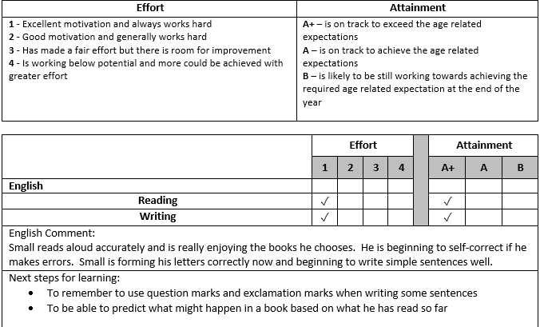
What will that look like at the February parents evening?

Slide 7
So what does the ‘expected level’ look like and how can we help?
In order to help teachers assess children they look to something called ‘Key Performance Indicators’ (KPIs)
These exist for all year groups, becoming progressively more challenging and/or with new elements included for each year group
The expectation is that a child needs to be secure in all of these areas in order to be ‘secure’ overall

Slide 8
What do key performance indicators look like?
You are now going to have a few minutes to see if you can sort some of the key performance indicators into two different year groups
All of the KPIs have been labelled to indicate which area of Maths they fall into but you must decide if they belong to year 2 or year 4

Slide 9
Year 2
Number and place value (N&PV) | Addition and subtraction (A&S) | Multiplication and division (M&D) | Fractions – including decimals (F) | Measurement (M) | Geometry: properties of shape (PoS) | Geometry: position and direction (P&D) | Statistics(S)
N&PV Counts in steps of two, three, and five from 0, and in tens from any number, forward and backward N&PV Compares and orders numbers from 0 up to 100 N&PV Uses < > and = signs correctly N&PV Uses place value and number facts to solve problems | A&S Solves problems with addition and subtraction by: 1. using concrete objects and pictorial representations, including those involving numbers, quantities and measures; and 2. applying an increasing knowledge of mental and written methods. A&S Recalls and uses addition and subtraction facts to 20 and 100: fluently up to 20. | M&D Recalls and uses multiplication and division facts for the two, five and 10 multiplication tables, including recognising odd and even numbers M&D Solves problems involving multiplication and division, using materials, arrays, repeated addition, mental methods, and multiplication and division facts, including problems in contexts | F Recognises, finds, names and writes fractions 1/3, 1/4, 2/4, and 3/4 of a length, shape, set of objects or quantity | M Solves simple problems in a practical context involving addition and subtraction of money of the same unit including giving change | PoS Compares and sorts common 2-D and 3-D shapes and everyday objects | P&D Uses mathematical vocabulary to describe position, direction and movement including movement in a straight line, and distinguishes between rotation as a turn and in terms of right angles for quarter, half and three-quarter turns (clockwise and anti-clockwise) | S Asks and answers questions about totalling and comparing categorical data.

Slide 10
Year 4
Number and place value (N&PV) | Addition and subtraction (A&S) | Multiplication and division (M&D) | Fractions – including decimals (F) | Measurement (M) | Geometry: properties of shape (PoS) | Geometry: position and direction (P&D) | Statistics(S)
N&PV Counts in multiples of six, seven, nine, 25 and 1,000 N&PV Counts backwards through zero to include negative numbers N&PV Orders and compares numbers beyond 1,000 N&PV Rounds any number to the nearest 10, 100 or 1,000 | A&S Solves addition and subtraction two-step problems in context, deciding which operations and methods to use and why | M&D Recalls multiplication and division facts for multiplication tables up to 12 x 12 | F Recognises and shows, using diagrams, families of common equivalent fractions F Counts up and down in hundredths; recognises that hundredths arise when dividing an object by 100 and dividing tenths by 10 F Rounds decimals with one decimal place to the nearest whole number F Solves simple measure and money problems involving fractions and decimals to two decimal places | M Converts between different units of measure eg kilometre to metre; hour to minute | PoS Compares and classifies geometric shapes, including quadrilaterals and triangles, based on their properties and sizes PoS Identifies lines of symmetry in two dimensional shapes presented in different orientations | P&D Plots specified points and draws sides to complete a given polygon | S Solves comparison, sum and difference problems using information presented in bar charts, pictograms, tables and other graphs

Slide 11
What will this look like to the children?
The children will not notice day to day assessments that their teachers make
The children in Year 2 will need to sit ‘tests’ and these MUST be done during May 2016. We will make them as stress-free as possible so please do not ‘warn’ your children or ‘build them up’. We don’t want any of them worrying.
This is an example of what they will look like:

Slide 12
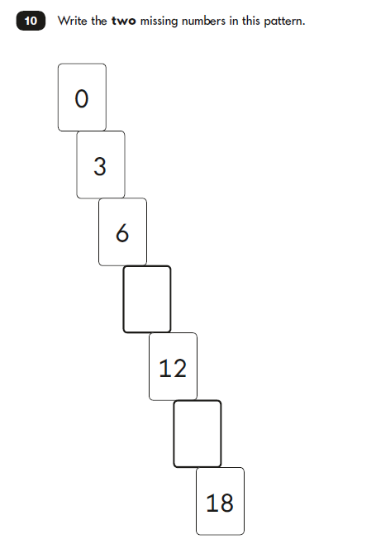
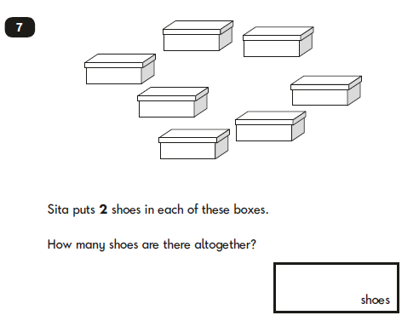
Maths - Reasoning

Slide 13
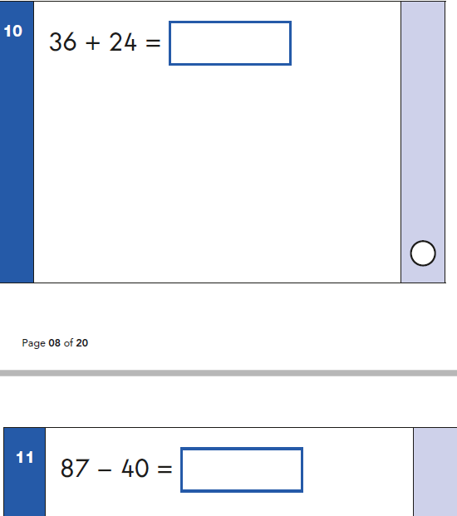
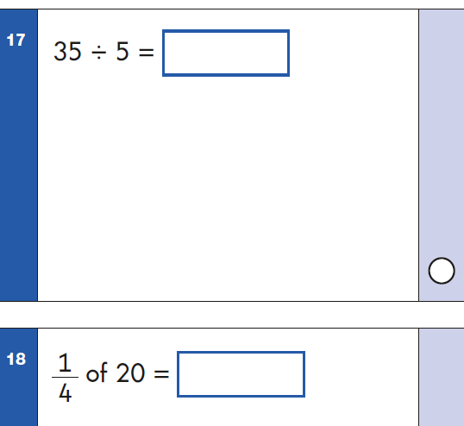
Maths - Arithmetic

Slide 14
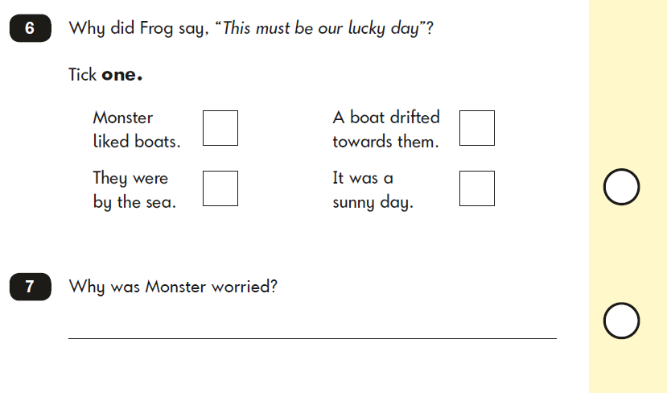
English - Reading

Slide 15
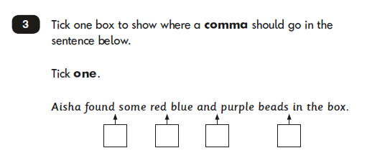
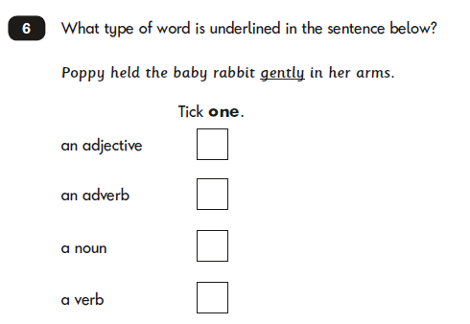
English – Grammar, Punctuation and Spelling

Slide 16
What next and what can we do to help?
Mid-year spring report to let you know how your child is getting on and their next steps – this will come our prior to the parents evening
Parents Evening – a chance to discuss the mid-year spring report
Copies of all of the ‘Expectations’ for each year group
Create fun, practical, real-life ways of discussing and experiencing some of the things mentioned on the ‘Expectations’ sheet for your child’s year group (especially Maths – think about the shoe box question for example), read with your child at least 4 times a week and ensure there is a focus on discussion and asking and answering questions too, support children to learn spellings or high frequency words, think ‘out loud’ to model what you do. For example: writing a note to Daddy: ‘I’ll put a full stop there because it is the end of my sentence.’ Reading is a brilliant time to discuss grammar, spelling and punctuation too! Support children to learn their tables, number bonds, doubles and halves (instant recall/spaced repetitive practice).

Slide 17
Evaluation please
Please take a minute to compete the short evaluation. It will help us inform future sessions. Thank You.
Thank you for taking the time to attend this session this evening.
A short Parent Governor Forum meeting will take place following this meeting. Please stay behind.

