Slide 1
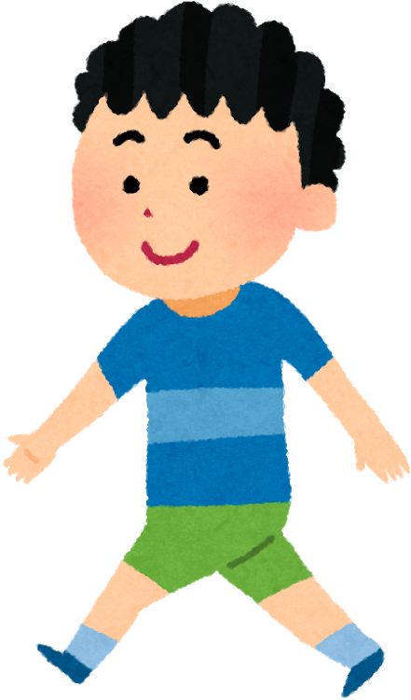
Looking after our mental health (how we feel)
On the Friday before half term we wore our bright clothes to school
Why did we do that?

Slide 2
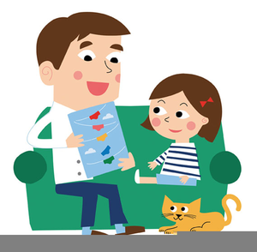
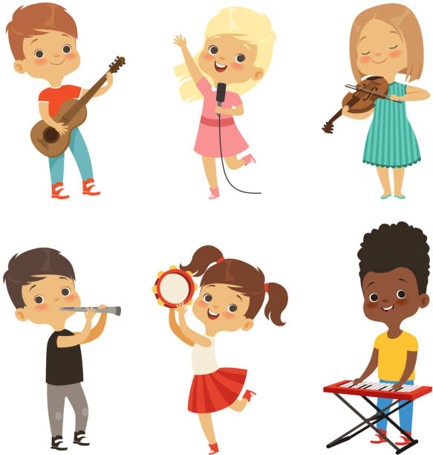
How can YOU help and support each other grow?
Talk to one another
Get active
Learn a new skill
Practise self care
Notes:
You’ve come up with some really good ideas about what it means to ‘grow together’ but next I want you to think about how you can help and support each other grow?
Idea – Class to think of ideas of ways to help and support each other growing
Here’s some way’s we’ve/I’ve thought of to help you ‘grow together’
- Talk to one another – talk about your friends’ best qualities, the things that make them special and unique
- Get Active – stepping outside for some fresh air and going for a walk with a parent/carer can help clear your mind. Any activity where we are moving our bodies usually makes us feel better. There are lots of ways to stay active – skipping, netball, football etc
Learn a new skill – start a new club – there’s lots on offer here at school such as…teacher to give examples
Practise self care – you may not know what this means so we’re going to have a look at this on the next slide…

Slide 3
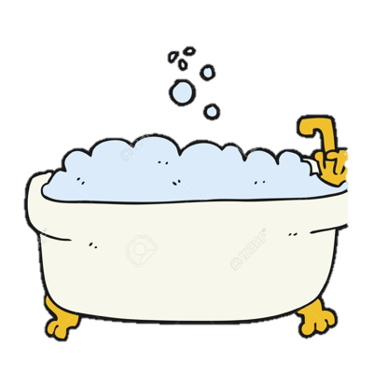
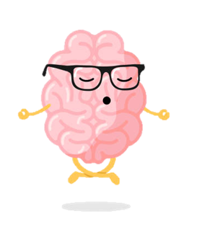
Self Care
It’s really important to look after ourselves in order to help us grow physically, emotionally and mentally
Here are some tips:
Notes:
It’s really important to look after ourselves in order to help us grow physically, emotionally and mentally
Here are some tips:
Have a bath
Listen to a song that makes you smile
Watch a film that makes you laugh
Write down a list of nice things about yourself
Practise relaxation – e.g. deep breathing (we will try this in a moment, next slide)
Can anyone think of some more ideas? Idea – everyone write on a post it note 3 x self care ideas they are already doing or are going to start practising

Slide 4
Breathing exercise – deep breathing
It is okay to be upset, cross or angry, but it isn’t okay to hurt anyone with our actions or our words – Kind words; kind hands.
Notes:
Sometimes we can face setbacks and challenges in life. Other times we can feel angry, worried or scared. It is important to learn and grow from these moments. Deep breathing can really help us with these difficult times.

Slide 5
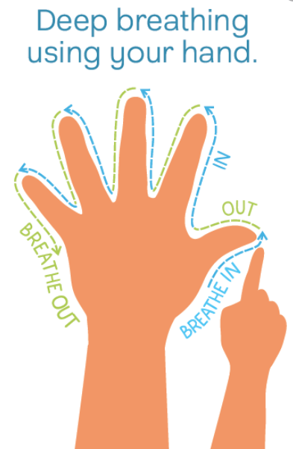
Let’s give it a go!
Notes:
Practice deep breathing – follow script. Pick one 4/7 or 3/5/5 and repeat multiple times.
To begin, sit still somewhere comfortable. Close your eyes and begin breathing through your nose. Try one of the following techniques… Breathe in for a count of 4…Then breathe out for a count of 7 Breathe in for a count of 3…Hold for a count of 4…Then breathe out for a count of 5 Make sure you are breathing deeply, imagine you are filling up a balloon in your stomach when breathing in. Your shoulders should not move. When you breathe in your tummy should come out as it fills with air. When you breathe out, your tummy should go down as the air comes out. It can be really helpful to practice with a cushion on your belly to see it go up and down. If you find this difficult you can reduce the count as long as the out-breath is longer than the inbreath. Deep breathing is really good because it can help us come out of fight or flight. Our heart rate slows down, and our body starts to feel calm.

Slide 6
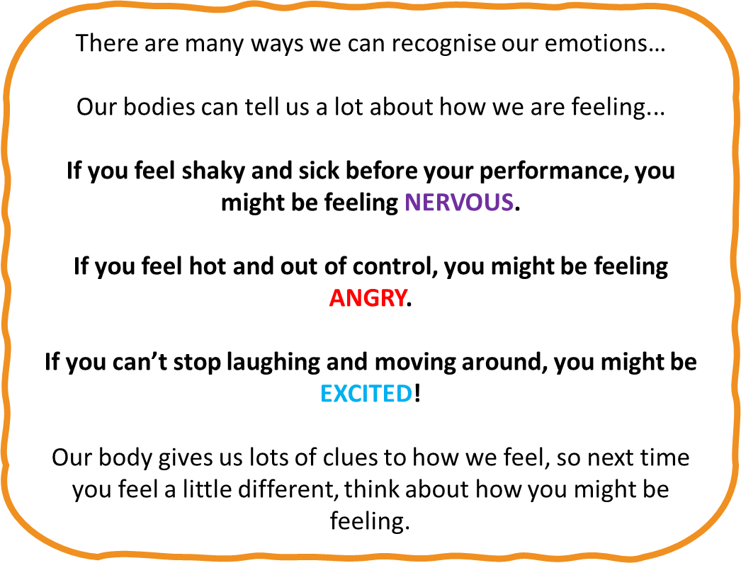
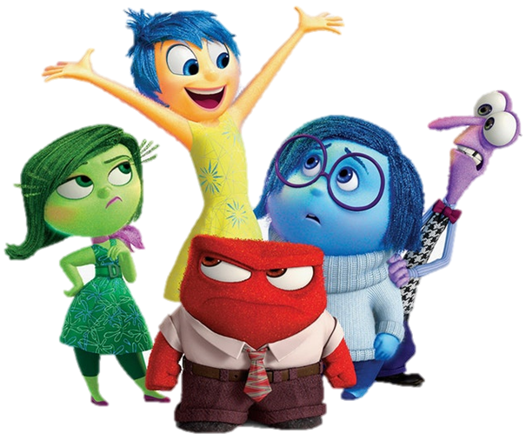
Recognising our emotions
To be able to express and talk about your feelings, you need to be able to know what you are feeling!
Can you name any emotions?
Notes:
The deep breathing mindfulness exercise is a nice way to help us manage those difficult emotions we face.
To be able to express and talk about your feelings, you need to be able to know what you are feeling!
Can you name any emotions?
Examples - happy, sad, angry, nervous, worried, hopeless, ashamed etc

Slide 7
Sarah’s Emoji Chart | Morning | Afternoon/Evening
Monday
Tuesday
Wednesday
Notes:
Check understanding of emoji chart and set up a class one if you’d like to

Slide 8
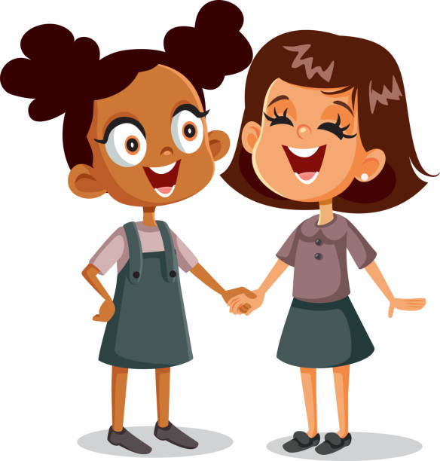
Look out for others
Being able to notice other people’s feelings is an amazing skill to have!
If you notice your friend isn’t feeling their best, be there for them and try something to make them feel better such as talking to them, playing a game with them or making them laugh.
By helping out others it promotes ‘growing together’
Notes:
Being able to notice other peoples feelings is an amazing skill to have.
If you notice your friend isn’t feeling their best, be there for them and try something to make them feel better such as talking to them, playing a game with them or making them laugh.
By helping out others it promotes ‘growing together’.
Idea – everyone think of an idea for how they could help a friend or teacher this week, share idea with class teacher or peer sitting next to you.

Slide 11
