Slide 1
Volunteering in school
SEPTEMBER 2023

Slide 2
Thank you – you will make a HUGE difference!
Thank you for coming…
Please sign in

Slide 3
Agenda:
Volunteer helpers in school policy and protocols
Child protection and safeguarding training, team, policy and procedures
Covid/health measures
Protocol signing/DBS requirement
How to get started
Resources:
Volunteer helpers in school policy
Identity documents letter
Copies of the protocol for signing
Annex A – Keeping Children Safe in Education
PowerPoint – access via website – parent tab – parent workshops

Slide 4
Volunteer helpers in school policy

Slide 5
Protocol - school

Slide 6
Protocol – you

Slide 7
Please read this policy Key points:
Confidentiality and safeguarding
All volunteers are accepted at the Headteacher’s discretion
Fire
When volunteer helpers arrive in the school they must sign in at the school office signing in screen. They will be given a visitor’s lanyard, which they must wear at all times
The teacher must always have the last word on what happens in a classroom
Having an adult to challenge the learning is very helpful. Questions like: “I wonder what would happen if we put it the other way up?”, “Why do you think it does that?”, “Where has that answer come from?”, “How do you know you are right?”, “How did you find that out?” and “What do you think?” (rather than us giving the children answers!)
We aim to make our children as independent as possible
It is important that all our own behaviours in school are always those we want the children to copy

Slide 8
Child Protection and Safeguarding

Slide 10
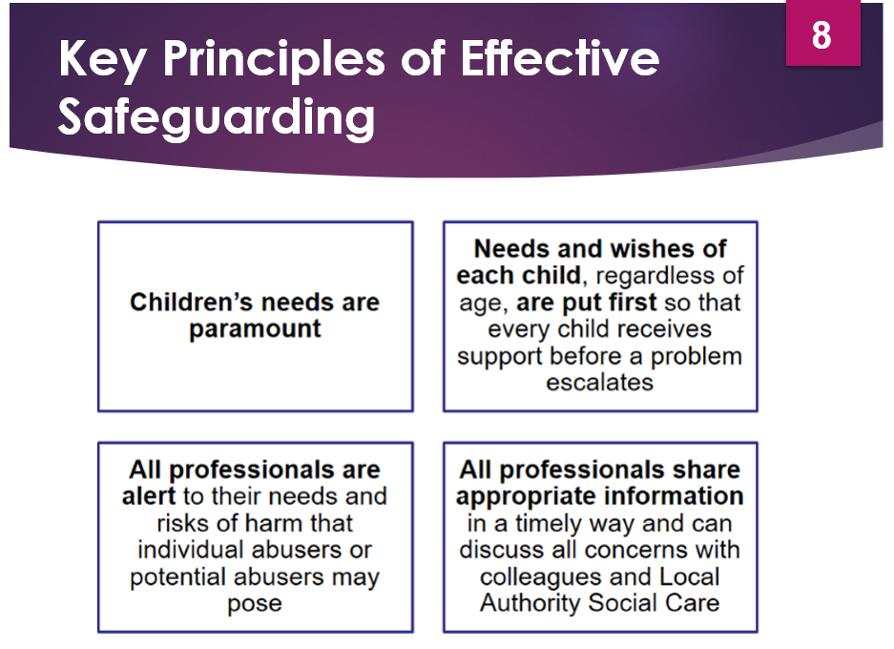

Slide 11
Hannah Leech is our Safeguarding Governor

Slide 12
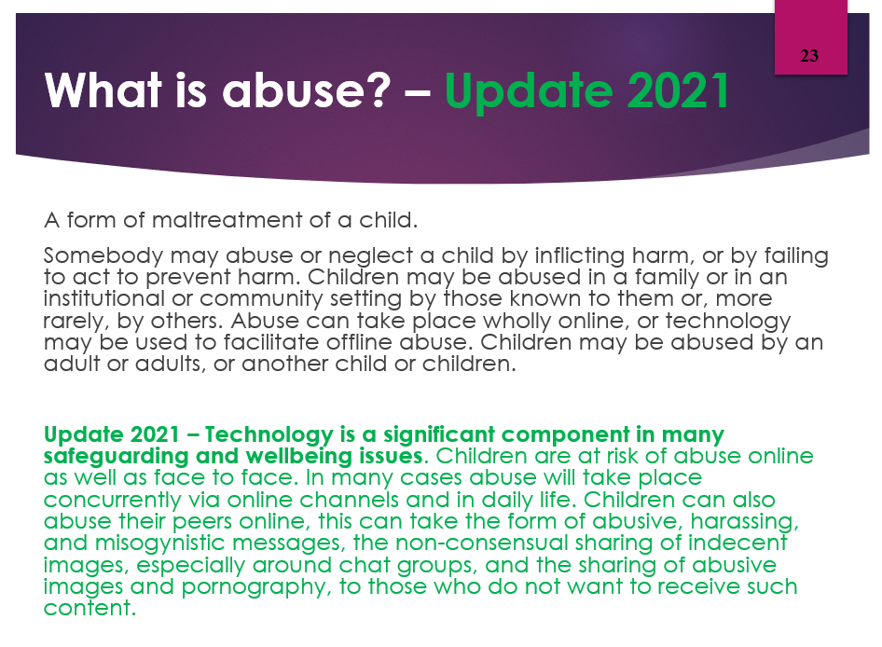

Slide 16
Signs and Indicators of abuse

Slide 17
Child on Child abuse – a new category in 2021, a new name 2022 (formerly peer on peer)

Slide 23
To safeguard you, avoid…
No use of mobile phones in the presence of children
Not to use yourself
Not to take photos
Not to let anyone else take photos

Slide 24
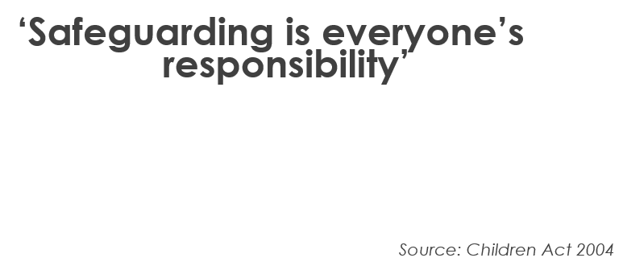
Further information and training?

Slide 25
Hannah Leech is our Safeguarding Governor

Slide 26
Covid/Health measures
We need to ensure that we do not increase the risk of Covid/Flu/Strep A coming into school and disrupting education as much as humanly possible. As a result, we request that anyone wishing to volunteer:
Attends a short induction session to inform you about child protection, Covid/Health measures and our Parent Volunteer Protocols
Ideally, has had two Covid vaccinations (to protect you)
Does not volunteer if they have any symptoms of Covid/or a temperature
Already has, or is prepared to have a DBS (disclosure and barring) with Russell Lower School’s name on it (ones from previous years are still fine)
Everyone MUST attend an induction session and MUST have a DBS in place before working with the children.

Slide 27
Always required
Good hand hygiene – washing hands for 20 seconds/sanitiser
Good respiratory hygiene – catch it, bin it, kill it. Sneeze or cough into crook of elbow or a tissue
Good ventilation – opening windows/doors where possible to balance air flow and temperature
Minimal skin to skin touch (safeguarding!)
Sit side by side rather than face to face
Stand behind
Avoid getting down to their level

Slide 28
Measures may have to change…
We are constantly assessing the impact of Covid/Flu and Strep A
Measures may have to change if cases rise – nationally, locally or in school
We may have to stop visitors coming into school again for a short period of time. Sorry in advance if this happens
We may have to reintroduce face coverings etc.

Slide 29
DBS process
Simply bring in the forms of identification needed to the school office
We generate a link to a DBS document that will be emailed to you. You will then need to follow the link and complete the electronic form at home with your details
Your details are then verified with the school
Your DBS certificate will arrive by post at your home
You need to bring this into school so we can record the number and see that there have been no convictions
WHAT IF I AM PART OF THE UPDATE SERVICE? – Then we need you to bring your DBS certificate into the school office and complete a CONSENT FORM so we can look at it.
You can then begin volunteering!
The DBS is then valid for the whole time your child is in school, or until you are contacted with a request to update it

Slide 30
When and how do I start?
If you already have a DBS, please begin volunteering at a mutually convenient time. Please just tell the class teacher you are ready to start and agree a time.
If you do not yet have a DBS, please get that process started first. It will take a little while to come back (usually 1 – 2 weeks). Once this is back, please bring the certificate in to the school office and then liaise with the class teacher to arrange your volunteering slot
Can I volunteer in a class/year group that my child is NOT in? YES!!! Just let us know and we will liaise with a suitable teacher for you.

Slide 31
Finally…
Any general questions?
Please sign and leave one of the protocol sheets
Thank you for coming

