Slide 1
Well-being and resilience
February 2024

Slide 3
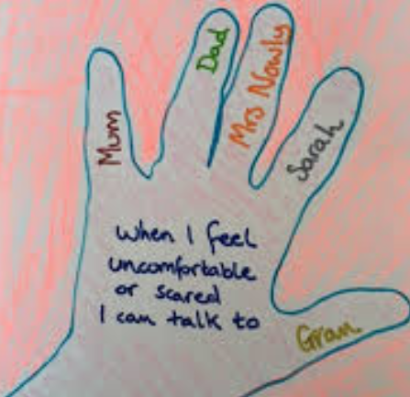
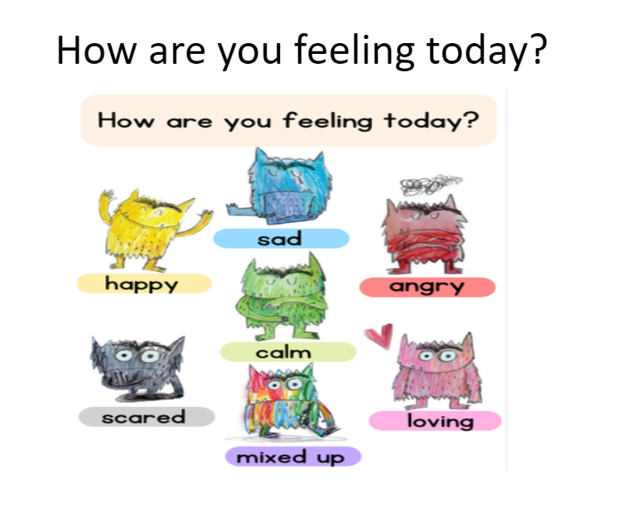
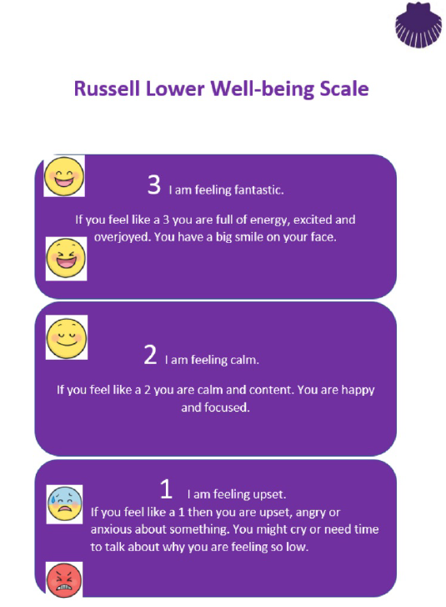
Well-being scale and Network Hand (Telling School)

Slide 6
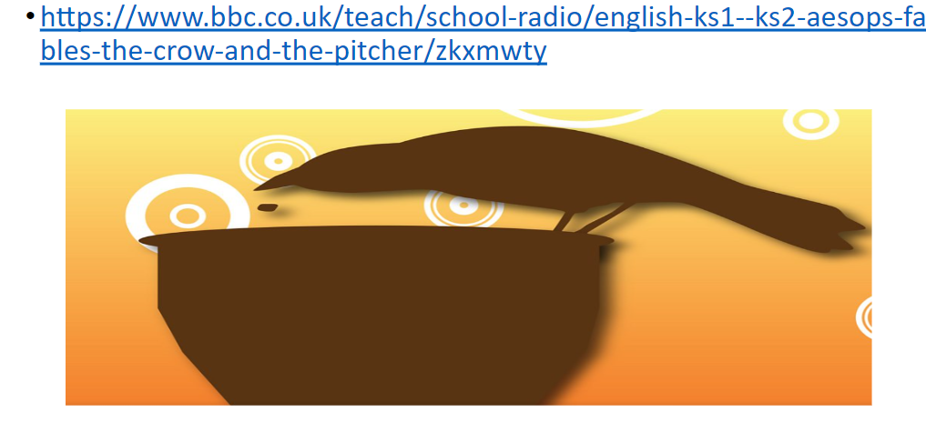
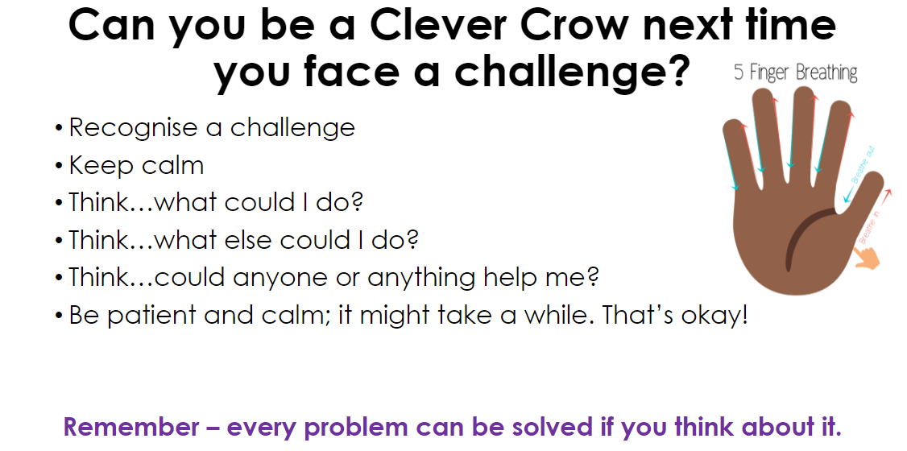
Resilience begun with staff, children and parents…

Slide 7
The Power of Yet in the classroom:
Praise the process: effort, focus, improvement, strategies used, perseverance etc. rather than the outcome per se
Use the language of ‘Yet’ and ‘Not Yet’
Role model being out of comfort zones and the science behind growing more neurons/stronger pathways/better connections for achievement
The power of yet will breed equality
You can use it at home too! It works just as well with our children and other adults too

Slide 10
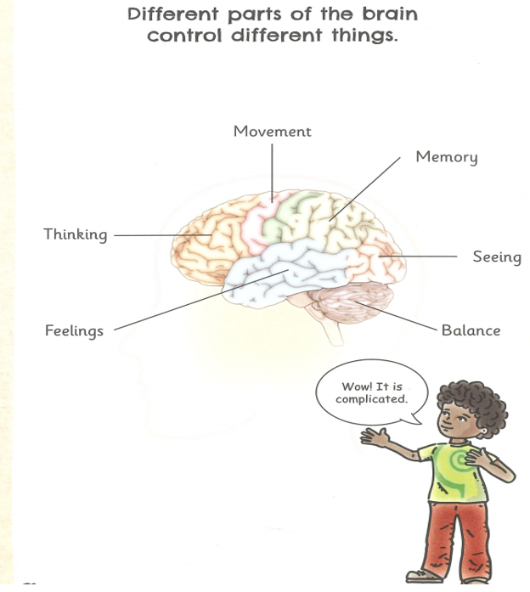
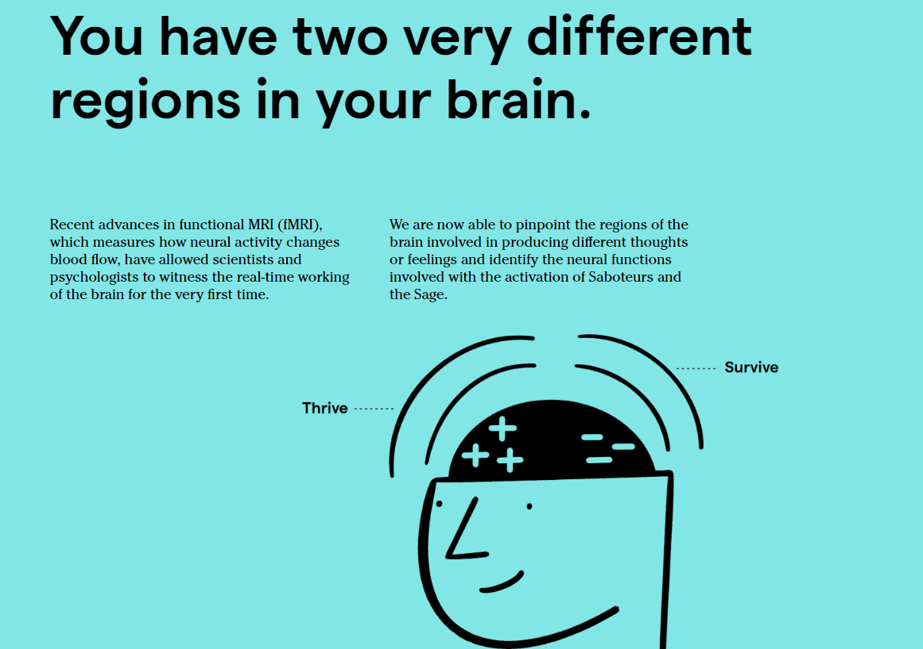
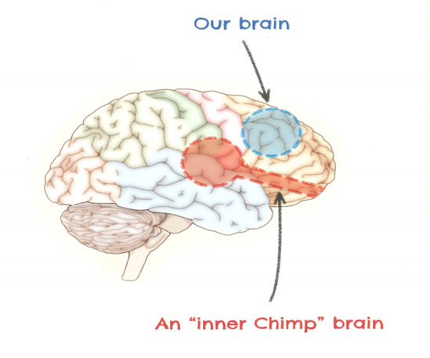
An approach to build resilience – the science

Slide 11
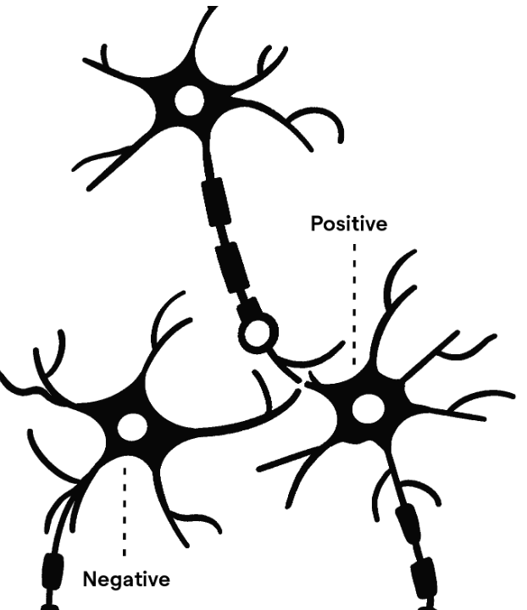
It isn’t set! You choose the pathway, but it takes practice – Growth Mindset
Mental fitness is about building mental muscles.
Saboteur Interceptor Muscle
Your Saboteurs generate all your negative emotions, including stress, anxiety, self-doubt, anger, avoidance, procrastination, insensitivity or discontent. Mental fitness requires the ability to intercept and discredit the Saboteurs – as CBT would!

Slide 12
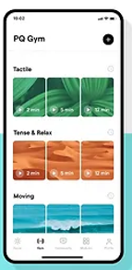
Problems and challenges are just weights we need to lift – build mental muscle – in the zone – you in control

Slide 13
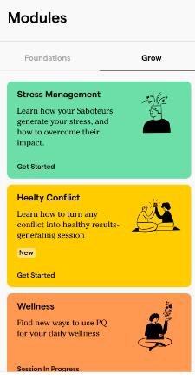
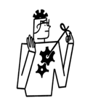
6 weeks + 2 weeks – daily practice/focused tasked and weekly videos. Now GROW for 3 months
Recognise: Judge/Saboteurs
Do: PQ Reps
Respond: Sage Powers:
Empathy
Explore
Innovate
Navigate
Activate

Slide 14
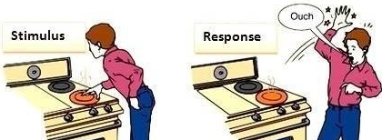
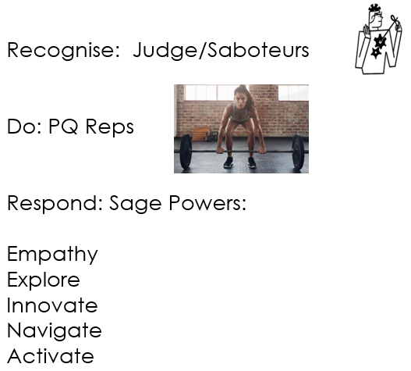
Training Summary
Know the science – your brain has 2 distinct regions
You need to rewire – this is not a passive thing. Think of it like working a muscle at a gym
Recognise Saboteurs and RESPOND
RESPOND –
Label thoughts/emotions and saboteurs and let it go (because you know it is ‘manufactured’ in your ‘survive’ region and should not remain a focus
Quieten that part of your brain – take a moment to breathe/calm/ground/use positive self-talk and refocus
Plan a positive response – on your own or with someone else – Power of Yet – 5 Powers of the Sage

Slide 17
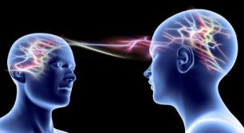
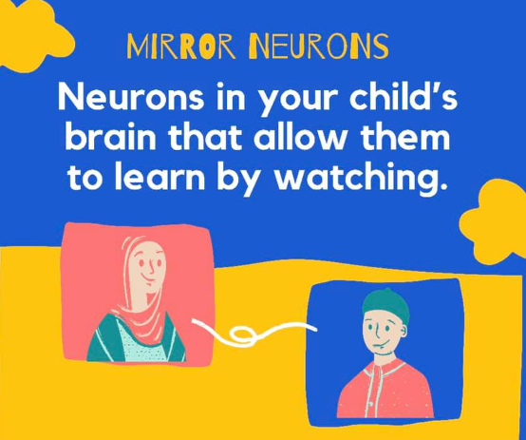
Mirror neurons and their impact at home and school
Children will do what you do not what you say!
Anxiety is contagious
Being angry is contagious
Mood is contagious
We can use this however we want to…but it has to start with us
Setting an example to others isn’t the main means of influencing others, it’s the only one. Albert Einstein
If you think you can; if you think you can’t; you’re right! Henry Ford
What you pay attention to; you get more of
You cannot be too positive…just make sure you praise the RIGHT things

