Slide 2
Aims
To learn about British Science Week 2023.
To learn about where we see connections in our everyday lives.

Slide 3
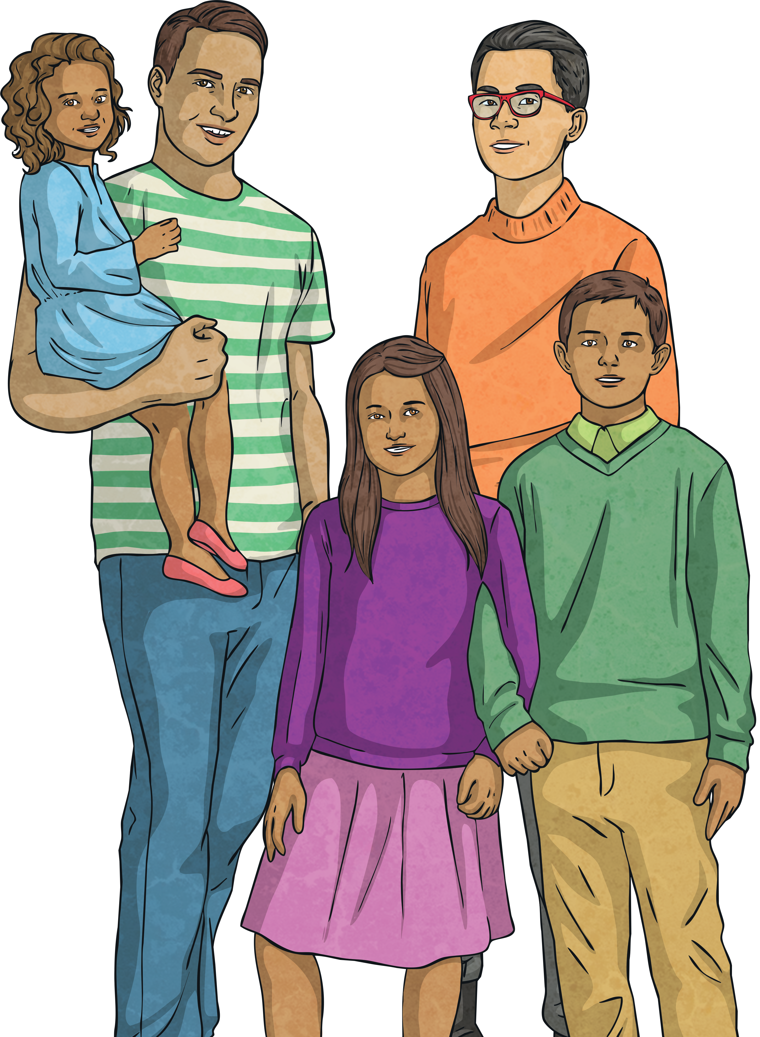
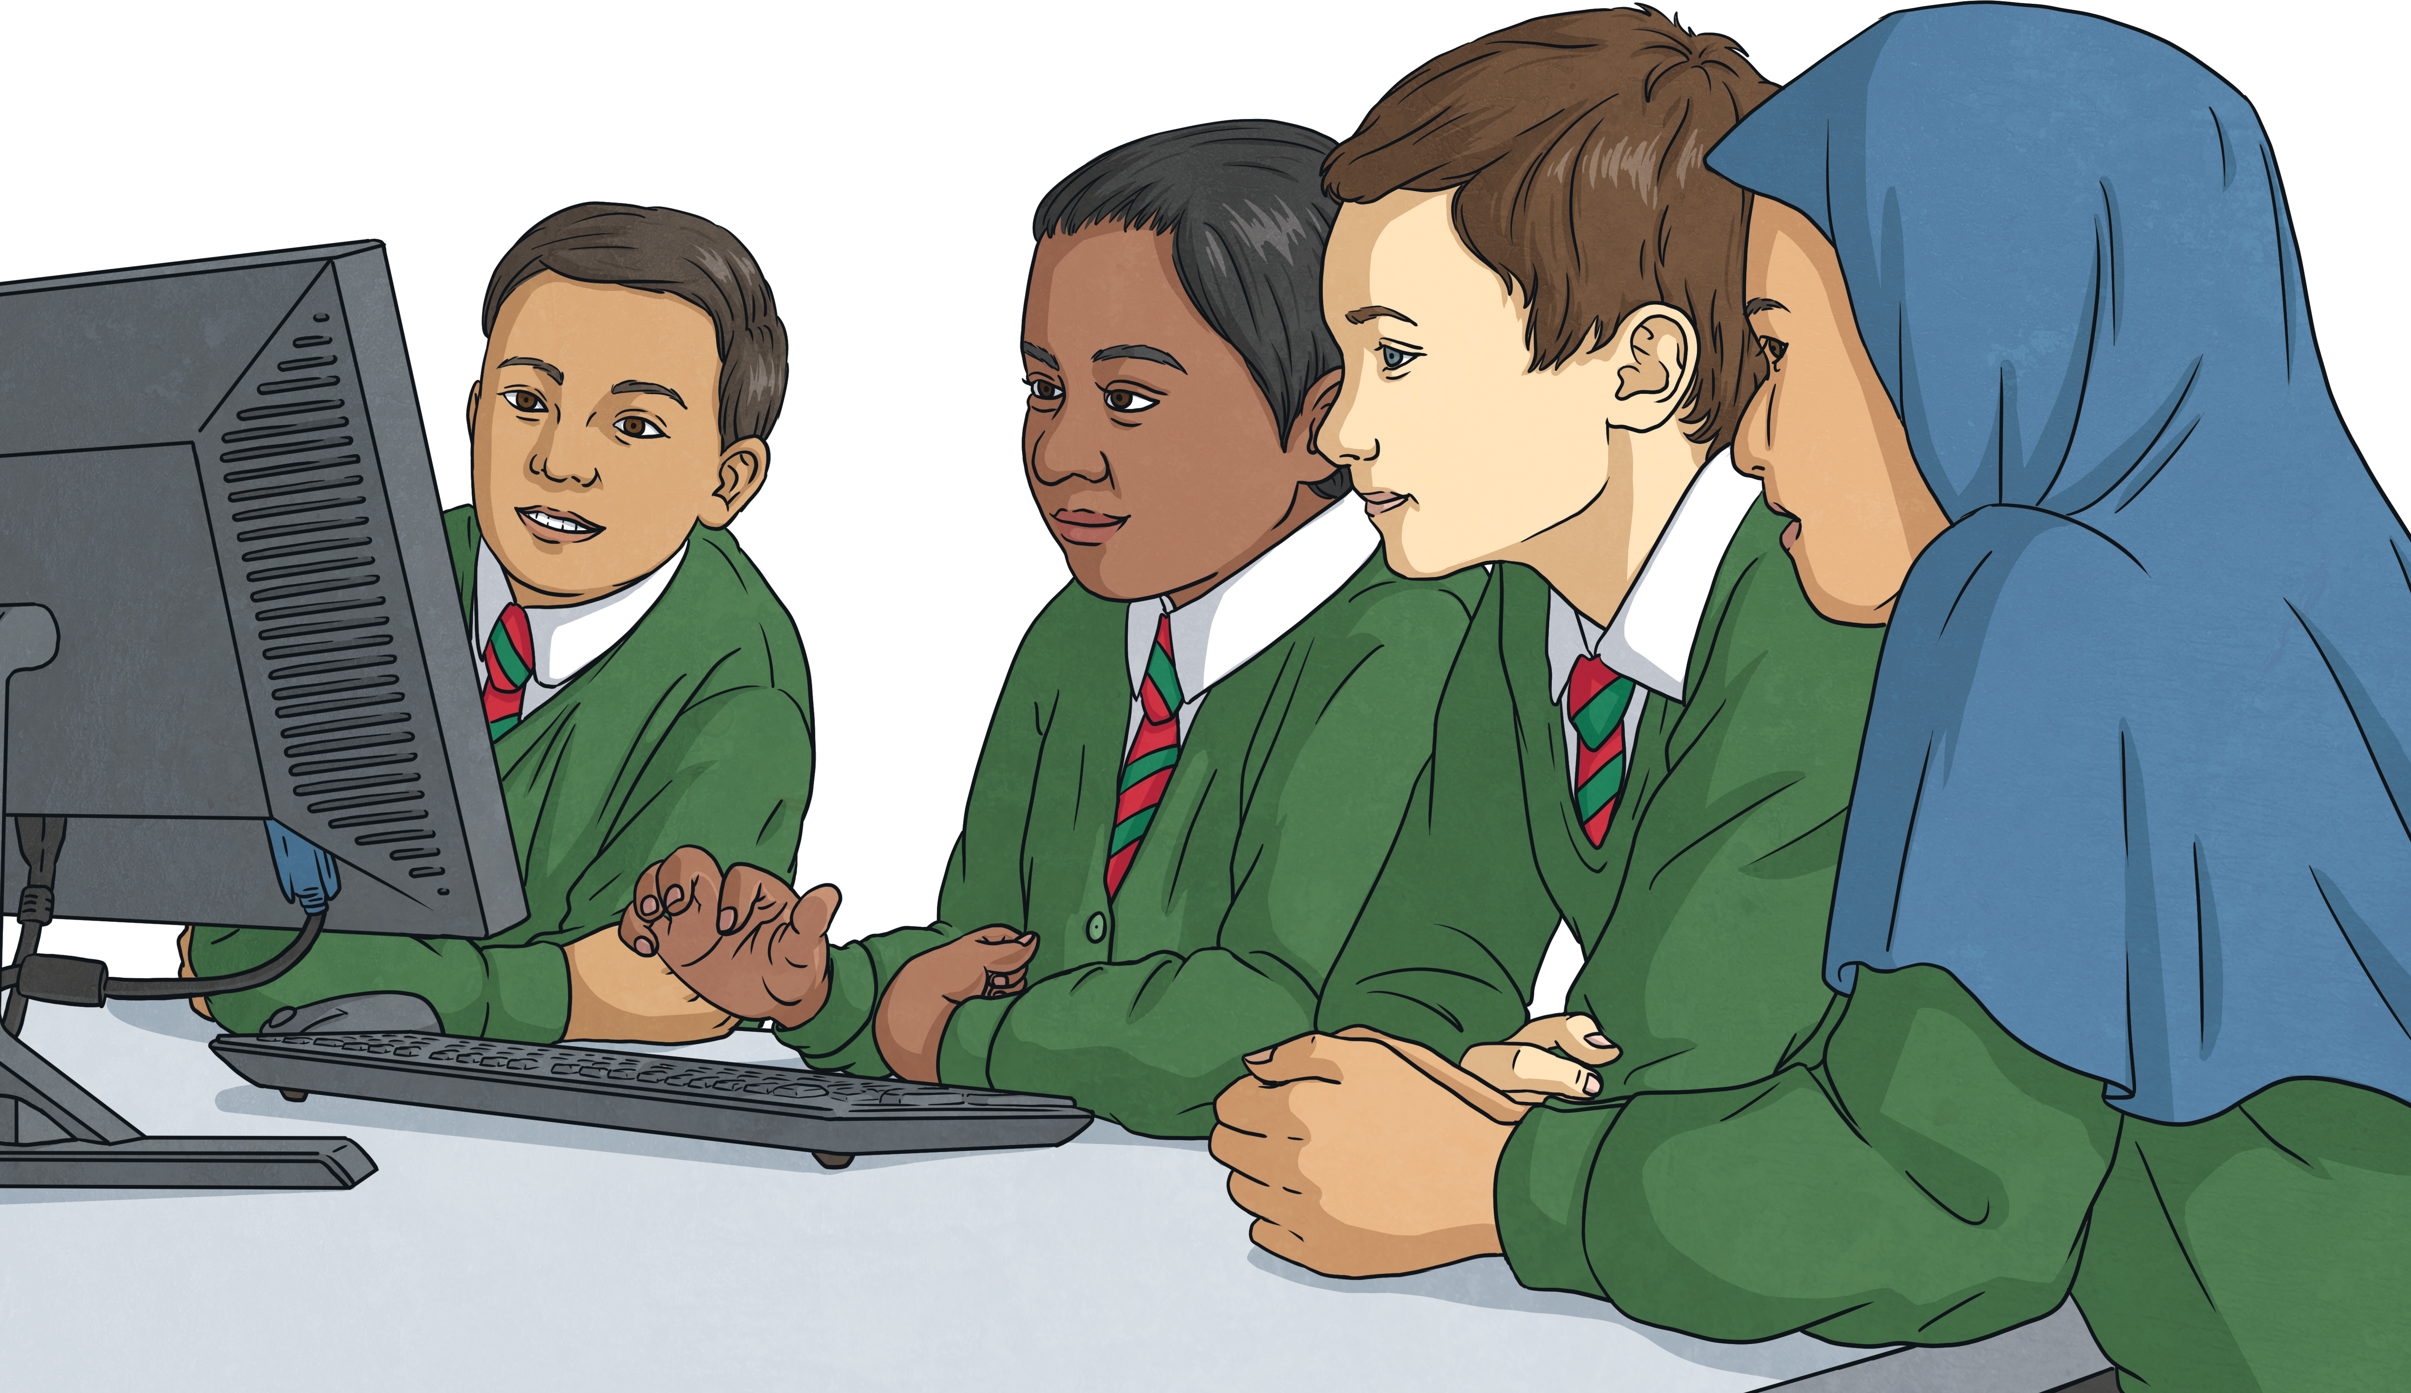
Connections
The theme for British Science Week 2023 is ‘Connections’.
There are examples of connections everywhere, whether that be in our bodies, in our gadgets or in the world around us. That’s what makes it such a wonderful topic for this year’s British Science Week!
What is an example of a connection?
This list just never ends! A good example of a connection is the connection that you as children have with each other.
Let’s think.
What does the word ‘connection’ mean?
A connection is when a person or thing is linked together with something else.
If the school office need to speak to someone at home, they can connect with them by telephone, email or text message.
You’re connected because you are classmates.
You are connected with your families.

Slide 4
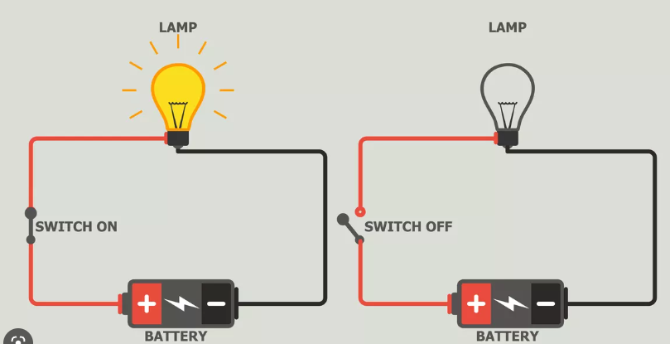

Slide 5
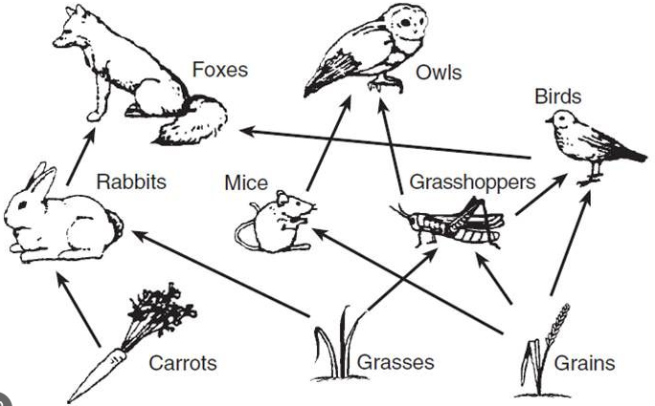

Slide 6
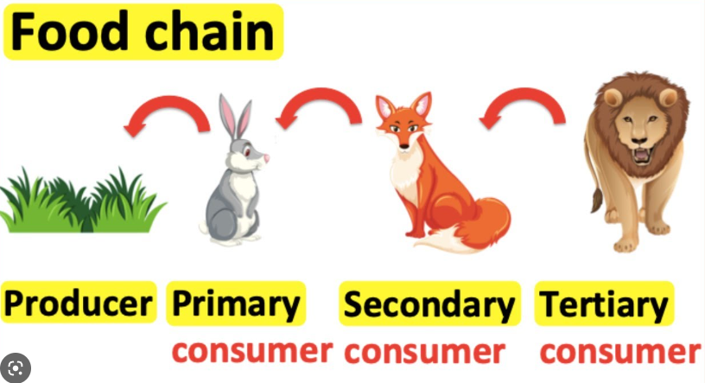

Slide 7
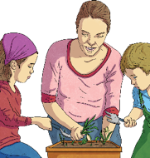
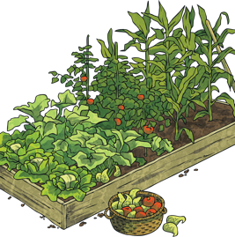
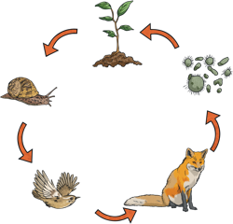
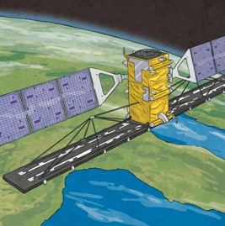
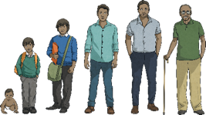
Why Is This Year’s Theme ‘Connections’?
Our world is full of connections - connections in our bodies, with other people and to other countries. There are connections to other planets, between different animals in their habitats and even electrical connections that mean you can watch this on a projector!
You may decide to explore electrical connections by building circuits or look at how different species are connected in your local habitat, or perhaps you may investigate your own ideas. ‘Connections’ as a theme offers a huge range of topics to research during British Science Week 2023.
------------------------------------------------------------
What other ways can you think of to explore connections?

Slide 8
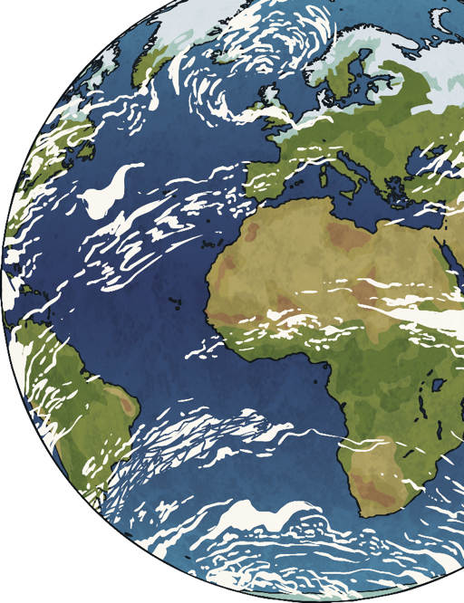
STEM: A Perfect Way to Form Connections
Connections can be made between all STEM subjects (science, technology, engineering and maths).
The connection between these people is so important to understand the world around us, help to solve its problems and make it a better place.
engineer
mathematician
scientist
technologist

Slide 9
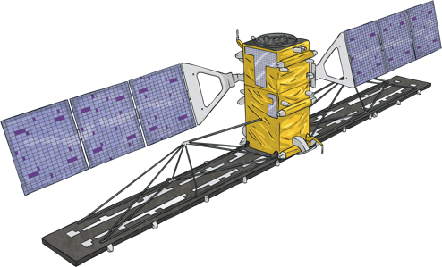
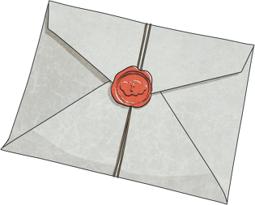
Connecting with Others
Imagine you are sat at home and you would like to contact your friend. How many ways can you think to connect with them?
Are they all as efficient as each other?
You could text them.
You could write to them.
You could go to see them.
You could phone them.

Slide 10
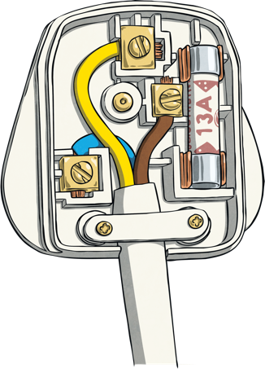
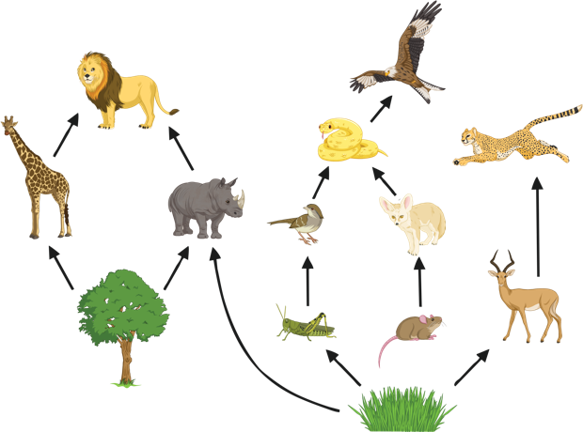
Important Discoveries Involving Connections
On 8th November 1904, Harvey Hubbell II patented the first detachable electric plug in the United States. Plugs used to be known as electrical connectors.
1st January 1983 is considered the official birthday of the Internet. The Internet helps people all over the world to stay connected.
Food webs show all of the possible connections between an ecosystem’s energy cycle. The idea of food webs was first discussed in 1927.
Let’s Think…
What do you use the Internet for?
What food webs can you think of?
How many plugs are there in your classroom?

Slide 11
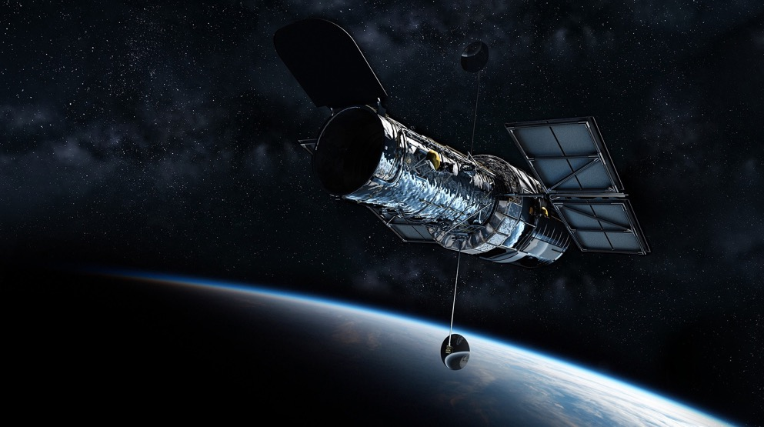
Important Discoveries Involving Connections
The latest measurements with the Hubble Space Telescope tell us that the universe is growing faster than scientists predicted.
At this point, even the rocket scientists don’t really know why!
The Hubble Space Telescope is a special telescope that was launched into low-Earth orbit in 1990. The Hubble isn’t the first space telescope but it is one of the largest and most useful. Its discoveries have connected scientific research ideas and also allowed us to connect the dots and figure out that our universe is known to be about 13.8 billion years old!

Slide 12
Skills Scientists Need
Some discoveries happen by accident or through good luck.
Some happen with lots of people working together over a long time. The scientific community love to share their knowledge so they can grow together.
Let’s think.
What skills do you think you might need to be a scientist?
curiosity
perseverance
patience
Can you think of any more?

Slide 13
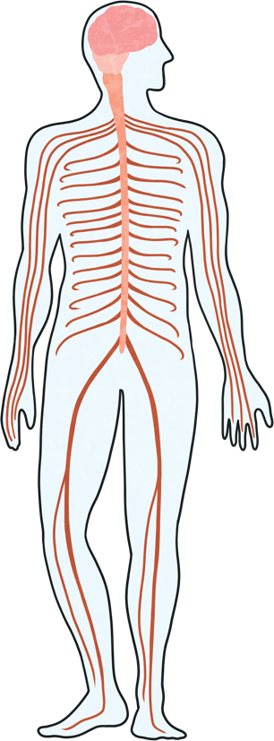
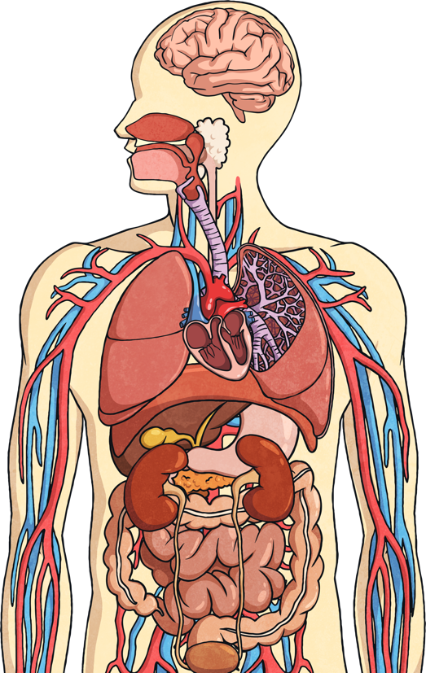
There Are Connections inside You!
There are many different organs in your body. These form organ systems, which all work together. They’re all connected to make the wonderful organism that is you! Do you know the names of any of these organ systems?
Did You Know…?
Some of the connections in your body are nerve cells. There are over 7 trillion nerve cells in your body! We would need a microscope to see them but they are some of the oldest and longest cells in your body. In fact, if we lined up all the nerves a body has, they would stretch for almost 45 miles.

Slide 14
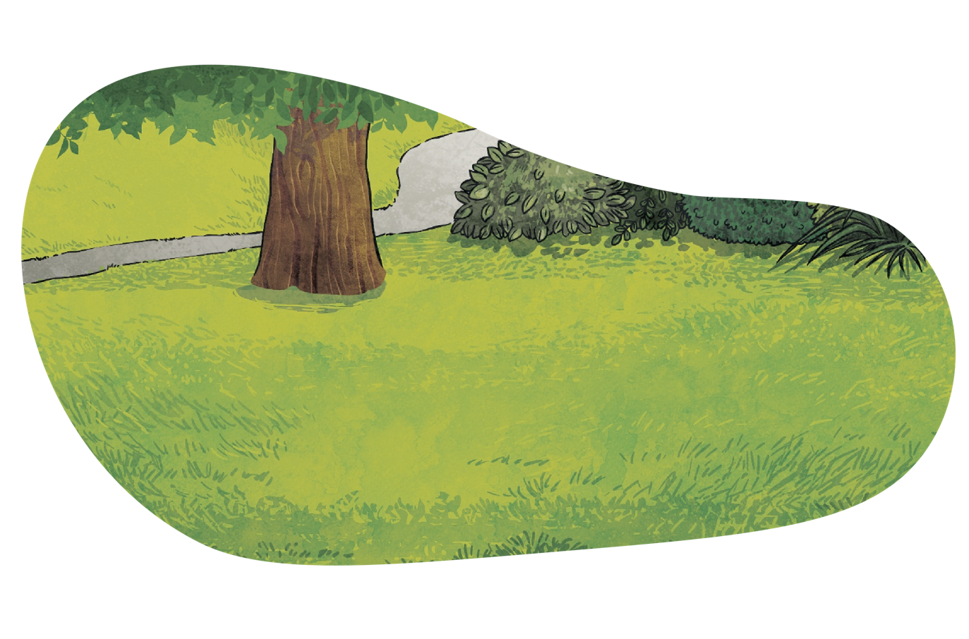
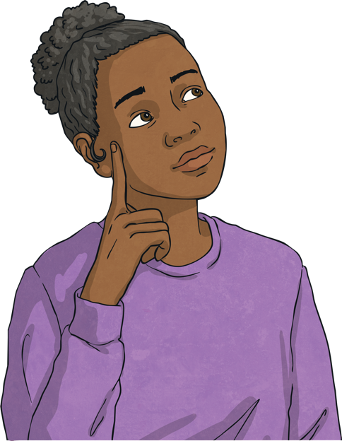
Connect with Others
‘No one has ever become poor by giving.’ - Anne Frank
Now, it’s over to you.
What do you think this quote means?
How is this quote related to being connected?

Slide 15
Over to You!
The organisers of British Science Week would like you to enter a poster competition on the topic of ‘connections’. Follow this link for more information.
Why not get involved?
Science is such a big part of our daily lives. You could have a think about some questions that interest you and try to find the answers to them online with an adult.
Why do all food chains start with a plant?
How can we grow a more planet-friendly community?
How can I make the lights brighter in my circuit?
Why do we explore space?

