Slide 1
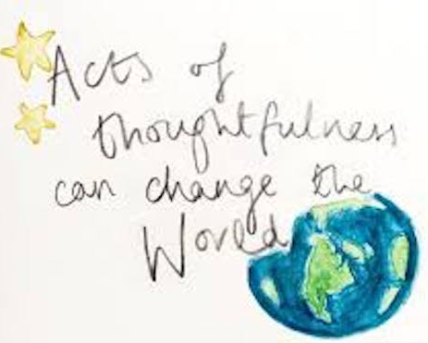
Thoughtfulness
AUTUMN 2

Slide 2
Welcome to our ‘Values’ assembly
A value is a principle that guides our thinking and behaviour

Slide 3
Values so far…
Can you remember which values we have already covered this year?
respect

Slide 4
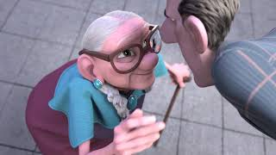
THOUGHTFULNESS
What is thoughtfulness?
When have you experienced thoughtfulness?
How can we be thoughtful?

Slide 5
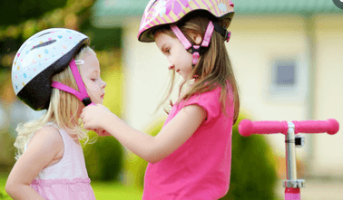
What does it mean to be thoughtful?
Thinking carefully before acting
Being a nice person and a good friend
Being understanding
Thinking about the needs of other people
Showing careful attention to detail
Taking time for ourselves

Slide 6
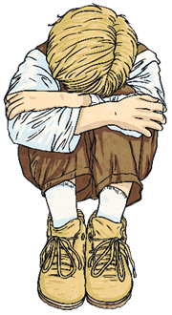
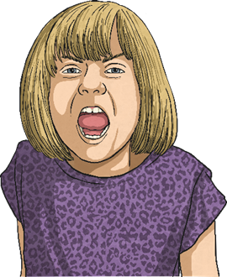
Being thoughtful is about recognising feelings
How are these people feeling?
How could we be thoughtful towards them?
Upset
Scared
Angry

Slide 7
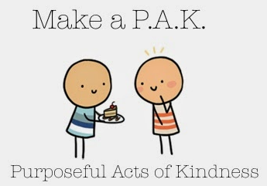
How can we be thoughtful?
Say ‘hello’ to a friend or adult
Use people’s names when you speak to them
Listen to people carefully
Apologise if you need to
Do something kind for someone at home,
at school, in the community
Give a compliment – be a bucket filler
Use kind hands and words
Colour the world with kindness

Slide 8
Armistice day and Remembrance Sunday
Do you know what is special about the 11th hour of the 11th day of the 11th month?
Remembrance Day takes place on the Sunday closest to this date
These are times to be thoughtful and reflect on what others have done for us in the past to make the world what it is today

Slide 9
Remembering others
Armistice Day/Remembrance Sunday are times to think about and remember the people who have died in or been affected by wars.
WHY?
It happens on 11th November because this is when the First World War ended (11th November 1918 at 11am).
It is known as Armistice Day, when all arms were put down, agreement by all warring parties to stop fighting
People marked it to remember the people who had been killed and their bravery and this tradition of remembering has continued to the present day.
Now, 11th November is also seen as a time to remember or think about those involved in subsequent wars as well.

Slide 10
How do we show our support for all the people who fought to create peace?
The British Legion has been fundraising for ex-service men and women as well as existing ones by selling poppies to the public.
Over the years it has become known as the poppy appeal and has gone on to raise hundred of millions of pounds for charity.
The poppy has become one of our most poignant symbols with millions of commemorative flowers produced each year to honour Britain’s war dead

Slide 11
How can we show thoughtfulness?
be kind
be caring
respect others
listen to others
Russell Rights
keep promises
be mindful
put others before ourselves

