Slide 1


Russell lower school
February 2023

Slide 2

Look how much we helped!

Slide 3


Slide 4


Slide 5


Slide 6
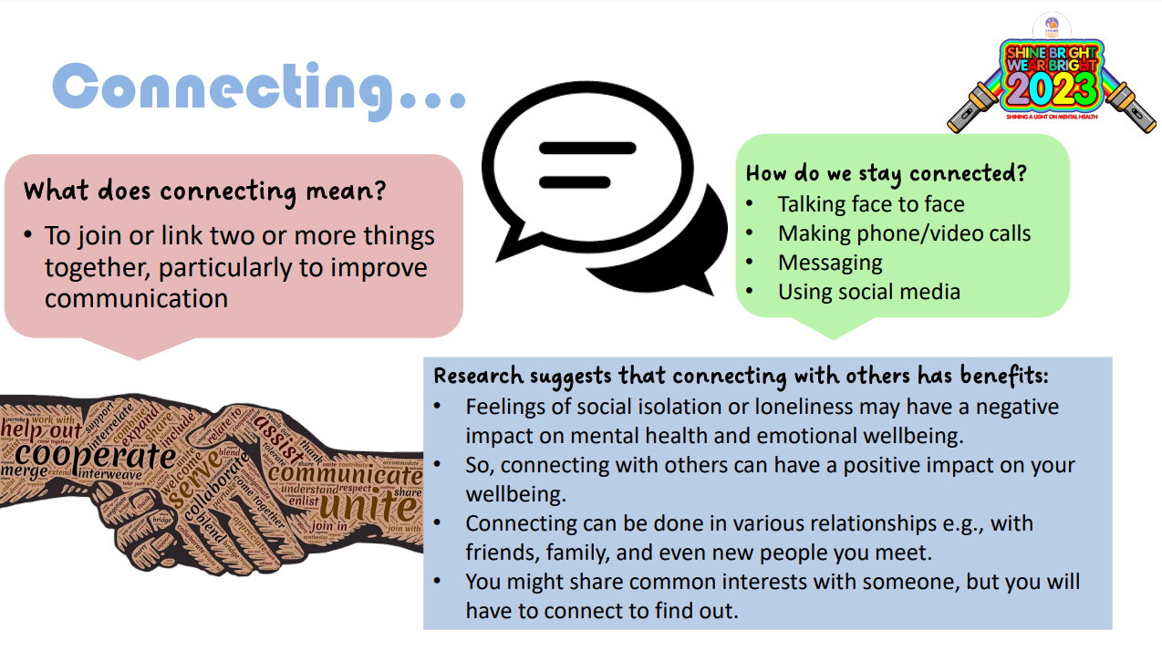

Slide 7
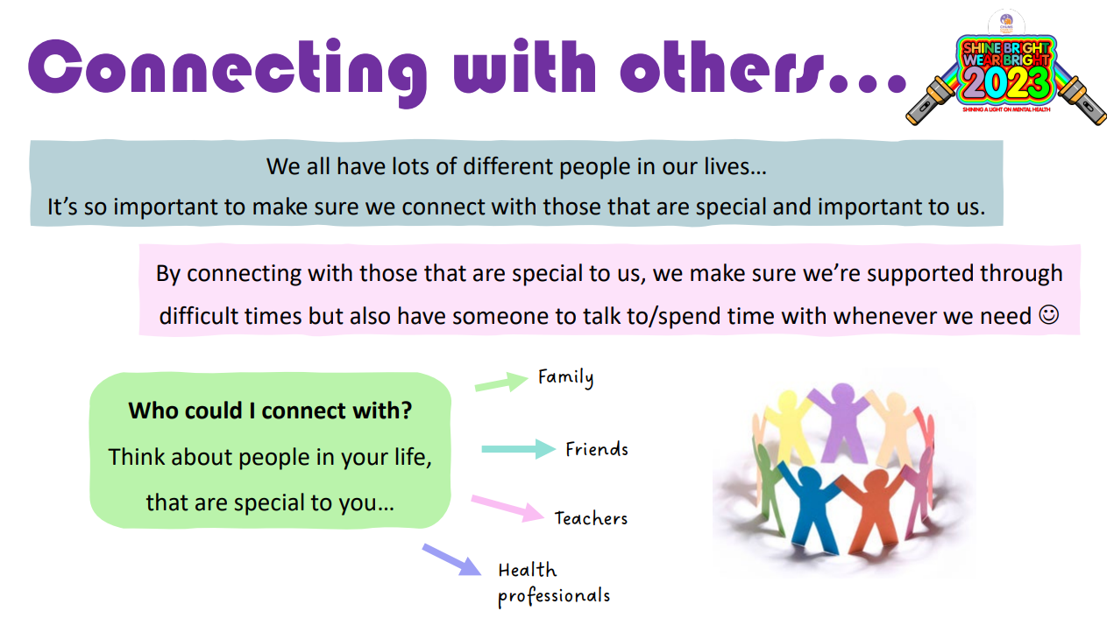

Slide 8
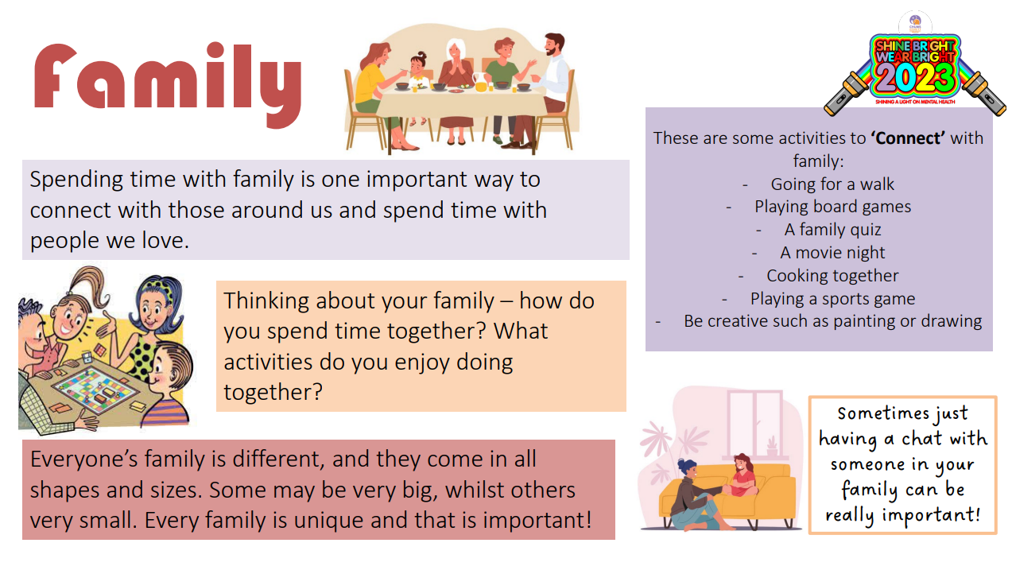

Slide 9
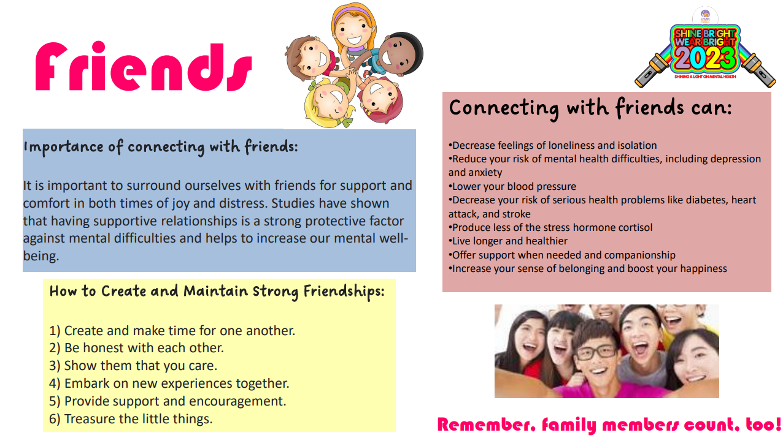

Slide 10
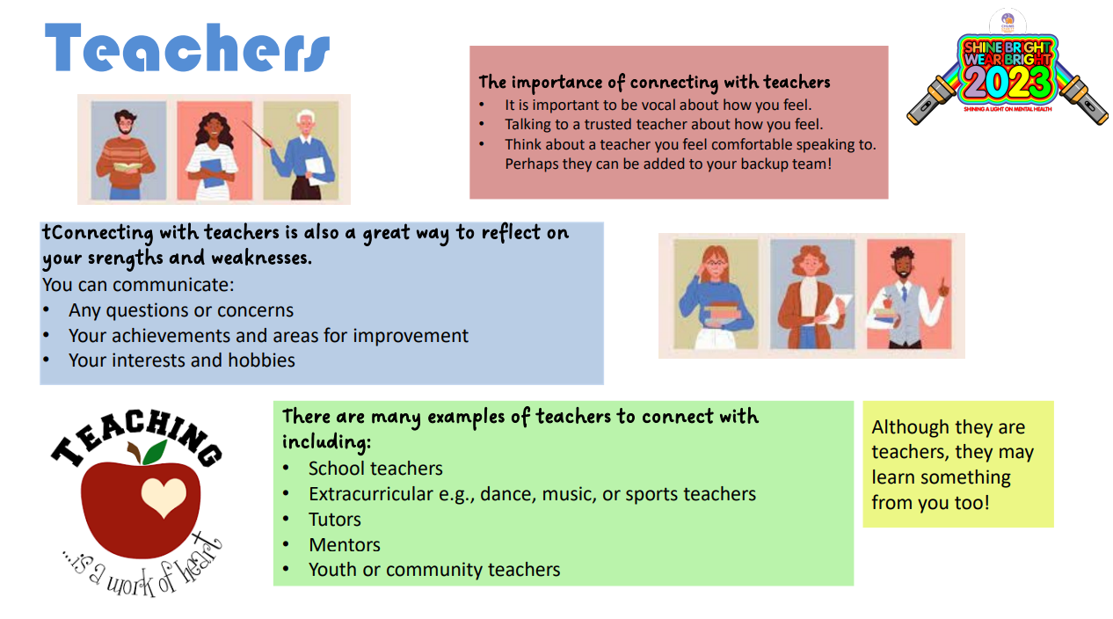

Slide 11
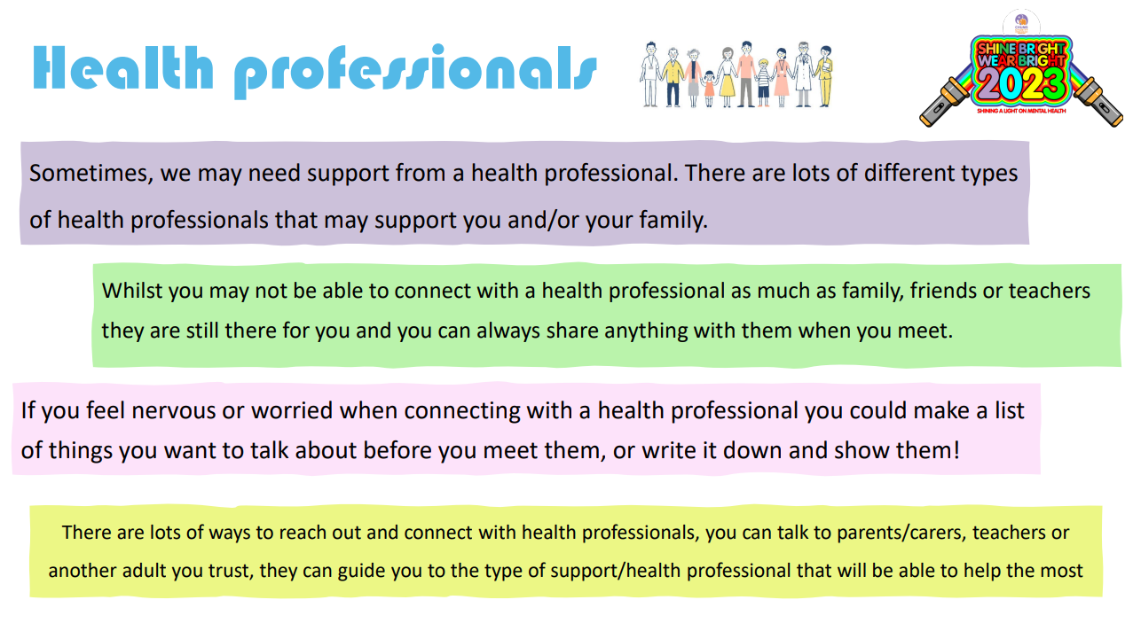

Slide 12
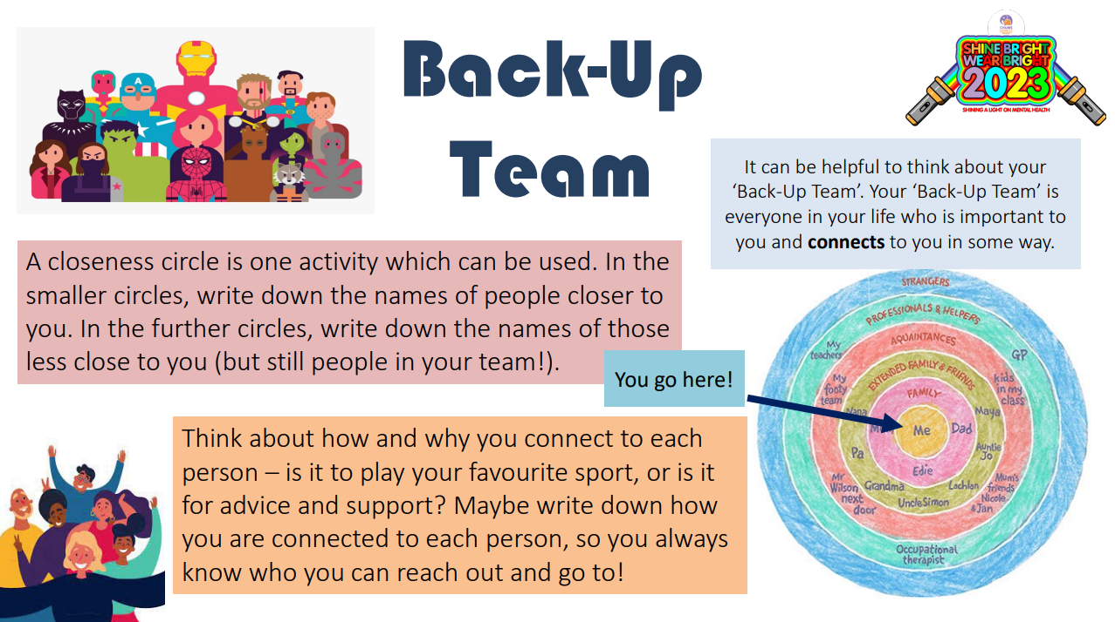

Slide 13

What if someone is not kind or is mean to me?
TELL adults in your class
TELL an adult on the playground
TELL Mrs Walker or Mrs Bunney
TELL
TELL
TELL!

Slide 14
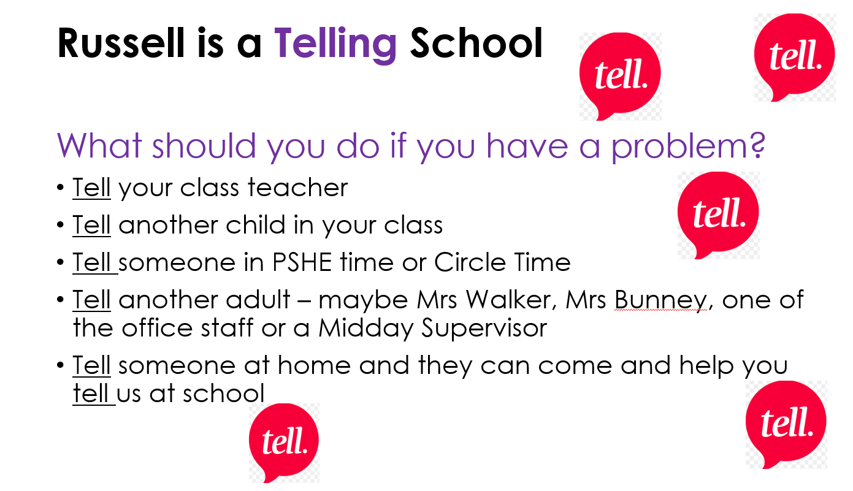
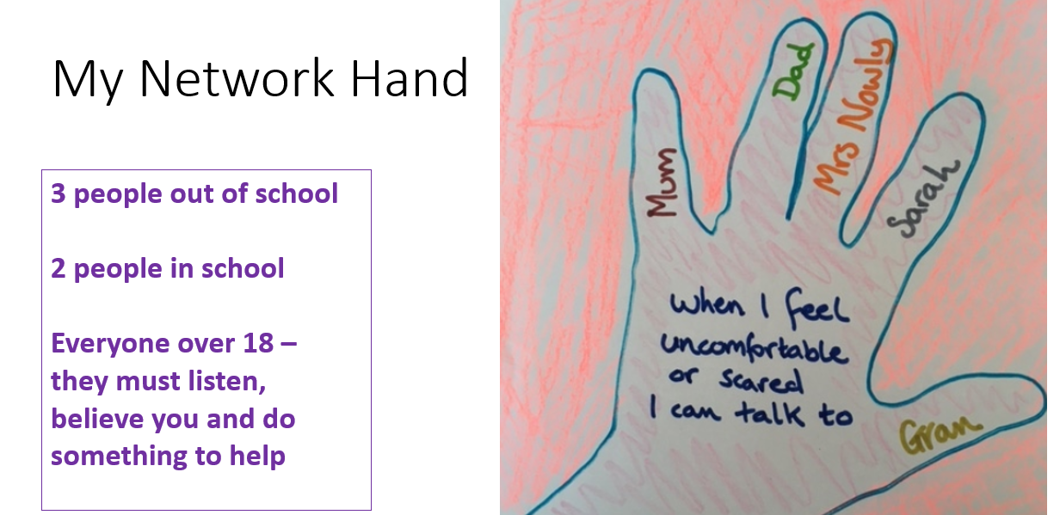
But…we are a telling school so use your voice if someone is being unkind and not following the Russell rights and values

Slide 15
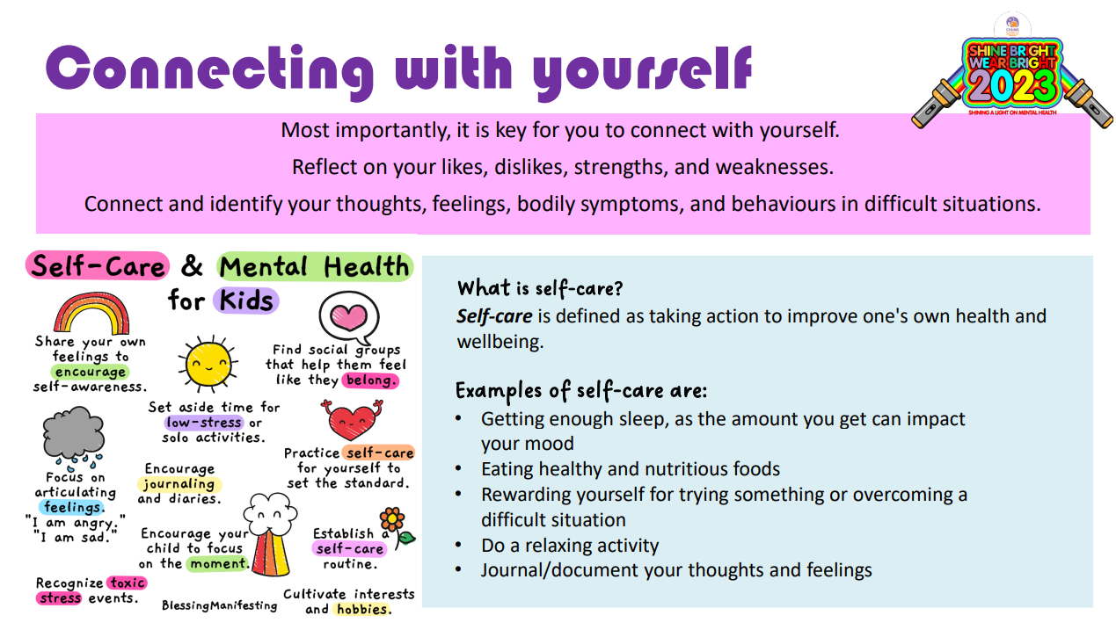

Slide 16
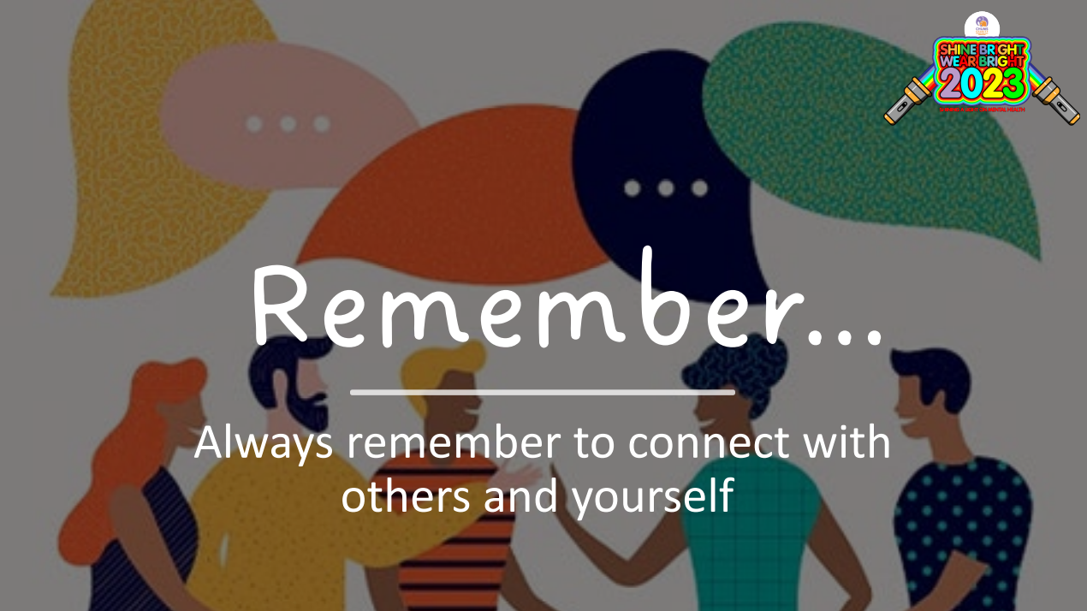

Slide 17



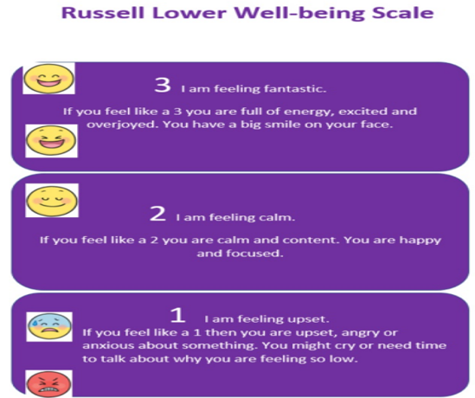

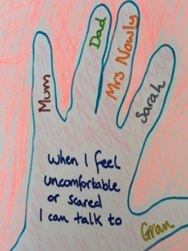

What it means to belong to Russell lower school
Bucket Fillers
Values
Russell Rights
Know the importance of emotions and well-being
Telling School

Slide 18

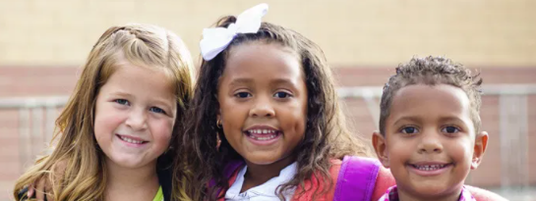
Every class is a team too.
We need to get along and respect each other. We don’t all have to be friends.
We all respect each other at Russell
We let anyone play
We can be friends with everyone. Just because I choose to play with someone else for a day/lunchtime/playtime does not mean that I am not friends with you any more
No child is ‘the boss’ of others and tells other children what to do. The adults are in charge. We ask others what they want to do too
We share everything – including whose turn it is to choose the game
We can have lots of friends
No one is left out
No one is laughed at
We always use kind hands and kind words

Slide 19

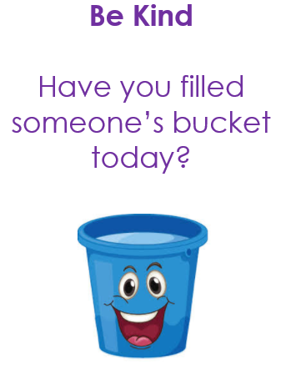
Give…a compliment, a smile, a helping hand, a kind word…
When we are kind, helpful, honest, caring, respectful, tolerant, thoughtful (using ALL our values), it makes other people feel good AND we feel good too!
It’s a ‘win/win’!

Slide 20
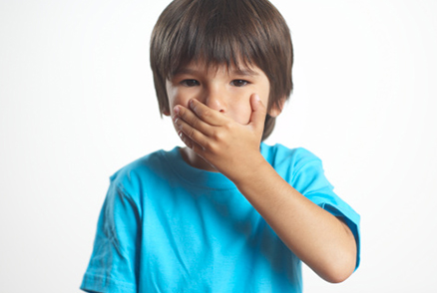
If I can’t say anything kind, I don’t say anything at all
Ugly
Stupid
Fat
An idiot
Annoying

Slide 21


Slide 22


Kindness, caring, Russell Rights and using our values = happiness at school

Slide 23
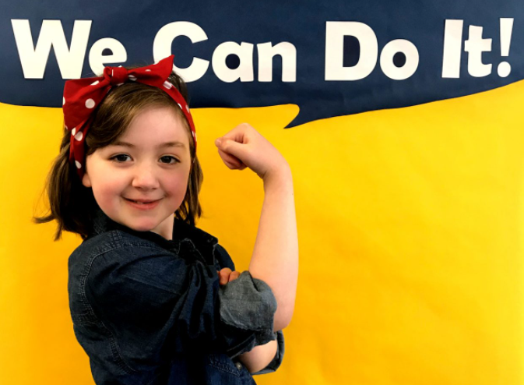

We are Russell lower school
Together, We can do it!

Slide 24
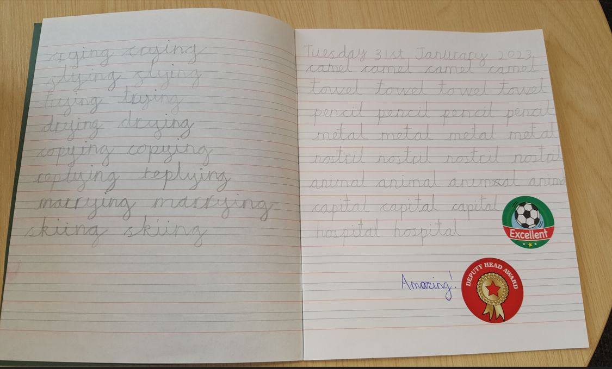
WOW! What amazing writing!
Any ‘top tips’ Jaxon?

