Slide 1
Wheel of well-being and mental health?
14th October 2019

Slide 2
What is well-being and mental health?

Slide 3
What can cause tricky mental helath?

Slide 4
What might it look like?

Slide 5
What can I do to help myself or someone else?

Slide 6
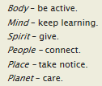
The wheel of well-being

