Slide 1
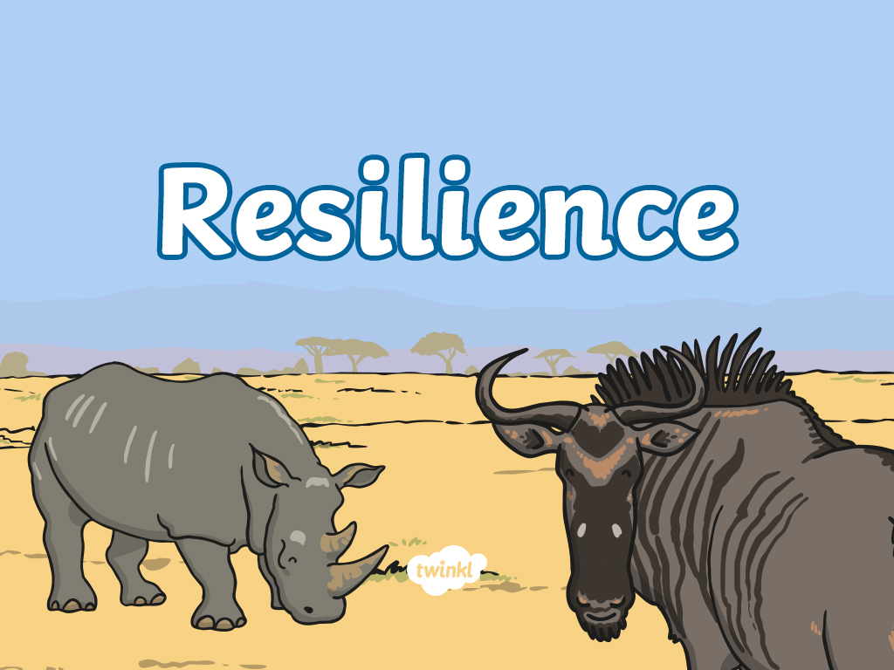

Slide 2
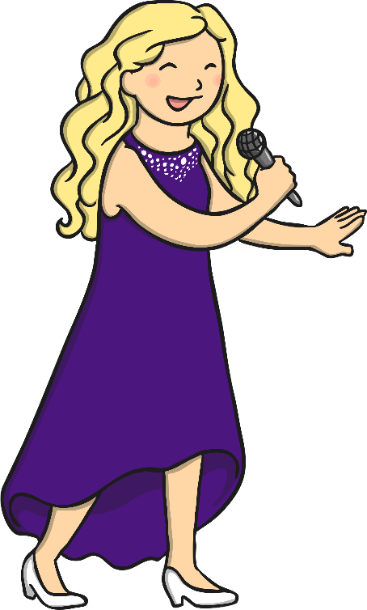

Super Songs
‘Skyfall’ by Adele
‘Survivor’ by Destiny’s Child
‘Pick Yourself Up’ by Frank Sinatra
Listen and discuss It!
What could have happened to
the person in the song?
What are these songs about?
How did they overcome it?

Slide 3
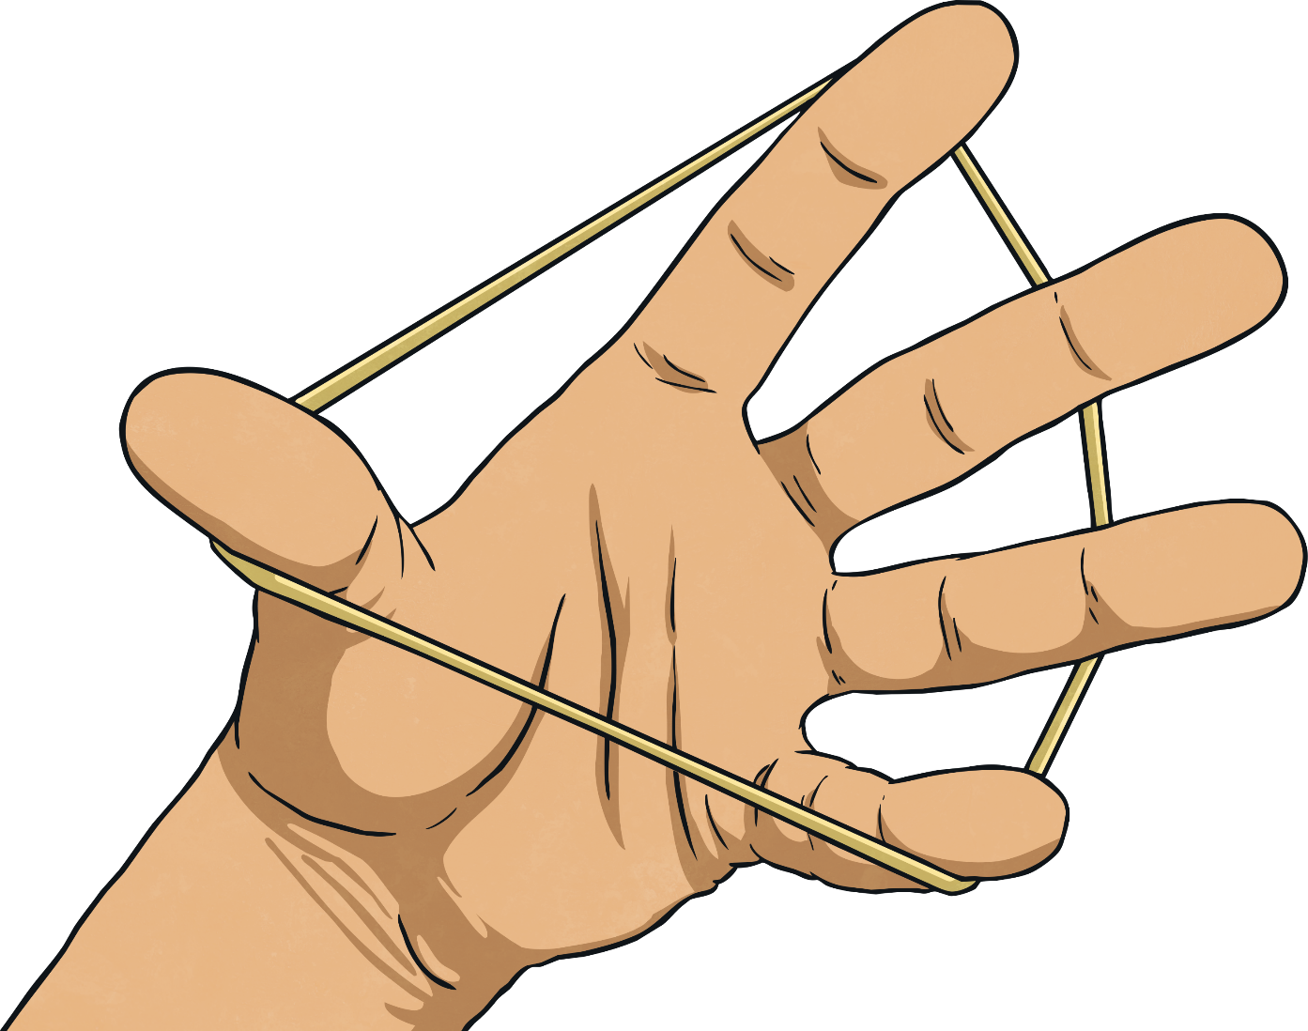
Rubber Band
Can you permanently change the shape of the rubber band? What do you notice? What happens?
We need five volunteers!
Do It!

Slide 4
Resilience
Some materials are able to bounce back after they have been bent or stretched.
People who can bounce back when things have happened to them are known as
resilient.
Can we clap out the word ‘resilient’?
Can we whisper the word ‘resilient’?
Can we shout the word ‘resilient’?

Slide 5
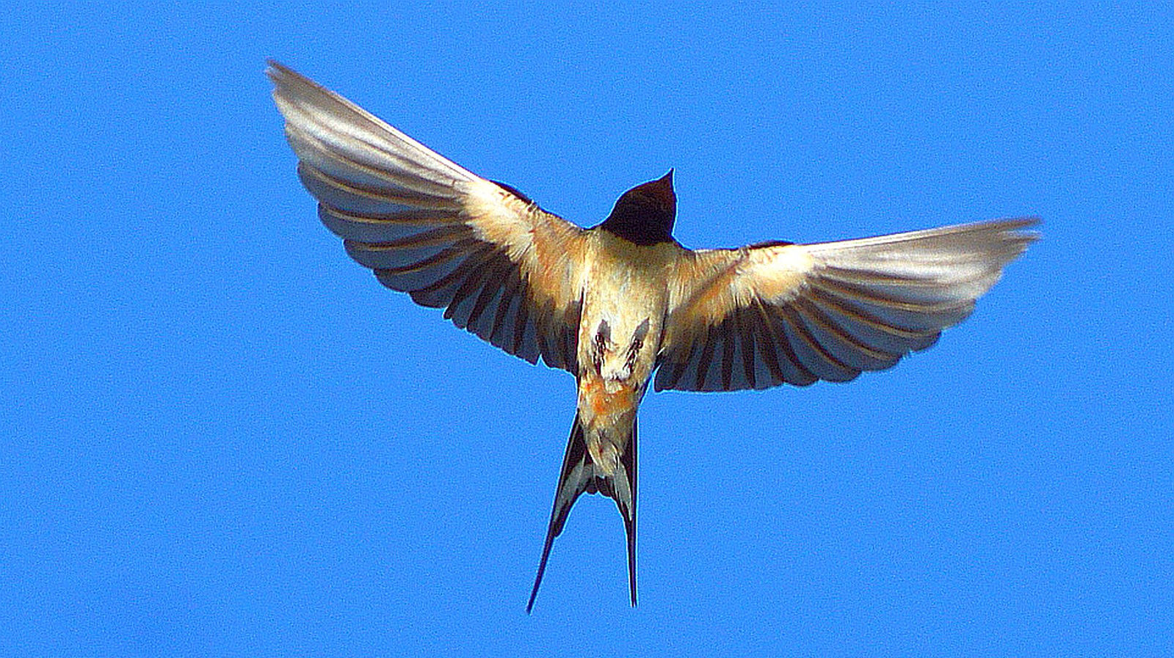
Some Animals Are Resilient Too!
Does anyone know anything special about a swallow?
What kind of animal is this?
How do we know what it is?
Who has seen a swallow?
What kind of bird?
Discuss It!
Photo by MICOLO J (CC BY 2.0)

Slide 6
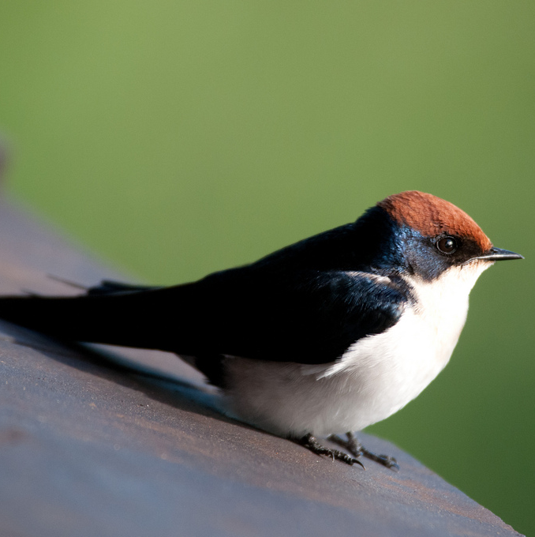
The Swallow's Story
Savannah the swallow had spent the winter months in Africa, roosting in a forest of elephant grass. One morning she woke up and knew that it was time to make the 3,000 mile journey back to Scotland to hatch her young. Her feathers felt restless, and Savannah began to soar and swoop through the skies with
her friends.
Photo by MICOLO J (CC BY 2.0)

Slide 7
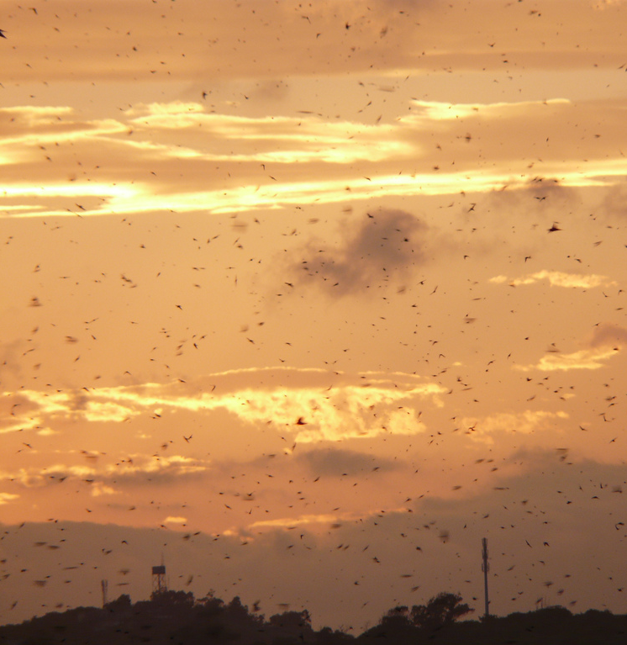
The Swallow's Story
Along with a great flock of swallows, Savannah soared into the sky, ready for the journey over the enormous Sahara desert. Savannah made sure she had eaten as many insects as she could before leaving as there would be no food in the desert. She wondered whether she would make the journey safely, but knew that she would have to try.
Photo by MongFish@flickr.com (CC BY 2.0)

Slide 8
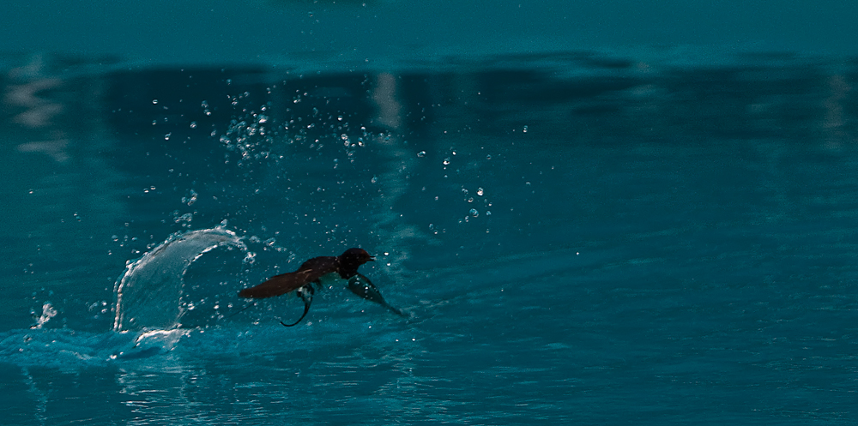

The Swallow's Story
Savannah flew as fast as she could, travelling 200 miles a day with her friends over fields and water. Still the journey would take her weeks. She had to believe in herself and keep going, learning new skills such as drinking water whilst flying, without stopping!
Click on the swallow to watch a clip of a swallow drinking water on the wing.
Photo by The Torch@flickr.com (CC BY 2.0)

Slide 9
The Swallow's Story
Does the swallow drinking look easy or hard?
Can you think of words to describe the swallows on their journey?

Slide 10
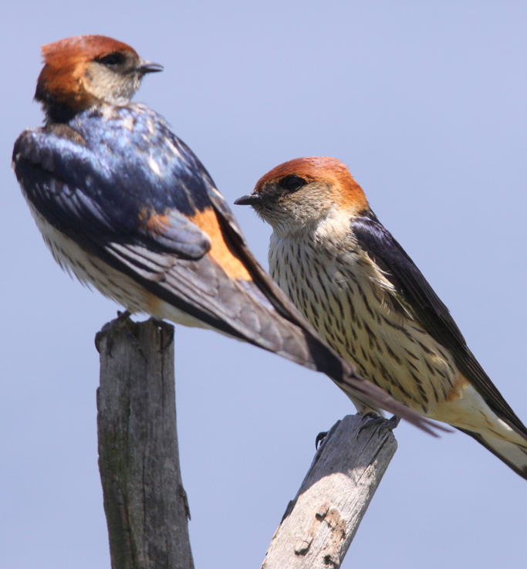
The Swallow's Story
Savannah would rest with her friends and feed whenever she could. She sheltered in the reeds from the rains and tropical storms, drying her wings before continuing with the journey. The dense reed bed protected her from predators such as sparrow hawks. Although there were many dangers and Savannah was very tired, her friends made her feel safe and she knew she had to keep going.
Photo by Derek Keats@flickr.com (CC BY 2.0)

Slide 11
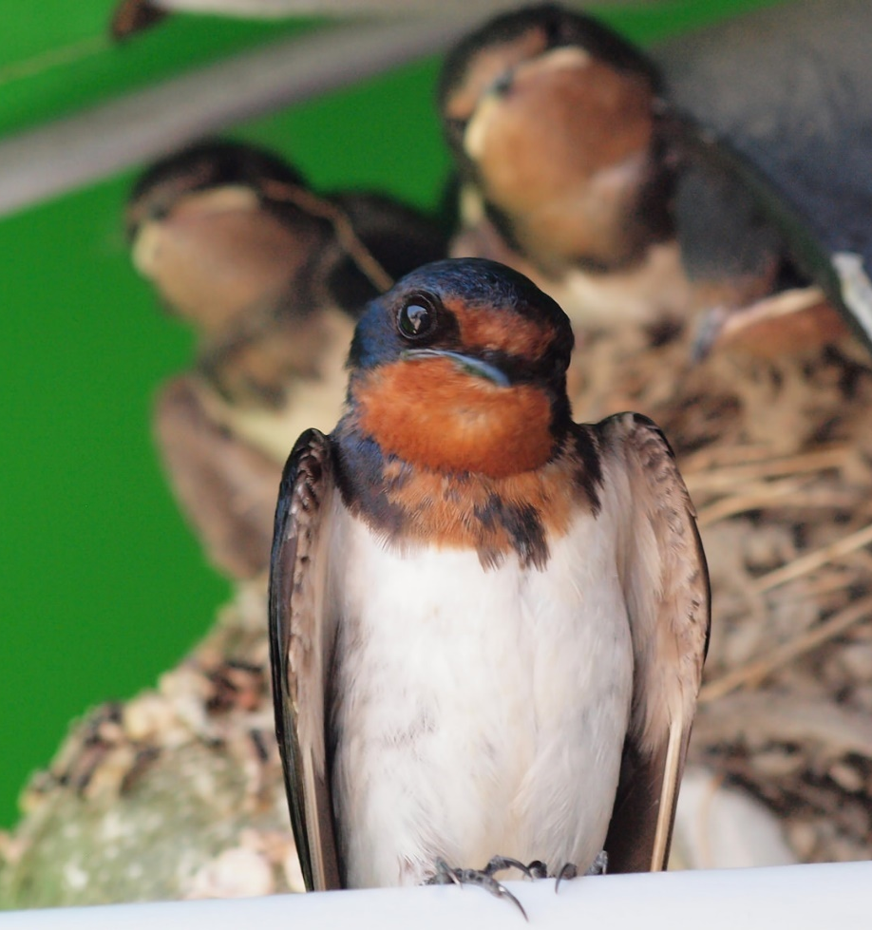
The Swallow's Story
Finally, Savannah reached her special spot in Scotland where, nestled under a school roof, she found her nest, safe and sound. Savannah had been using the same nest for ten years and it felt like home. She raised her chicks until it was time to return to Africa, just a few months later.
Photo by coniferconifer@flickr.com (CC BY 2.0)

Slide 12
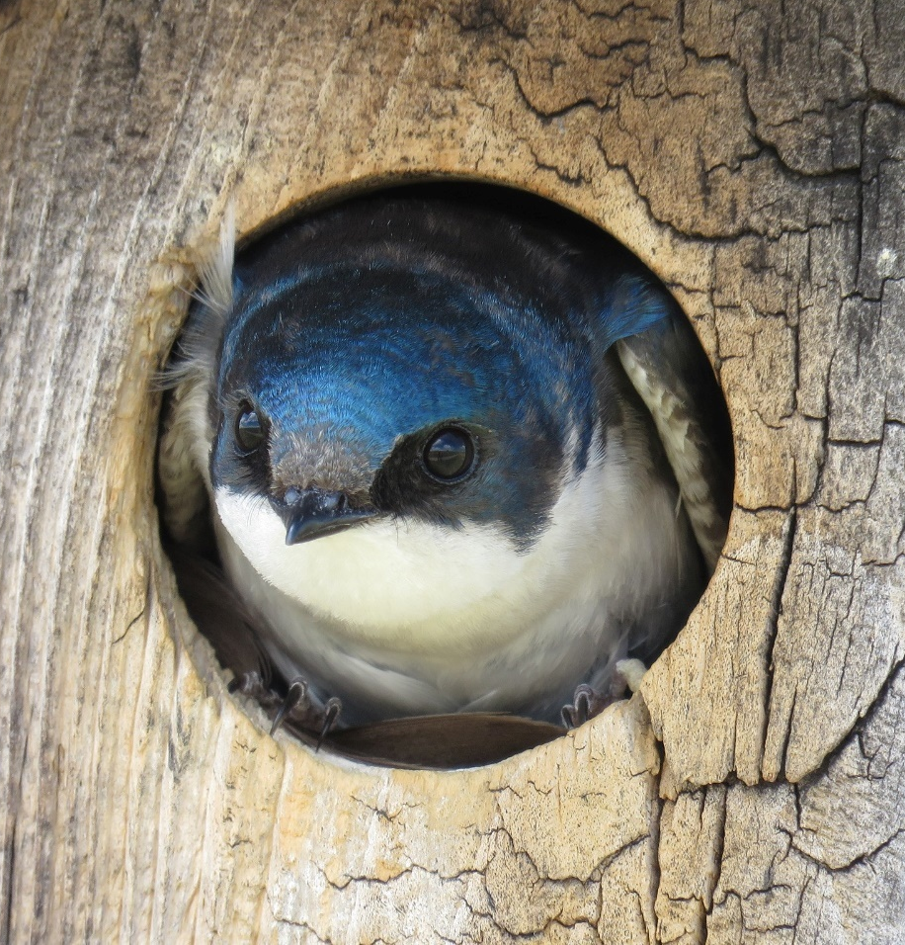
The Swallow's Story
What can we learn from the swallow’s story?
What challenges did she face?
What helped her to overcome them?
What can we learn?
Photo by sdymchenko@flickr.com (CC BY 2.0)

Slide 13
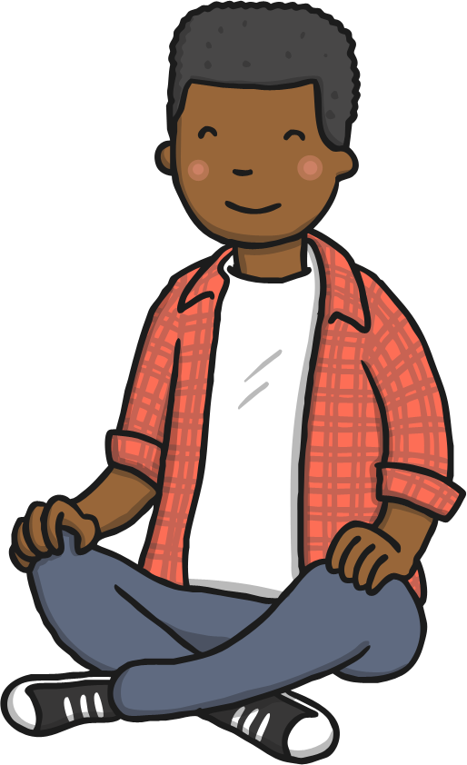
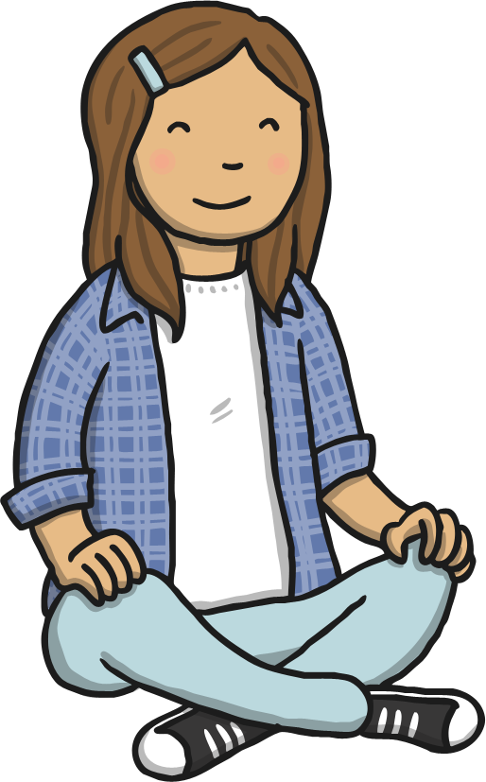
Top Tips for Resilience

Slide 14


Be Thankful
Discuss It!
Tell the person next to you something that you are thankful for today. Try to do this every day. This is something you should remember when you are facing a challenge.

Slide 15
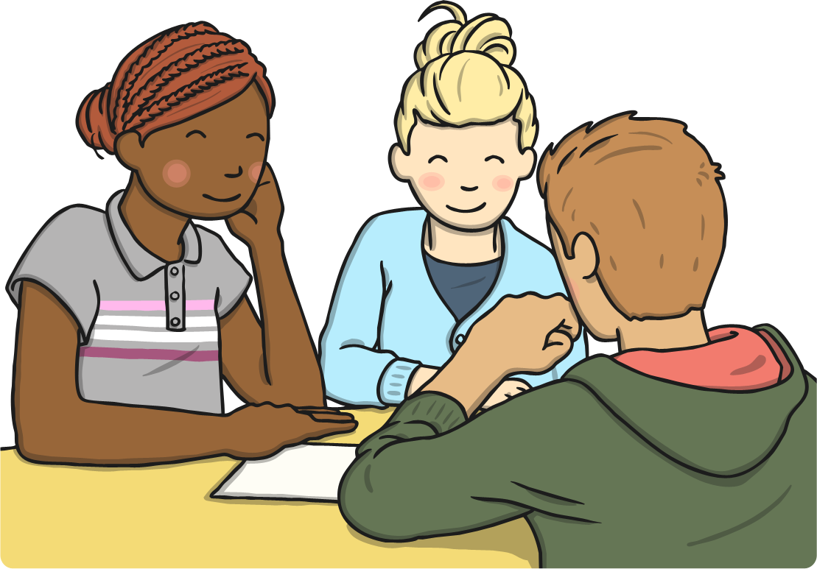
Work Hard
Discuss It!
We can achieve great things when we work together. Can you think of a time when a friend helped you to achieve something tricky?

Slide 16
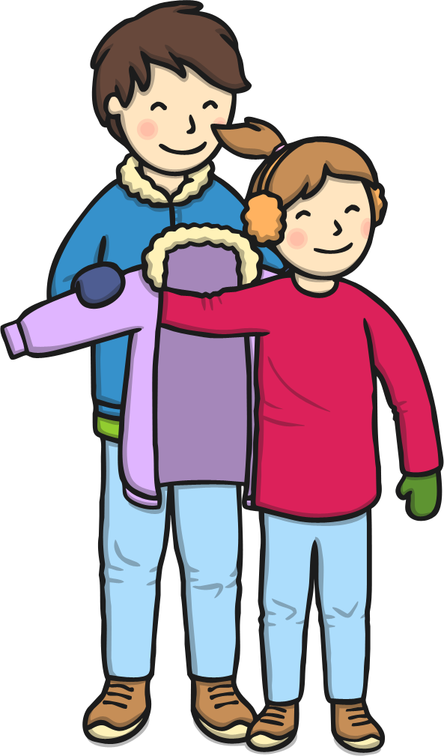
Ask For Help
You should always work hard and try your best. Can you think of a time when trying your best helped you to succeed?
Discuss It!

Slide 17
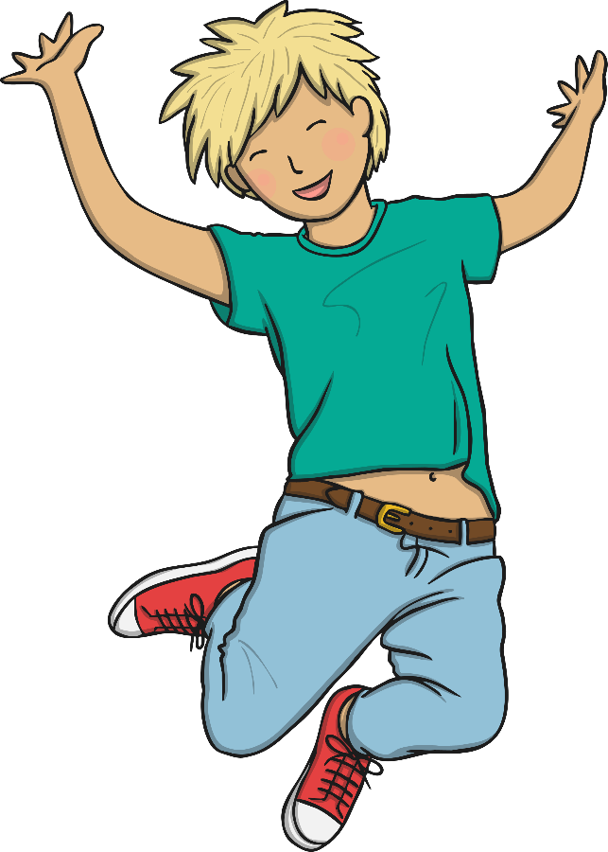
Keep Trying
Watch this video to see the incredible Houdini Horse!
Do you think the horse learnt to do this straight away? How many attempts do you think it took? What can we learn from
Houdini Horse?

Slide 18




Believe in Yourself
I am great because…
I make
people smile when I…
I am really good at…
I can…
Do It!
Click on a star and complete the sentence.

Slide 19
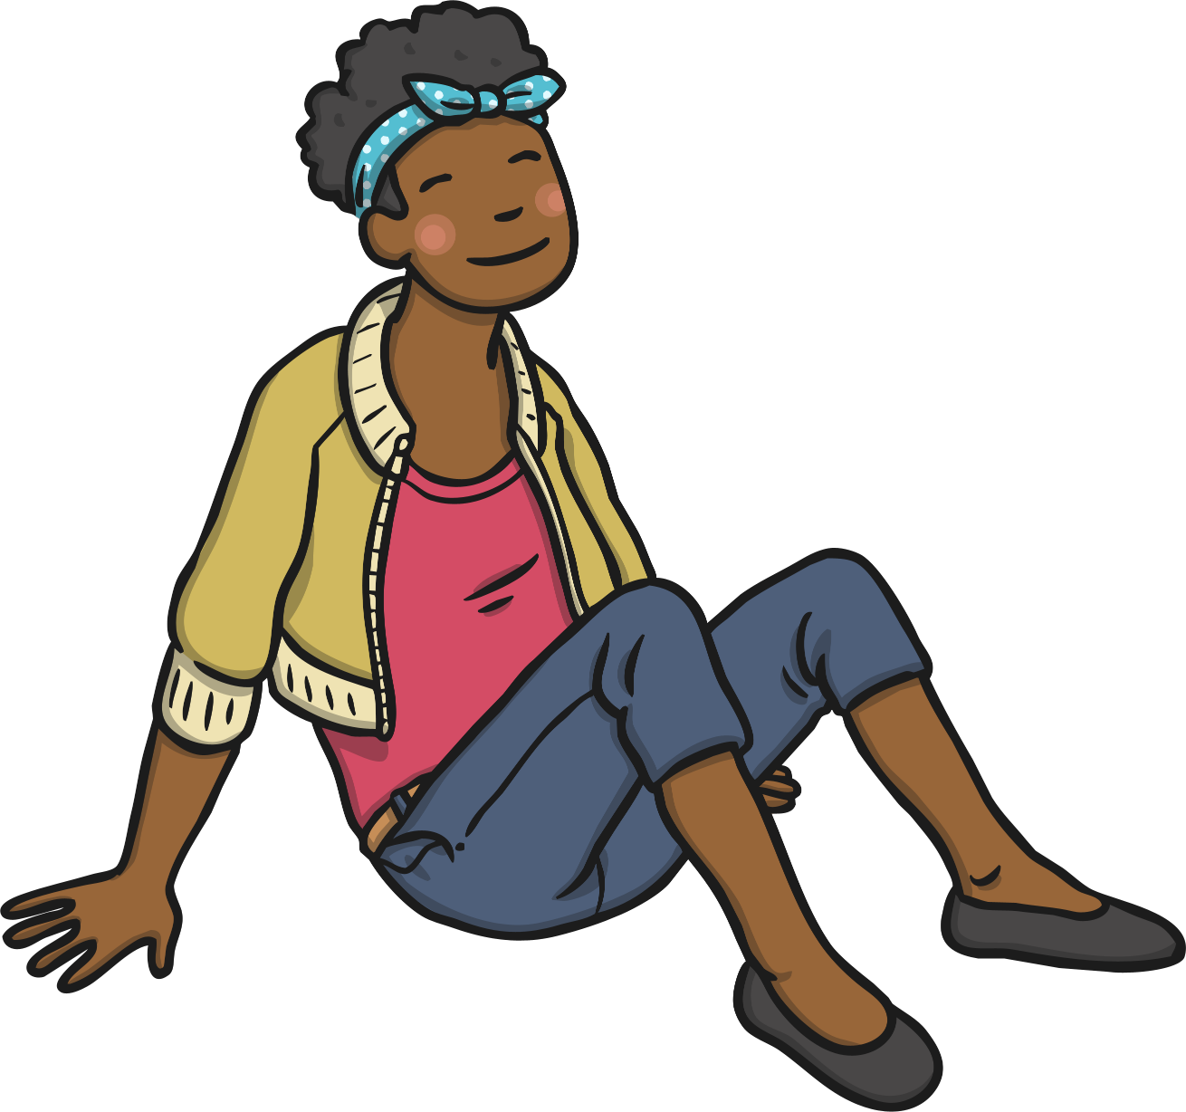
Stay Calm
How do you feel?
Watch the video.
Now how do you feel?
Why is it good to feel calm?
Watch It!

Slide 20
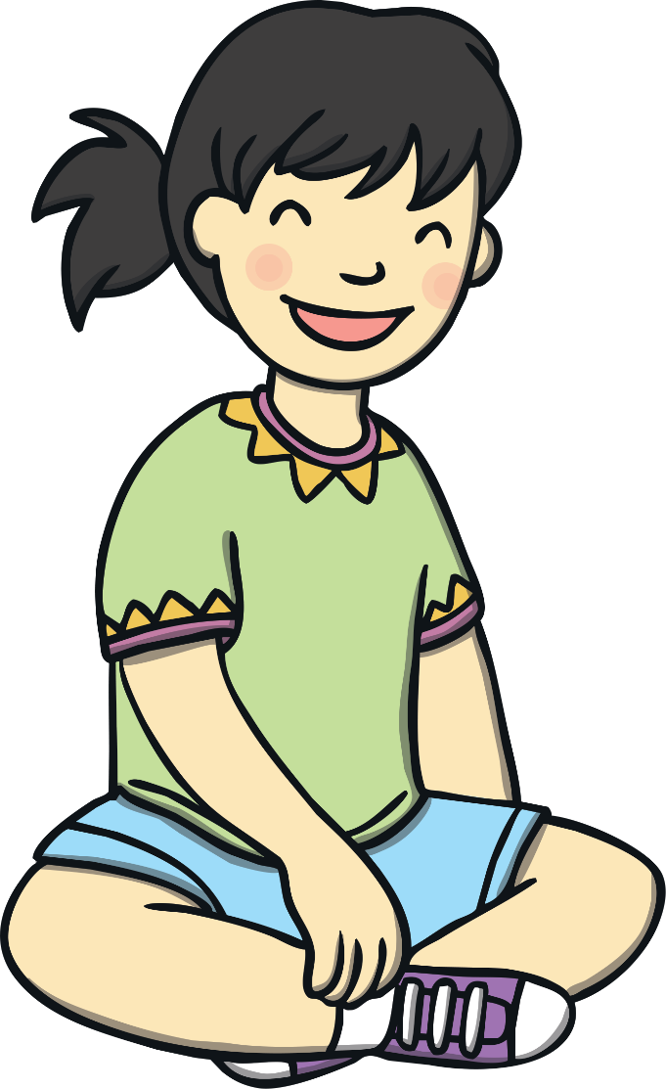
Laugh!
What is brown and sticky? Click to find out!
A stick!
Did this joke make you laugh? Can you do better?
Do It!
Have a joke telling competition! Who has a joke to share?

Slide 21
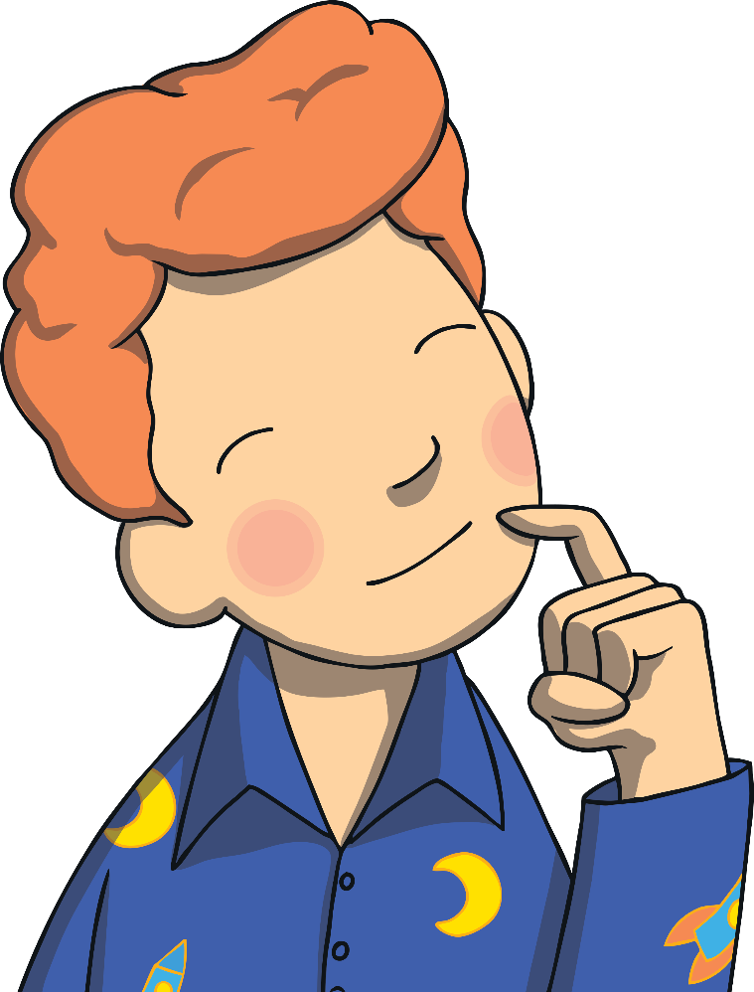
Thinking Time
What can we learn from the swallow’s story?
Take a quiet minute to think of a time when you showed true resilience.
What can you do to become more resilient?
Keep working hard to achieve your ambitions!
Take a quiet moment to think about what your ambitions are.

