Slide 1
A happy and healthy school

Slide 2



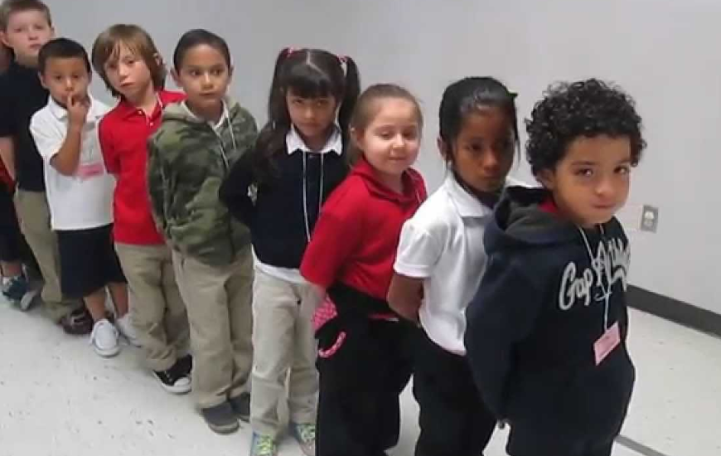
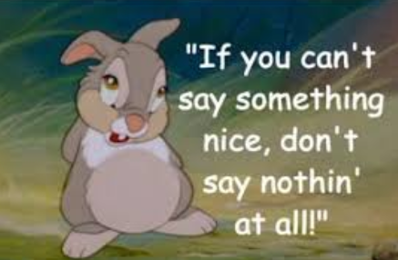

Slide 3

Thank you
Thank you for holding doors open and
Using good manners
Thank you for remembering kind hands, feet and words
Thank you for walking round school and lining up calmly and quietly
Thank you for using your indoor voice
Thank you for protecting our Russell Rights
Thank you for keeping your tables and the space under your table clean at lunchtime
Thank you for using good table manners
Thank you for being a bucket filler

Slide 4
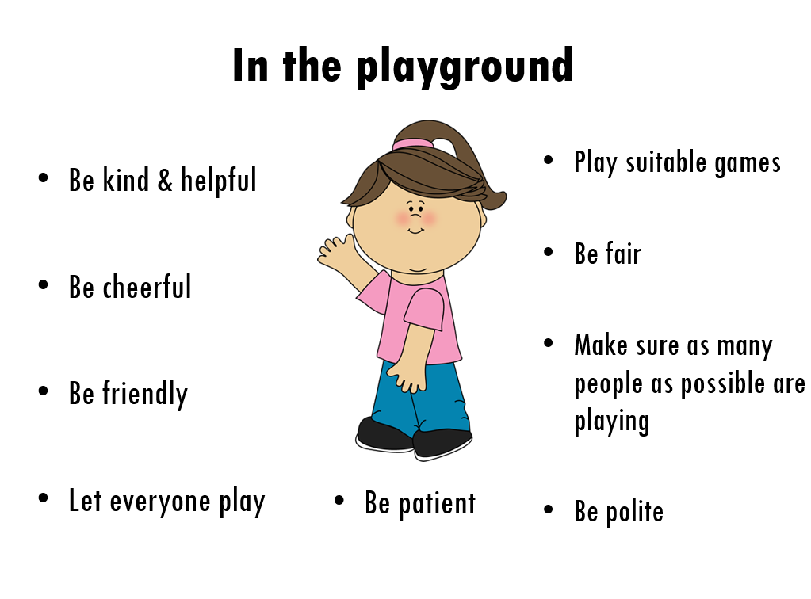

Slide 5
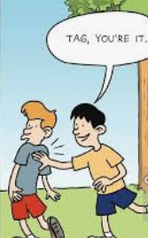
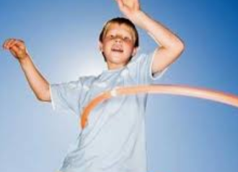
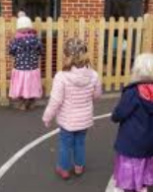

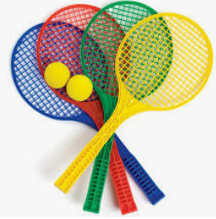
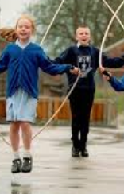
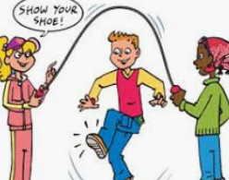
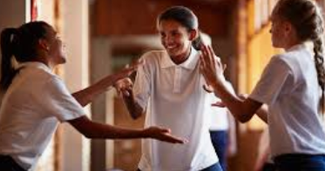
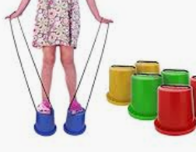
What are suitable games?

Slide 6
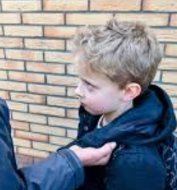

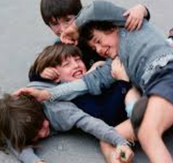

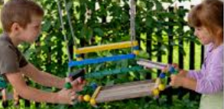
What are unsuitable games?
No fighting
No PLAY fighting
No trying to trip people up
No taking toys off each other
No grabbing clothes
No fighting over toys
No chasing people who don’t want to be chased
USE YOUR VOICE/GET AN ADULT
KIND HANDS, FEET and WORDS

Slide 7


ALL adults and children get respect at RUSSell
WE ARE A TELLING SCHOOL
If you are not respectful to any adult or children they WILL TELL
You will then lose your right to play outside

Slide 8
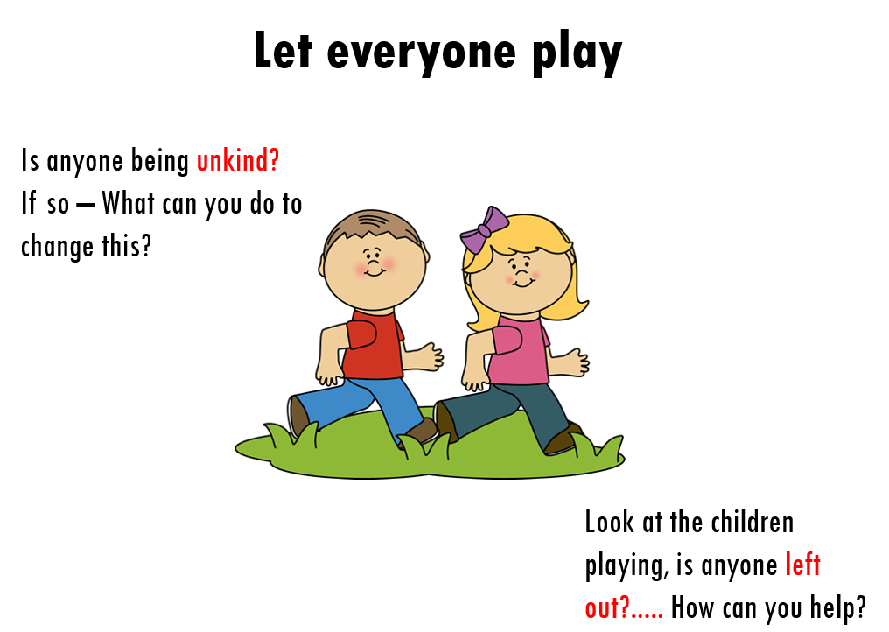
Right to be happy
We protect our Russell Rights:
The right to be SAFE
The right to be HAPPY
The right to LEARN
The right to be INCLUDED
No one should be at Russell if they don’t agree with these. They make our school a happy place for EVERYONE

Slide 9

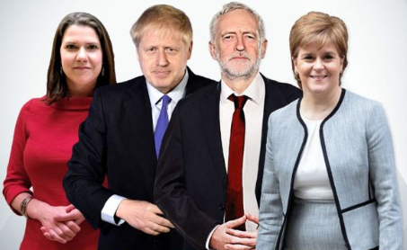


12th December 2019 – General Election
1
1 Nicola Sturgeon – Scottish Nationalist Party (SNP)
2 Jeremy Corbyn – Labour
3 Boris Johnson – Conservative
4 Jo Swinson – Liberal Democrat
4
2
3

