Slide 1



Our Telling School
September 2019

Slide 2
Russell is a Telling School
What should you do if you have a problem?
Tell your class teacher
Tell another child in your class
Tell someone in PSHE time or Circle Time
Tell another adult – maybe Mrs Walker, Mrs Bunney, one of the office staff or a Midday Supervisor
Tell someone at home and they can come and help you tell us at school

Slide 3


Speak out. Stay Safe.
Say NO to bullying.
Speak out until things get better.
What is the difference between bullying and being mean?
STOP – Several times on purpose
From my head to my toes, I say what goes!

Slide 4

A problem shared is a problem halved!
A small problem can seem enormous, but can often be quickly sorted out.
Therefore it is important that you tell somebody who can do something about it.
We do listen and there are several options if you feel uncomfortable about talking to a specific person.
Do talk, sooner rather than later, because worries can grow if left.

Slide 5
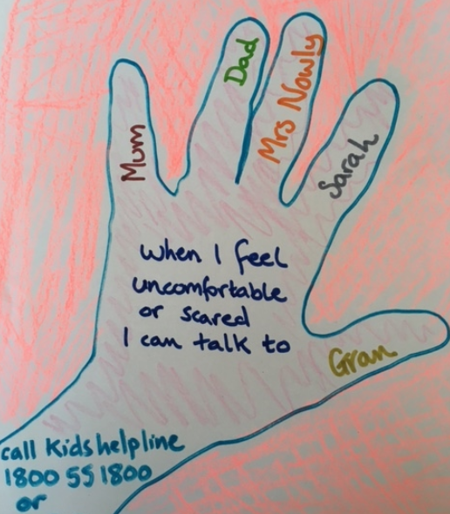
My Network Hand
3 people out of school
2 people in school
Everyone over 18 – they must listen, believe you and do something to help

Slide 6



Slide 7


Milton - Courage

