Slide 1
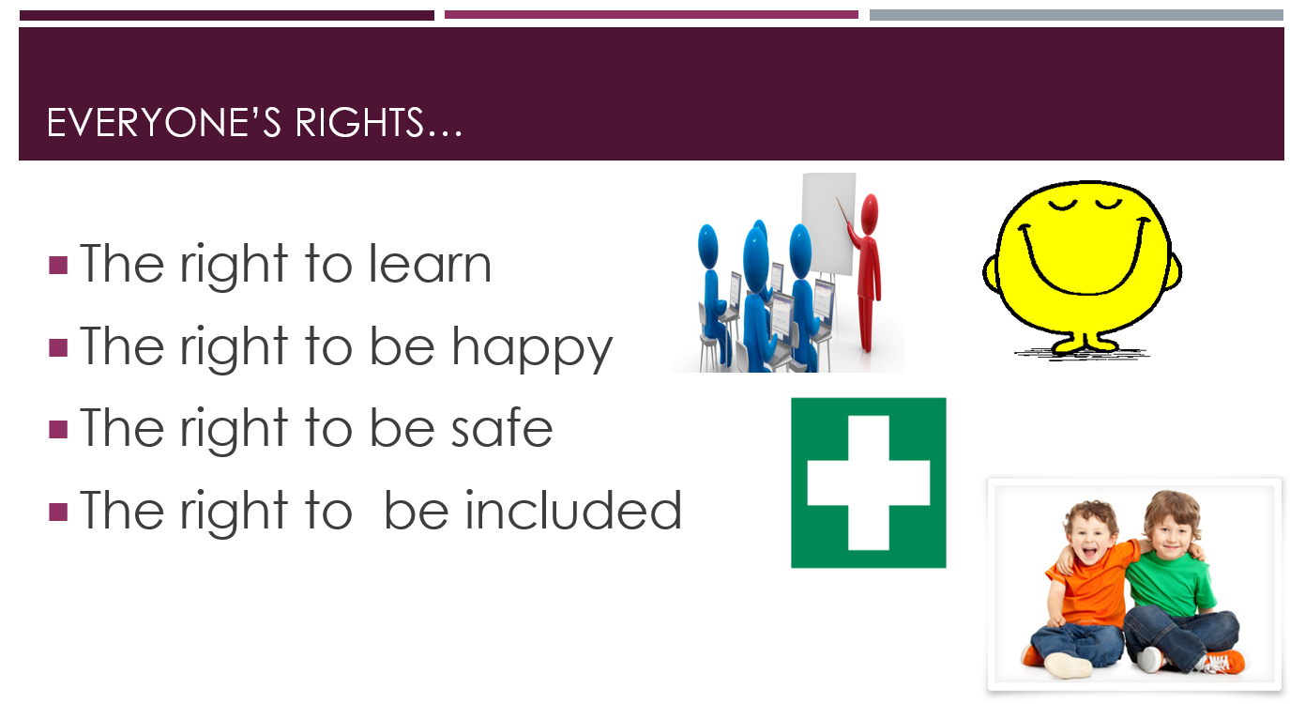

Slide 2

The right to be happy

Slide 3

Z
Z
Z
Taking care of myself:
Ready for sleep

Slide 4


Sleep: What’s our starting point?
Think about:
All of the things that you know about sleep
The things someone can do to help them fall asleep
The things that may stop someone from falling asleep
Notes:
Teacher Notes - Baseline assessment (10 mins)
It is important that pupils complete this activity individually. Do not guide or prompt their answers. When finished, collect in their papers. Explain you will revisit this work at the end of the lesson. Look through pupils’ ideas to elicit an understanding of what pupils already know about the importance of sleep and routines that promote good sleep.

Slide 5



      We are learning about the things that will help us to fall asleep and get a good night’s sleep
      We will be able to:
  describe some reasons why sleep is important
  recognise some things that may be stopping us getting to sleep, and ideas to manage them
  Identify some things that might help us get to sleep (including rest and relaxation)
Notes:
Teacher Notes – Learning objective and outcomes
Introduce the learning objectives and outcomes, explaining that this lesson will explore why sleep is so important in children’s lives, how it can sometimes be difficult to fall asleep or stay asleep, and some of the reasons for this.

Slide 6
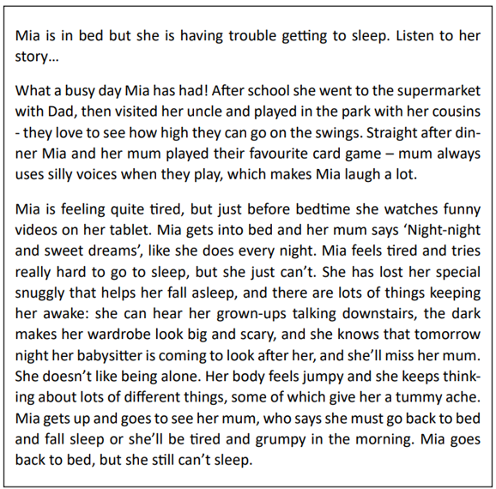
Mia’s story -
Listen to a story about Mia’s day…

Slide 7

Mia’s story
Now have a go at answering the questions:
What does Mia’s mum say every night to show Mia that it is time for her to go to sleep? What might other families say or do?
Mia has lost the snuggly that usually helps her to fall asleep. What might this snuggly be?
Does everyone have a special snuggly?
Notes:
Teacher Notes – Mia’s story (5mins)
To the whole class, read the scenario on Resource 1: Mia’s story.
Ask pupils the following questions:
What does Mia’s mum say every night to show Mia that it is time for her to go to sleep?
What might other families say or do? Encourage pupils to respond with the phrase: ‘Other families might…’
Mia has lost the snuggly that usually helps her to fall asleep, what might this snuggly be? Possible answers: a favourite pillow, a special blanket, toy or teddy, a thumb or dummy to suck.
Does everyone have a special snuggly? Ensure that pupils know that this is personal choice as some people do, and some people don’t.
Talk about how different families have different routines for bedtime. Sometimes families have special words or customs that they do at bedtime, and this is a good way to mark the end of the day and shows that it’s time for sleep.

Slide 8
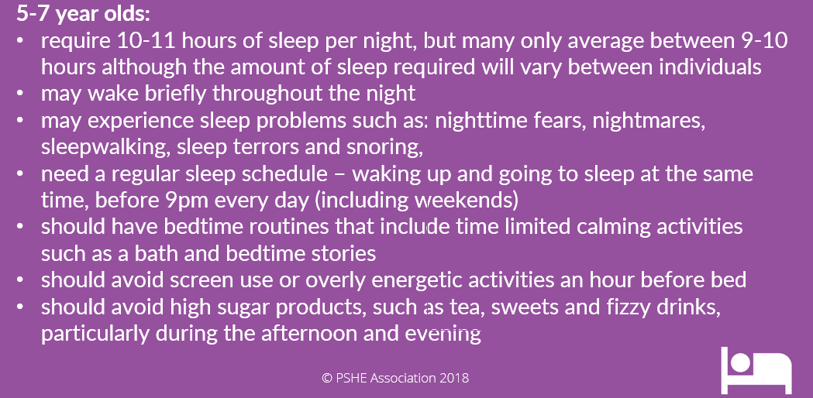

Slide 9



Mia’s story: Things that keep Mia awake
Notes:
Teacher Notes – Mia’s story: Things that keep Mia awake (10 mins)
Draw or display a spider diagram on the board/flip chart with ‘Things that keep Mia awake’ in the middle section. In pairs or talk partners, pupils should discuss some of the things that are keeping Mia awake. Volunteers should feedback their ideas to the whole class. Record these ideas on the spider diagram, grouping them in to categories as you go.
Some of the responses that pupils may give, and possible categories could be:
Night time fears – of the dark/being alone or away from loved ones/imagined threats (such as monsters)/something she has seen or heard about
Physical – busy minds/busy bodies (jumpy legs)/tummy ache – this may be a result of being worried about something/feeling unwell/thirsty or hungry
Environment – noise (outside and inside)/temperature/screens or tech in sleeping area.
Pick up on any commonalities or misconceptions and draw out the learning that most of these fears or worries are normal and that anyone can experience them. Quite often the things that we fear at night aren’t very scary during the day – Mia isn’t scared of her wardrobe during the day, nor of being on her own in her bedroom.

Slide 10
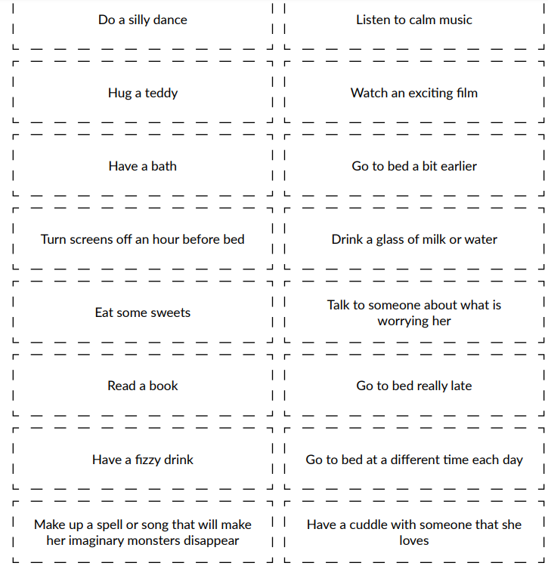






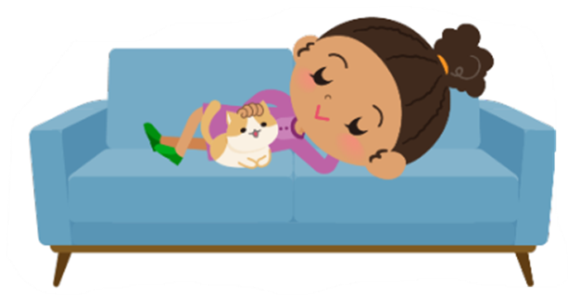
What can Mia do to rest and relax?
1. Good for relaxing | 2. Not so good for relaxing | 3. Unsure
Notes:
Teacher Notes – What can Mia do to rest and relax (10 mins)
Explain to the pupils that we know that Mia had a really busy day with school, shopping, visiting family and playing. She didn’t have a lot of time to rest or relax before going to bed.
Working in pairs or small groups pupils use Resource 2: What can Mia do to rest and relax to sort each of the suggestions into the three categories:
1) good suggestions for what Mia can do that might help her to rest and relax throughout her day and when she is getting ready for bed
2) suggestions that are not so good for relaxing
3) suggestions that you are unsure of
Sorting rings can be used if required.
Support: Pupils who may require some support could be given fewer cards to sort
Challenge: Ask pupils the challenge question: Do you have any ideas of your own? Provide pupils with some paper for recording ideas of their own.
Discuss results as a class, using the expected answers on Resource 2 to support feedback. Are there any not-so-good suggestions? Why are these not a good idea? Are there any suggestions that you’re unsure of?
An alternative to cutting out cards could be to highlight the three categories in different colours. Pupils could then highlight each statement according to the colour of the category.

Slide 11

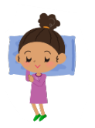


Mia’s new bedtime routine
What would a calm and relaxing bedtime routine for Mia look like?
What might someone do or say to help Mia feel relaxed and ready for bed?
What other things might help Mia to get to sleep?
Notes:
Teacher Notes – Mia’s new bedtime routine (10 mins)
Ask pupils to suggest a relaxing bedtime routine for Mia.
Working in pairs, pupils are provided with cut out cards from Resource 3a: Mia’s new bedtime routine. Using the suggestions on the cards, pupils should sequence these into a calm and relaxing bedtime routine for Mia. They can add any of their own ideas. Discuss the routines that pupils create and ask them to suggest something that someone might do or say to help Mia feel relaxed and ready for bed. Identify that different families might have different night time routines, which include some of these suggestions as well as different ways to get to sleep.
Support: Resource 3b – pupils should sequence the cut out picture cards, and talk about the routine they have created
Challenge: Resource 3c - pupils complete the sentence starters and justify their choices.

Slide 12
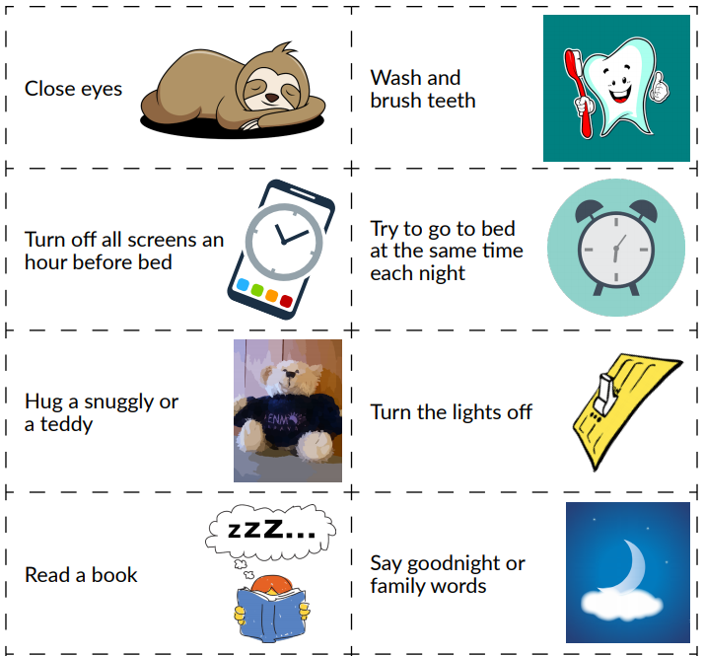

Slide 13
