Slide 1
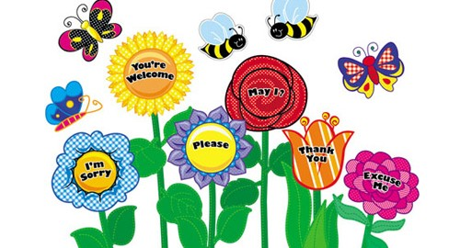
The power of good manners at Russell Lower School

Slide 2
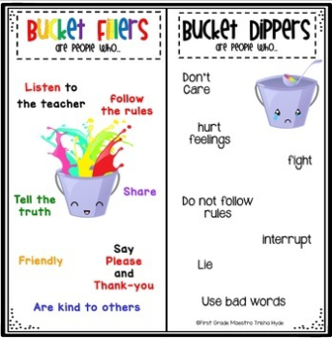
At Russell Lower School we have good manners based on Russell Rights and our shared Values – We are Bucket Fillers ☺

Slide 4
What are Good Manners?
Courtesy, politeness or having
are all about respecting others and yourself.
It’s not just about
eating quietly and neatly, it’s about paying
attention to the person who is talking to you and
treating every individual equally regardless of their
appearance, beliefs and backgrounds.
Good
manners imply being cheerful and generous to
others and make sure we stick to the Russell Rights.

Slide 5
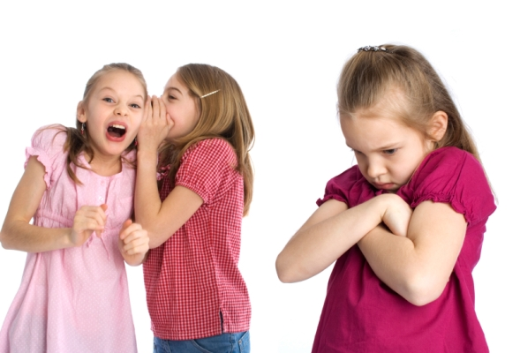
How would you feel if someone talked to your
friend but turned his back on you?
Or if someone pushed you out of the way to get
the seat you were about to sit on?

Slide 6
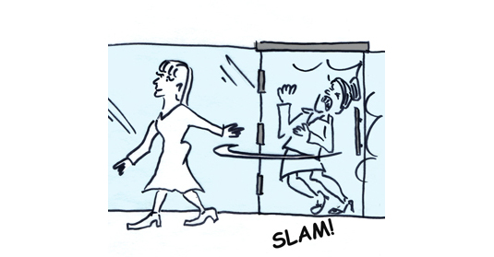
How would you feel if someone let the door slam
in your face as you were about to walk through it?
Or if someone shared your things but never
shared anything of theirs?

Slide 7
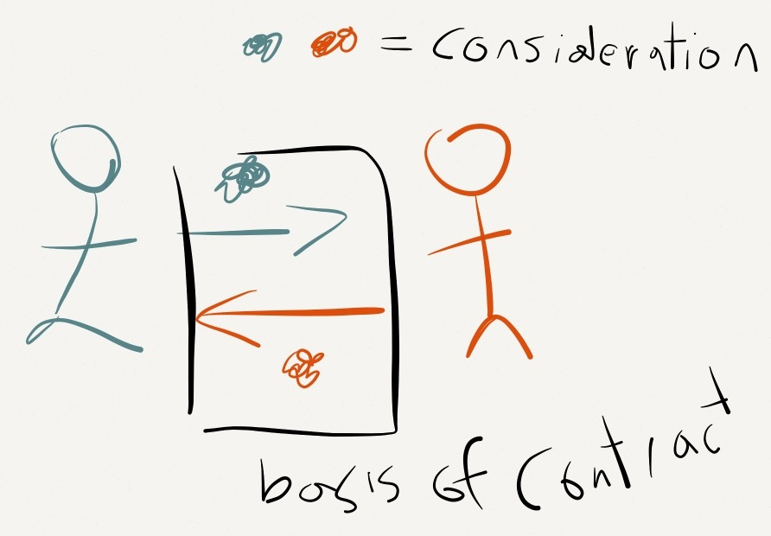
How would you feel if someone never said
‘please’, ‘excuse me’ or ‘thank you’?
Good manners is about considering the feelings
of other people, and being the kind of person
that others will like and respect.

Slide 8
They also help to promote friendship and live
happily amongst the people around you. If you
show good manners everywhere you go, then you
are more likely to encourage others to behave in
the same way towards you.

Slide 9
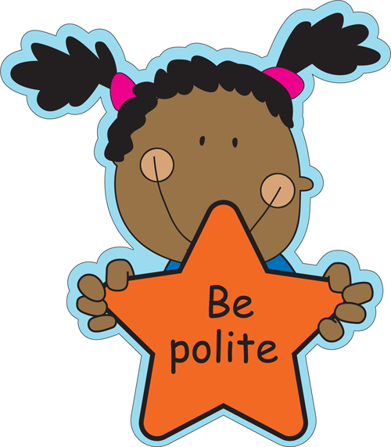
Example of Good Manners
to everyone you meet.
You will never regret being too polite, but you
might regret being rude.

Slide 10
Use the magic words as often as possible:
Hello, Please, Excuse me, Sorry
And these two most important words:
Thank you

Slide 11
Do not use swear words or rude words.
If you receive a rude message, do not
respond with rudeness, but
Remember that your words are the most
powerful thing you have working for you,
or against you.

Slide 12
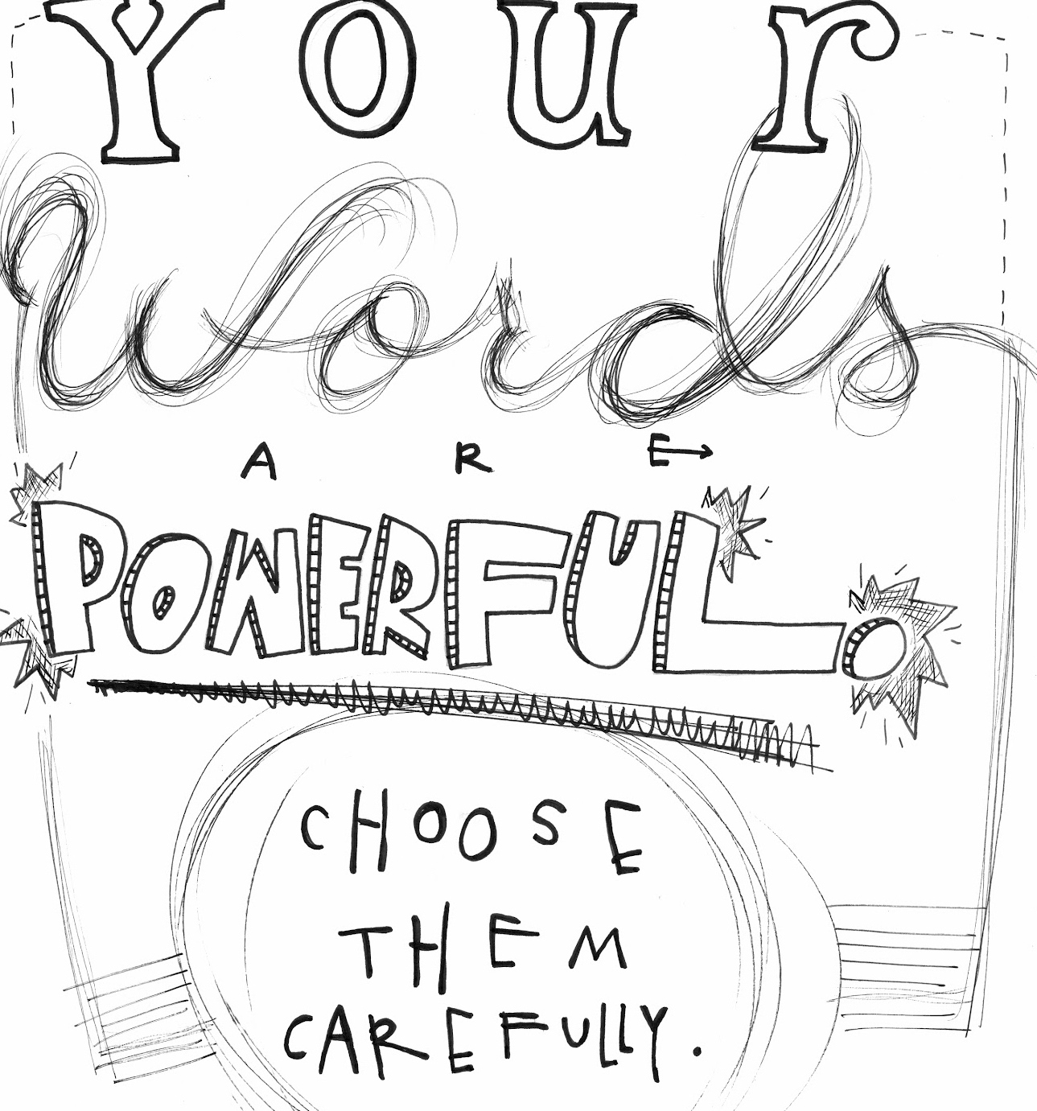

Slide 13
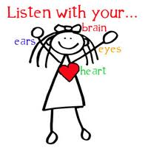
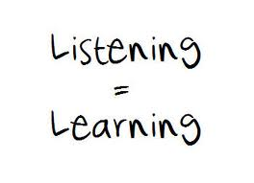
Do not interrupt people and learn to be a good
listener. This will help you see the world
through the of others.

Slide 14
How to SHOW good manners at Russell :
We use kind hands and kind words
We use ‘please’, ‘thank you’, ‘sorry’ and ‘after you’
We pay attention to people who are speaking by looking at them, or not fiddling
We wait politely if someone is already talking and we want to say something
We abide by the class rules – such as putting our hand up when we want to speak
We wait politely in a queue for our turn, we don’t push in
We hold a door open, or stand back if someone else wants to walk through it too
If someone says good morning, say good morning back

Slide 15
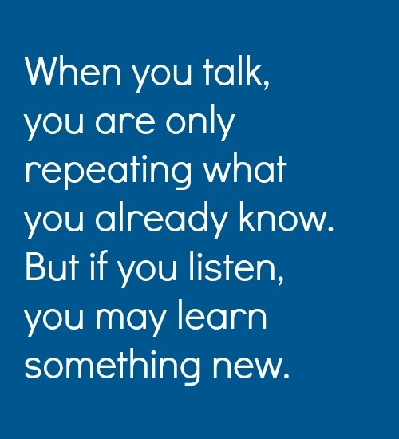
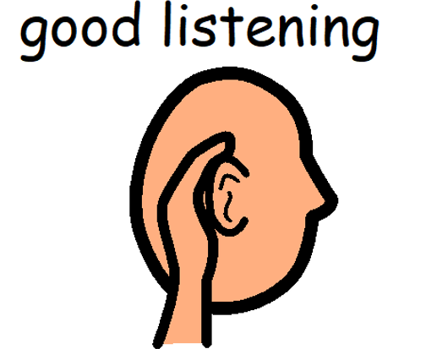

Slide 16
Show your appreciation at every
opportunity, even for small things.
When you show your appreciation to
others, you will get back some of what
you give. Appreciation is always appreciated.

Slide 17
Show appreciation by saying thank you

Slide 18
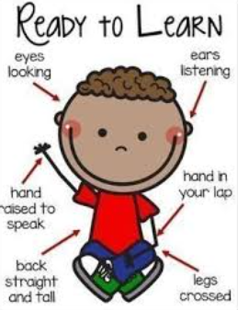
Be punctual (on time). Not just when you arrive at school, but every time you need to start learning.

Slide 19
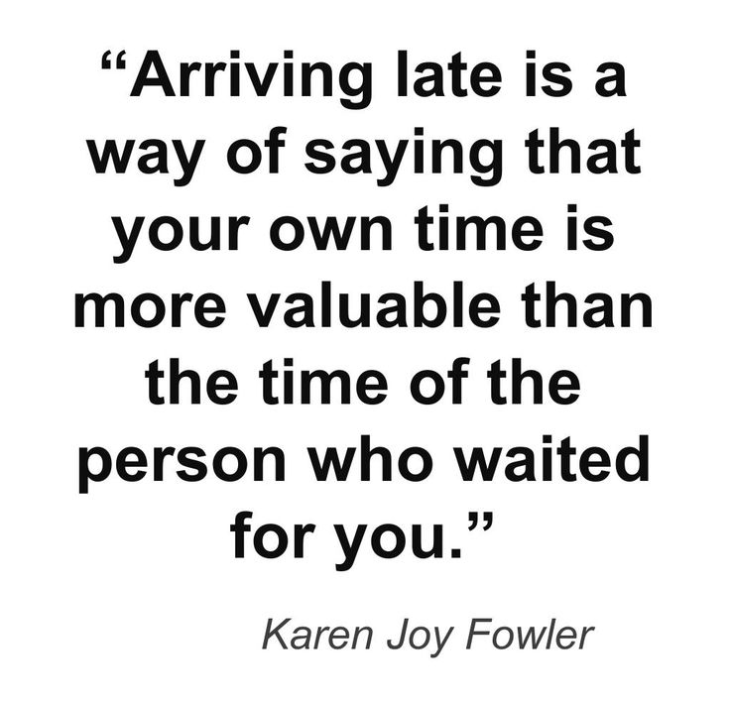

Slide 20
A good sense of is good manners.
However, jokes that are mean about other people are just that – mean!

Slide 21
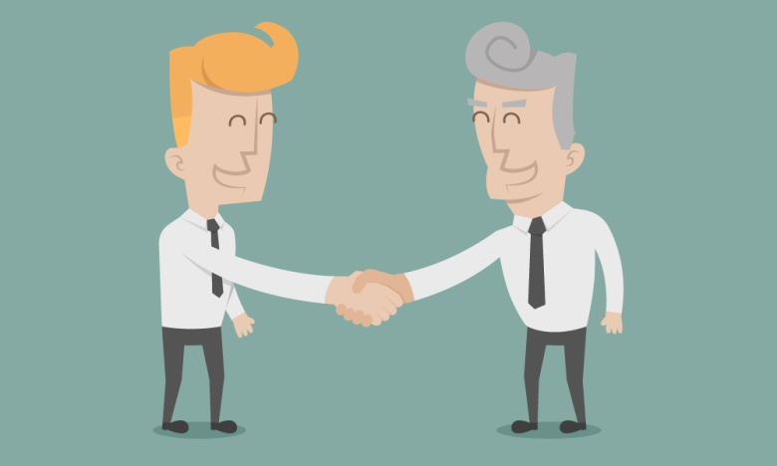
If someone treats you with bad manners, do not
lower yourself to the same level. Show others the way with your best manners. For example:
If they forget to say please or thank you, make a point of saying please and thank you so they can hear!

Slide 22
Before starting important conversations, meals or
meetings, turn off your TV, tablet, game or mobile phone. Ignoring people while you are doing something else is disrespectful.
Make the most of your family and friends time.

Slide 23
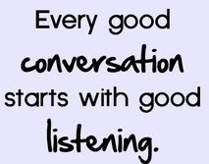
Do not try to show off or prove you are more
important than others. This only shows poor
manners. Instead, share your friend's good
experiences without bringing up your own story.

Slide 24
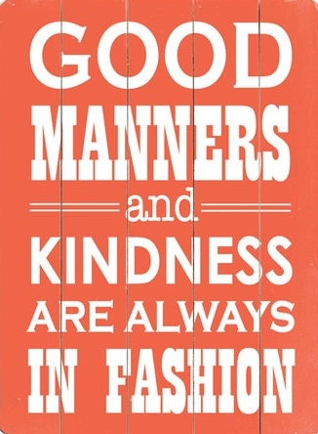
As you improve your manners, you will enjoy more
support, admiration and respect from everyone
around you. Remember that good manners never go
out of style and are a reflection of who you are.

Slide 25
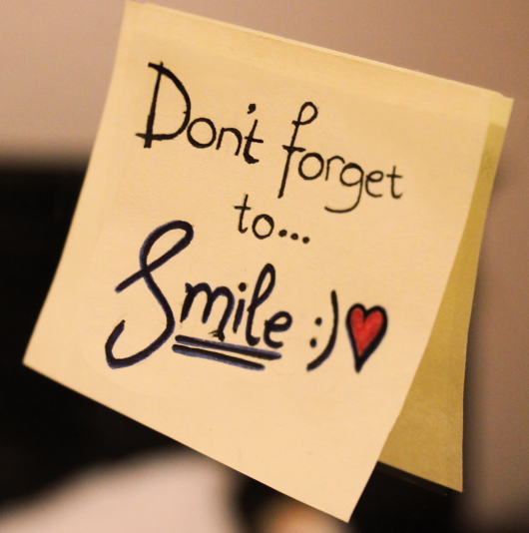
We should we start right now!
Say please and thank you
Smile
Ask someone if they would like help
Give someone a compliment
Open the door for someone
Wave to a friend
Greet your teachers
Encourage someone who is discouraged
Say something positive
There are hundreds of little things we can do to show kindness.

Slide 26
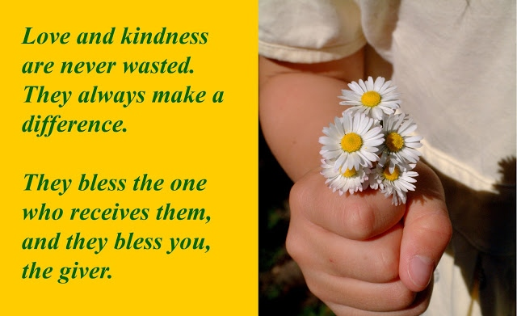

Slide 27
At Russell Lower School we have good manners based on Russell Rights and our shared Values – We are Bucket Fillers ☺

