Slide 1

Russell Lower School Sustainability Day 2021
Part of a ‘Sustainability Month’

Slide 2


Slide 3
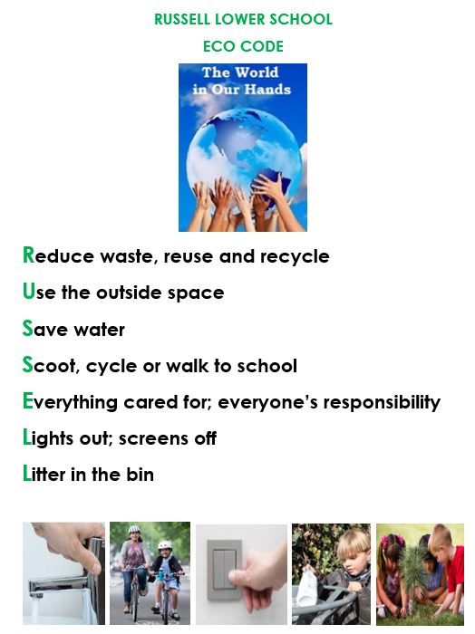

Slide 4




What Can You Do to Help?
Although it might feel impossible to reverse climate change, each of us can make changes to help our world.
Reduce consumption of unsustainable fossil fuels. Switch off lights when not needed. Unplug electronics not in use. Choose natural, sustainable materials, such as bamboo or woods from FSC forests, rather than plastics.
Reduce pollution. Walk or use a bike when possible. Put litter in waste bins or take it to recycling centres. Take a bag and some gloves and go on a litter-pick around your home or school.

Slide 5
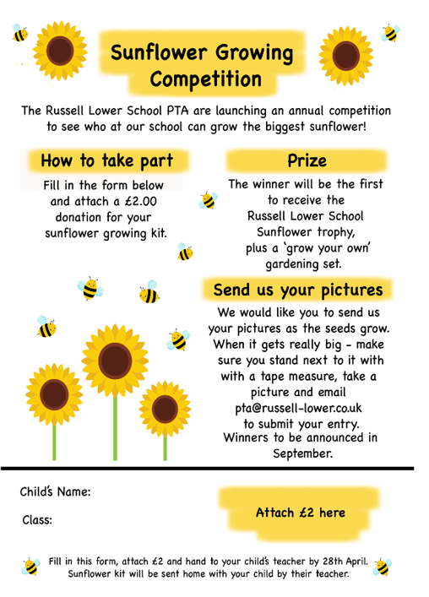
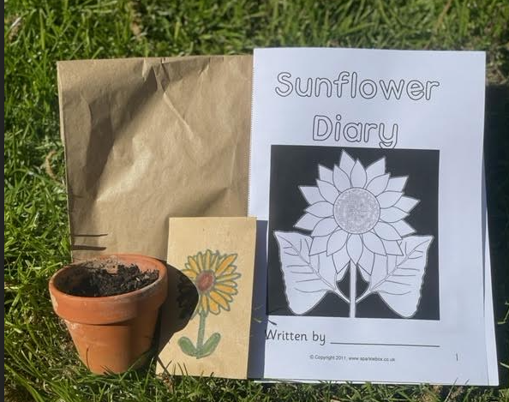
Use the outside space
Everything cared for

Slide 6
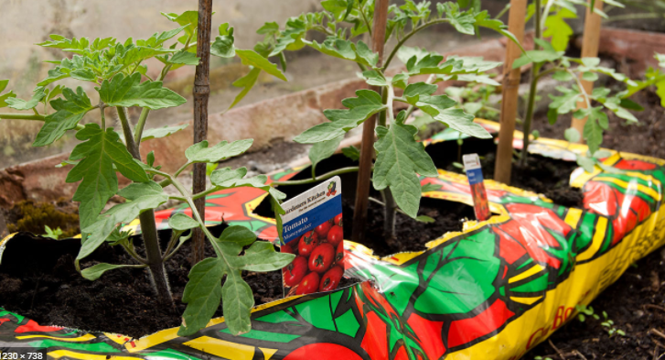
The PTA want to watch us grow our own tomatoes!

Slide 7

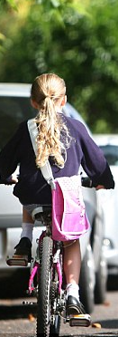
Scoot, Cycle or Walk to School

Slide 8
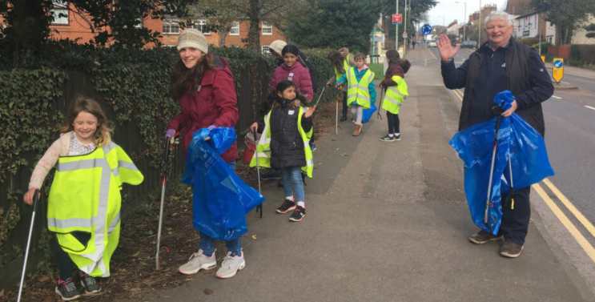
Litter in the bins – Saturday 12th June with Ampthill Climate Change Group

Slide 9
