Slide 2
Aims
To understand what Earth Day is.
To understand how we can take action to support Earth Day’s aims.

Slide 3

Today We Will Ask…
What is Earth Day?
Why is Earth Day important?
What is the theme for
Earth Day 2021?
Why is it important to
restore our earth?
How can our world leaders
help against climate change?
What can you
do to help?

Slide 4
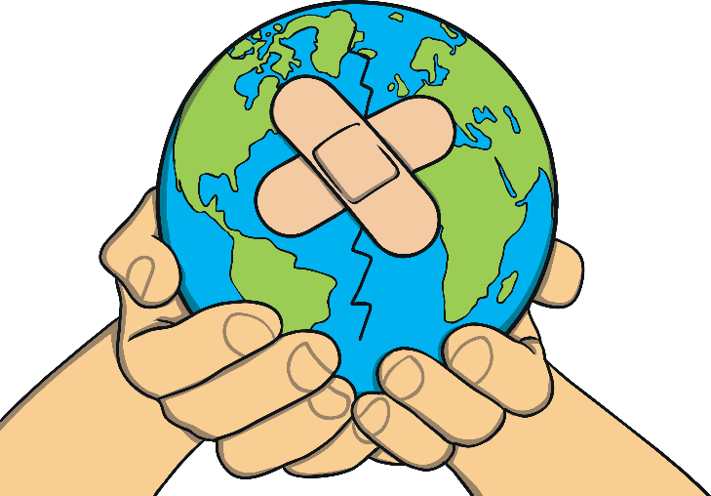
What Is Earth Day?
Earth Day is an annual global event that takes place on the 22nd April. This year it takes place over three days, beginning the 20th April.
1970 was the first year Earth Day was held and, since then, more and more people have shown their support for the environment by becoming involved.

Slide 5
Why Is Earth Day Important?
We only have one planet Earth.
Some people say, “There is no Planet B.”
Can you explain what this means?
Earth Day is an opportunity to remind ourselves that this earth is important to us all, all year round. Climate change and other environmental breakdowns have lead to new, fatal diseases spreading worldwide.
Did You Know…?
The Earth’s average temperature has risen by 1ºC since the Industrial Revolution due to the impact of human activity. This might not sound much, but such a little change is having a devastating impact worldwide.

Slide 6
What Is the Theme for Earth Day 2021?
Restore Our Earth
We must restore our Earth not just because we care but because we live on it. Everyone deserves to live on a healthy planet.
This year, Earth Day’s aims for a variety of campaigns to lead the way for us to restore our earth such as:
The Canopy Project - to sustainably plant trees for a greener future;
The Great Global Clean-up - help clean up waste and recycle reusable materials in our public places;
The Earth Challenge - give us the power to capture and collect billions of observations around the world in many areas, such as air quality, climate change and plastic pollution.

Slide 7
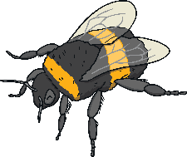





Why Is It Important to Restore Our Earth?
Earth Day is a campaign that features plants and animals that provide us with essential services to our ecosystem. We depend on these for our world to stay healthy.
These include:
coral
bees
butterflies
forests
fish
After the recent events of the global pandemic, our Earth needs all the love and care we can provide so that it can be restored back to its former glory.

Slide 8
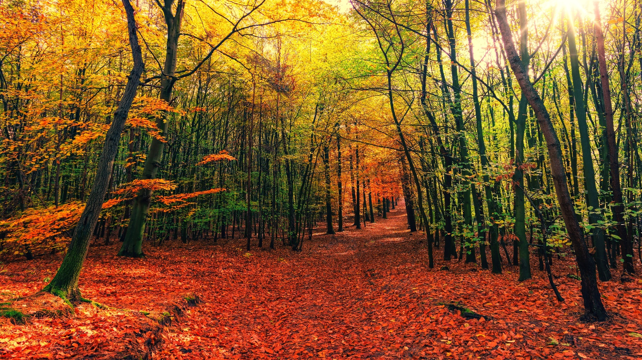
Forests
Our forests have an important role. They capture and store huge amounts of carbon and release oxygen into the air.
Did You Know…?
Forests are home to about 80% of the planet’s animals and plants.

Slide 9
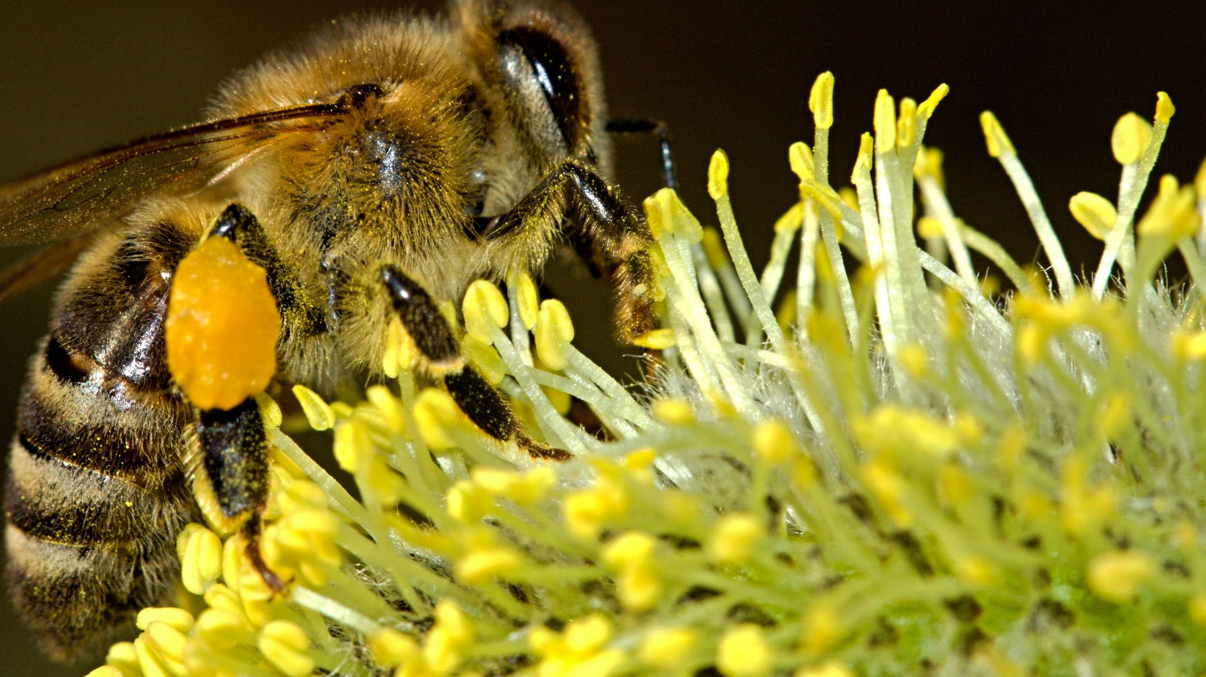
Bees
Bees are essential pollinators. They provide food for humans and other animals. Every third bite of food we take is thanks to the work of bees.
Did You Know…?
A queen bee can live for up to five years with the help of her worker bees and drone bees, which only live for just five to six weeks.

Slide 10
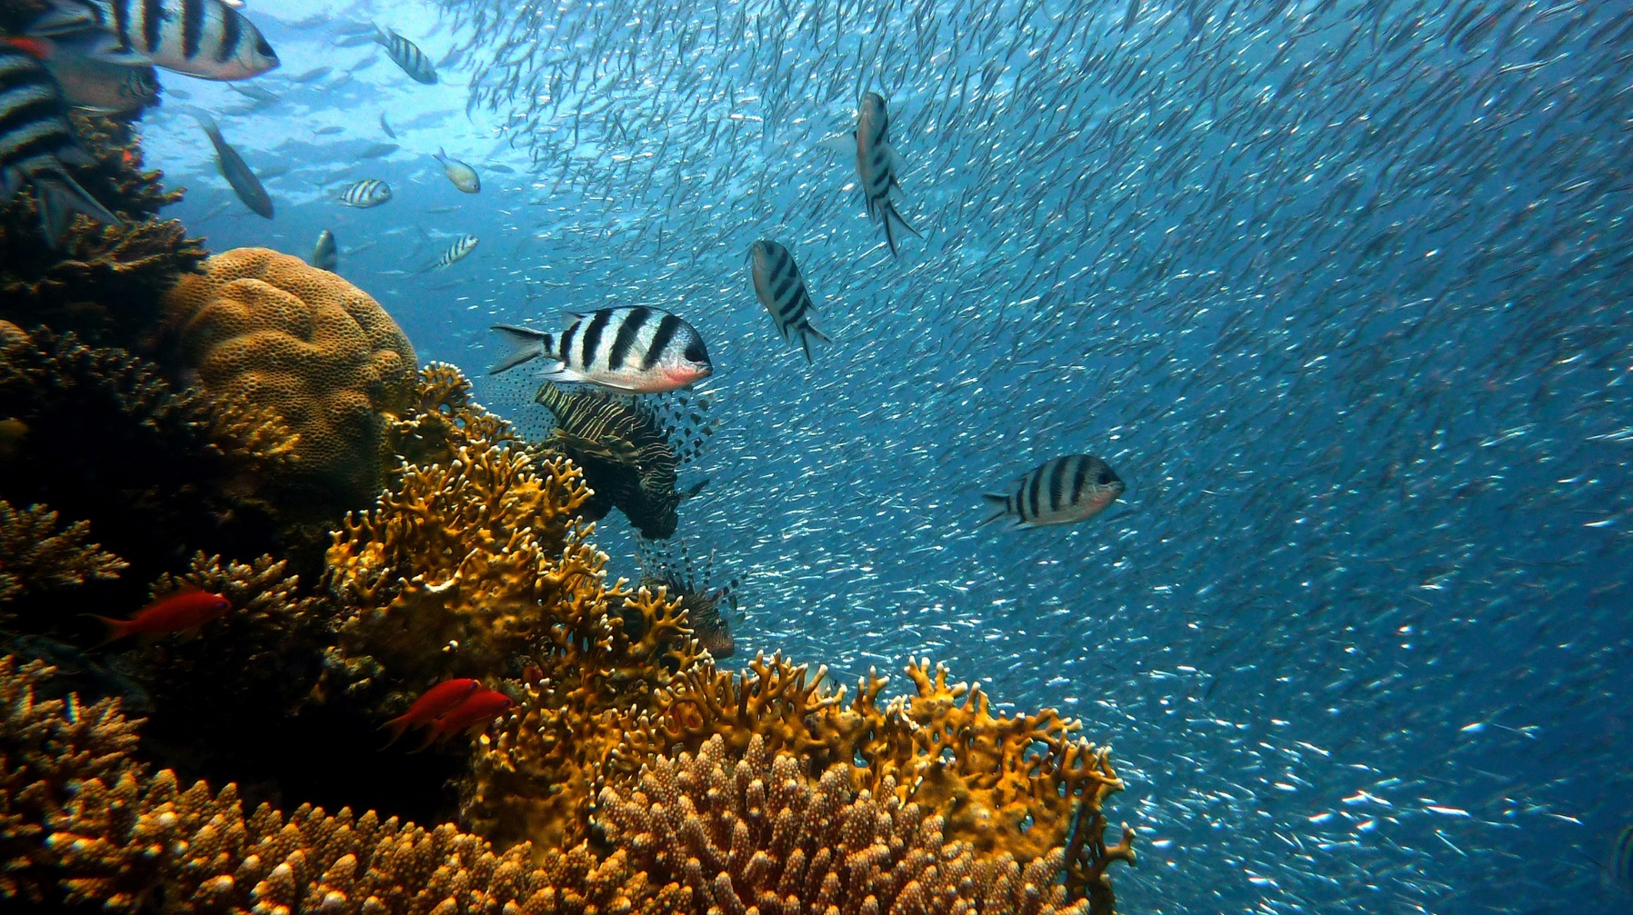
Coral
Coral reefs take up less than 1% of the ocean floor. However, they support more than 25% of all ocean life.
Did You Know…?
The world's largest coral reef is the Great Barrier Reef, just off the coast of Australia. It is so big that it can be seen from space.

Slide 11
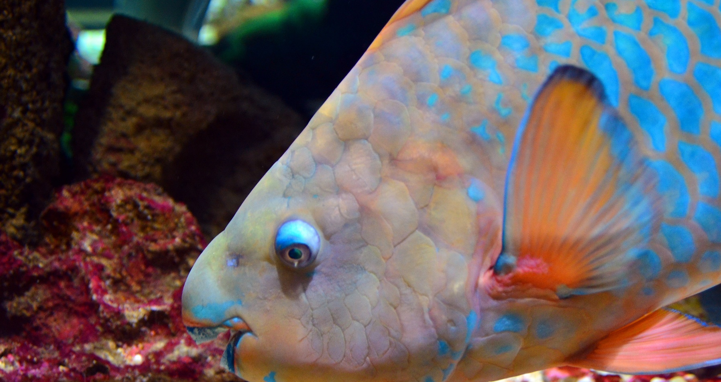
Fish
Fish play an important role in the health of life in our oceans. For example, parrot fish help coral reefs to stay healthy by removing excess algae that make it difficult for corals to thrive.
Did You Know…?
The largest parrot fish on record grew to about 4 feet (1.2 metres) long.

Slide 12
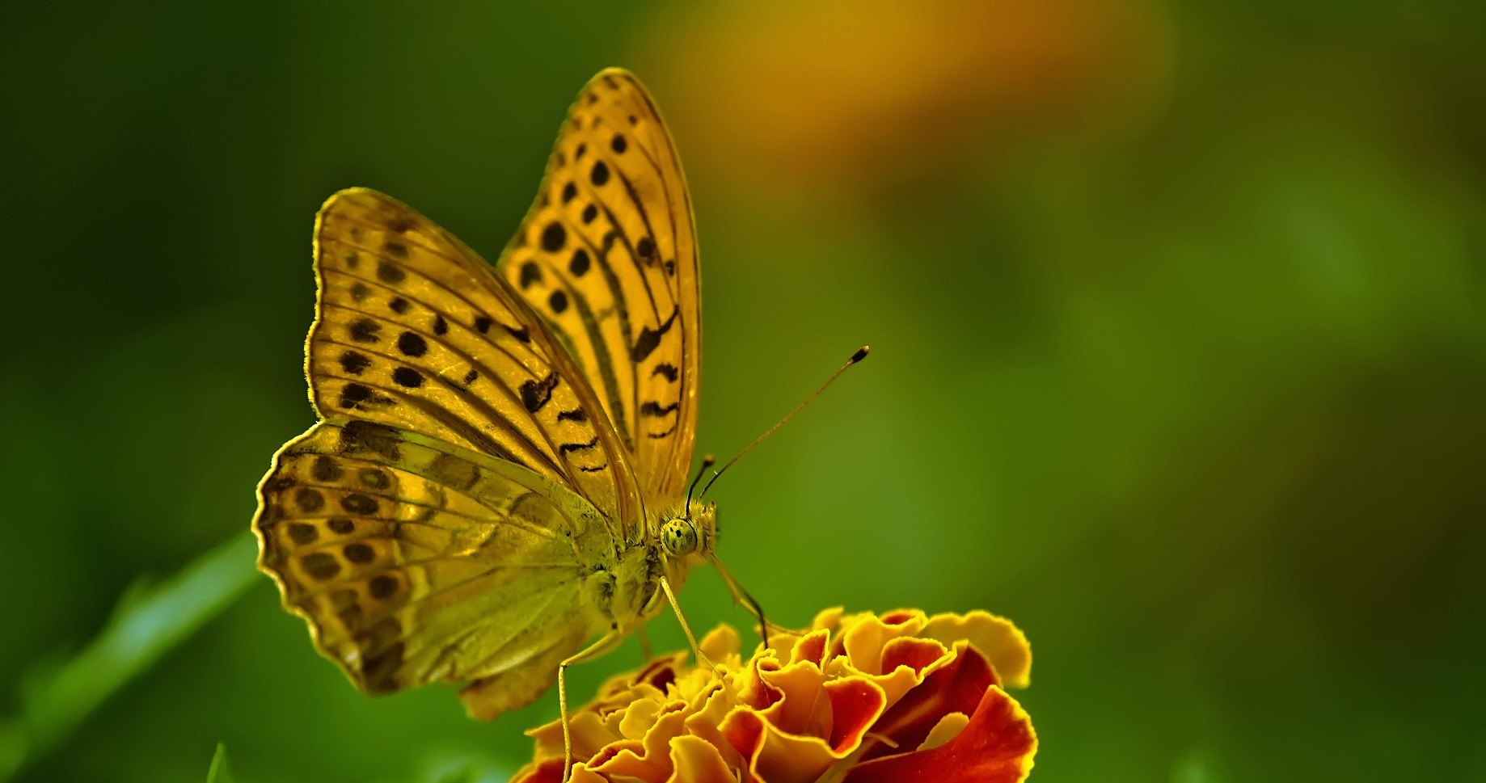
Butterflies
Butterflies pollinate a variety of plants, creating diversity among plants and animal life.
Did You Know…?
Scientists estimate there are between 15,000 and 20,000 different species of butterfly in the world.

Slide 13


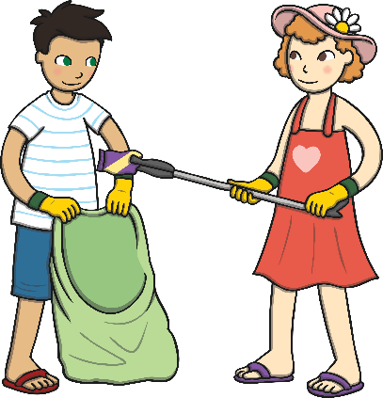

What Can You Do to Help?
Although it might feel impossible to reverse climate change, each of us can make changes to help our world.
Reduce consumption of unsustainable fossil fuels. Switch off lights when not needed. Unplug electronics not in use. Choose natural, sustainable materials, such as bamboo or woods from FSC forests, rather than plastics.
Reduce pollution. Walk or use a bike when possible. Put litter in waste bins or take it to recycling centres. Take a bag and some gloves and go on a litter-pick around your home or school.

Slide 14
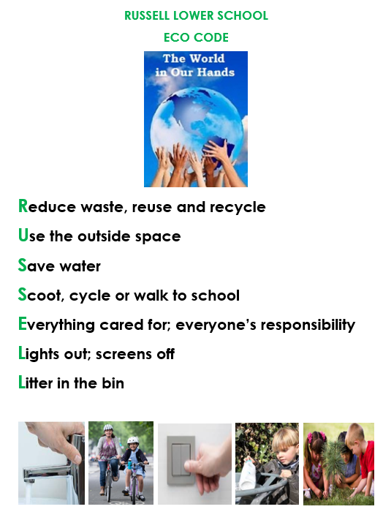

Slide 15
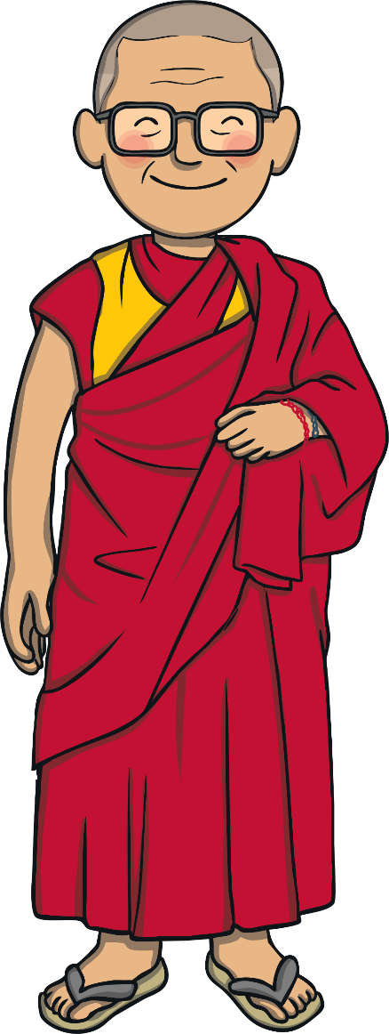
How Can Our World Leaders Help Against Climate Change?
We all have a responsibility to look after our planet for future generations to enjoy.
This year, the President of the USA, Joe Biden, is bringing world leaders together to discuss climate change on Earth Day as part of a youth-led summit.
‘We have a responsibility to look after our planet.
It is our only home.’ – Dalai Lama
What action will you take today?

