Slide 1
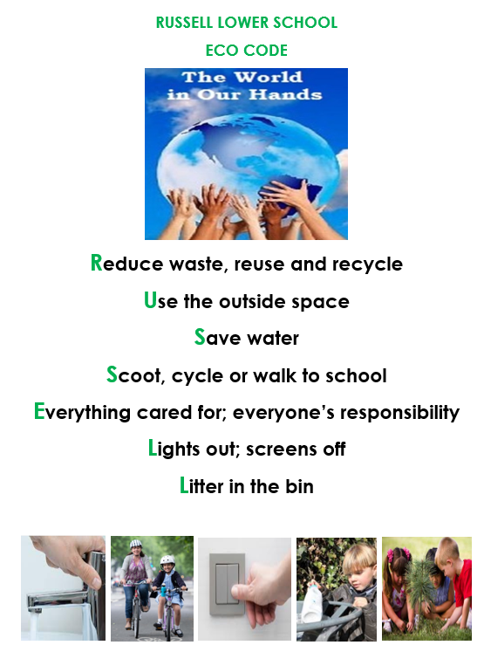

Slide 2
What kind of environment is this?
Notes:
Q What kind of environment is this?
Woodland (This is deciduous woodland – the trees shed their leaves each year. Evergreen trees don’t shed their leaves in Autumn.)
Q Is this environment natural or manmade?
Natural. If there were no humans around most of the UK would be covered in woodland.
For most of the UK this is the natural environment.
Today the UK still has almost 3 million hectares of woodland, that’s an eighth of our country.

Slide 3
What kind of environment is this?
Notes:
Q What kind of environment is this?
Farmland/fields
Q Is this environment natural or manmade?
Manmade, most fields are actually unnatural.
When humans started farming thousands of years ago they cutting down a lot of woodland and created fields where they planted crops and grazed domestic animals.
Today a lot of our natural woodland environment is in nature reserves – specially designated areas which stop people from cutting down trees.
Q How have humans changed the environment in this picture?
Cut down the trees
Planted crops
Built houses/roads/wind turbines

Slide 4
What kind of environment is this?
Notes:
Q What kind of environment is this?
City/urban
Q Is this environment natural or manmade?
Manmade.
Cities really started growing around 200 years ago, as people moved from the countryside to get jobs in factories and power stations.
Q How have humans changed the environment in this picture?
Cut down trees to build houses/roads/bridges.
Introduced vehicles e.g. trains, cars, bringing noise and air pollution.
Embanked the river – built walls to contain the flow of the river, and make it possible to build on the marshy land either side.
Put sewage in the river.
Created parks.
In fact they’ve completely changed it! There’s really no natural environment left!

Slide 5
Environmental change
Woodland
Farmland
City
How would these changes affect living things?
Notes:
From woodland, to farmland to city, most of the UK has undergone massive change to the environment. This must have affected the animals and plants which live there.
Q How would these changes affect living things?
Habitat loss: wild animals/plants don’t have so many places to grow and live.
Habitat gain: domestic animals and crops (e.g. cows/maize) live on farmland not woodland. Some species have adapted well to the change (e.g. foxes/rats thrive in cities).

Slide 6
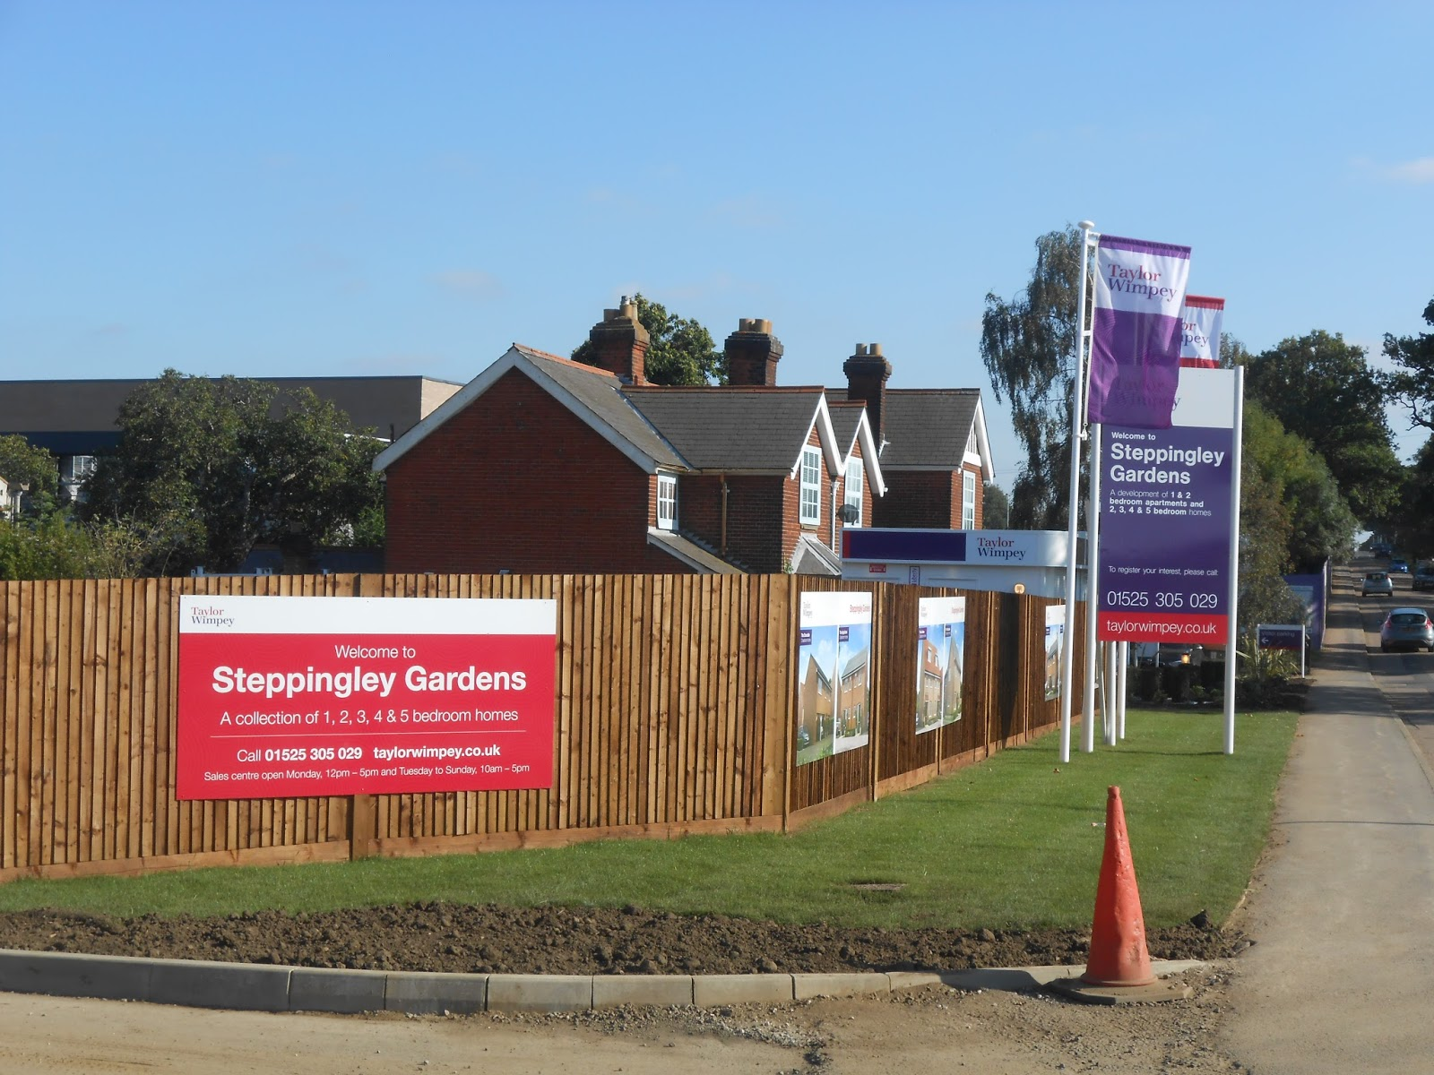
You can see existing mature trees still growing.
Notes:
Planners and builders can often keep mature trees and hedgerows which maintain the biodiversity of the local environment.
Tarmac/paving/shorter grass take away the habitats of trees/insects/ground-laying birds
Animals can get stuck/tangled in/swallow litter
There are no apparent street lights which will affect bird migration and moths

Slide 7
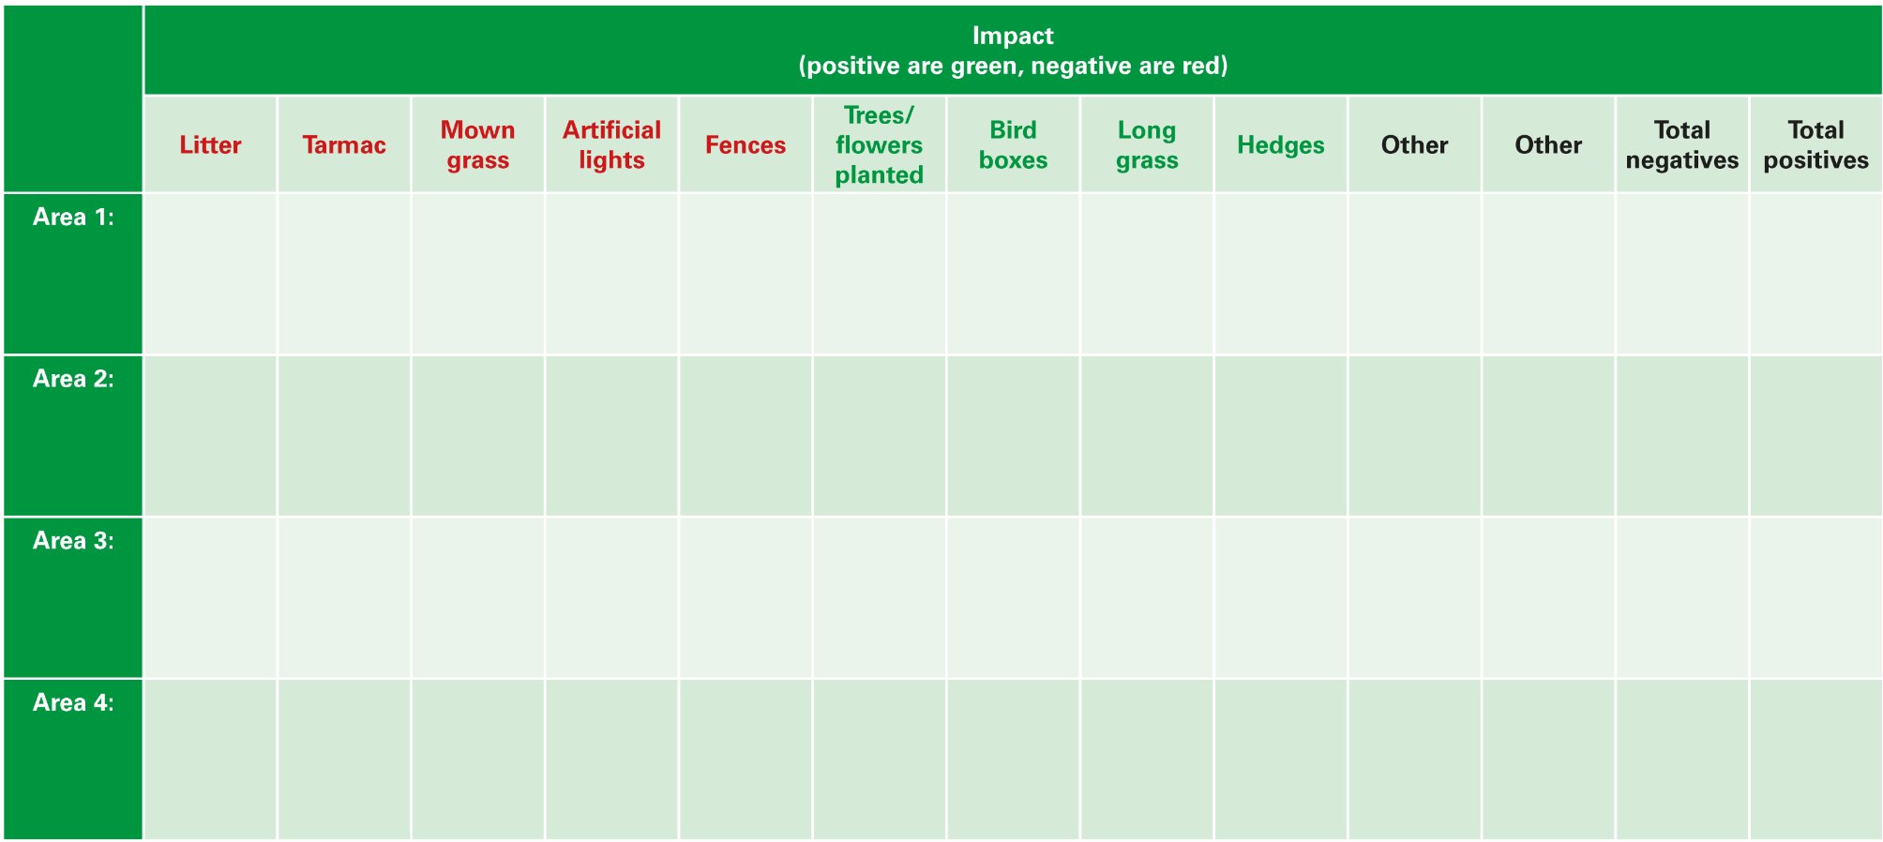
School Environment Survey
Notes:
We are going to do an environment survey to identify the places in the school where humans have had a positive or negative impact on the environment.
Take the pupils outside to look at different areas within the school grounds, or a local area. They can use the School Environment Survey worksheet to record their findings, or produce their own survey.
Optional: give pupils cameras to document each impact they find.

Slide 8
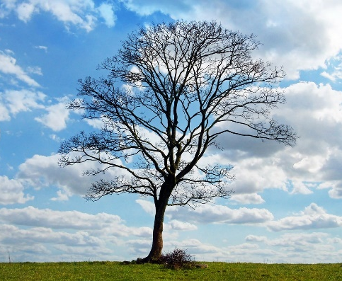
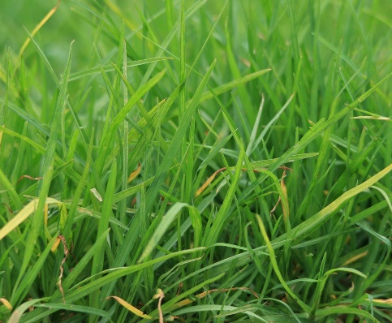
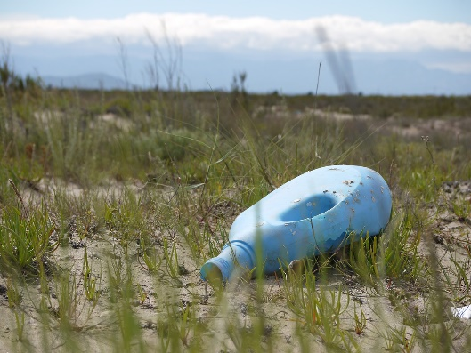
What can we do?
Leave a wild area of grass
Litter picking
School recycling scheme
Plant a tree
Notes:
Back in the classroom, discuss the results of the survey:
Where are humans changing the environment?
Where are they having a negative impact?
What could be done to minimise this?
After a group discussion reveal the ideas on this slide. Can you put any of these things into practice?

Slide 9
Russell Lower School
What we will do
At Russell we will,
Turn off the lights when we don’t need them.
Wash our hands properly but turn off the taps quickly when we don’t need running water.
Eat our healthy snacks and school dinners and reduce food waste.
Switch off the heating when we don’t need it – do more movement breaks/ activities to keep warm (Supermovers – BBC)
Walk. Scoot, bike or park and stride to school
Have a few long grass areas in the school grounds
Plant trees, sunflowers, restore the hedgerow on the boundary.
Erect a bird or bat box.

Slide 10
Litter and rubbish
Hedgehogs
Sea birds
Hedgehogs like to nest in enclosed dark spaces
Sea birds feed their young on small fish
Notes:
Ask pupils why litter and rubbish would affects living things, including the ones on the slide.
Answers
Hedgehogs like to nest in enclosed dark spaces, if black bin bags are left open they provide an attractive (but deadly) nesting spot. Keeping bin bags tied up is an easy way to save a hedgehogs life. Hedgehogs can also get stuck in plastic pots and cans.
Adult birds can mistake small bits of plastic for fish. They then catch it and feed it to their young. Albatross chicks have been discovered by researchers after they died from eating too much plastic. Find out more here: https://www.theguardian.com/environment/gallery/2009/nov/03/albatross-plastic-poison-pacific (please note: photos are quite graphic). Sea birds can also get their necks trapped in drinks can holders and tangled in fishing net.
Lots of animals can be killed or injured by getting tangled up and trapped, suffocating or choking. The main problems are balloons, plastic bags, elastic bands and food containers.

Slide 11
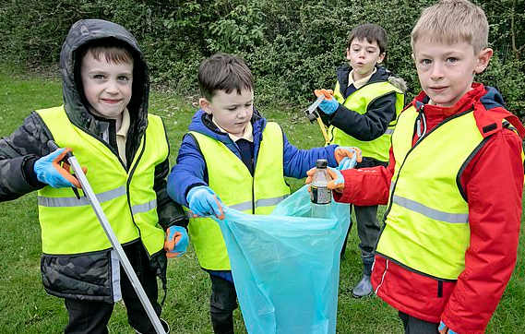

Slide 15
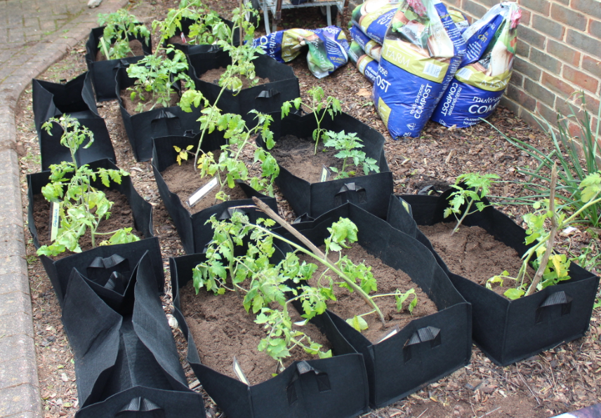

Slide 16
