Slide 1
Emotion coaching and Calming down
July 2021

Slide 2
Name your emotions; feel your emotions

Slide 3
Well-being scale

Slide 4
Use our emotion coaching and calm brain to protect our Russell Rights

Slide 5
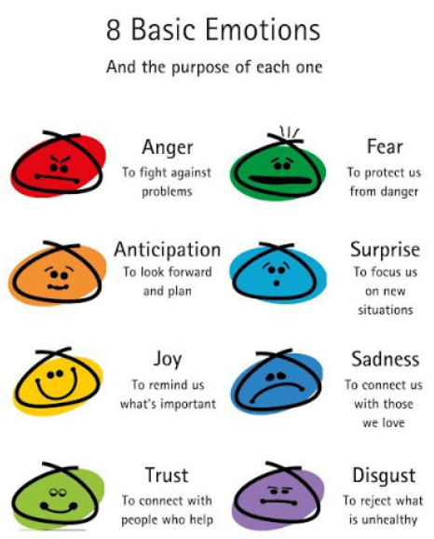
Emotion coaching – get control
https://nurtureandthriveblog.com/emotion-coaching-parents/

Slide 6
Emotion Coaching

Slide 7
Emotion Coaching
We separate the emotion (which is always fine to have), from the behaviour (which isn’t always fine)

Slide 8
Emotion coaching
We separate the emotion (which is always fine to have), from the behaviour (which isn’t always fine)

Slide 9
Emotion coaching

Slide 10
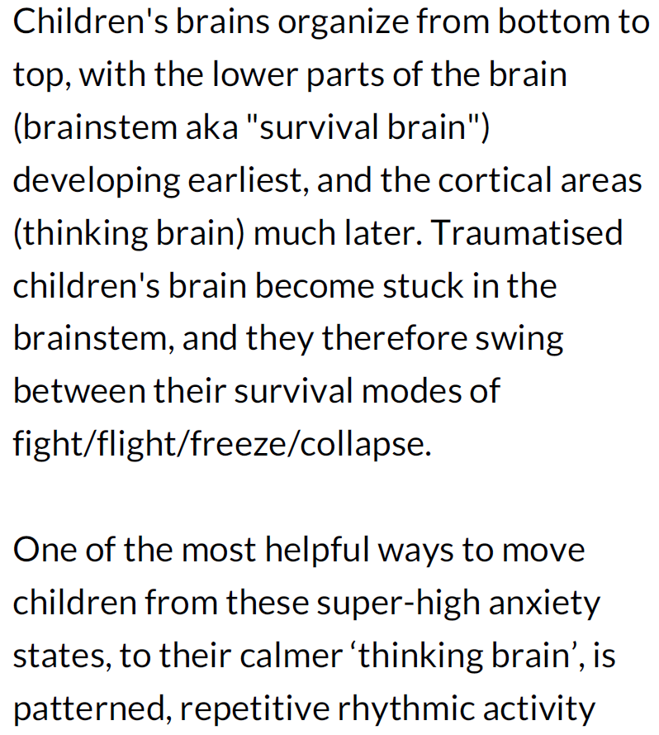

Slide 11
Feeling upset, angry or frustrated? We all do sometimes and that’s okay…it is what we do that matters
We separate the emotion (which is always fine to have), from the behaviour (which isn’t always fine)

Slide 12
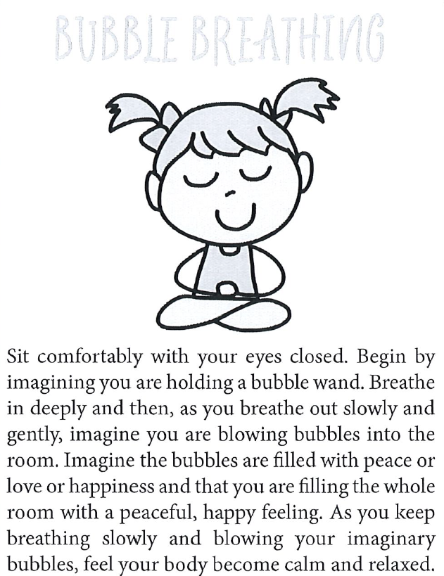
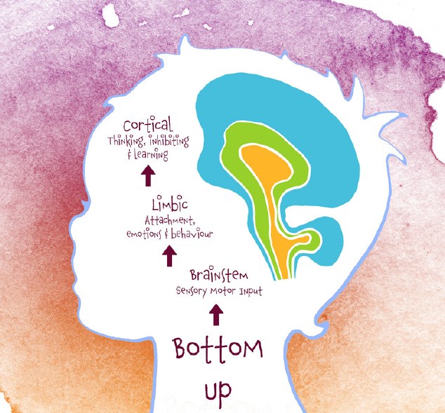
time to let our brain make better choices
Calm Starts With Me

Slide 13
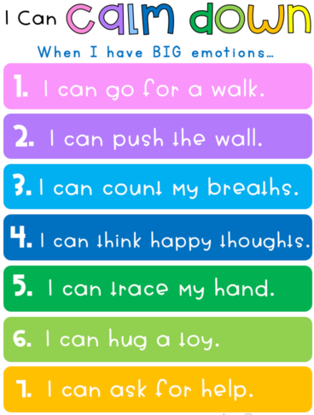
We could also:
Talk about what is upsetting us – use our Network hand
Do something to relax, like bubble breathing with your eyes closed
Do Mindful Colouring for 5 minutes, then try again
Count slowly to 10
Listen to calm music
Go for a walk
Blow bubbles

Slide 14
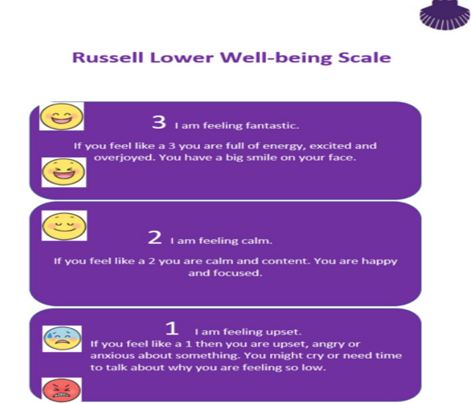
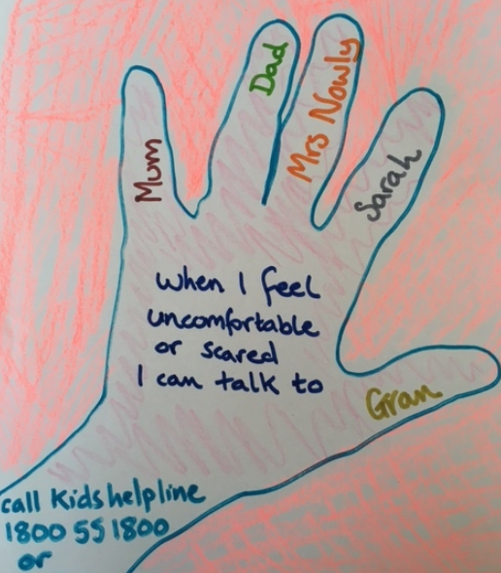
At Russell we:
All protect our Russell Rights by the way we behave – we all aim to be bucket fillers
Talk about and label our emotions – well-being scale
Agree to differ
Are a telling school
Use our network hand for support
Believe in the power of yet…and have a growth mindset

