Slide 1





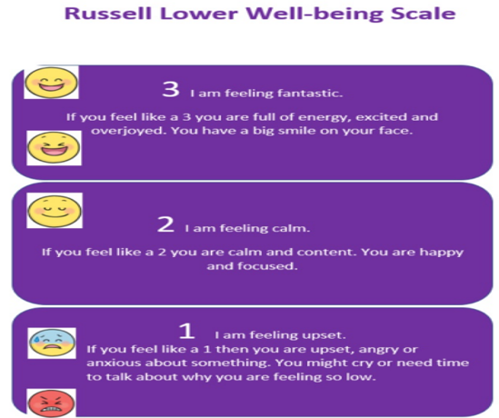
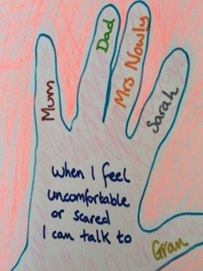

What it means to belong to Russell lower school
Bucket Fillers
Values
Russell Rights
Telling School
Know the importance of emotions and well-being

Slide 2
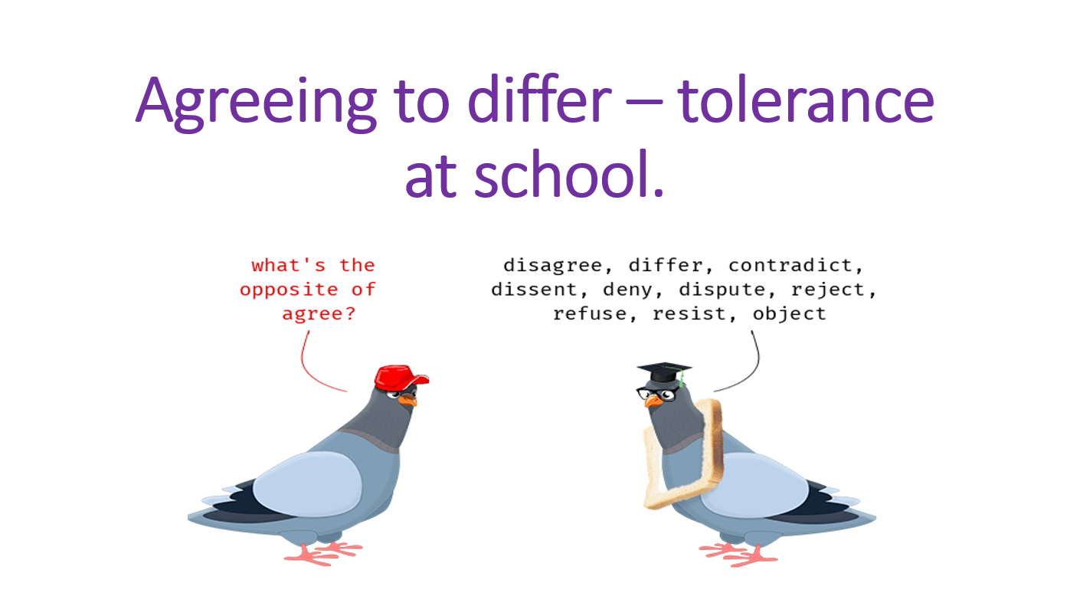
Tolerance – agreeing to differ

Slide 3
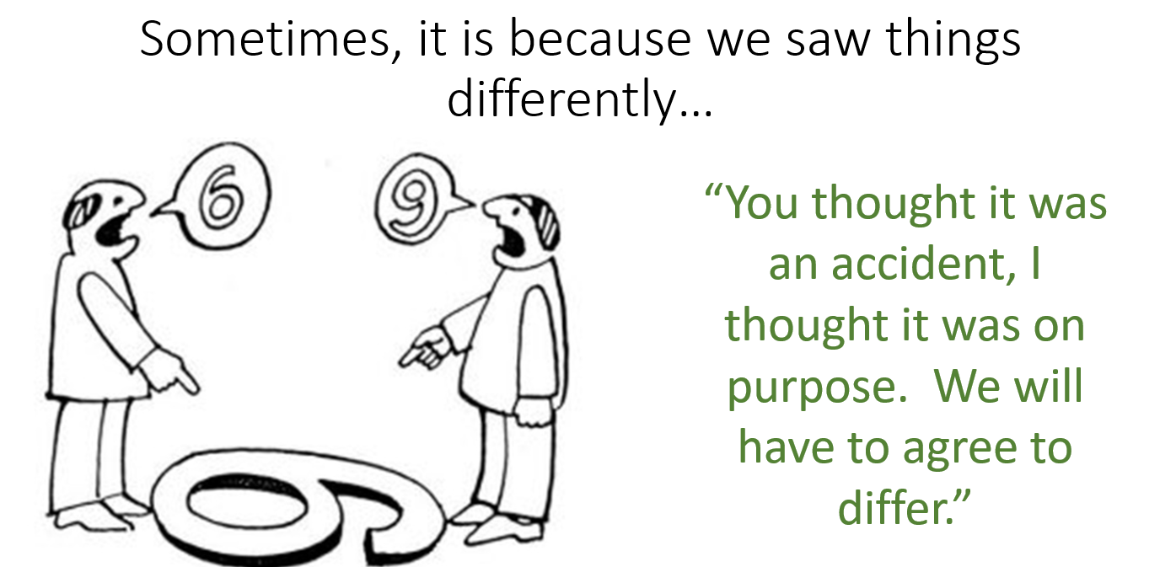
We can agree to see things differently – because to each of us they are different. There is not necessarily a right and wrong.

Slide 4
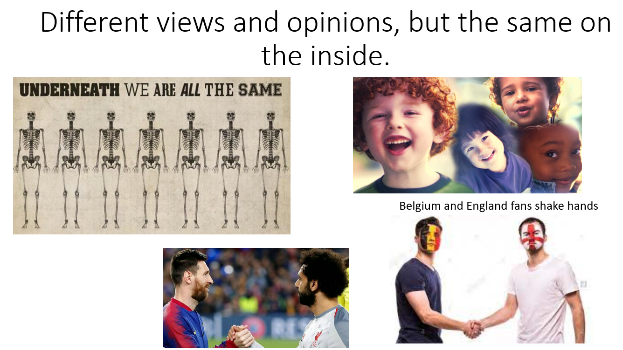
Different opinions – same on the inside

Slide 5


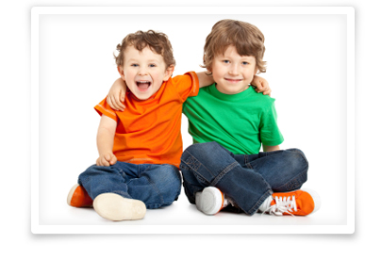

We are a team at Russell lower school…we use the Russell rights

Slide 6
Everyone’s rights…
The right to learn
The right to be happy
The right to be safe
The right to be included

Slide 7
Why do we need to behave, follow the Russell rights and values in school?
To keep us all safe
So we are all happy at school
So that we can learn
So we can all be included

Slide 8
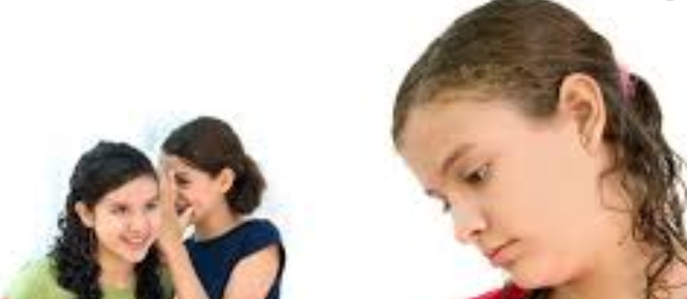
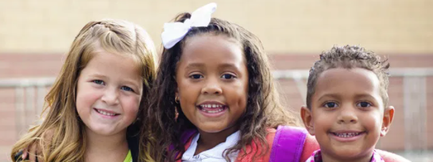
Every class is a team too.
We need to be good friends.
We are all friends
We let anyone play
We can be friends with everyone. Just because I choose to play with someone else for a day/lunchtime/playtime does not mean that I am not friends with you any more
No child is ‘the boss’ of others and tells other children what to do. The adults are in charge. We ask others what they want to do too
We share everything – including whose turn it is to choose the game
We can have lots of friends
No one is left out
No one is laughed at
We always use kind hands and kind words

Slide 9

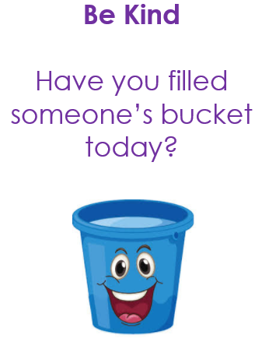
Give…a compliment, a smile, a helping hand, a kind word…
When we are kind, helpful, honest, caring, respectful, tolerant, thoughtful (using ALL our values), it makes other people feel good AND we feel good too!
It’s a ‘win/win’!

Slide 10
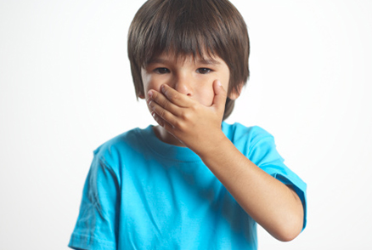
If I can’t say anything kind I don’t say anything at all
Ugly
Stupid
Fat
An idiot
Annoying

Slide 11
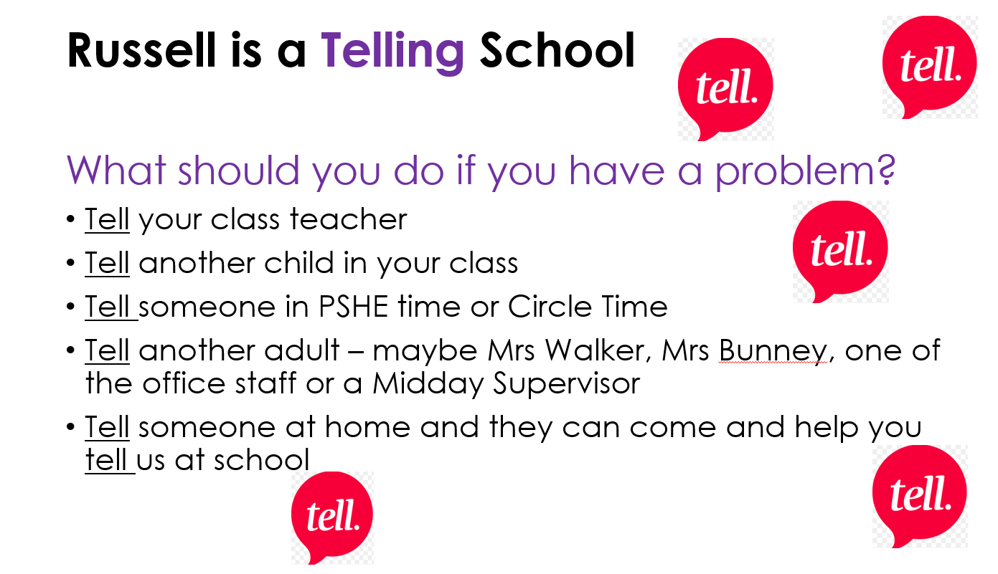
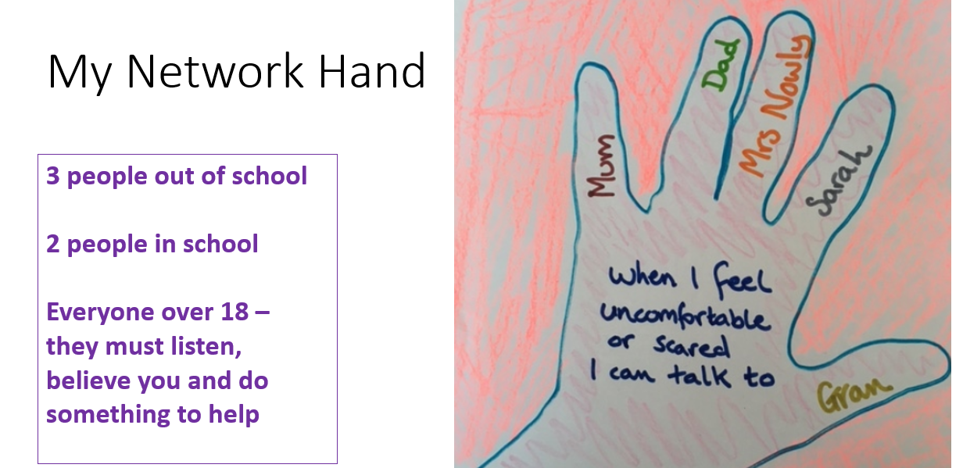
But…we are a telling school so use your voice if someone is being unkind and not following the Russell rights and values

Slide 12

What if someone is not kind or is mean to me?
TELL adults in your class
TELL an adult on the playground
TELL Mrs Walker or Mrs Bunney
TELL
TELL
TELL!

Slide 13

Do we all agree to our ‘rights’ and ‘values’ and will we all make sure we are kind in school?
Think about why we need Rights and Rules

Slide 14

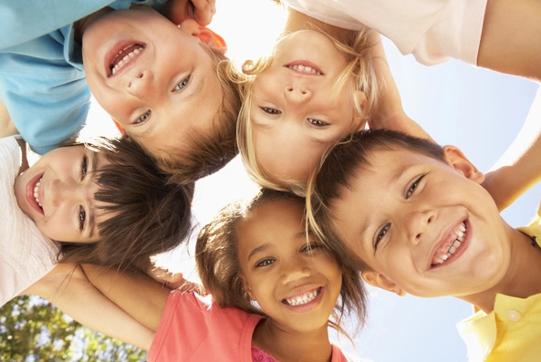
Kindness, caring, Russell Rights and using our values = happiness at school

Slide 15
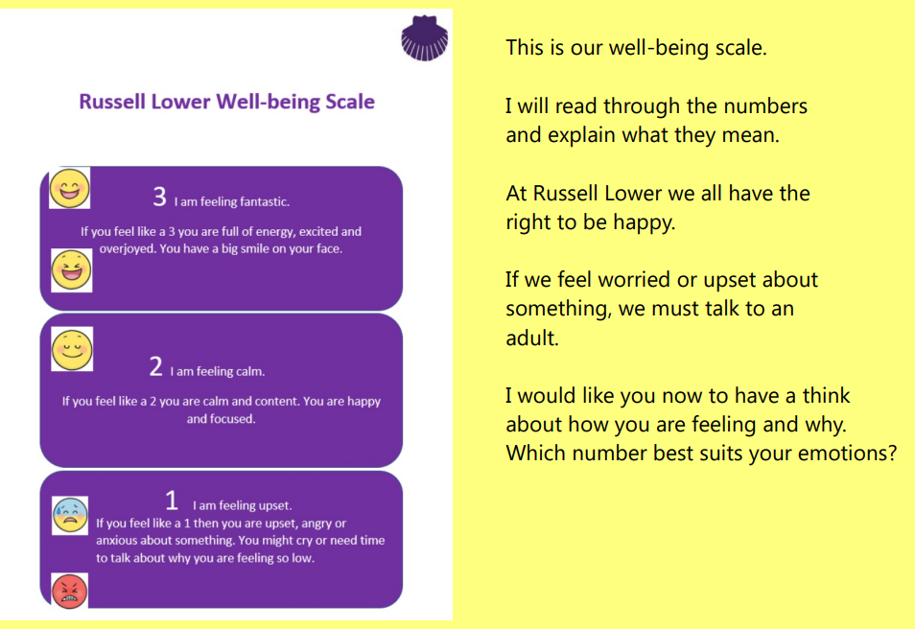
We want everyone to feel:
3 – Fantastic or
2 - calm

Slide 16
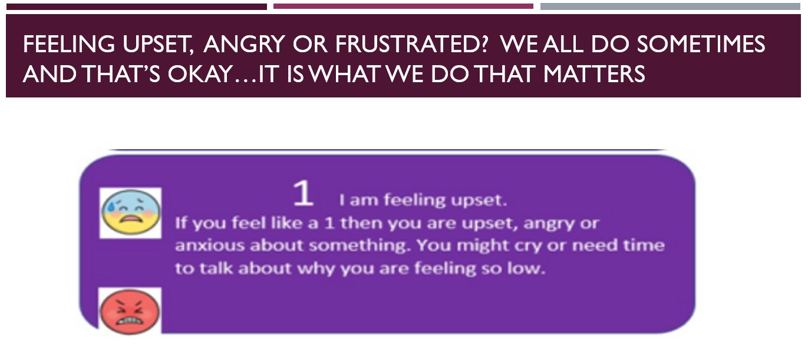

Slide 17
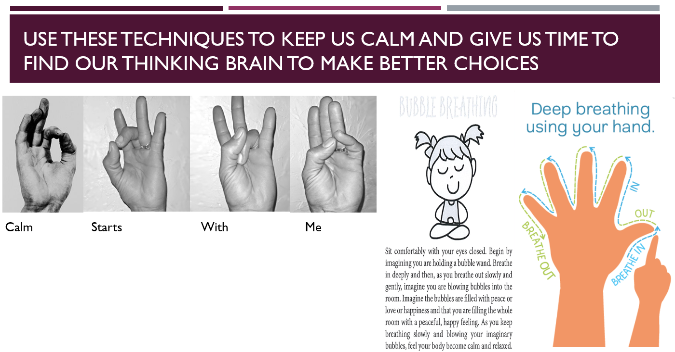
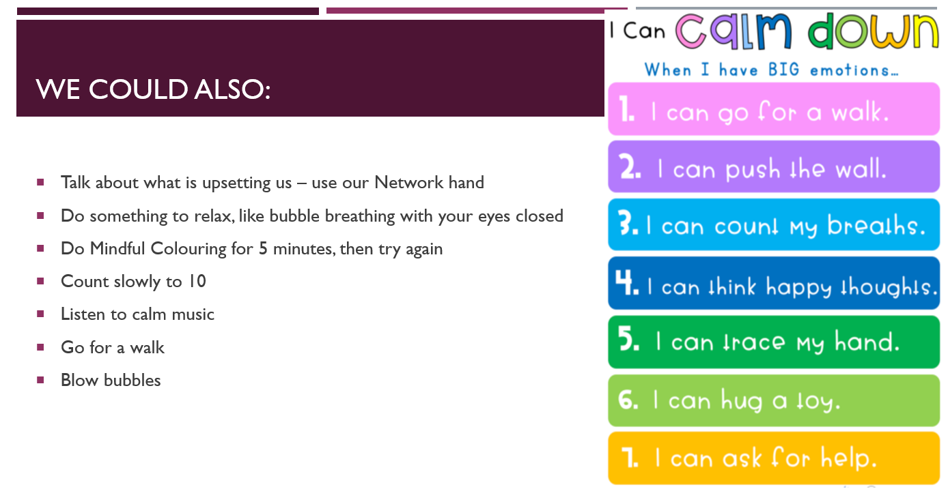

Slide 18
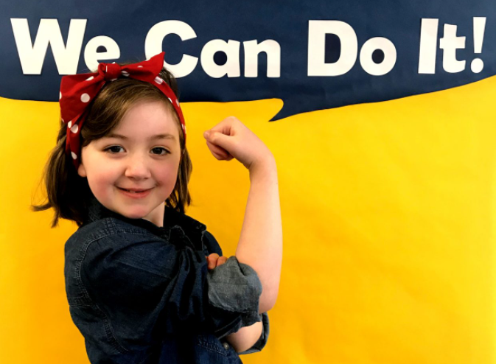

We are Russell lower school
Together, We can do it!

