Slide 1

Growing Together – Children’s Mental Health Awareness Week
7-13th February, 2022

Slide 2

What is CHUMS?
Put your hands up if you’ve heard of CHUMS before?
Does anyone know what they do?
Notes:
Q: Put your hands up if you’ve heard of CHUMS before?
Q: Does anyone know what they do?
CHUMS is a mental health and emotional wellbeing service which helps children and their families. They offer lots of different forms of support for children, young people and their families who are facing some challenges, for example, feeling worried.
Teachers can look at CHUMS website for more information – www.chums.uk.com

Slide 3

What does ‘growing together’ mean to you?
It’s about growing emotionally and finding ways to help each other grow.
It’s important that we look after our bodies, which is called our “physical health”. It’s also important that we look after our minds too, which is known as our “mental health”.
Notes:
Q: What does ‘growing together’ mean?
This year’s Children’s Mental Health Awareness week’s theme is ‘growing together.’ Often when we think of growing we think of physically getting taller, bigger and older. However, growth can also be about growing emotionally and learning to face our challenges.
Challenges and setbacks can help us to grow and adapt and trying new things can help us to move beyond our comfort zone into a new realm of possibility and potential. However, emotional growth is often a gradual process that happens over time and sometimes we might feel a bit ‘stuck’ which is why it’s really good to talk to those around you about how you’re feeling so that we can ‘grow together’.

Slide 4
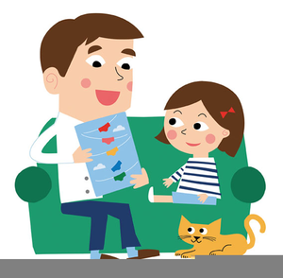
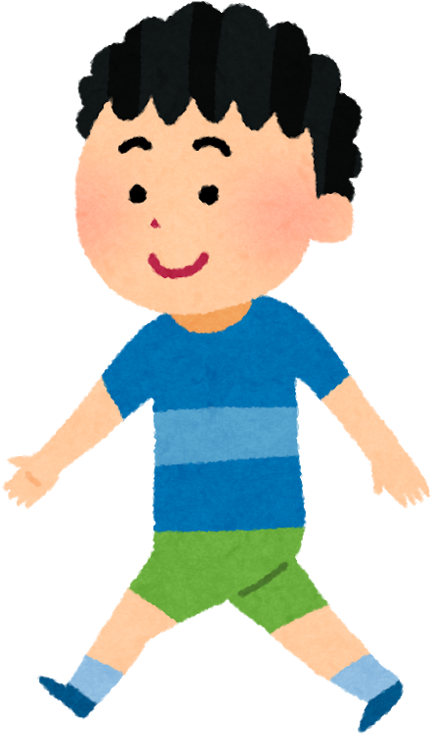
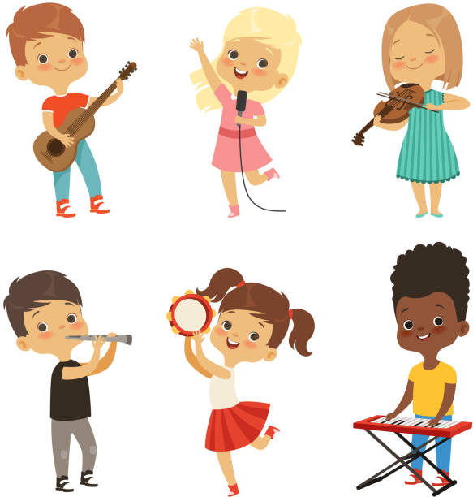

How can YOU help and support each other grow?
Talk to one another
Get active
Learn a new skill
Practise self care
Notes:
You’ve come up with some really good ideas about what it means to ‘grow together’ but next I want you to think about how you can help and support each other grow?
Idea – Class to think of ideas of ways to help and support each other growing
Here’s some way’s we’ve/I’ve thought of to help you ‘grow together’
- Talk to one another – talk about your friends’ best qualities, the things that make them special and unique
- Get Active – stepping outside for some fresh air and going for a walk with a parent/carer can help clear your mind. Any activity where we are moving our bodies usually makes us feel better. There are lots of ways to stay active – skipping, netball, football etc
Learn a new skill – start a new club – there’s lots on offer here at school such as…teacher to give examples
Practise self care – you may not know what this means so we’re going to have a look at this on the next slide…

Slide 5
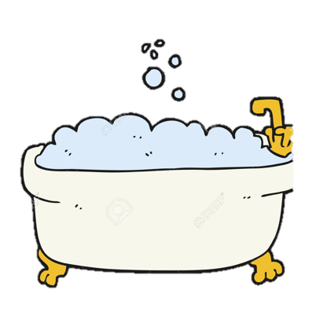



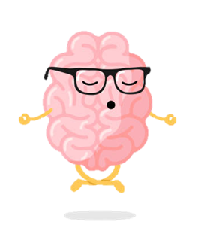
Self Care
It’s really important to look after ourselves in order to help us grow physically, emotionally and mentally
Here are some tips:
Notes:
It’s really important to look after ourselves in order to help us grow physically, emotionally and mentally
Here are some tips:
Have a bath
Listen to a song that makes you smile
Watch a film that makes you laugh
Write down a list of nice things about yourself
Practise relaxation – e.g. deep breathing (we will try this in a moment, next slide)
Can anyone think of some more ideas? Idea – everyone write on a post it note 3 x self care ideas they are already doing or are going to start practising

Slide 6

Breathing exercise – deep breathing
Sometimes we can face setbacks and challenges in life. Other times we can feel angry, worried or scared. It is important to learn and grow from these moments. Deep breathing can really help us with these difficult times!
It is okay to be upset, cross or angry, but it isn’t okay to hurt anyone with our actions or our words – Kind words; kind hands.
Notes:
Sometimes we can face setbacks and challenges in life. Other times we can feel angry, worried or scared. It is important to learn and grow from these moments. Deep breathing can really help us with these difficult times.

Slide 7
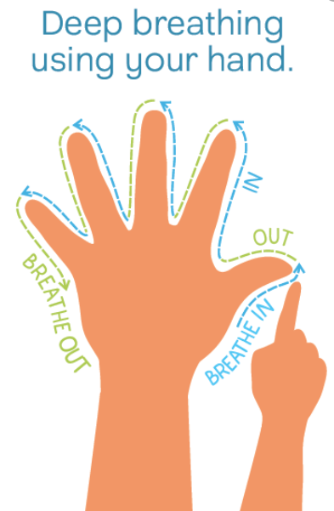
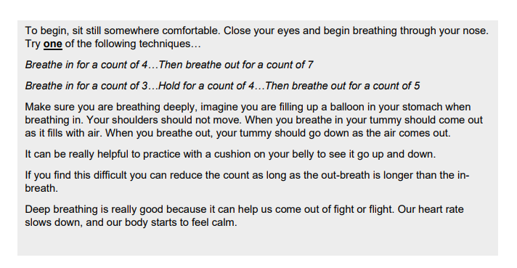
Let’s give it a go!
Notes:
Practice deep breathing – follow script. Pick one 4/7 or 3/5/5 and repeat multiple times.
To begin, sit still somewhere comfortable. Close your eyes and begin breathing through your nose. Try one of the following techniques… Breathe in for a count of 4…Then breathe out for a count of 7 Breathe in for a count of 3…Hold for a count of 4…Then breathe out for a count of 5 Make sure you are breathing deeply, imagine you are filling up a balloon in your stomach when breathing in. Your shoulders should not move. When you breathe in your tummy should come out as it fills with air. When you breathe out, your tummy should go down as the air comes out. It can be really helpful to practice with a cushion on your belly to see it go up and down. If you find this difficult you can reduce the count as long as the out-breath is longer than the inbreath. Deep breathing is really good because it can help us come out of fight or flight. Our heart rate slows down, and our body starts to feel calm.

Slide 8
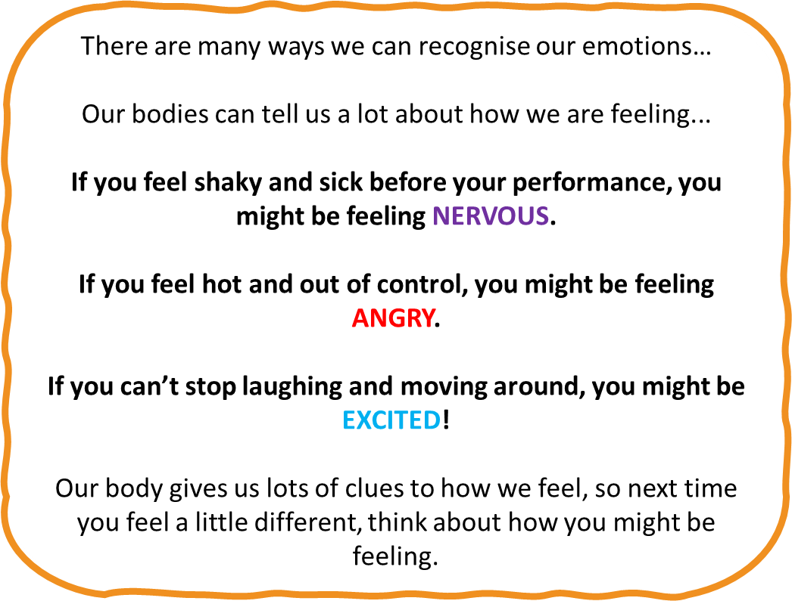


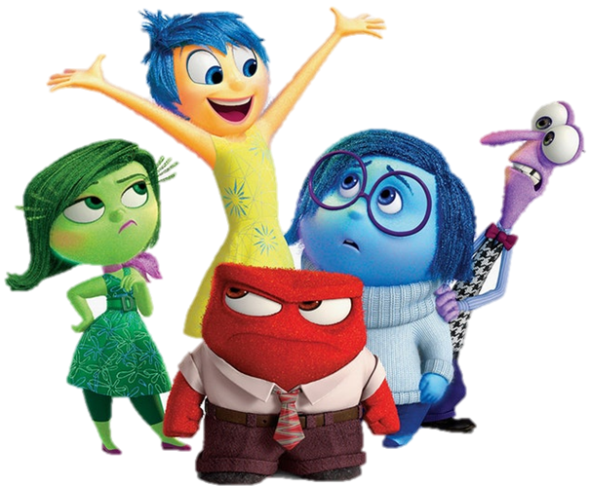

Recognising our emotions
To be able to express and talk about your feelings, you need to be able to know what you are feeling!
Can you name any emotions?
Notes:
The deep breathing mindfulness exercise is a nice way to help us manage those difficult emotions we face.
To be able to express and talk about your feelings, you need to be able to know what you are feeling!
Can you name any emotions?
Examples - happy, sad, angry, nervous, worried, hopeless, ashamed etc

Slide 9
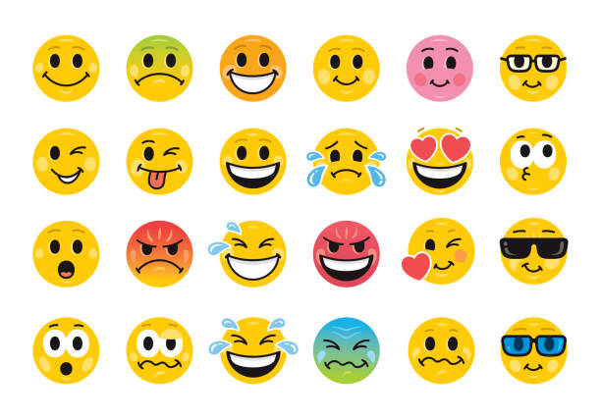
All of the feelings you named are normal and okay! Being able to learn and grow from them is so important!
Using Emoji charts at home or in your classroom is a great way to express how you are feeling using pictures!
You could make your own chart as a class and everyone can get involved!
Notes:
All of the feelings you named are normal and okay. Being able to learn and grow from them is so important.
Emoji charts are a creative way to recognise and communicate with others how you are feeling. You could set one of these up at home or school. There is an example on the next slide…

Slide 10




Sarah’s Emoji Chart | Morning | Afternoon/Evening
Monday
Tuesday
Wednesday
Notes:
Check understanding of emoji chart and set up a class one if you’d like to

Slide 11
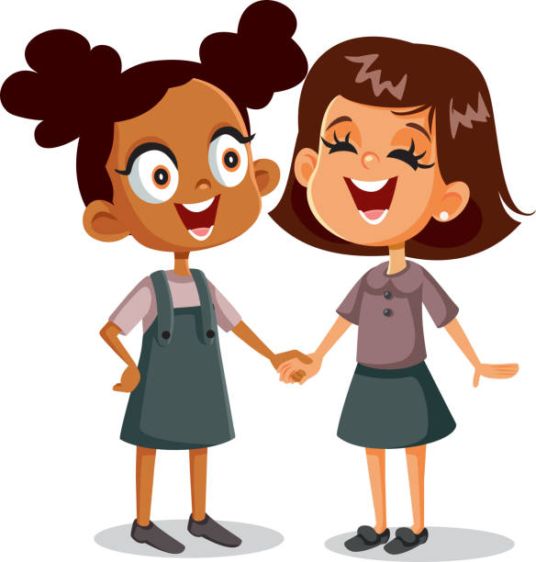
Look out for others
Being able to notice other people’s feelings is an amazing skill to have!
If you notice your friend isn’t feeling their best, be there for them and try something to make them feel better such as talking to them, playing a game with them or making them laugh.
By helping out others it promotes ‘growing together’
Notes:
Being able to notice other peoples feelings is an amazing skill to have.
If you notice your friend isn’t feeling their best, be there for them and try something to make them feel better such as talking to them, playing a game with them or making them laugh.
By helping out others it promotes ‘growing together’.
Idea – everyone think of an idea for how they could help a friend or teacher this week, share idea with class teacher or peer sitting next to you.

Slide 12
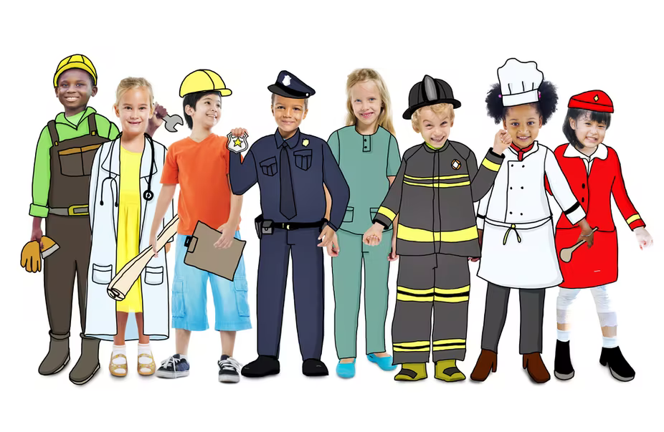
Thinking about the future
As we said before growth is both something that happens to our bodies but also to our minds.
Have a think about what you would like to CHANGE or be different in your life
What are your hopes and dreams for the future? Who will you grow to become?
Notes:
As we said before growth is both something that happens to our bodies but also to our minds.
Have a think about what you would like to CHANGE or be different in your life
What are your hopes and dreams for the future? Who will you grow to become? Idea – everyone shares ideas with teacher

Slide 13

We all grow and develop differently
Just like trees and plants need support to help them grow, we need support to help us grow emotionally. We often need others to help us believe in ourselves like our friends, families and teachers.
Sometimes we feel like we are growing and developing well and other times we may feel a little bit stuck, upset or feel like we aren’t doing our best.
It’s ok to feel like this. We all have ups and downs and we all grow, develop and change differently.
We will continue to grow, develop and change just like trees and plants do.
Notes:
As humans, we change and grow all the time and we do this in many different ways.
Physical growth is easy to see – we grow from babies to children, to teenagers and then to adults.
As we have already said, another way we can grow is emotionally. A good example of this is that things that upset us when we are younger may no longer upset us as we get slightly older.
It is important to remember that we all need support to help us to keep growing, especially when things get tough.

Slide 14
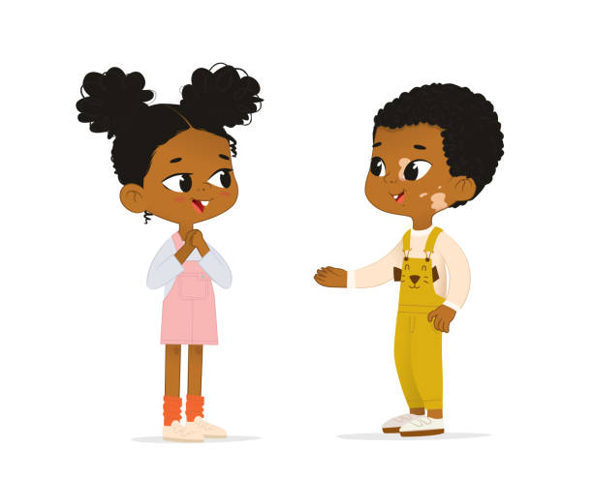
Your turn
Think about how you have grown this year? What have you achieved? What challenges have you faced?
Discuss with the person next to you how they have grown, what they have achieved and if they have faced any difficult moments
We all grow differently and that makes us unique!
Notes:
Give the children a couple of minutes to think about their answers to question 1
Allow children to discuss each other’s growth for a few minutes
Conclude with ‘I could hear you all talking about all the things you’ve achieved in the past year, some things sounded the same but there were a lot of different things you achieved e.g…’ it’s important to remember we all grow and develop differently and that’s what makes us unique. We’re all individuals who face our own challenges and setbacks. We all grow and develop at our own pace and that’s ok!

Slide 15
Things to remember
We all learn and grow differently and that’s ok!
It’s important to look after ourselves and look out for others so that we can ‘grow together’
Ask for help and support when you need it from your friends, families, teachers and other services like CHUMS
Notes:
Key points to take away
- We all learn and grow differently and that’s ok!
- It’s important to look after ourselves and look out for others so that we can ‘grow together’
- Ask for help and support when you need it from your friends, families, teachers and other services like CHUMS
Idea – everyone share one thing they have learnt from presentation

Slide 16
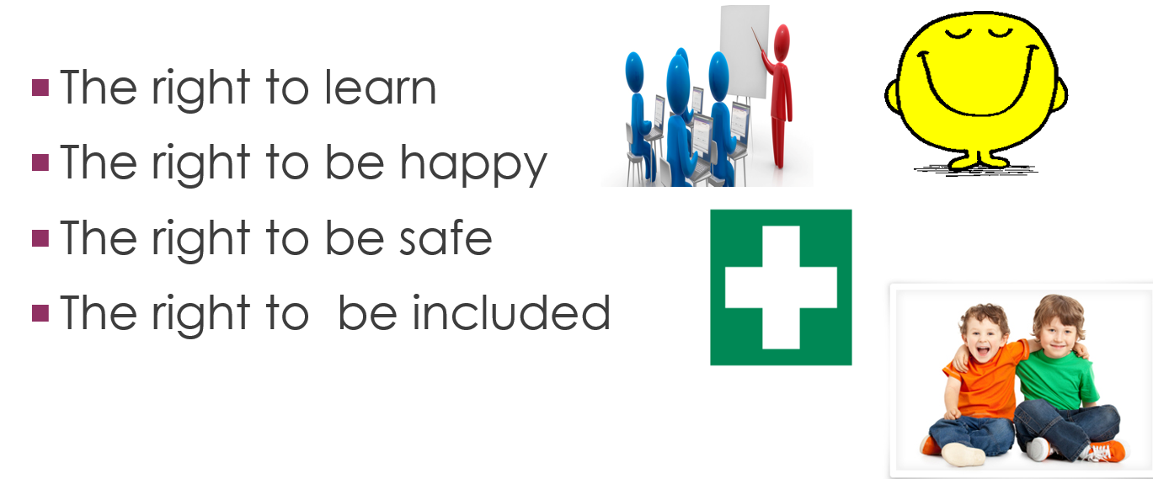

Slide 17
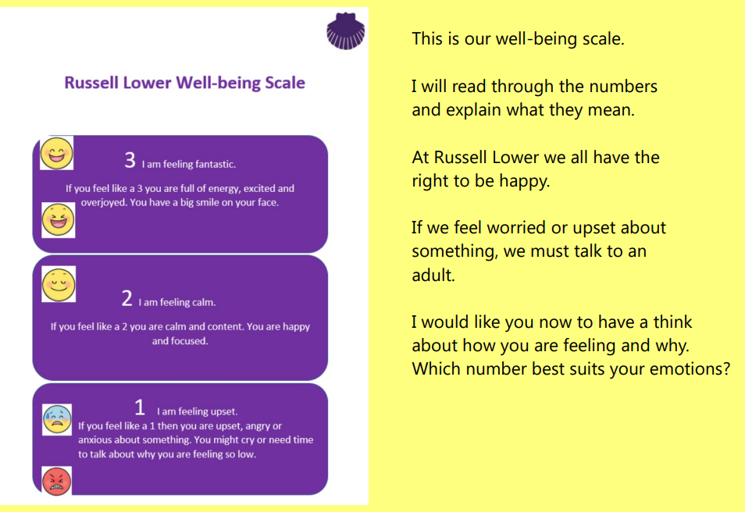
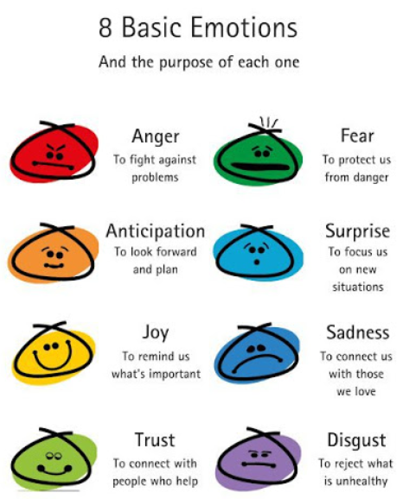

Slide 18
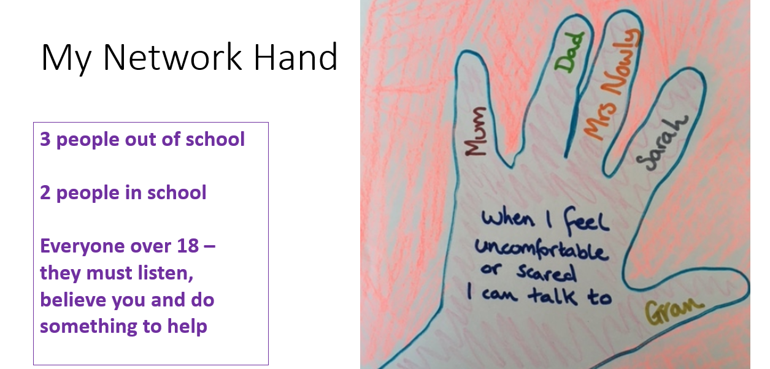


Slide 19
