Slide 1

In 2022, Her Majesty The Queen will become the first British Monarch to celebrate a Platinum Jubilee after 70 years of service..

Slide 2
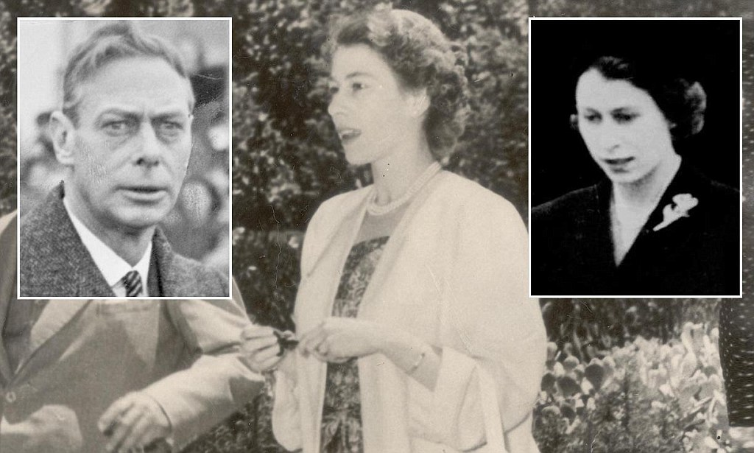
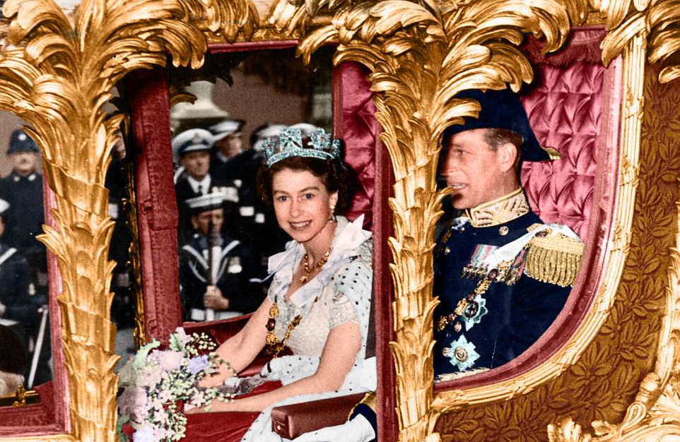

George V1 died February 1952 while Princess Elizabeth & Phillip were in Kenya, and she became Queen overnight
Elizabeth 11 Crowned Queen June 2 1953

Slide 3
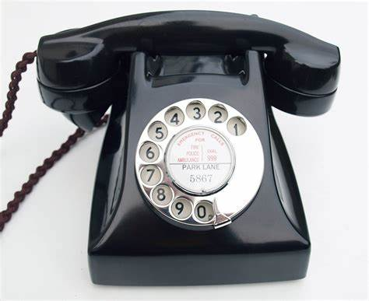
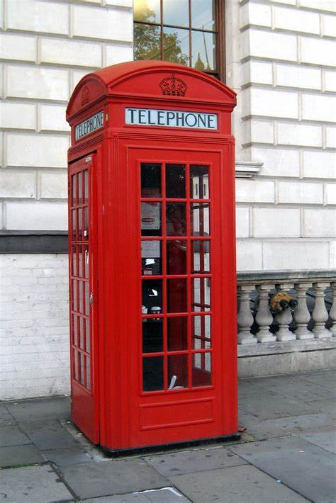
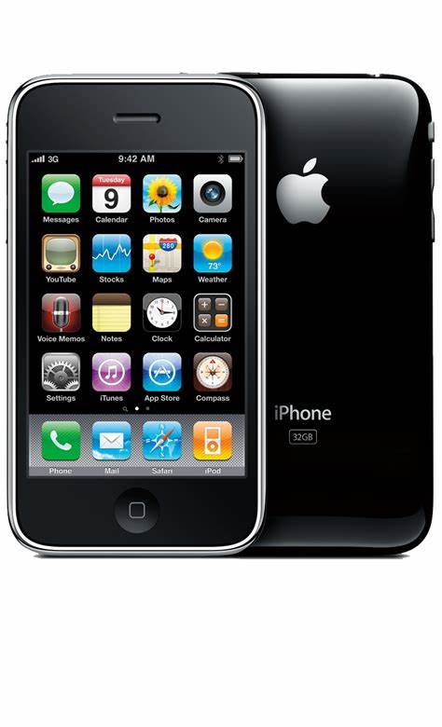

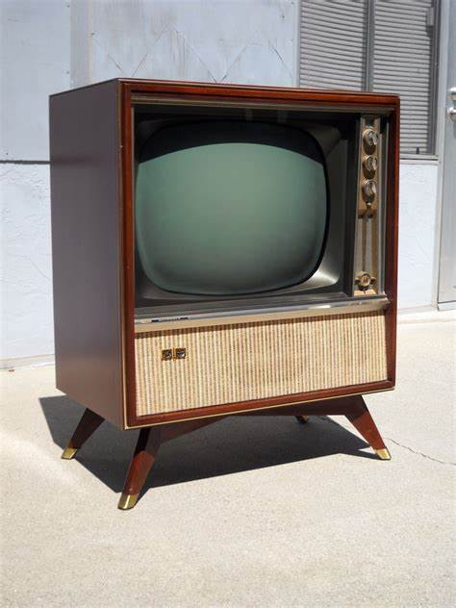

1950’s phone. Only the rich & businesses had phones
Most people used a
Telephone box
2022 When should you have a
mobile?
Not everybody had A TV 12- 16 inch was big
15 November 1969, First Coloured TV Channel in UK. BBC only
channels streamed on the www.
Only 1 channel. The BBC
Flat Screens 50—70+ inches. 100s of channels

Slide 4
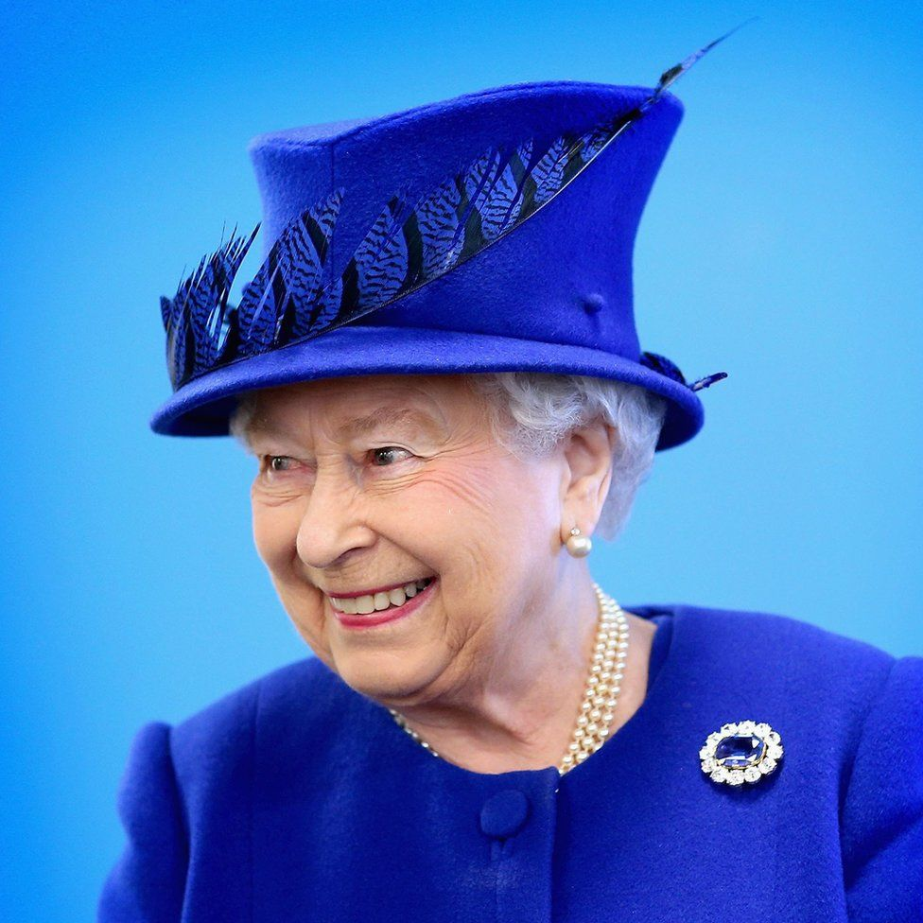

Slide 5
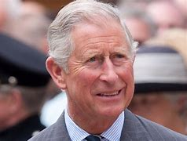
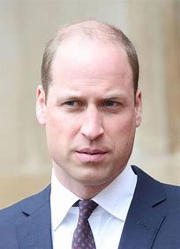
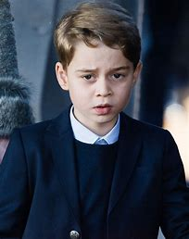
The Prince of Wales
Duke of Cambridge
Prince George
1st in Line to the Throne 2nd in Line 3rd in Line

Slide 6





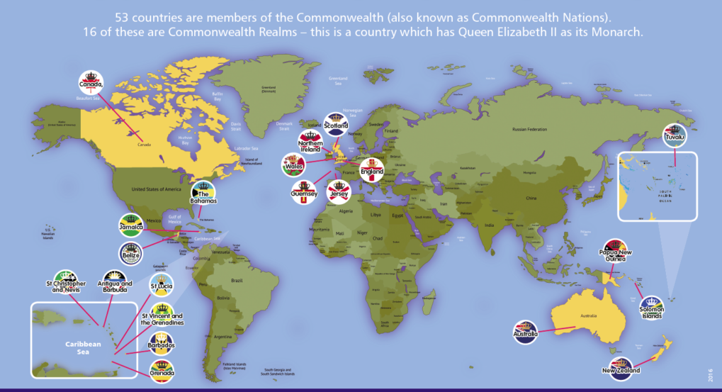










SOVEREIGN REALMS
Antigua & Barbuda Australia Belize Canada
United Kingdom
Grenada
Tuvalu
Jamaica
The
Bahamas
New Zealand
St Vincent St Lucia St Christopher Solomon Islands Papa New Guinea
& Grenadines & Nevis

Slide 7
SOVEREIGN REALMS- QUEEN HEAD OF STATE.

Slide 8


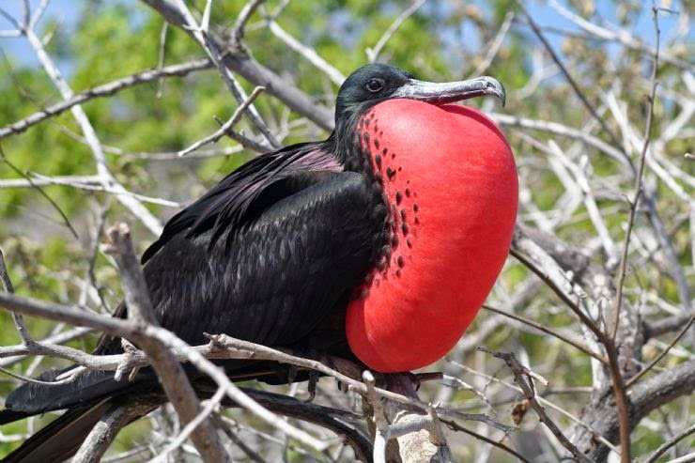
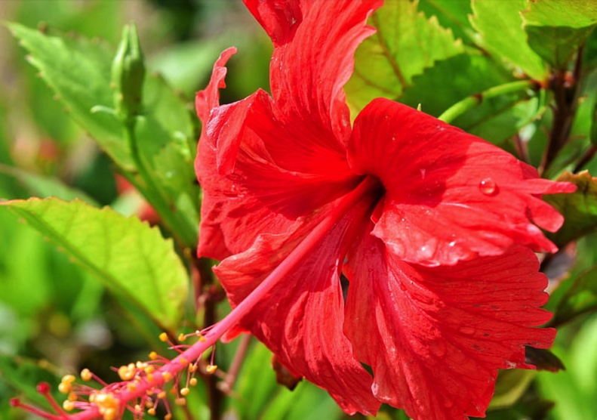
Antigua and Barbuda
:
"Each Endeavouring, All Achieving"
Frigate Bird
Red Hibiscus

Slide 9

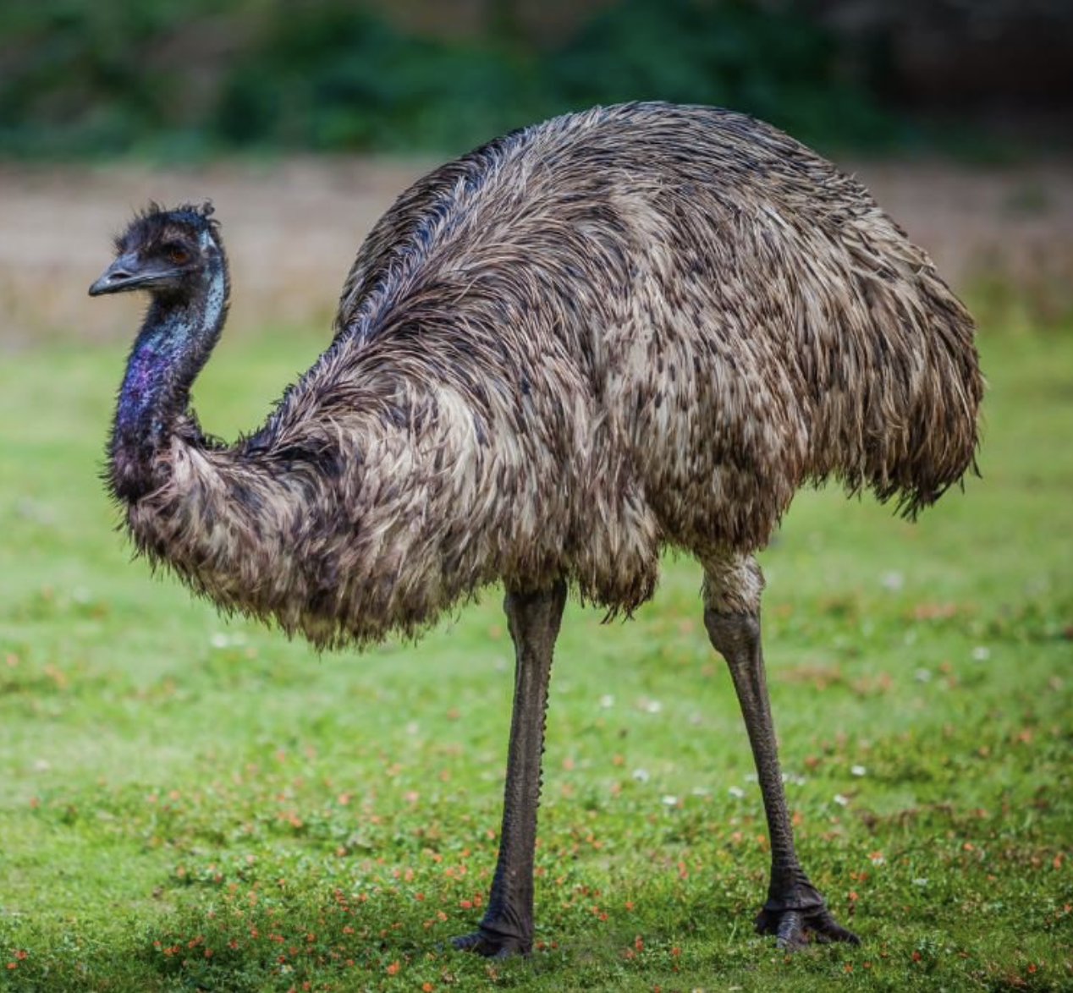
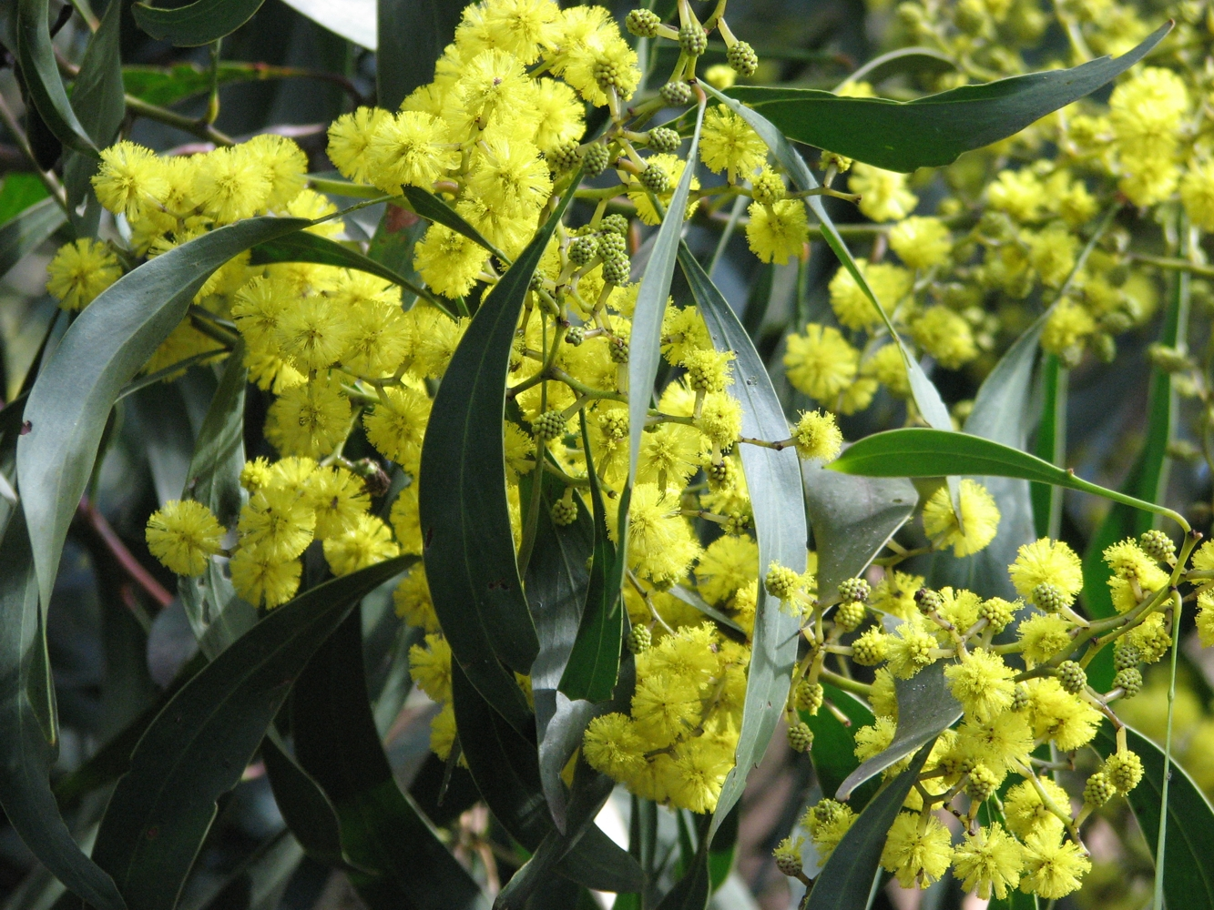
Australia
:
Emu
Golden Wattle

Slide 10
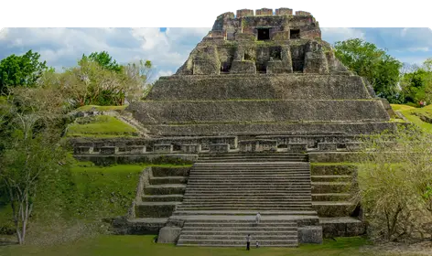

Belize

Slide 11
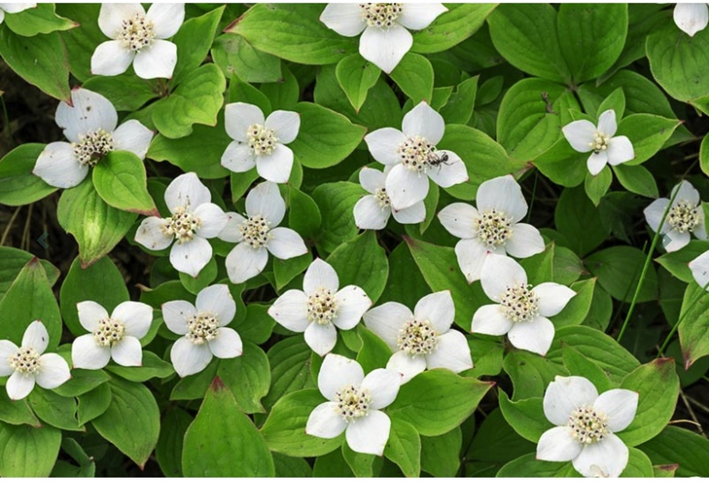
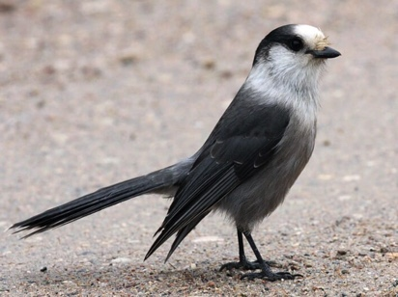
Canada
"From Sea to Sea"
Grey Jay
Bunchberry

Slide 12
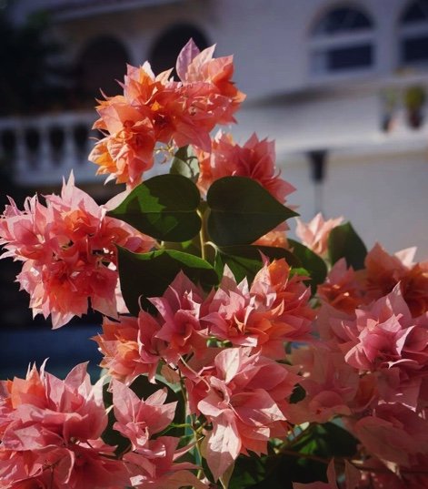
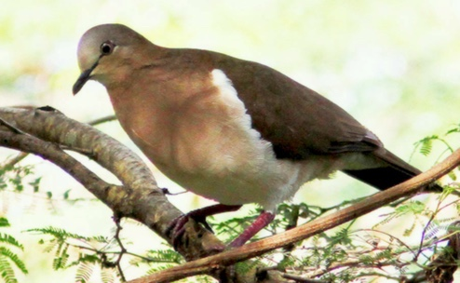
Grenada
"Ever Conscious of God We Aspire,
Build and Advance as One People"
Grenada Dove
Bougainvillea

Slide 13
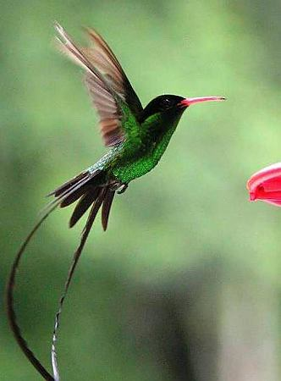
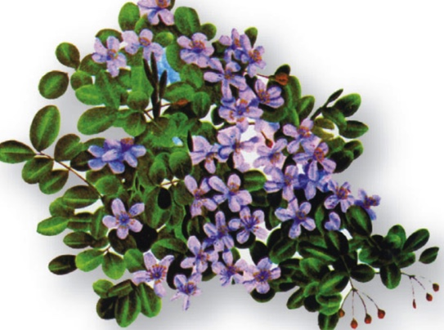
Jamaica
"Out of Many, One People"
Lignum vitae
Doctor bird

Slide 14
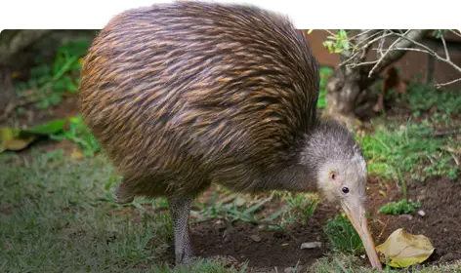
New Zealand

Slide 15
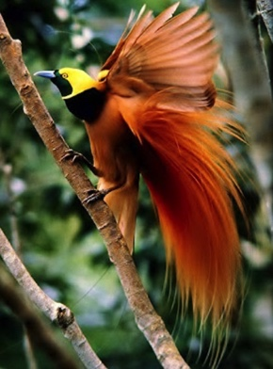
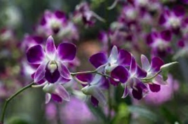
Papua New Guinea
‘Unity in Diversity’
Bird of Paradise
Dendrobium

Slide 16
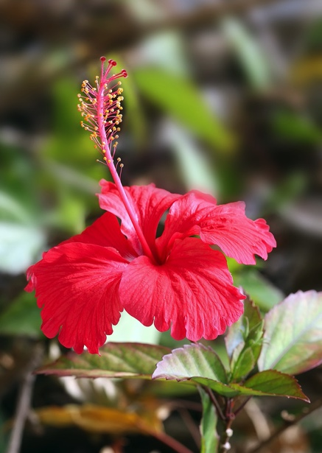
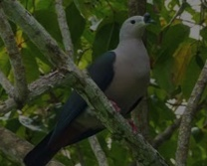
Solomon islands
"To Lead is to Serve"
KuruKuru
Hibiscus

Slide 17
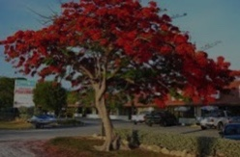
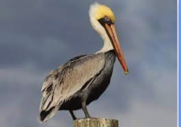
St Kitts & Nevis
St Christopher & Nevis
"Country Above Self"
Brown Pelican
Poinciana

Slide 18
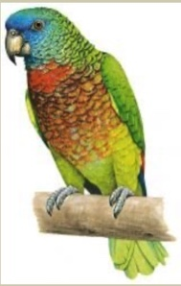
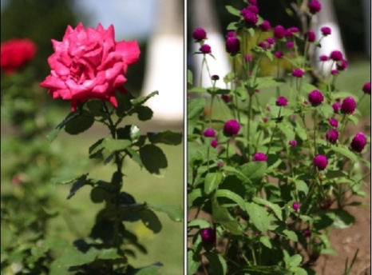
Saint Lucia
“The Land, The People, The Light”
St Lucia Parrot
The Rose and the Marguerite

Slide 19
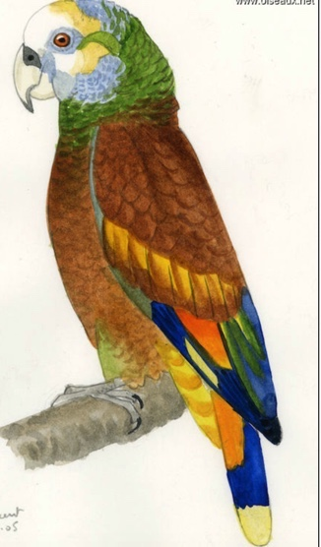
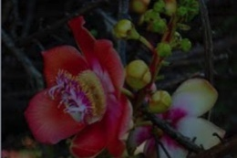
St Vincent & Grenadines
"Peace and Justice"
Vincent Amazon Parrott
Soufriere Tree

Slide 20
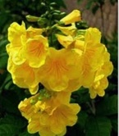
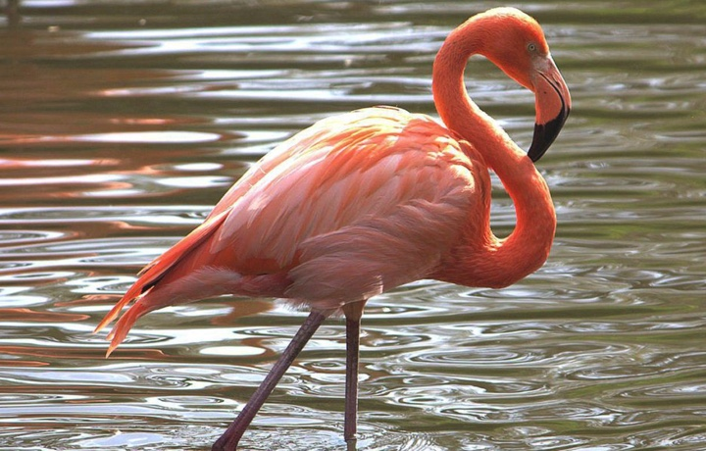
The Bahamas
"Forward, Upward, Onward, Together
Flamingo
Yellow Elder

Slide 21
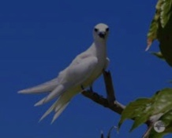
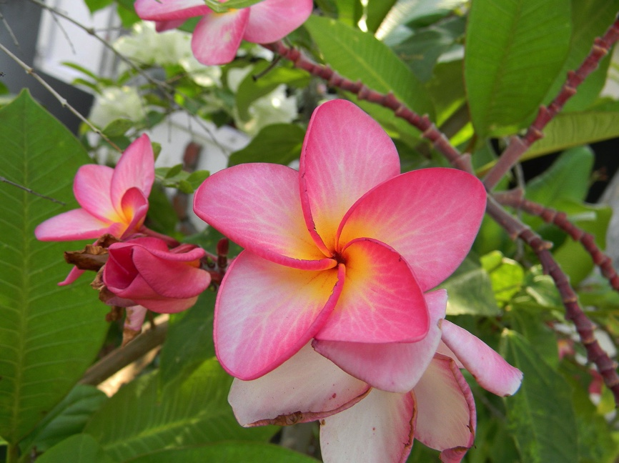
Tuvalu
"Tuvalu for the Almighty"
White Tern
Plumeria

Slide 22
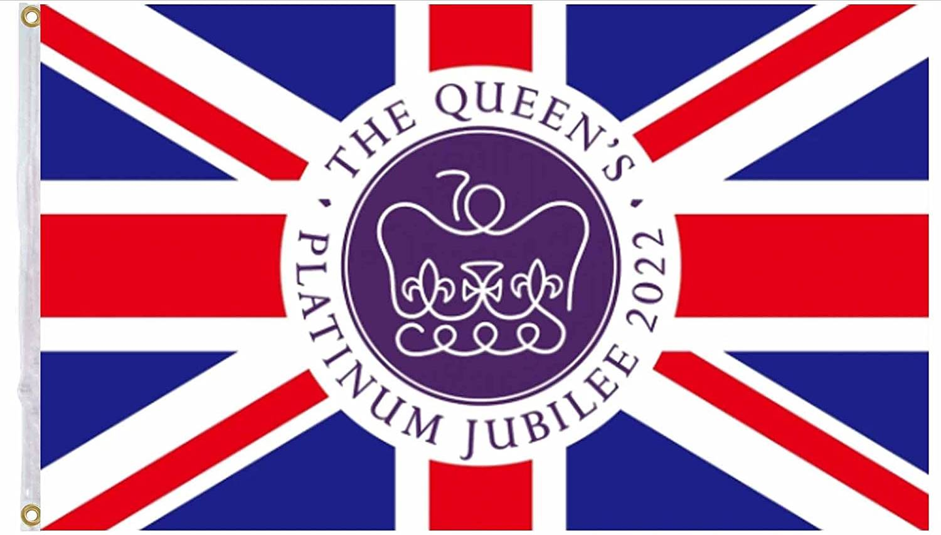

Slide 23
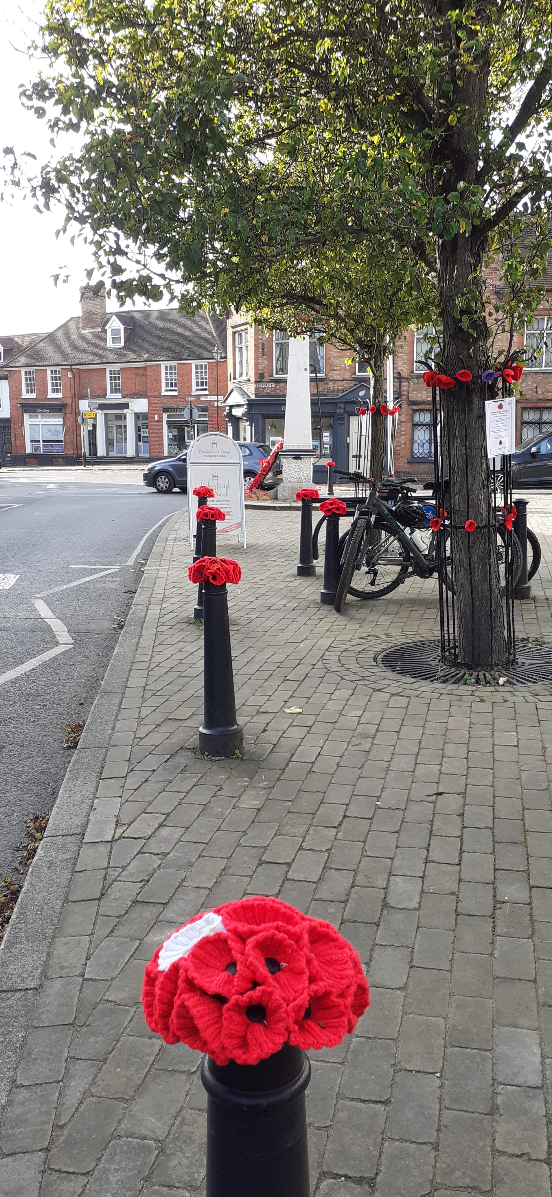
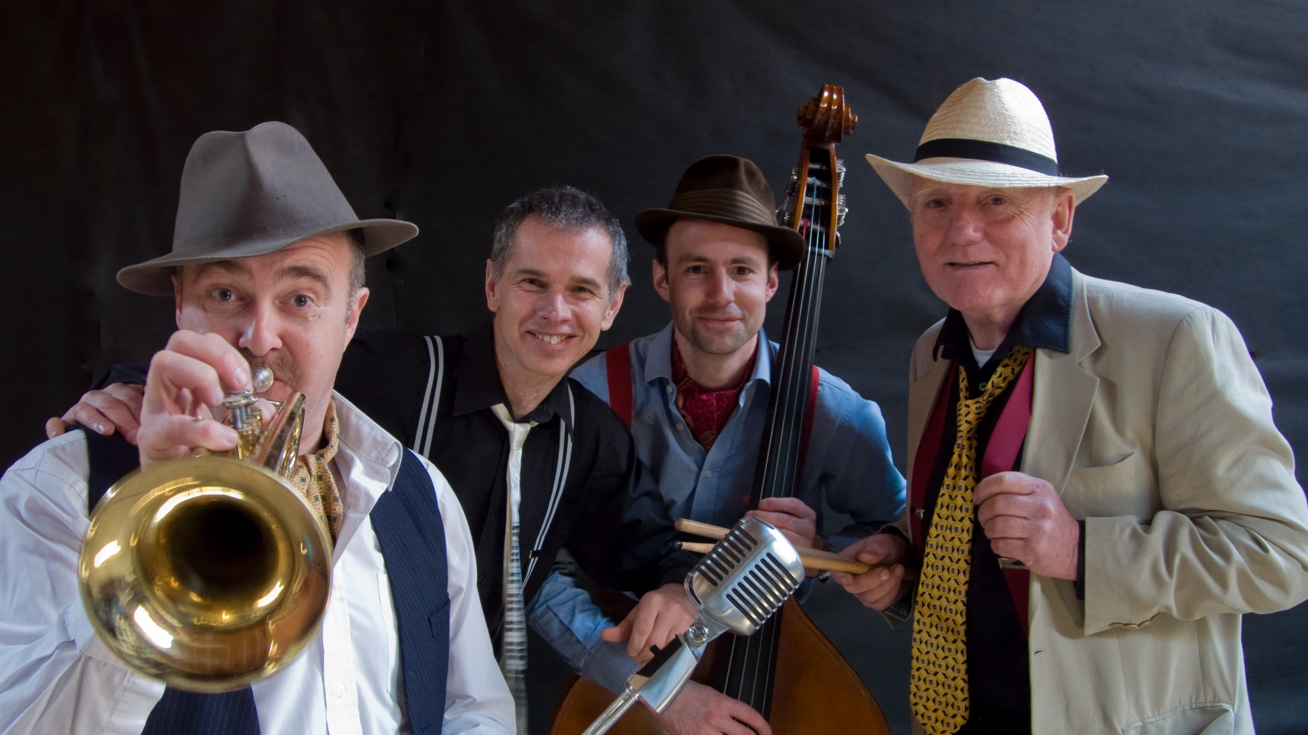
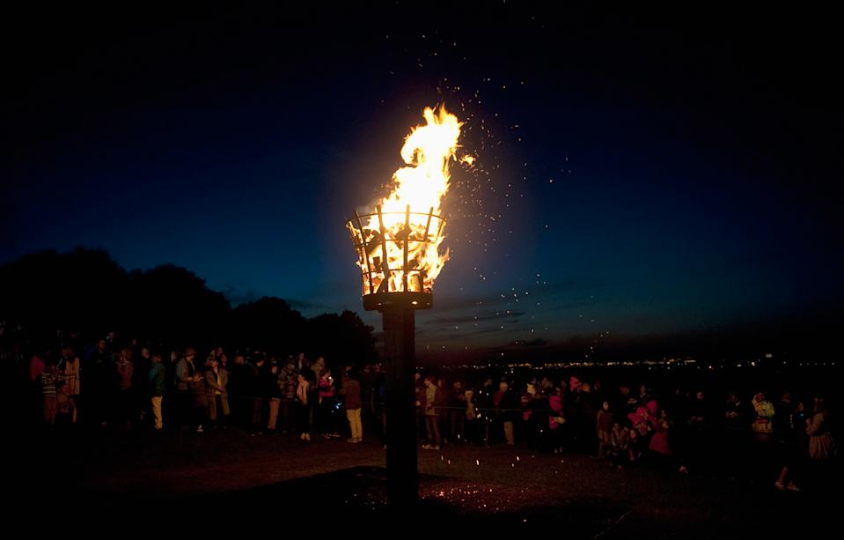
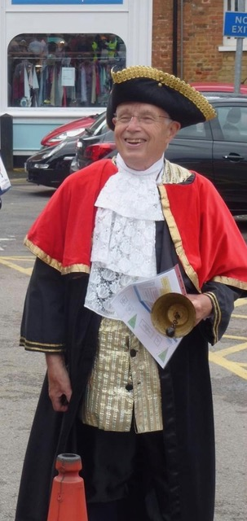
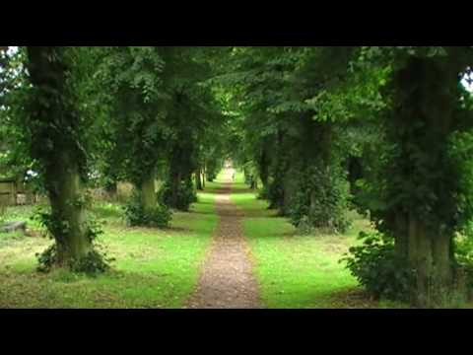
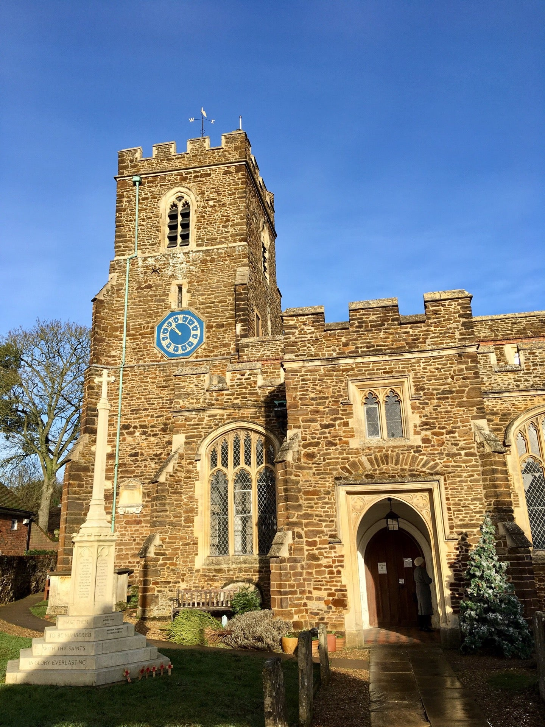

Platinum Musiv Evening 4th June. Parkside Hall 7.30pm
Commonwealth Flags
Queen’ Platinum Jubilee Events
Market Square decorated with Flags of the
Sovereign Realms & the United Kingdom
Town Cryer announces the Platinum Jubilee on the Market Square on the 2nd June at 1,00pm
Lighting of the Beacon in Ampthill Great Park at 9.30 pm. 2nd June
Platinum Music Evening. Parkside Hall 7.30—8.00 pm Saturday 4th June
Street Party. Alameda Sunday 5th June 12.00pm onwards
Service of Thanksgiving at St Andrews Church
6.30pm Sunday 5th June
Sunday 5^{th S}uSundaySss5th June 2022
2nd June. Beacon Lighting Ampthill Park
9.30pm
Town Cryer
2nd June
June Market Sq. 1.00pm
Ampthill Street Party The Alameda
Sunday 5th June
From 12.00pm onwards
Music & Live Band
Bring your own food &
refreshments & chairs
Platinum Church Service StAndrew’s Ampthill 6.30pm Sunday 5th June

