Slide 1
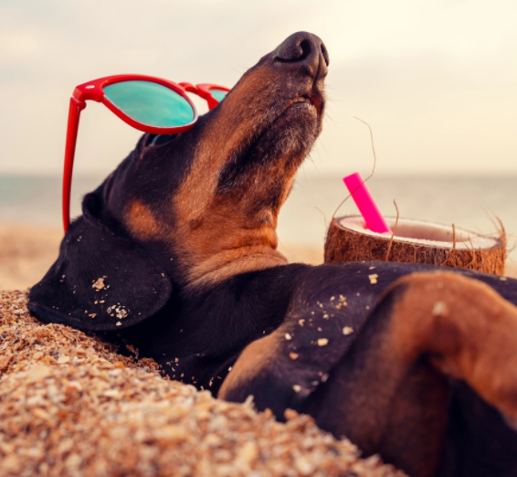
Welcome back to school! We hope you had a wonderful summer holiday.

Slide 2
Some assemblies will be back in the hall. Can we remember the rules? Come in one behind the other in a line without talking Sit in your class line (leave a gap in the middle) Sit with your legs crossed Sit with your hands in your lap No talking in assembly Eyes on the board or on the teacher

Slide 3
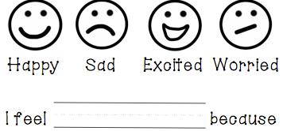
First day feelings…

Slide 4
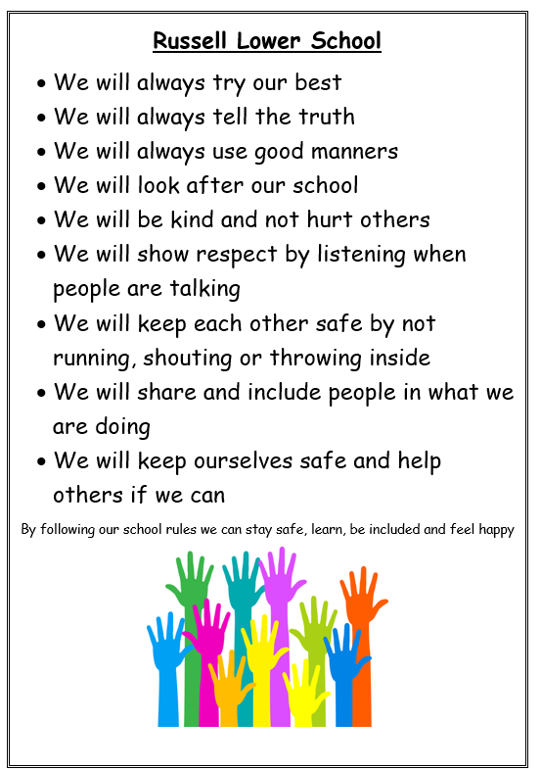
Russell Rights

Slide 5
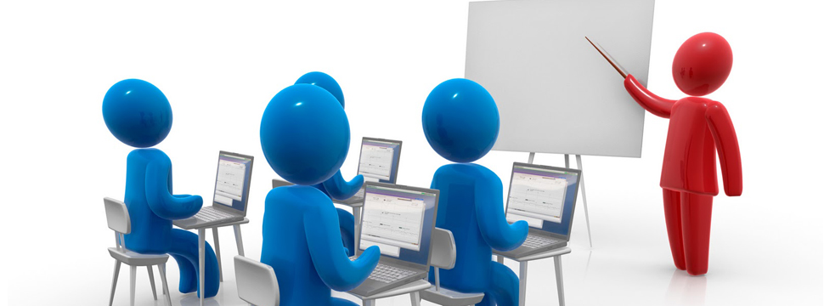
Everyone’s rights…including the adults
The right to learn
The right to be happy
The right to be safe
The right to be included

Slide 6
The right to be safe

Slide 7
The right to be safe
We are a ‘Telling School’

Slide 8
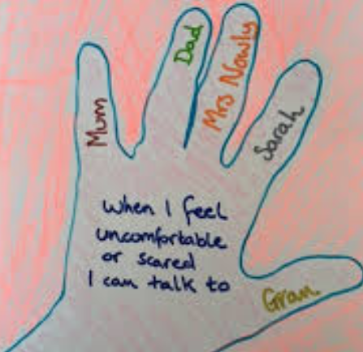
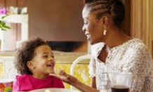
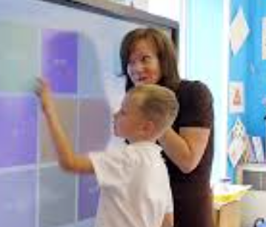
What do I do when I don’t feel safe?

