Slide 1
Allergy Aware School
Assembly

Slide 2
What is an allergy? What can you be allergic to?
Milk
Wheat
Strawberries
Gluten
Pollen (hay fever)
Bees/Wasps
Latex/rubber
Soya
Fish and Shellfish
Eggs
Animals
NHS - An allergy is a reaction the body has to a particular food or substance.
Allergies are very common. They're thought to affect more than 1 in 4 people in the UK at some point in their lives.
They're particularly common in children. Some allergies go away as a child gets older, although many are lifelong.
Adults can develop allergies to things they were not previously allergic to.
Having an allergy can be a nuisance and affect your everyday activities, but most allergic reactions are mild and can be largely kept under control.
Severe reactions can occasionally occur, but these are uncommon.

Slide 3
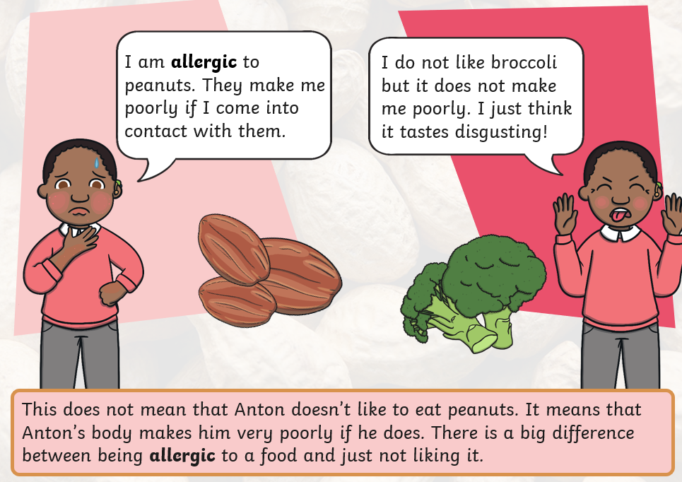
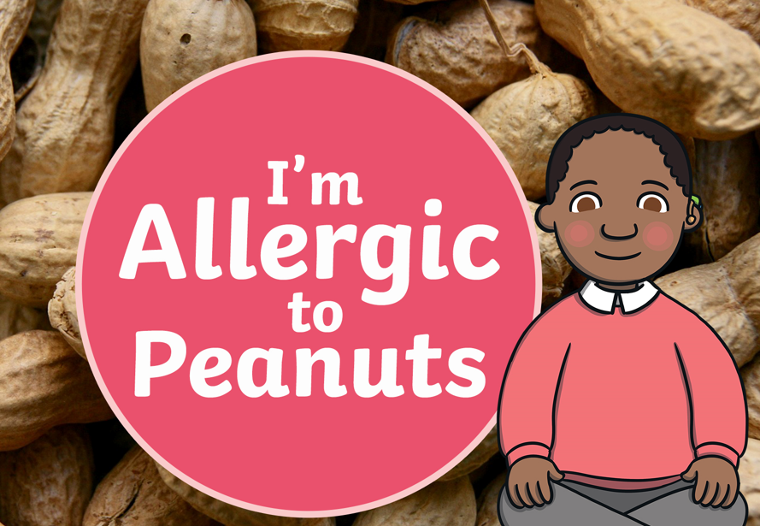
Having an allergy

Slide 4
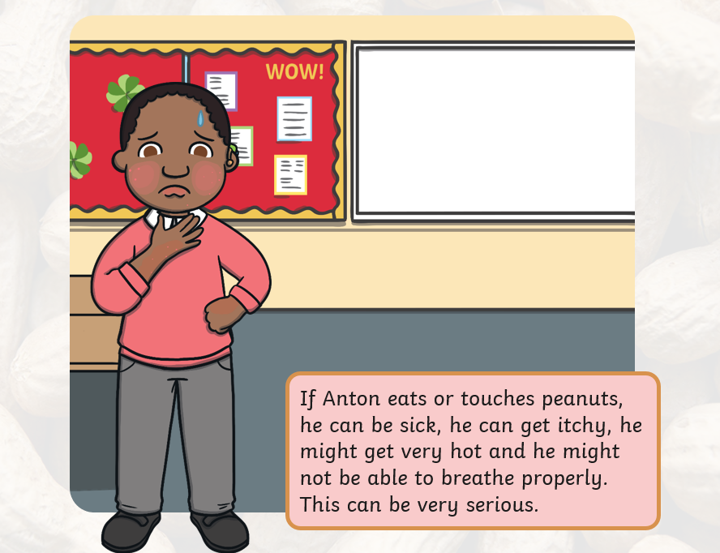
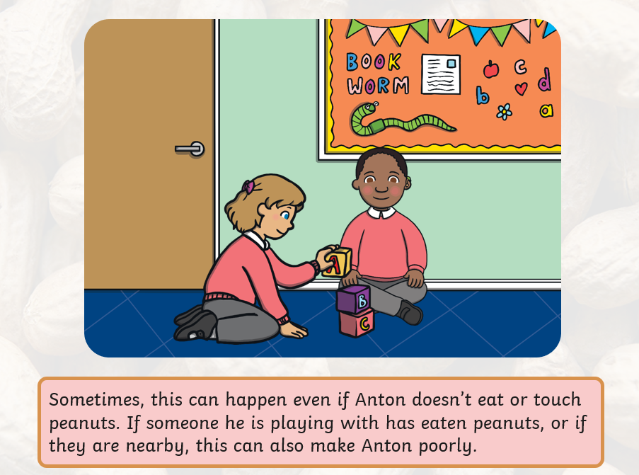
What might happen?

Slide 5
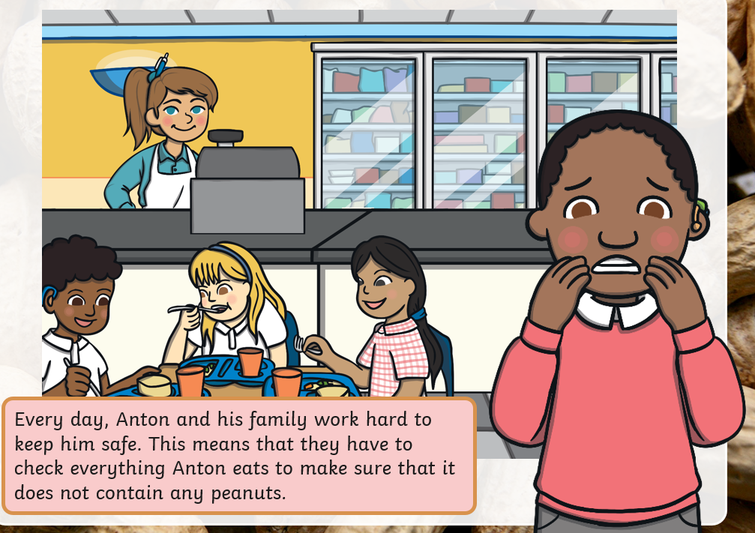

What can we do?

Slide 6
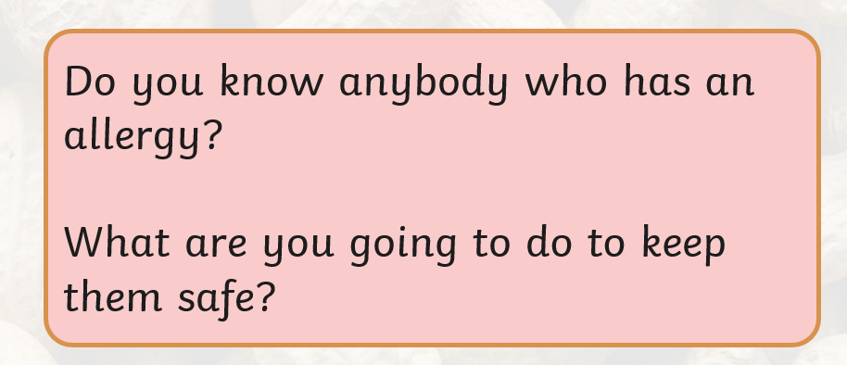
We can have allergies to all sorts of things
Milk
Wheat
Strawberries
Gluten
Pollen (hay fever)
Bees/Wasps
Latex/rubber
Soya
Fish and Shellfish
Eggs
Animals

Slide 7

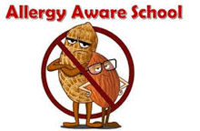
We are an allergy aware school

