Slide 1
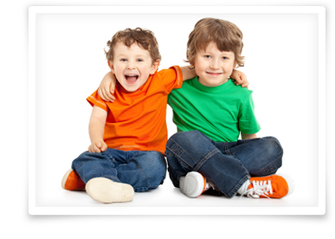
Everyone’s rights…
The right to learn
The right to be happy
The right to be safe
The right to be included

Slide 2
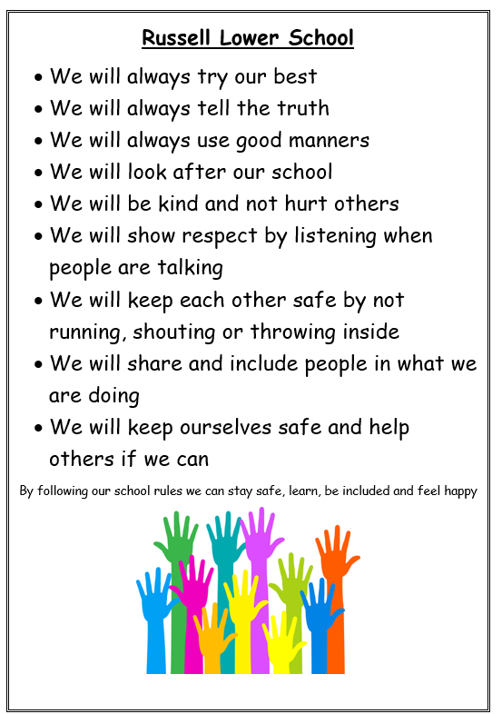
What is the same at school? Expectations!

Slide 3
The right to be safe

Slide 9
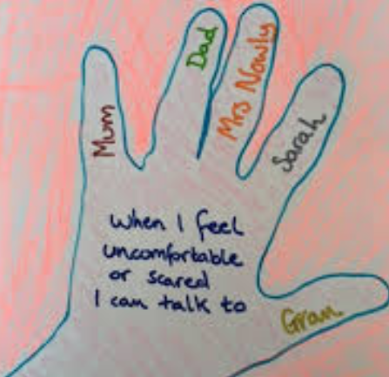
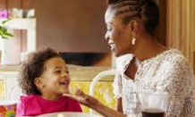
What do I do when I don’t feel safe?

Slide 10
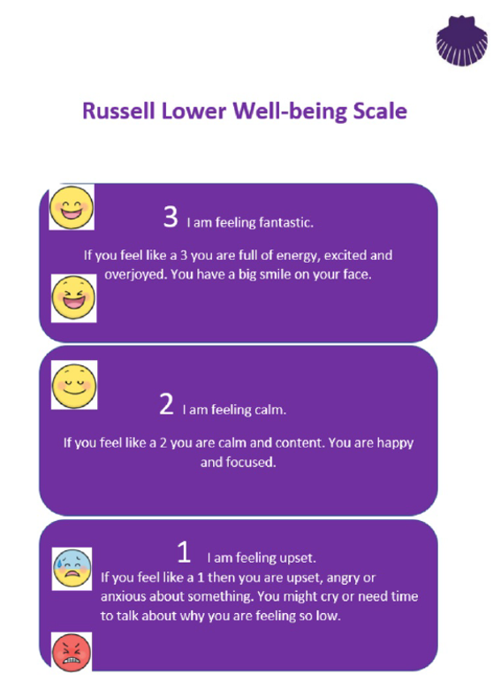
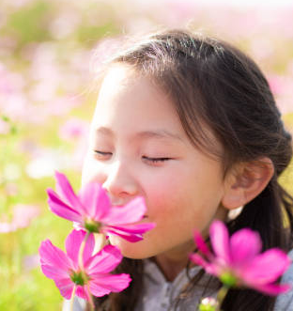
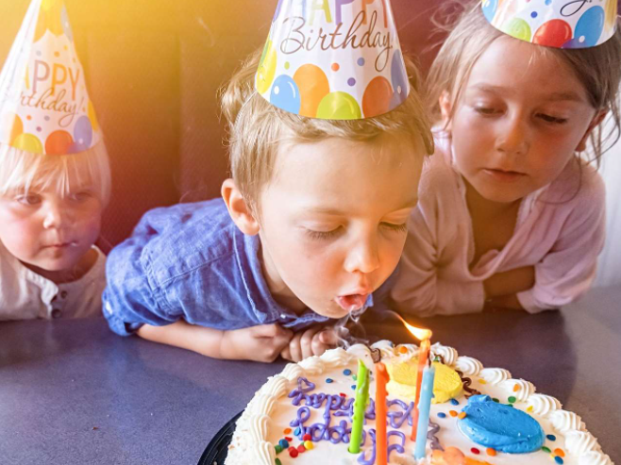
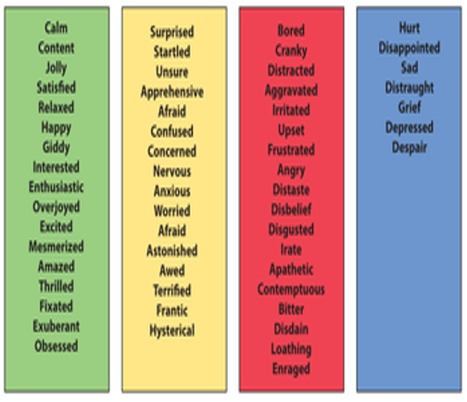
Calm ‘birthday’ breathing:
1.
2.

