Slide 2
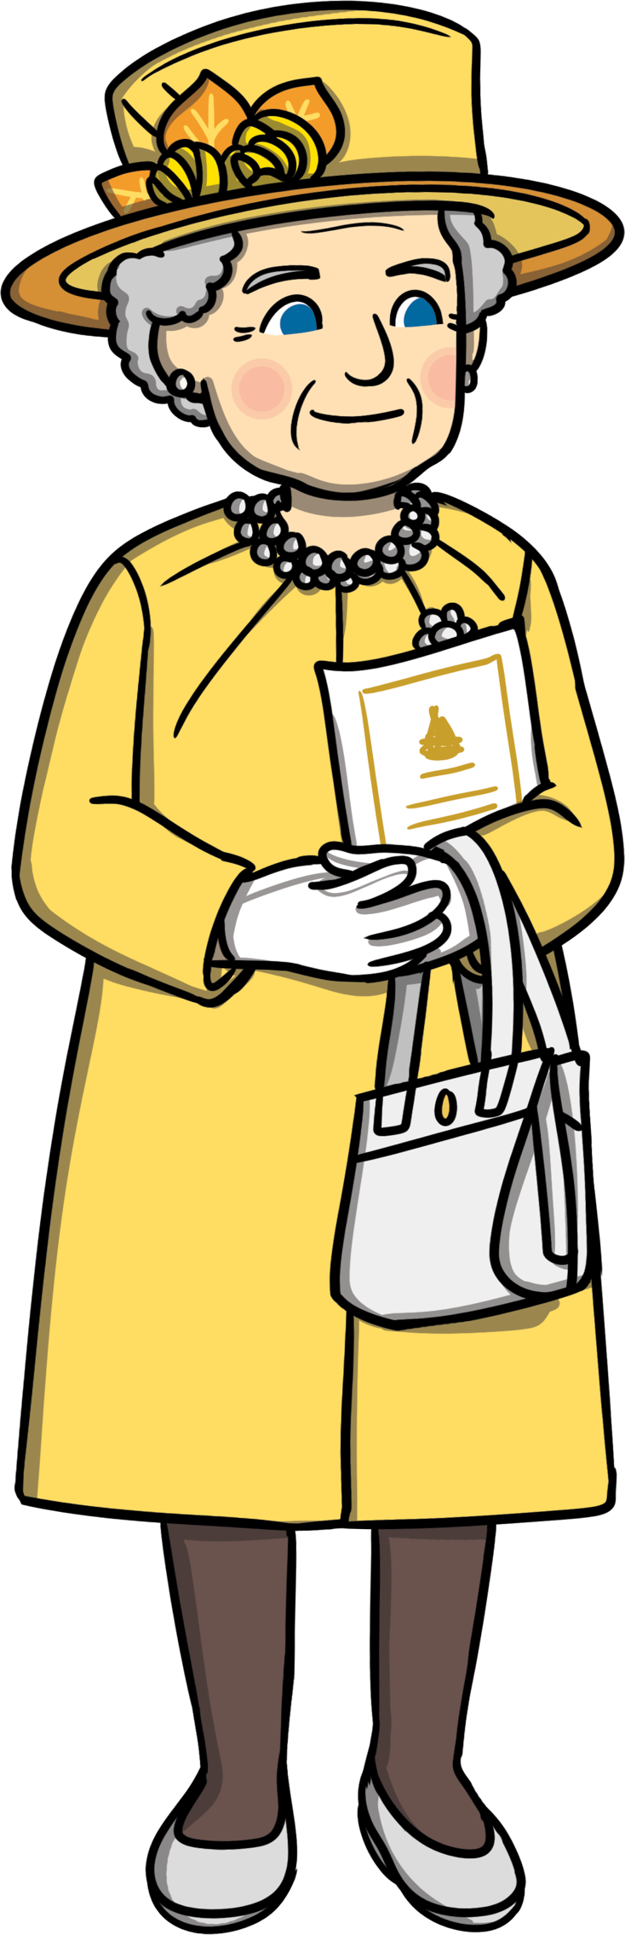
Contents
1
Who is Queen Elizabeth II?
Princess Elizabeth Becomes Queen
Platinum Jubilee
A Year of Jubilee Events
Trooping the Colour
Platinum Party at the Palace
The Big Jubilee Lunch
The Platinum Jubilee Pageant
Platinum Jubilee Celebration
Platinum Pudding Competition
Other Events
2
3
4
5
6
7
8
9
10
11

Slide 3
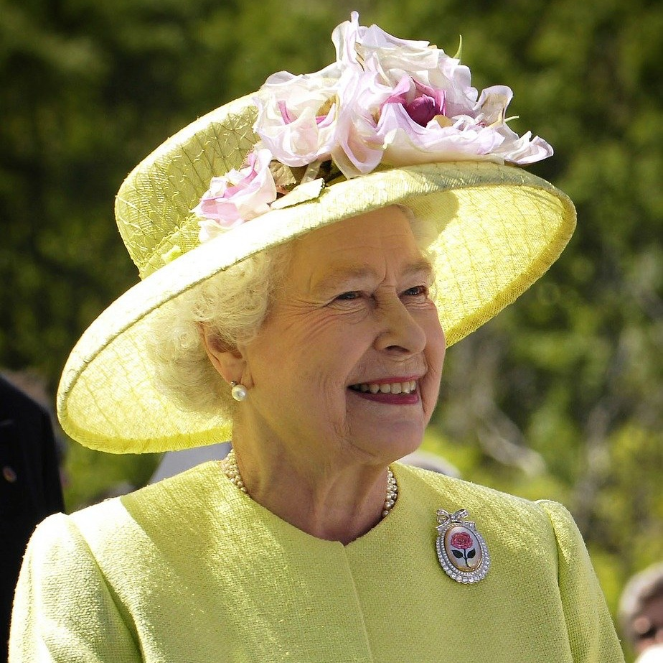
Who is Queen Elizabeth II?
Elizabeth was born on 21st April 1926 as Princess Elizabeth.
She was the first child of The Duke and Duchess of York. The Duke of York later became King George VI.
home

Slide 4
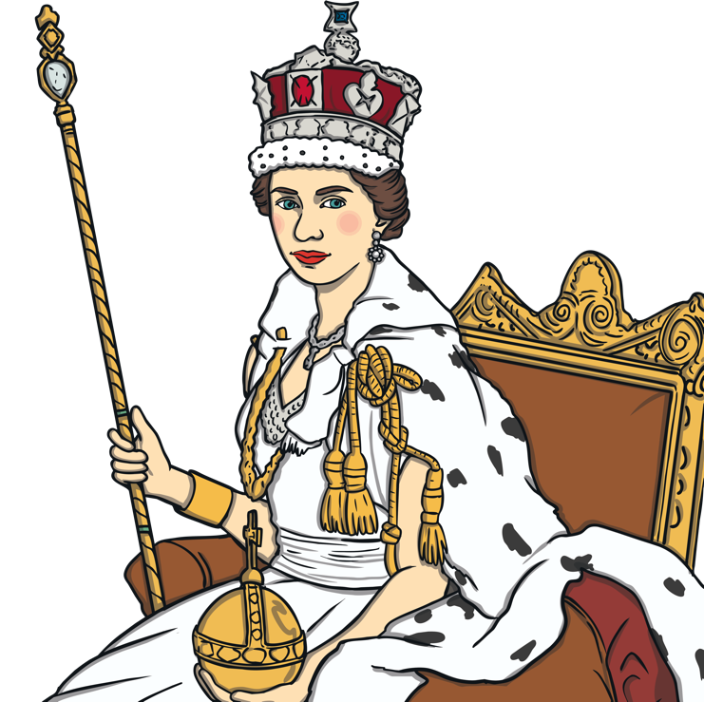
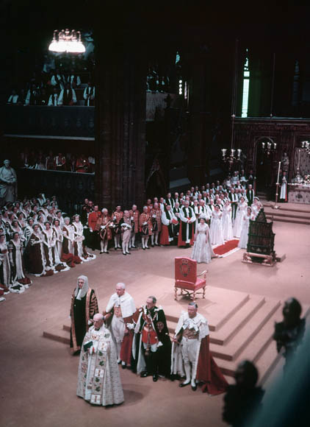
Princess Elizabeth Becomes Queen
In 1952, when she was 25, Princess Elizabeth’s father King George VI died.
Princess Elizabeth was in Kenya when she heard the sad news. She came home straight away and it was decided that Princess Elizabeth would become queen.
She became queen on 6th February 1952 and was crowned on 2nd June 1953.
home

Slide 5

Platinum Jubilee
A jubilee is a special celebration of an event.
Did you know?
Queen Elizabeth II is England’s longest reigning monarch.
This means that she has been The Queen for a longer time than any other queen or king.
A platinum jubilee celebrates 70 years of an event.
The Queen’s Platinum Jubilee is in 2022 and celebrates 70 years of her being the queen.
This will be the first time a British monarch has celebrated a Platinum Jubilee.
home

Slide 6
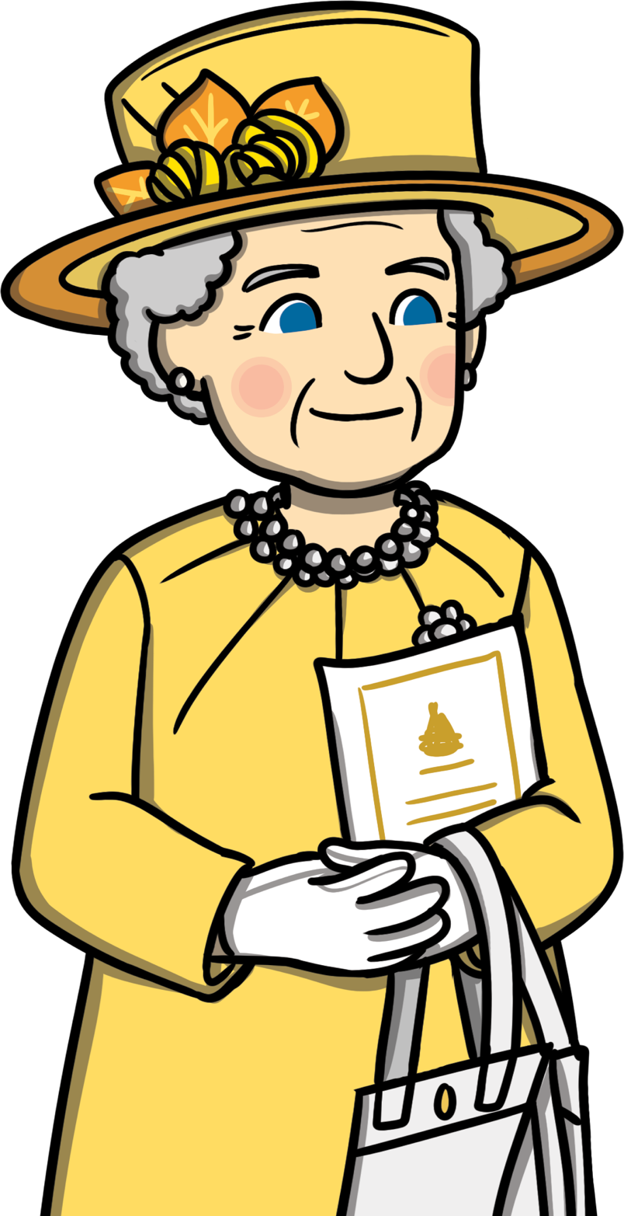
A Year of Jubilee Events
Throughout 2022, there will be several events to celebrate The Queen’s reign.
There will be a Bank Holiday in June to celebrate.
There will be lots of competitions and special items made to celebrate the event.
home

Slide 7
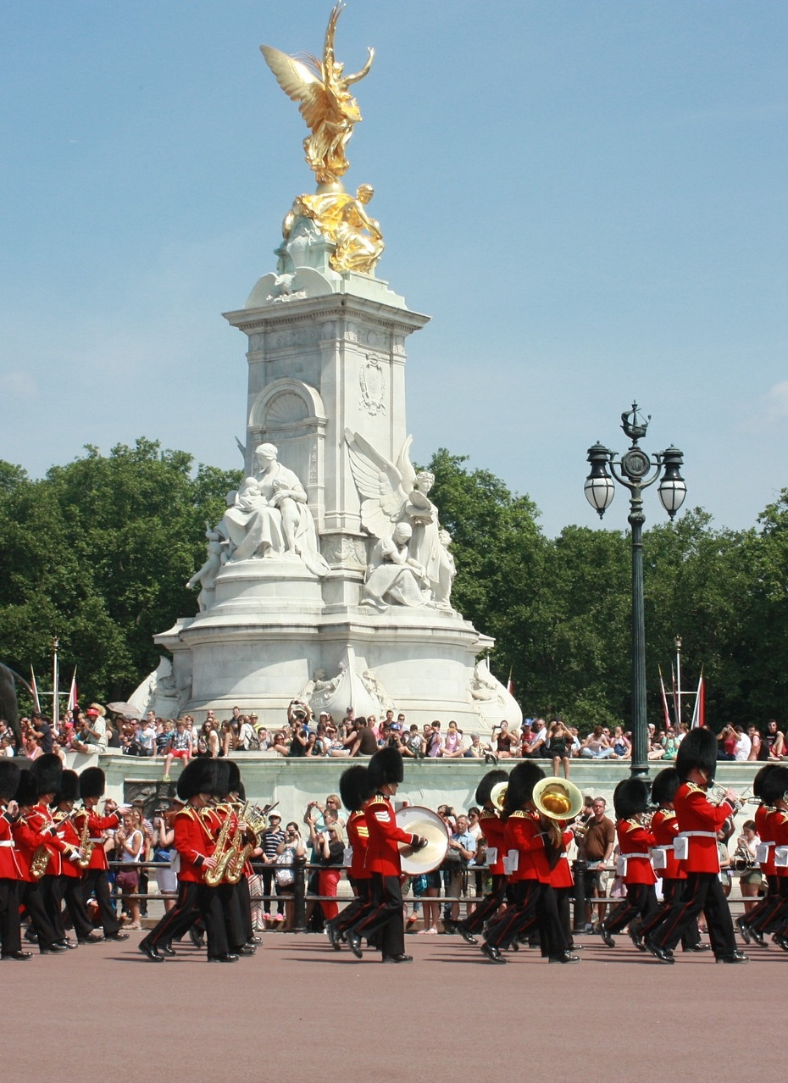
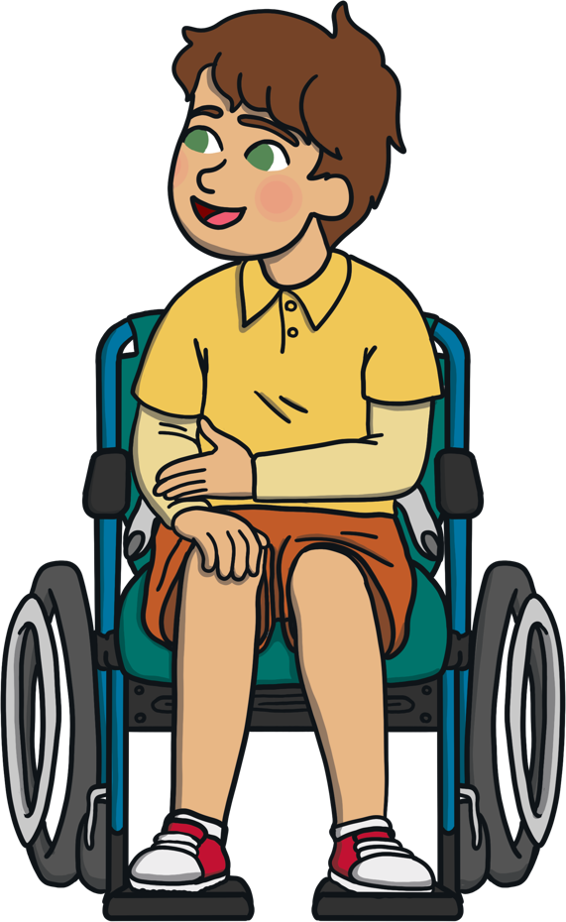
Trooping the Colour
The Queen’s official birthday in June is always celebrated by a special parade in London called Trooping the Colour.
Lots of soldiers, horses and musicians take part in the parade.
At the end of the parade, The Queen and other members of the Royal family will watch a display by the Royal Air Force.
What can you see in this photo?
Can you see any musical instruments?
home

Slide 8
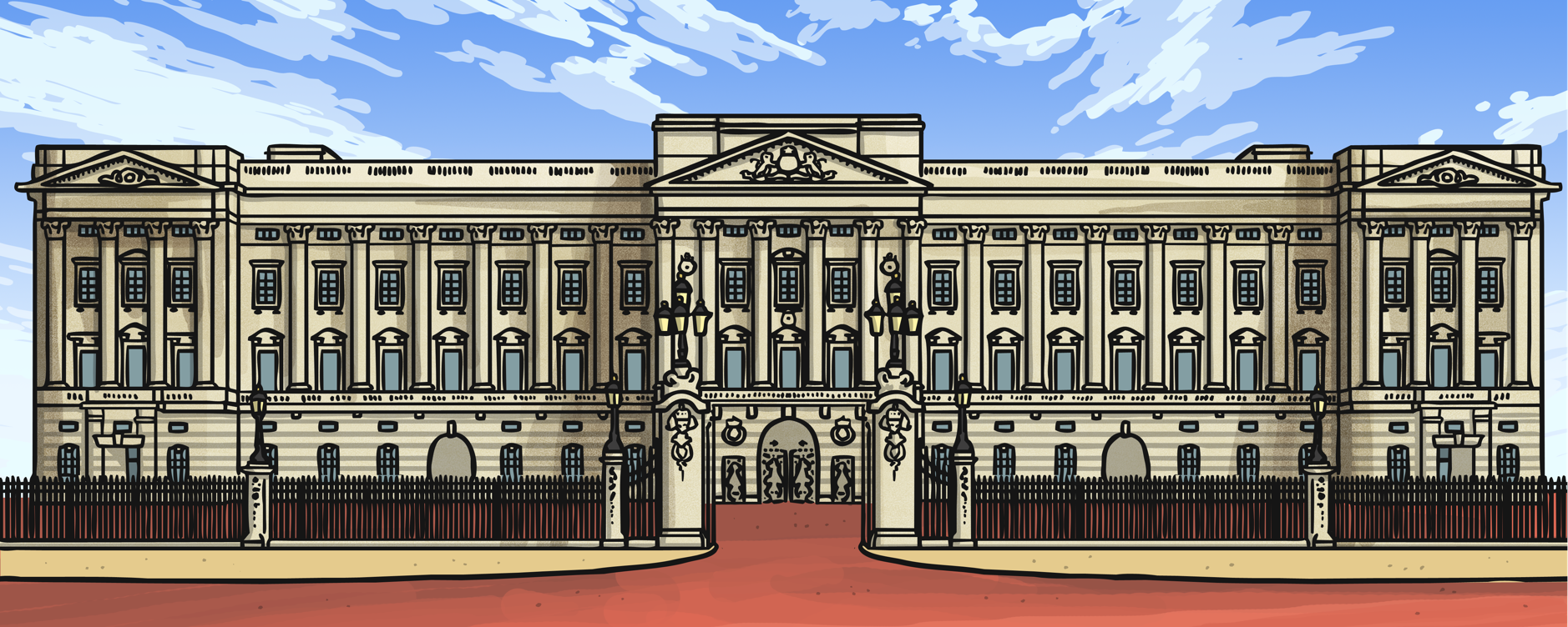
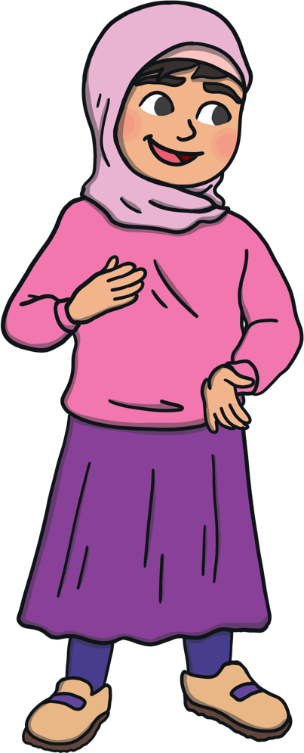
Platinum Party at the Palace
Would you like to go to a party at Buckingham palace?
What would you like to watch?
The Platinum Party at the Palace is a special concert at Buckingham Palace in London.
There will be lots of different performances by singers, dancers and musicians.
home

Slide 9
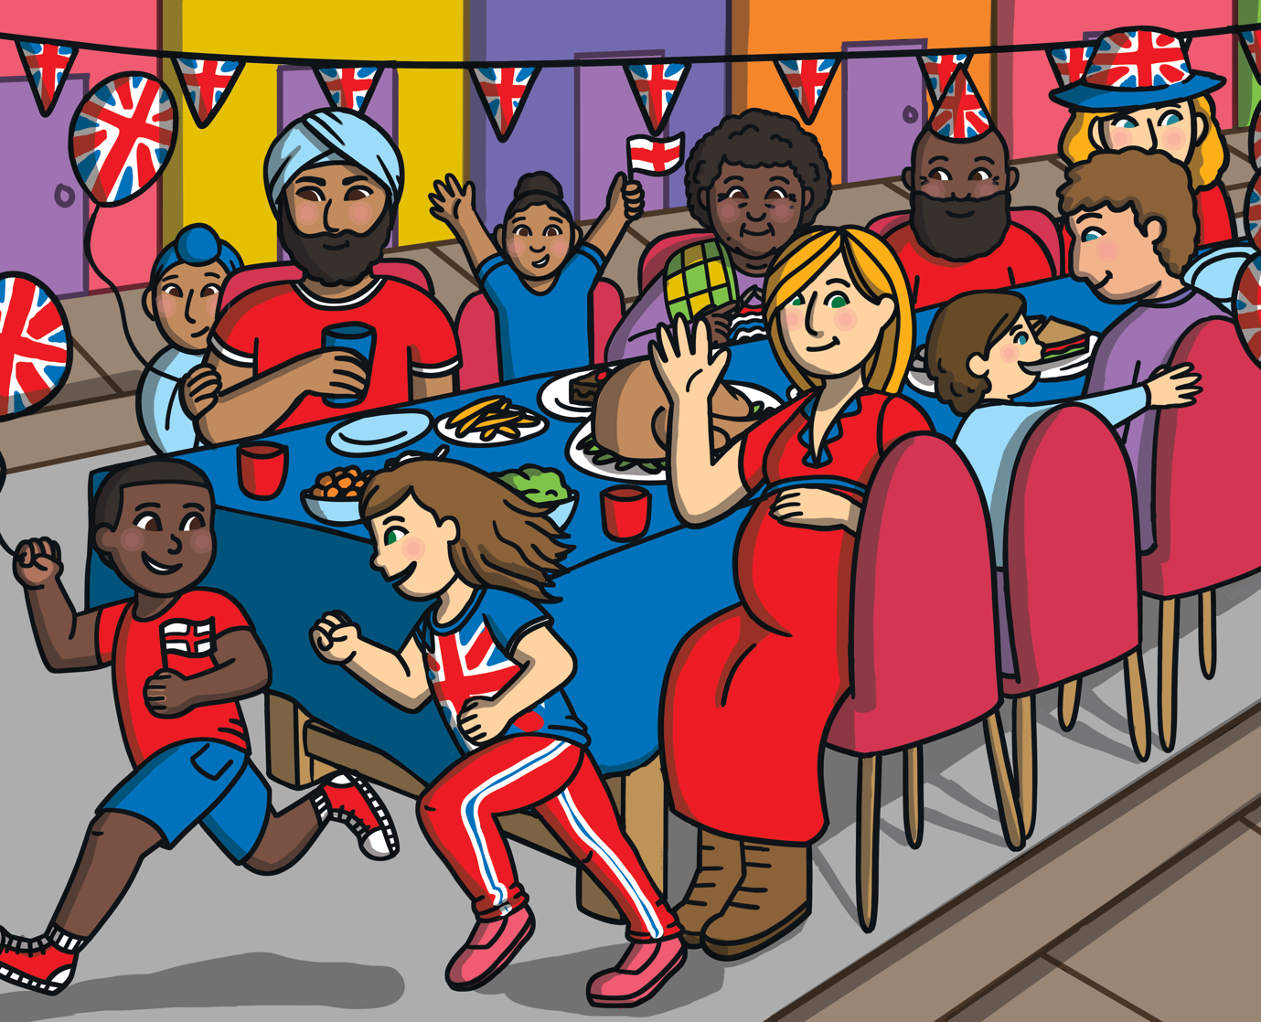

The Big Jubilee Lunch
The Big Jubilee Lunch invites people to get together to celebrate the jubilee.
People might have tea parties, picnics, barbecues or street parties.
It is a chance to celebrate with friends, family and members of your local community.
Have you been to a party before?
What type of food do you think The Queen would like to eat at a party?
home

Slide 10
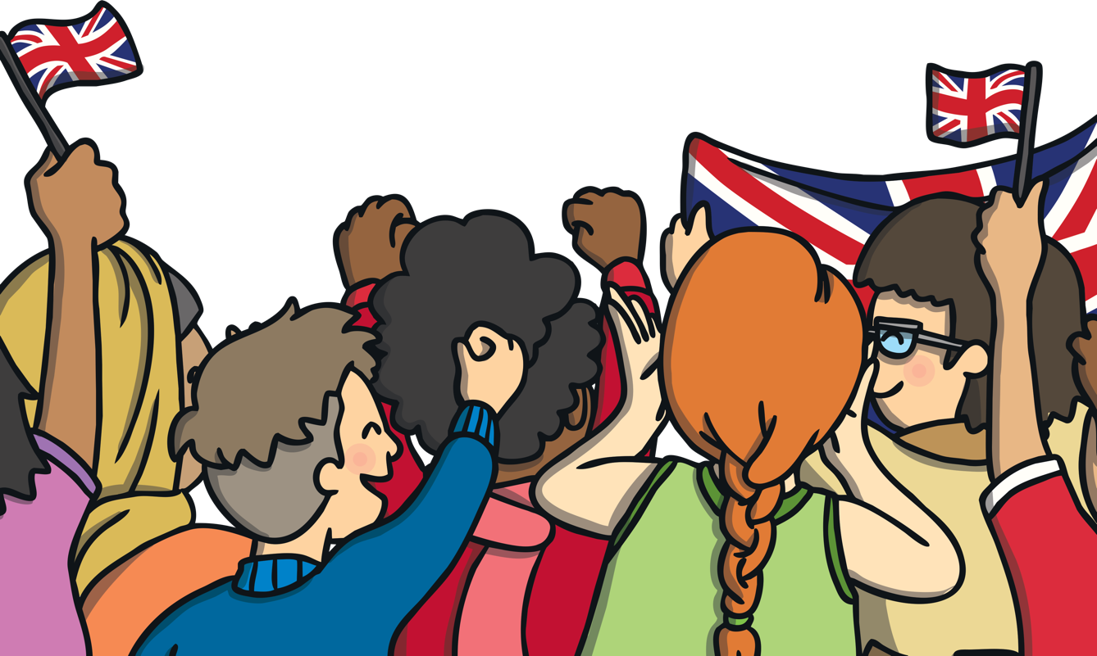
The Platinum Jubilee Pageant
A pageant is like a parade and often includes lots of people.
Pageants often include music, performances and colourful costumes.
The Platinum Jubilee Pageant includes a ‘River of Hope’ display. Silk scarves, decorated by children from around the country, will be held to look like a river. The scarves will show the children’s hopes for the planet over the next 70 years.
What would be your hopes for the future of the planet?
home

Slide 11
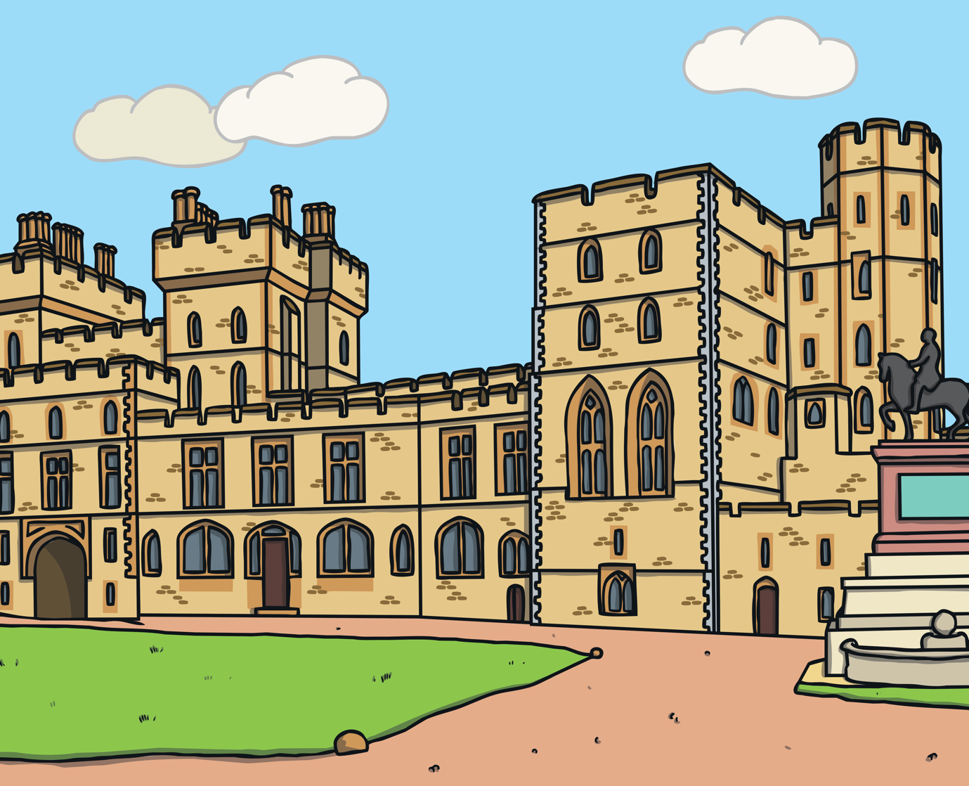

Platinum Jubilee Celebration
This special event will take place at Windsor Castle.
There will be singers, dancers, musicians, horses and performers.
The show will be about kings and queens and the history of Great Britain.
Have you been to a castle before?
What was it like?
home

Slide 12
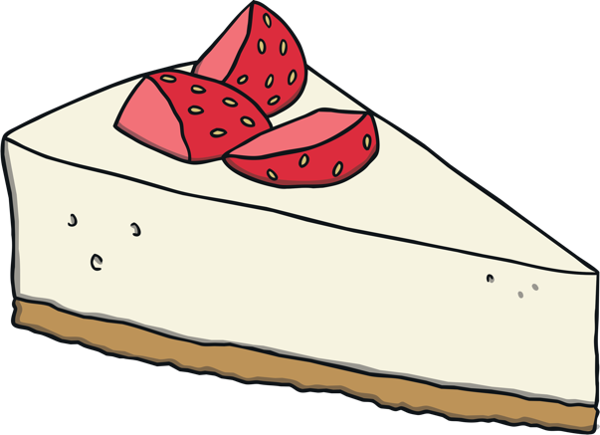

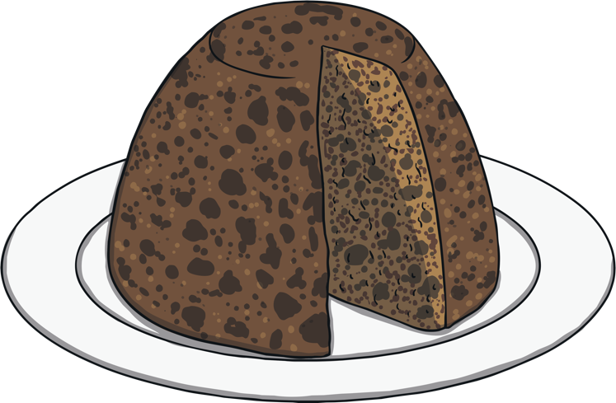
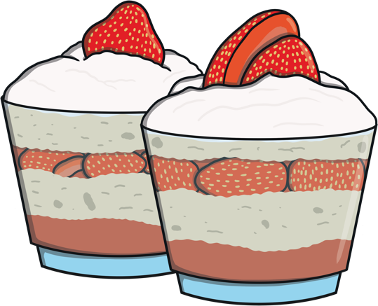
Platinum Pudding Competition
The Platinum Pudding competition is a baking competition to celebrate the jubilee.
Judges will look through the entries and choose a winner.
The recipe for the winning pudding will be shared so that it can be served at events throughout the year and for many years to come.
What pudding would you like to make?
home

Slide 13

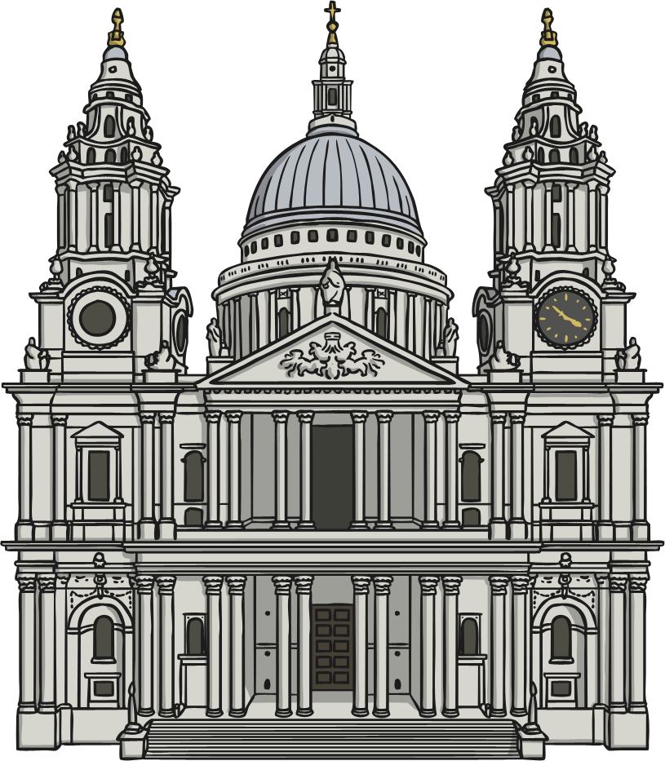
Other Events
Queen's Green Canopy – communities will be planting trees around the country to celebrate the jubilee.
Service of Thanksgiving – there will be a special Service of Thanksgiving for The Queen at St Paul’s Cathedral.
home

Slide 14
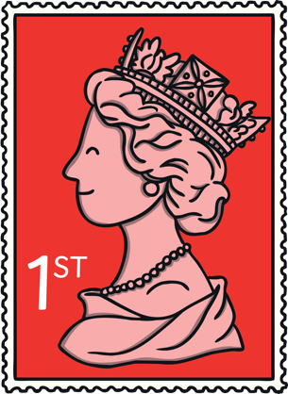
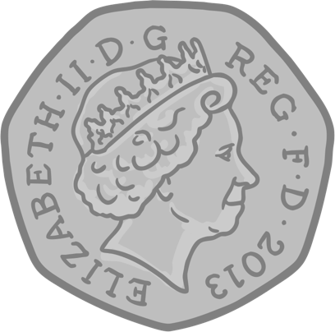
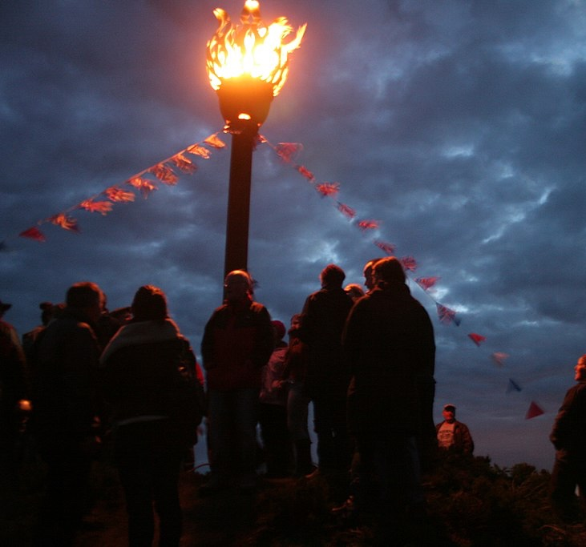
Other Events
Some special stamps and coins will be released for The Queen’s Platinum Jubilee.
Jubilee beacons – tall beacons (fires) will be lit in various places around the country, including Buckingham Palace. Beacons will also be lit in places around the world.
This is a photo of a jubilee beacon that was lit for The Queen’s Diamond Jubilee in 2012. What can you see in this photo?
“Jubilee Beacon at Danby 2.jpg” by Dearg Doom is licensed under CC BY 2.0
home

Slide 15
Your Platinum Jubilee Celebrations
Would you like to celebrate The Queen’s Platinum Jubilee?
What would you like to do?
Talk to a friend about your ideas for celebrating The Queen’s Platinum Jubilee.
home

