Slide 1


Slide 2


Slide 3

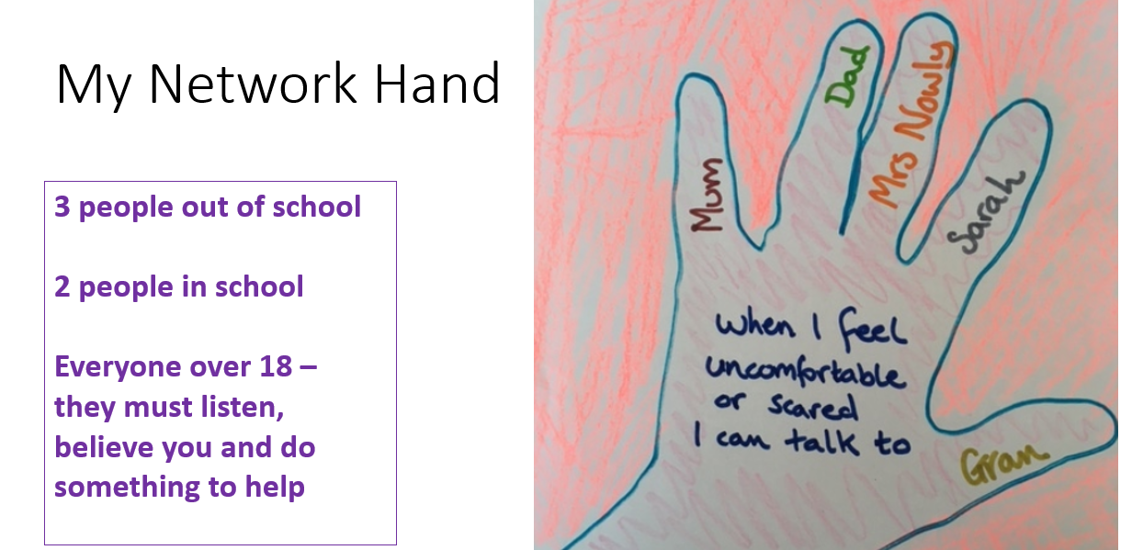

Slide 4


Slide 5


Slide 6
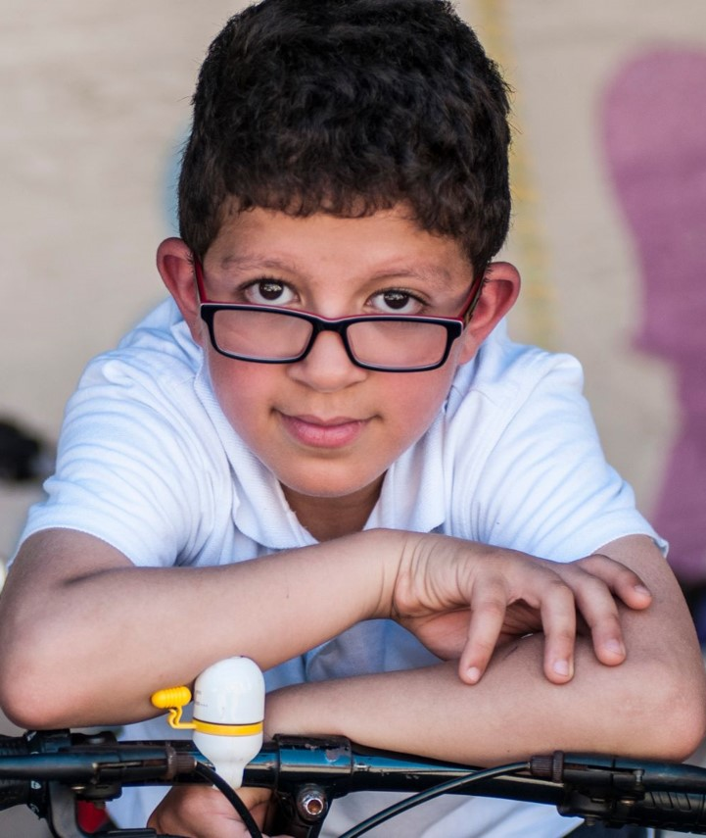



Russell Lower School
Is taking part in
Notes:
Add your school name on the front slide and use this presentation to introduce Cycle to School week in your class or assembly.

Slide 7
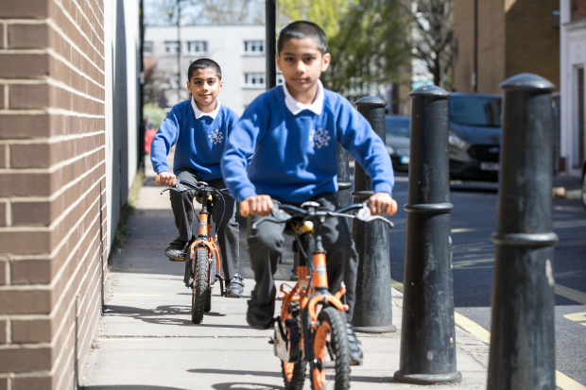
What is it? When is it?
Cycle to School Week is a week-long event where pupils, families and teachers try cycling or scooting to school.
Lets see how many people we can get cycling and scooting!
It is next week (from Monday 3rd October)
©2021, Kois Miah, all rights reserved

Slide 8
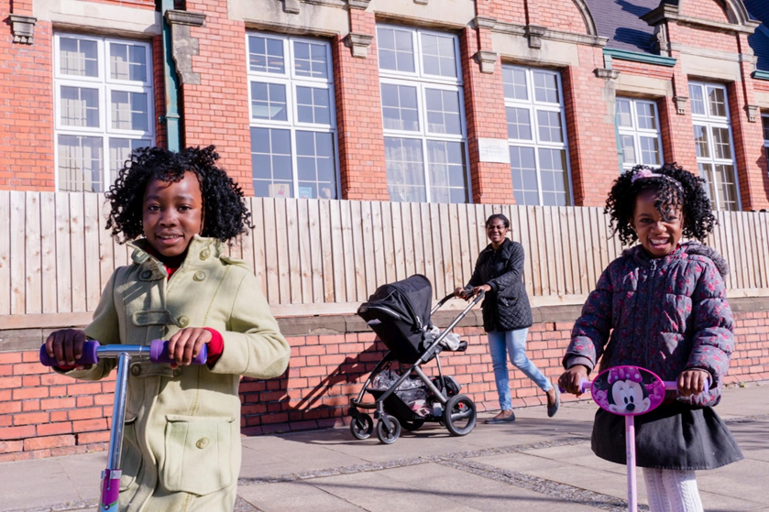
Why cycle or scoot to school?
Being active on the way to school has many benefits including:
Feeling more energised
Help the environment by replacing a car journey
Improve local air quality
Reduce traffic around the school
© 2017, Jonathan Bewley

Slide 9
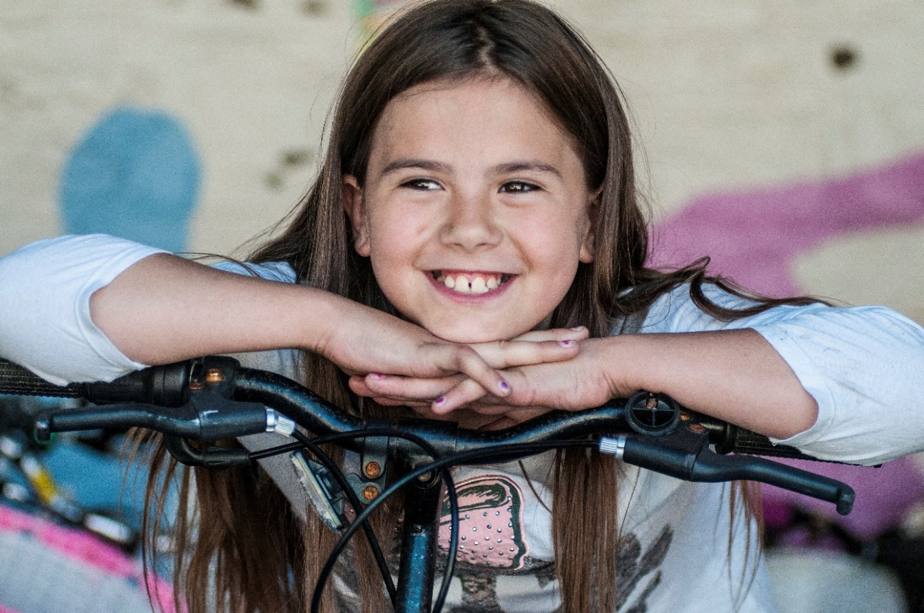
How can I cycle or scoot to school?
©2015, Sustrans
Notes:
Encourage pupils to think if they could cycle or scoot to school during Cycle to School Week

Slide 10
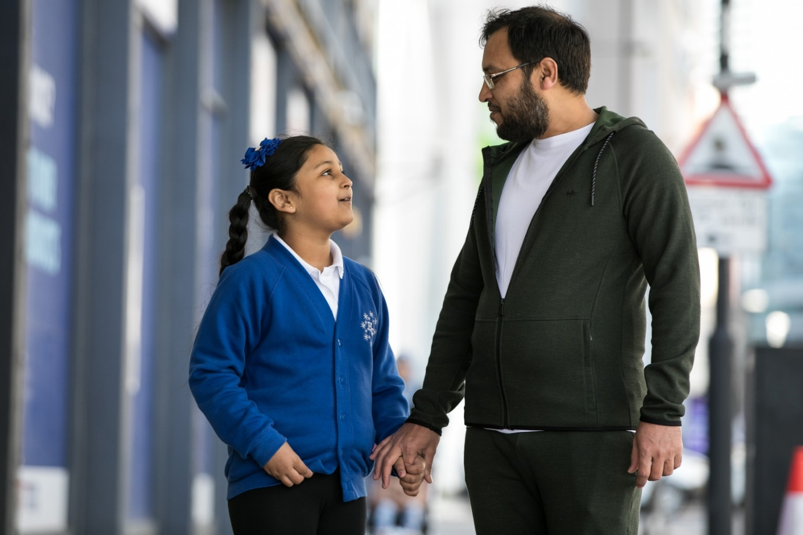
Ask a parent or guardian
©2021, Kois Miah, all rights reserved
Notes:
Encourage pupils to tell their parents or guardians about Cycle to School Week so they can plan to travel actively to school.

Slide 11
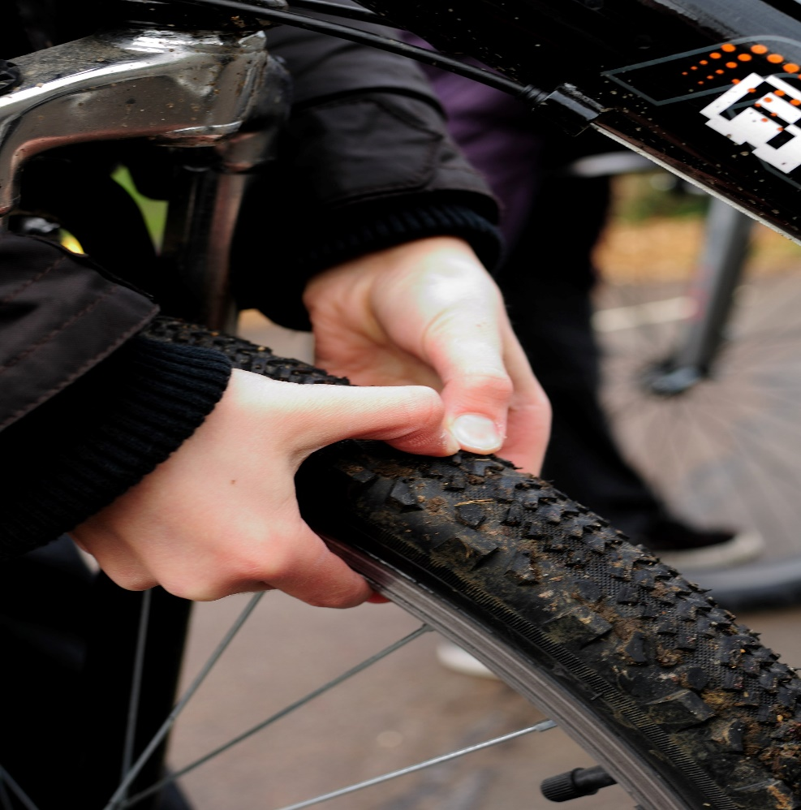
Check your cycle or scooter is safe to ride
Notes:
You can show pupils the Sustrans M-check: https://www.youtube.com/watch?v=4qtx60bcNk0 and L-check video: https://www.youtube.com/watch?v=hwQL_iorrAg

Slide 12
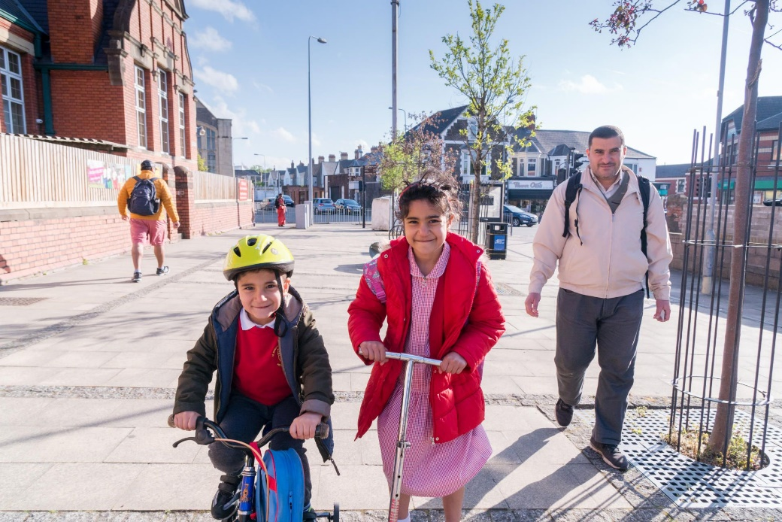
Choose a safe route
© 2017, Jonathan Bewley
Notes:
Encourage pupils to take a route to school which is safe. This could mean they choose a route which has less traffic or has cycle lanes. If you are taking part in Cycle to School Week in the winter make sure you have lights on your bike and wear high-vis clothing

Slide 13
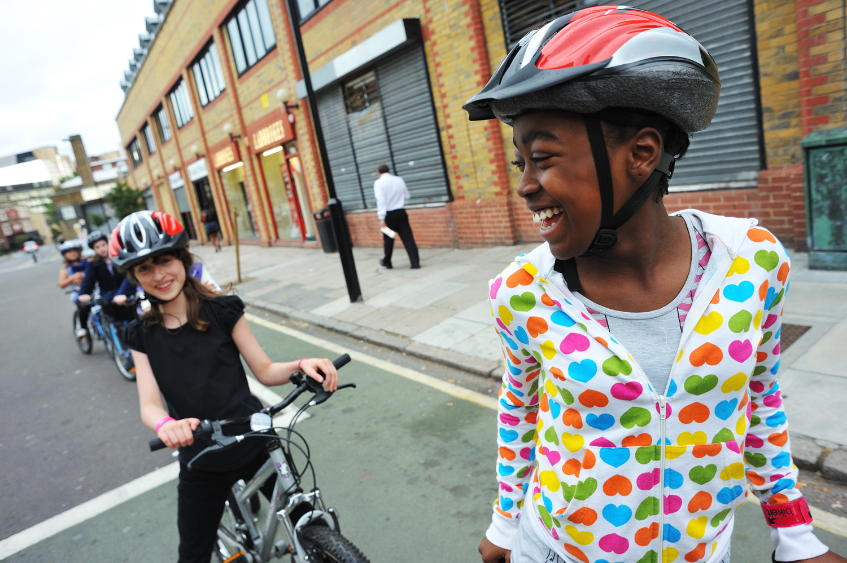
Put on your helmet
© J Bewley/Sustrans
Notes:
Inform pupils of the importance of wearing a helmet when riding a cycle or scooter

Slide 14
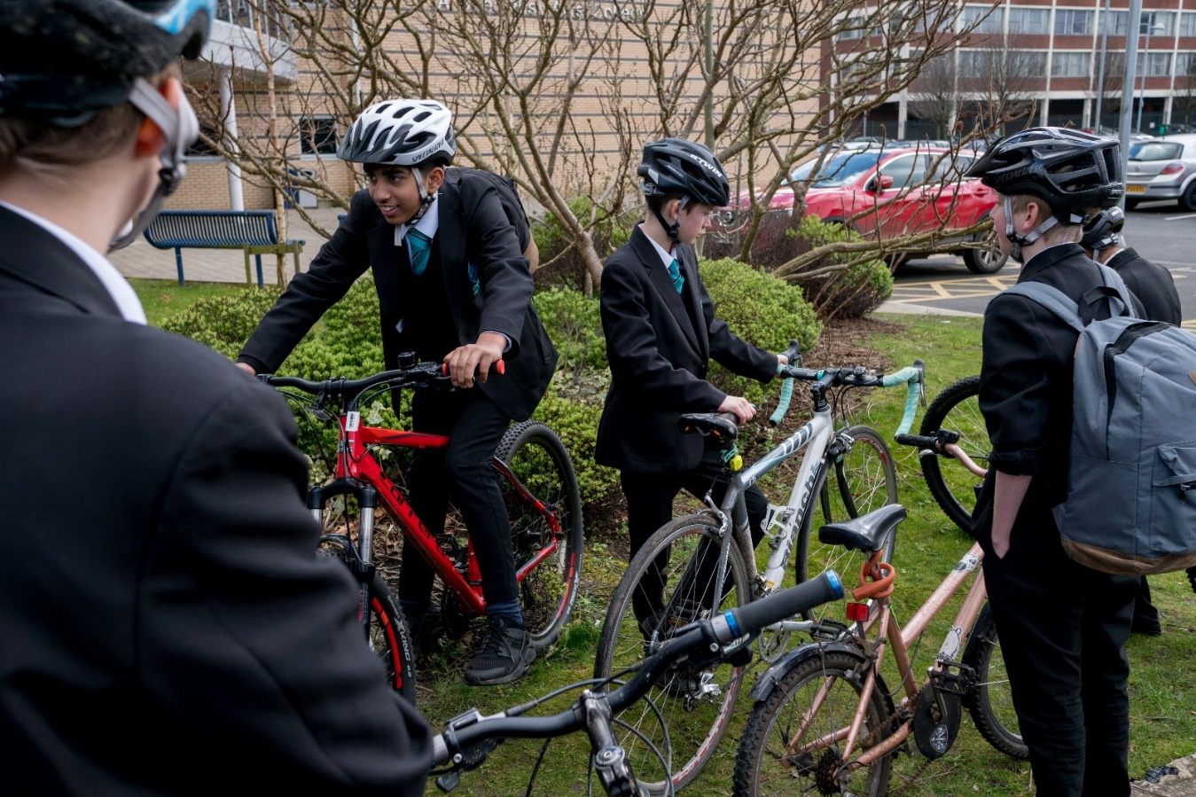
Meet up with friends
©2017, Jonathan Bewley, all rights reserved
Notes:
Encourage pupils to get their friends to take part in Cycle to School Week as well. They can either meet on the way to school or once they arrive.

Slide 15
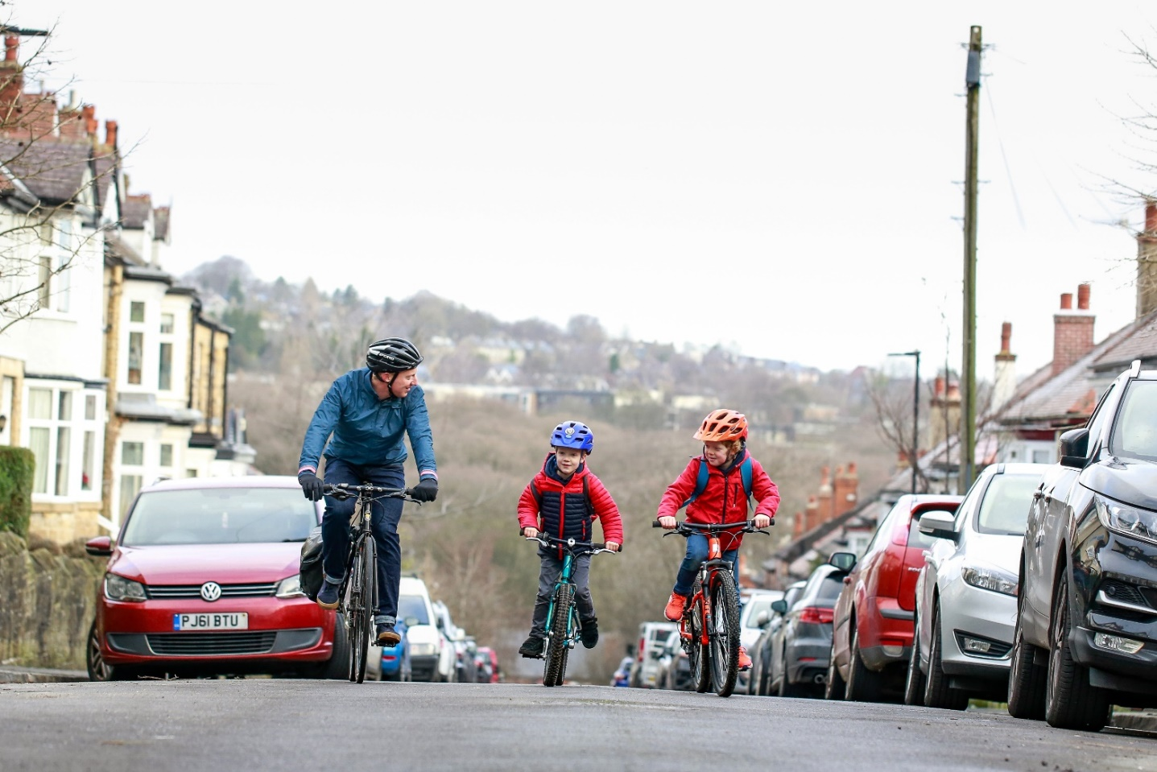
Encourage your family to join
©2020, Chris Foster, all rights reserved
Notes:
Parents and guardians are welcome to join in to. There is a free family guide to cycling or scooting which can be found here: https://www.sustrans.org.uk/sign-up-to-receive-your-free-school-run-guide/

Slide 16
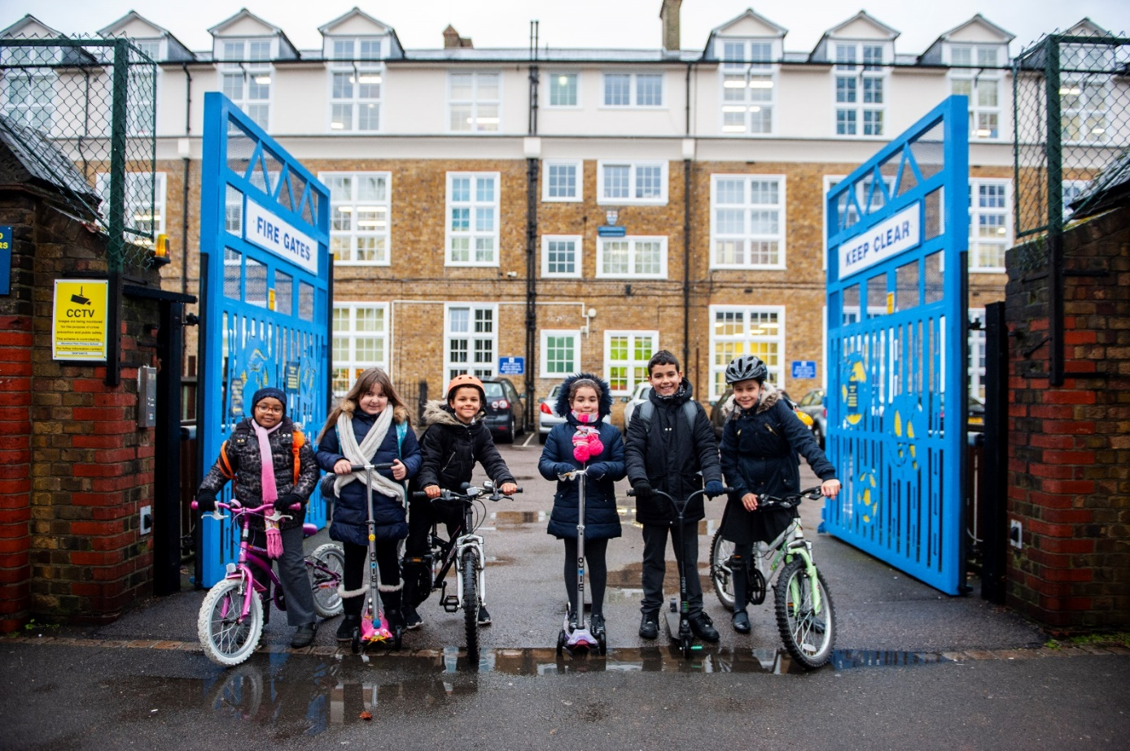
Not sure on something? Ask a teacher
©2019, Paul Tanner, all rights reserved
Notes:
Use the Inclusivity Guide to help children and families with barriers to cycling or scooting to school

Slide 17
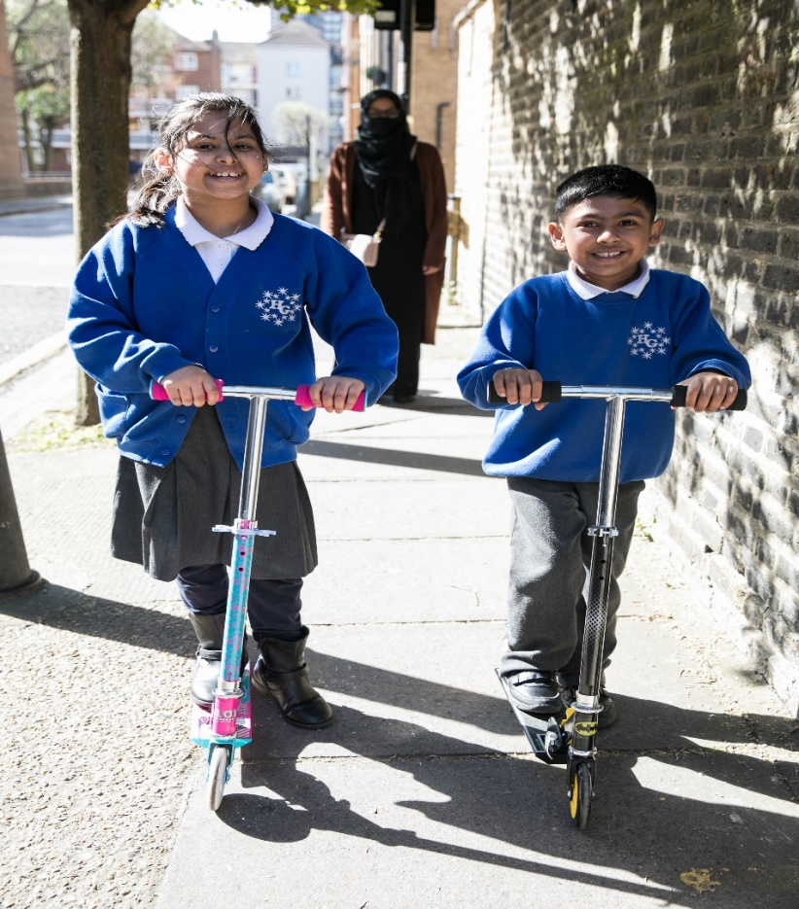
Enjoy the ride and good luck!
©2021, Kois Miah, all rights reserved

Slide 18


