Slide 1


In the playground – how we treat each other matters

Slide 2

In the playground
Play suitable games
Be fair
Make sure as many people as possible are playing
Be polite
Be kind & helpful
Be cheerful
Be friendly
Let everyone play
Be patient

Slide 3
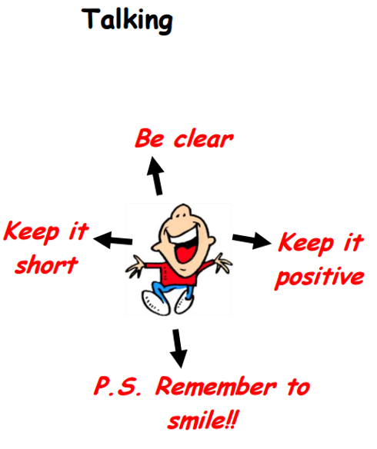
How to communicate

Slide 4
How to organise a game –
STEP!
Space - Where will your game be played?
Task – What game are you going to lead?
Equipment – What equipment will you need for your game?
People - How many people will be able to play?

Slide 5
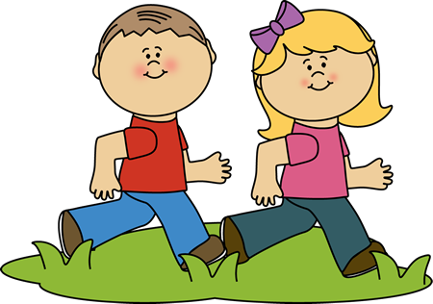
Let everyone play
Is anyone being unkind?
If so – What can you do to change this?
Look at the children playing, is anyone left out?..... How can you help?

Slide 6

TASK: Fair play
What do you need to think about if you want a game to be fair?

Slide 7
TASK: Fair play – THE ANSWERS!
What do you need to think about if you want a game to be fair?
Can everyone play?
Are the sides fair?
Did everyone play
For the same amount of
time?
Did everyone have
a turn?
Are the rules fair?
How were the
teams chosen?

Slide 8


Slide 9
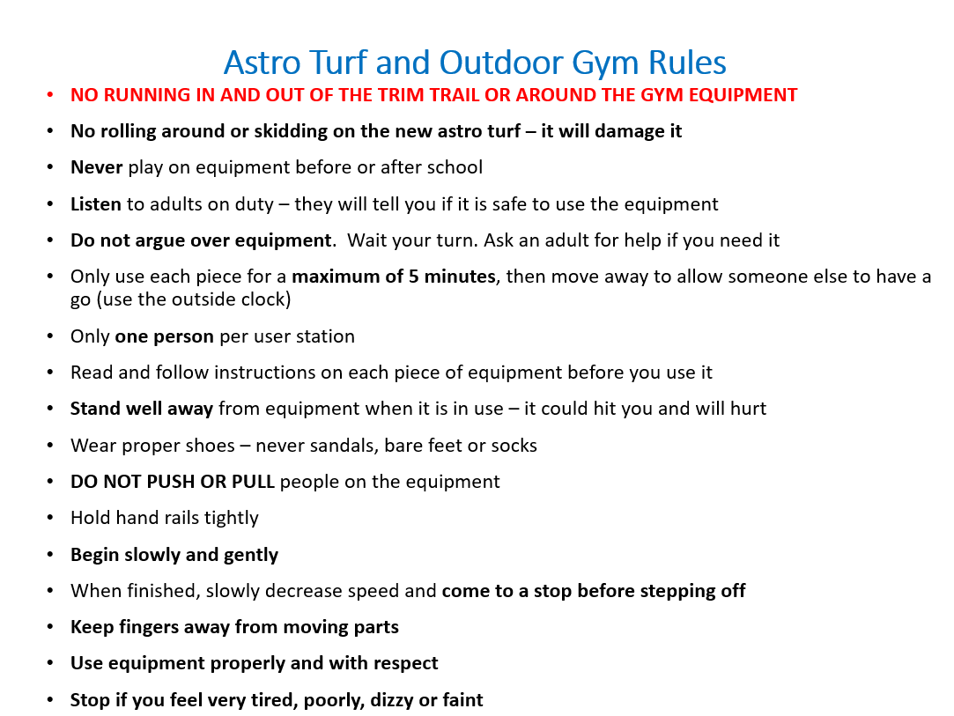

Slide 10
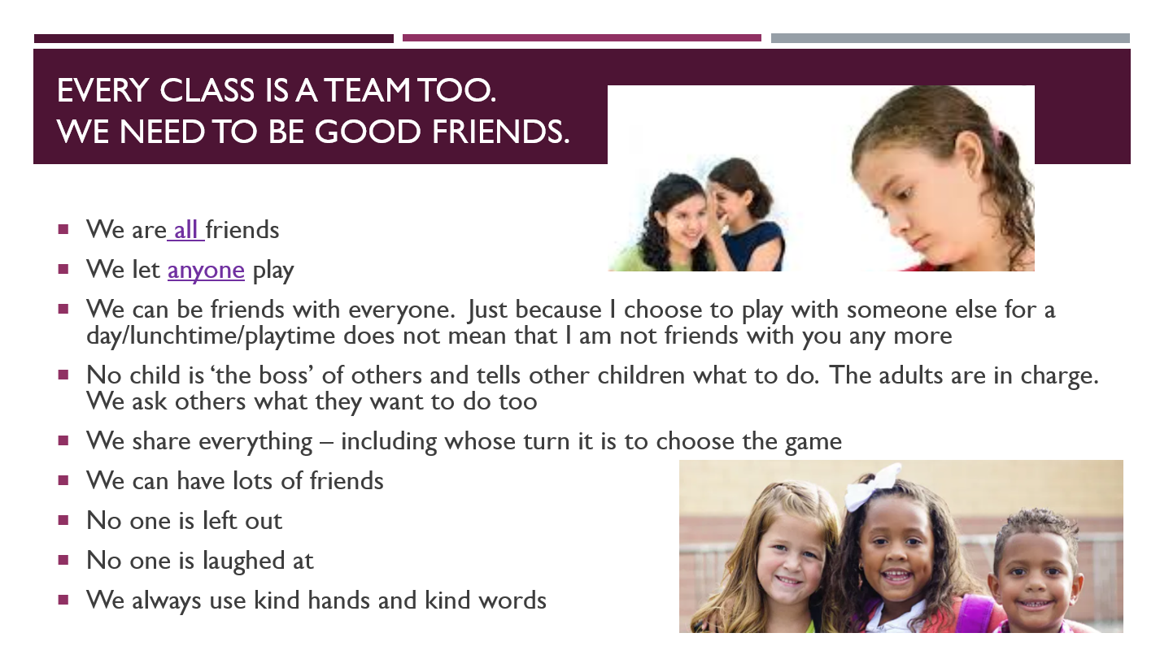

Slide 11
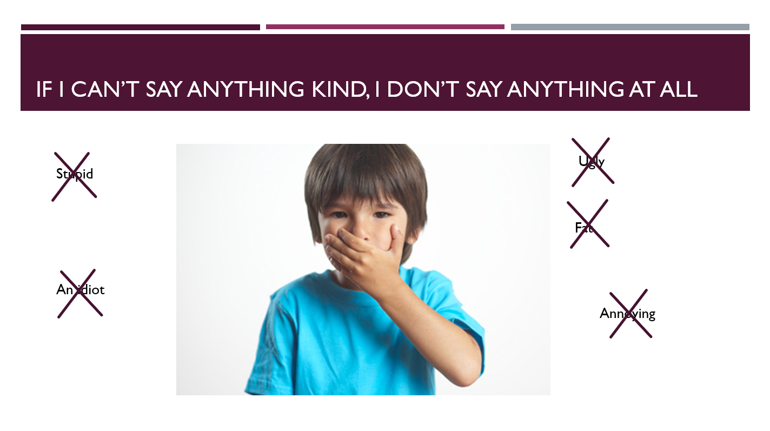

Slide 12
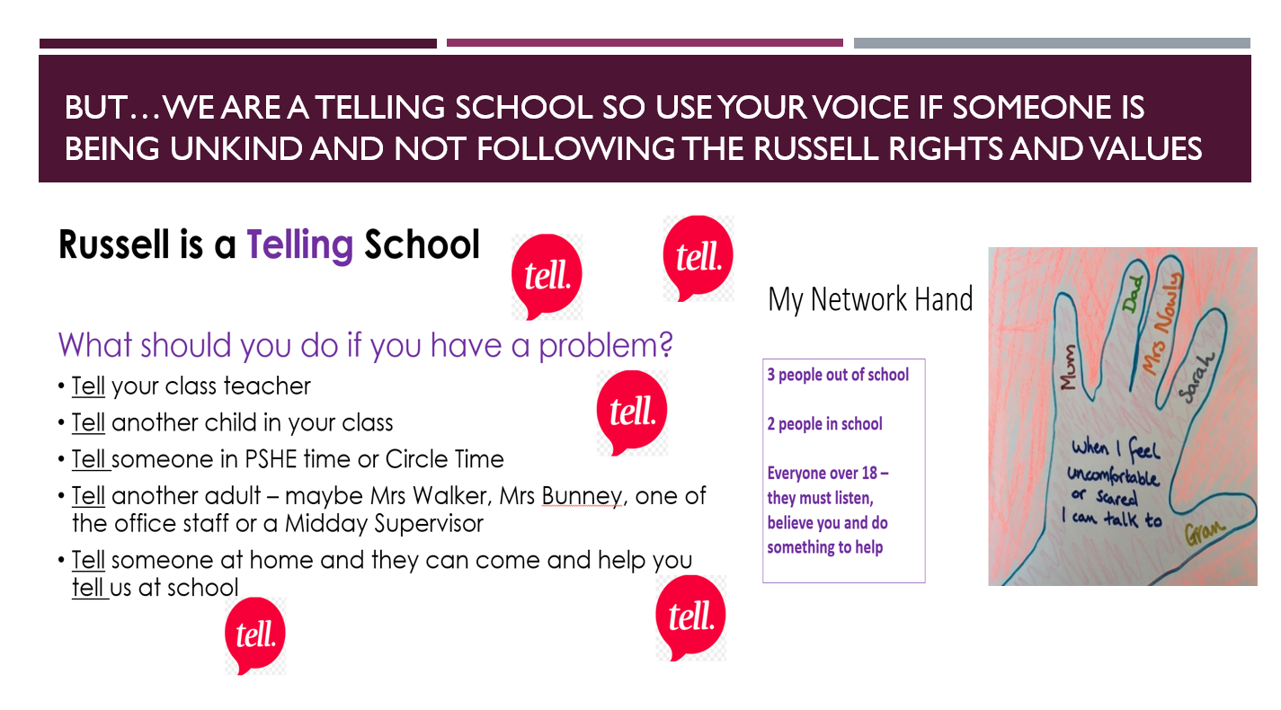
BUT sometimes we need to tell an adult too…

