Slide 1

World Book Day

Slide 2

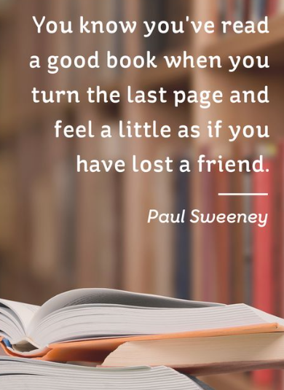

Celebrate reading and love of books

Slide 3
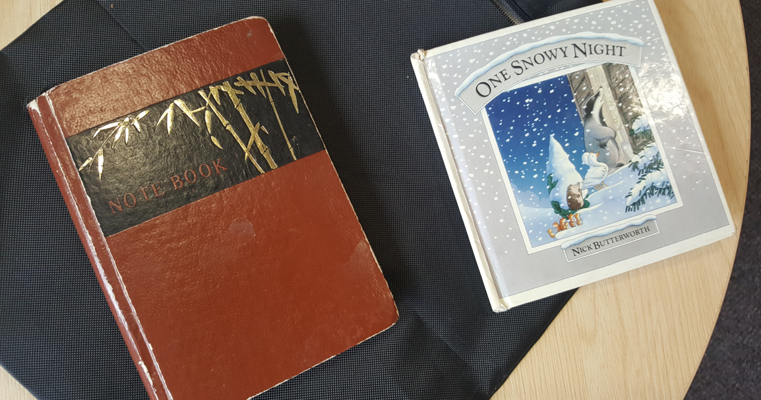
Favourite books

Slide 4
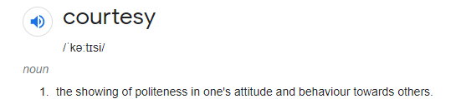
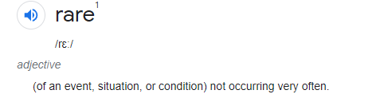
Poems and Rhymes
It’s nice to meet nice people.
On buses and on trains,
In restaurants, in queues or shops,
For courtesy remains,
The hallmark of the civilised,
The people who will say, ‘Thank you’, ‘Please’ and ‘Sorry’,
And they are all too rare today.
It warms and lifts your heart when someone smiles at you, or lends a helping hand,
It’s such a simple thing to do.
People who are pleasant and polite, though under strain,
Raise life from a lower level, to a higher plane.

Slide 5
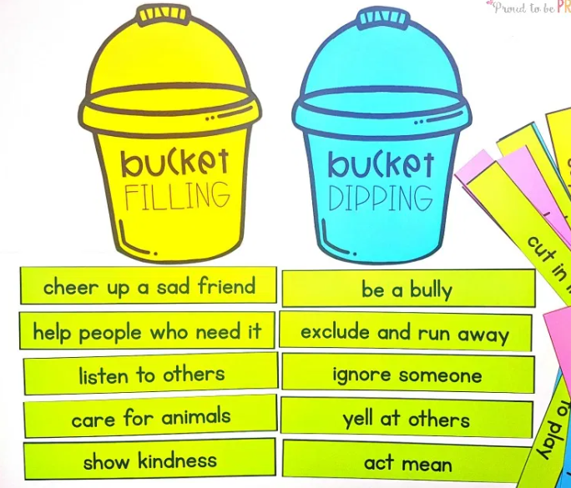


Poems, rhymes and stories so often have meaning…
The importance of manners and how they make everyone feel better – olden days ‘bucket fillers’!

