Slide 1

The Crow and the Pitcher – a story of resilience

Slide 2
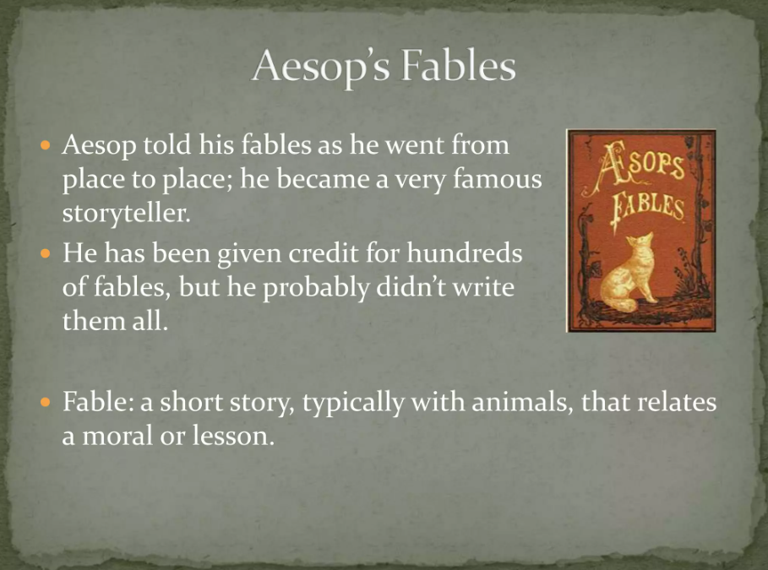
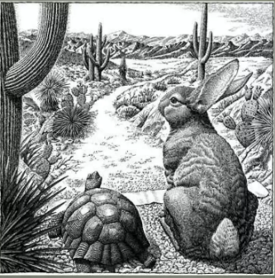
Aesop’s Fables

Slide 3
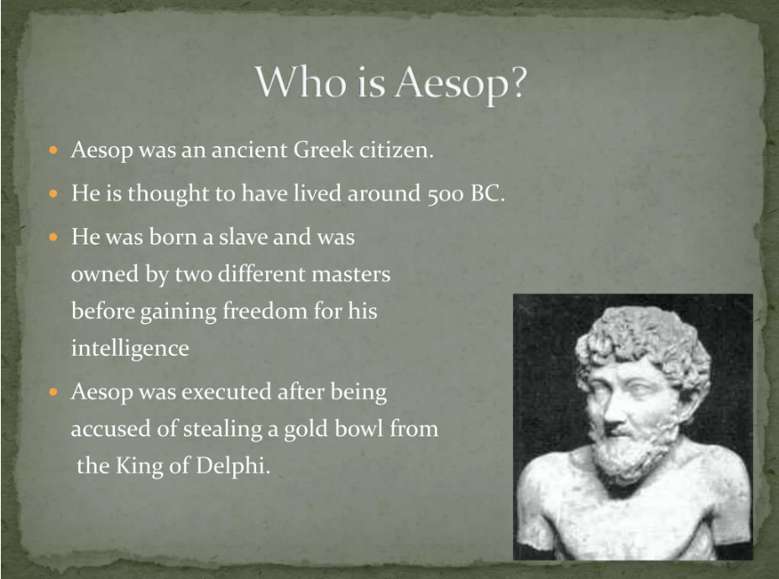

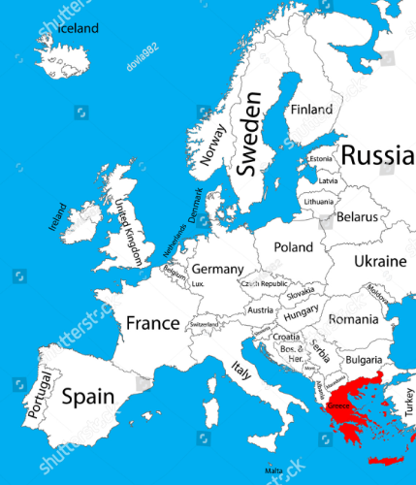

Slide 4
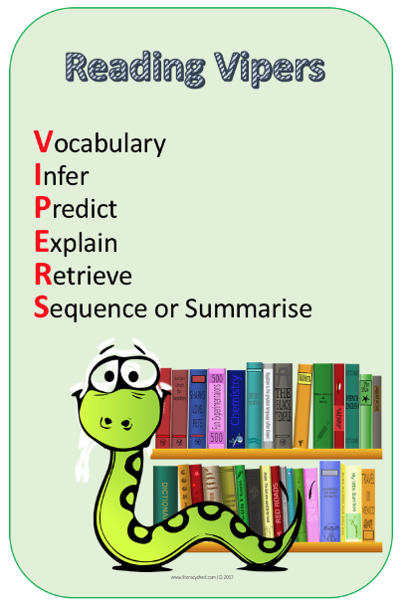
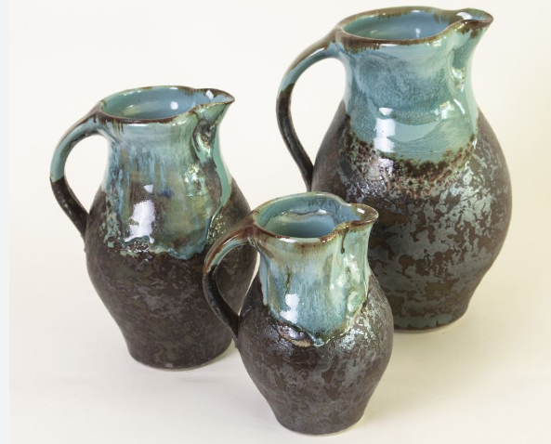
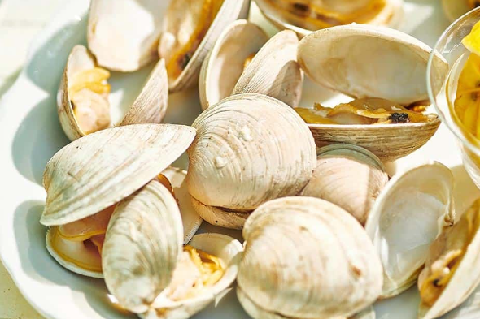
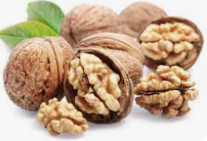
Vocabulary
Pitcher
Black
Clever
Problem
Clam
Walnut
Think
resilience

Slide 5
Listen to the story…you can close your eyes if it helps you focus
https://www.bbc.co.uk/teach/school-radio/english-ks1--ks2-aesops-fables-the-crow-and-the-pitcher/zkxmwty

Slide 6
You can fix a problem if you think about it…
Crack a clam?
Crack a walnut?
Reach water at the bottom of a pitcher?

Slide 7

Resilience – can you think what crow would do or say?
Resilient/Resilience - Being able to cope with challenges that life brings and keep calm
I have forgotten my water bottle…
My friend won’t play with me…
I’ve got to leave my mum and dad and go to school…
My work is tricky today…

Slide 8
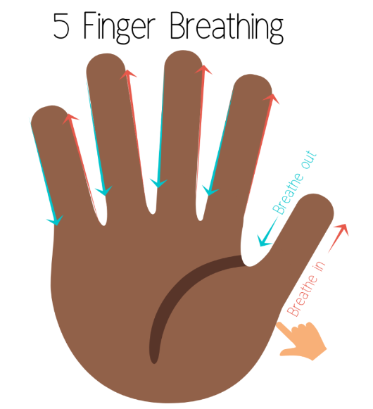
Can you be a Clever Crow next time you face a challenge?
Recognise a challenge
Keep calm
Think…what could I do?
Think…what else could I do?
Think…could anyone or anything help me?
Be patient and calm; it might take a while. That’s okay!
Remember – every problem can be solved if you think about it.

