Slide 3
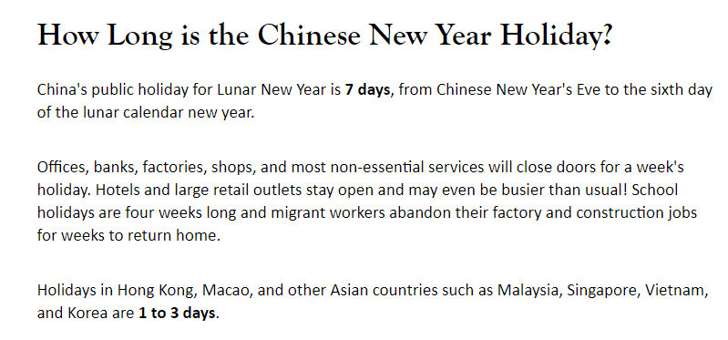

Slide 4
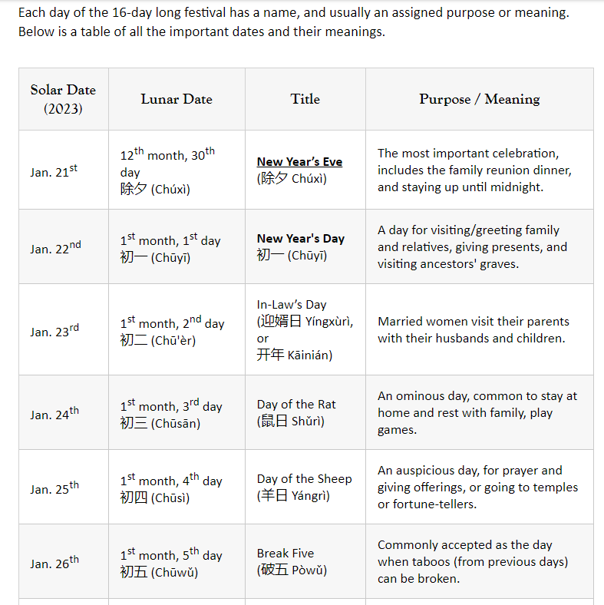

Slide 5
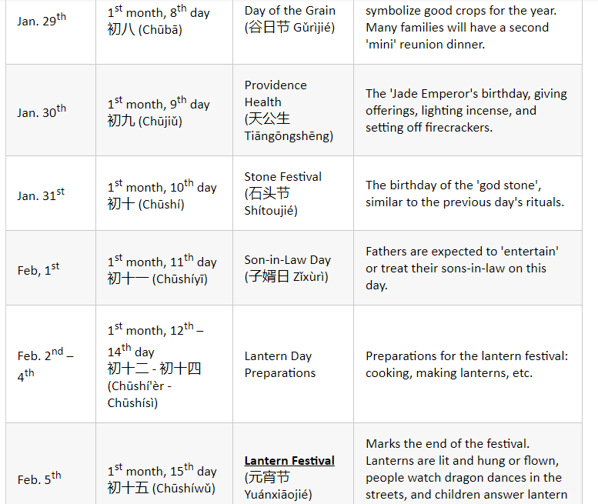

Slide 7
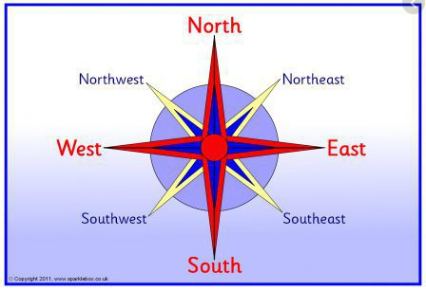
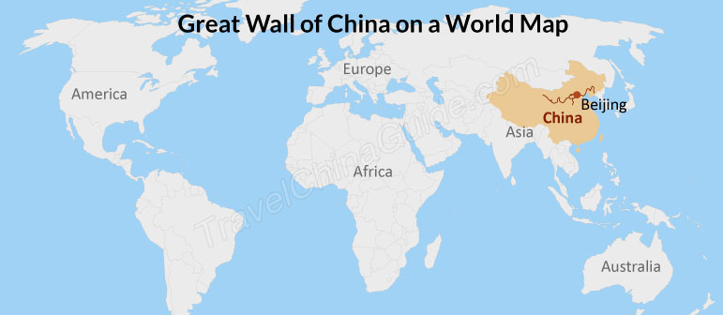
South America
Antarctica
Asia
China
Europe
United Kingdom
Great Britain
England
South America
Brazil
There are seven continents on Earth: Asia, Europe, Africa, North America, South America, Australia and Antarctica. There are five oceans on Earth: The Pacific Ocean, The Atlantic Ocean, The Indian Ocean, The Southern Ocean and the Arctic Ocean

Slide 8
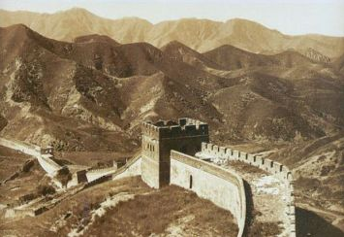
China is the largest country in the world with over 1.3 billion people living there. UK population is about 65 million
China is in the continent of Asia
The capital city is Beijing
China has the largest man-made item in the world – the Great Wall of China. It is over 5 500 miles long and can be seen from space. It was build to keep invaders out from the North, such as the Monguls
It is the 2nd richest country in the world after USA
The tallest mountain in the world is on the border of China – Mt Everest

Slide 9
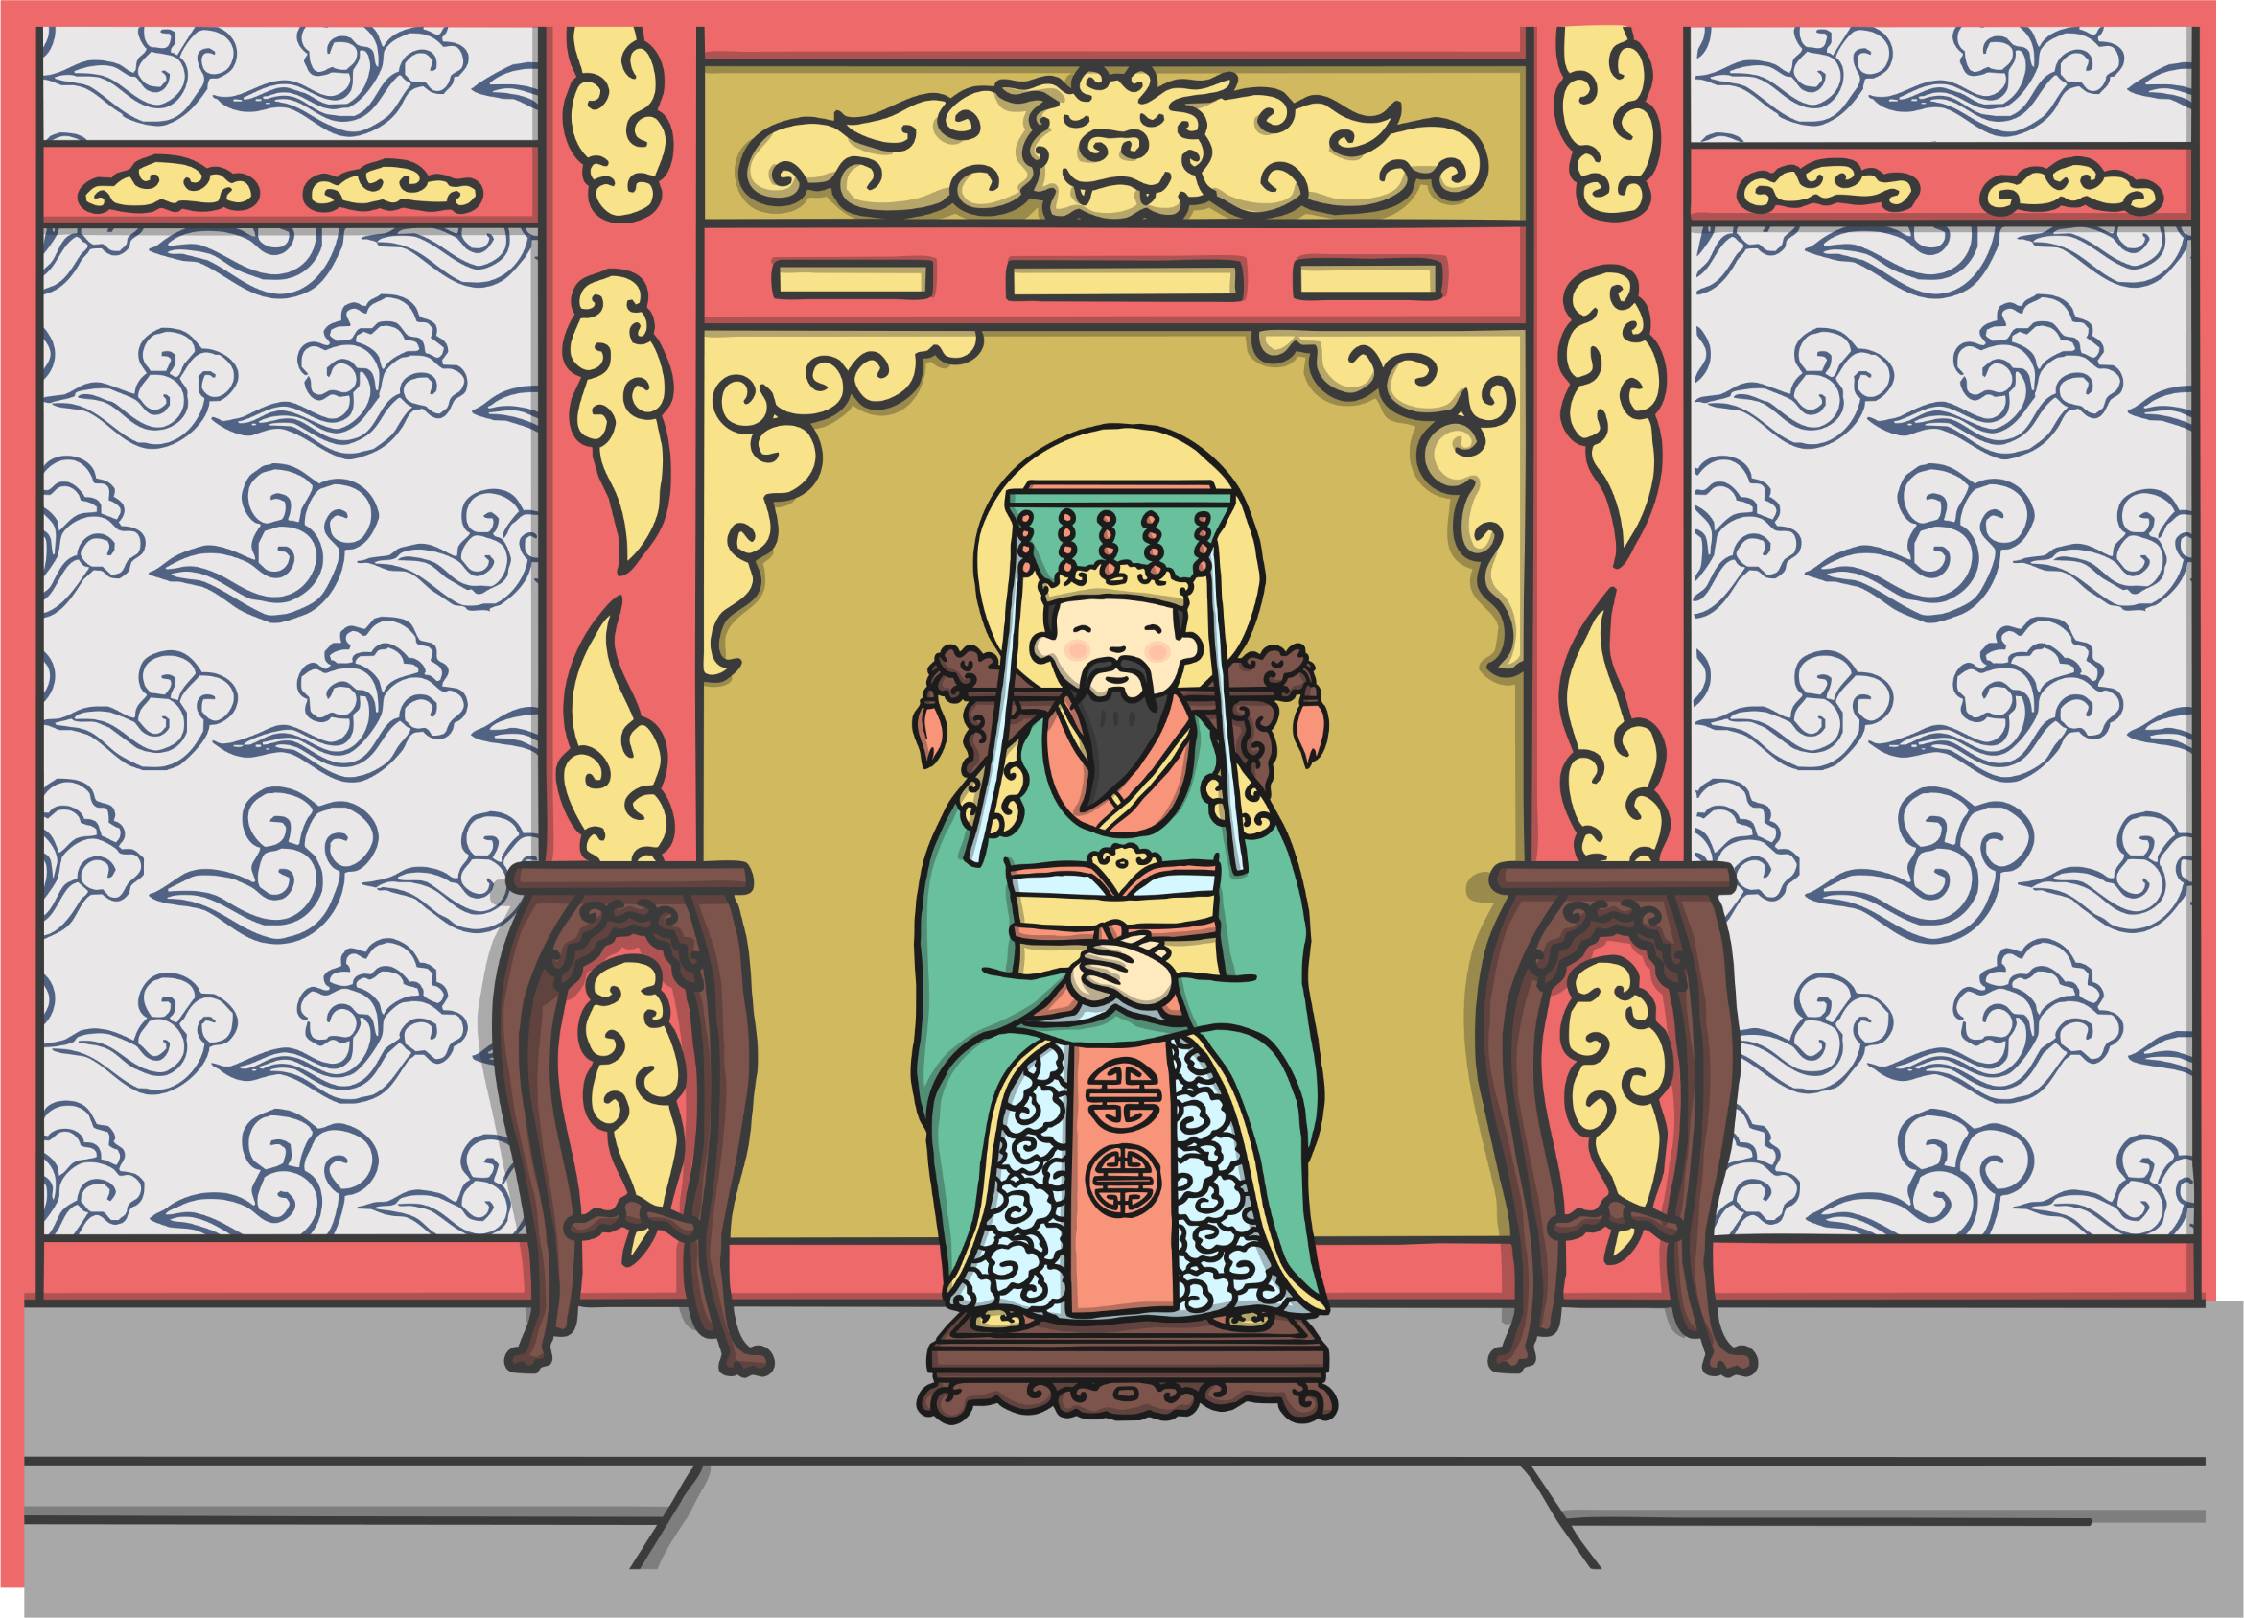
A long time ago, in China, the Jade Emperor decided that there should be a way to measure time. He told the animals they were to compete in a race. The first twelve animals would be rewarded by having a year named after them.

Slide 10
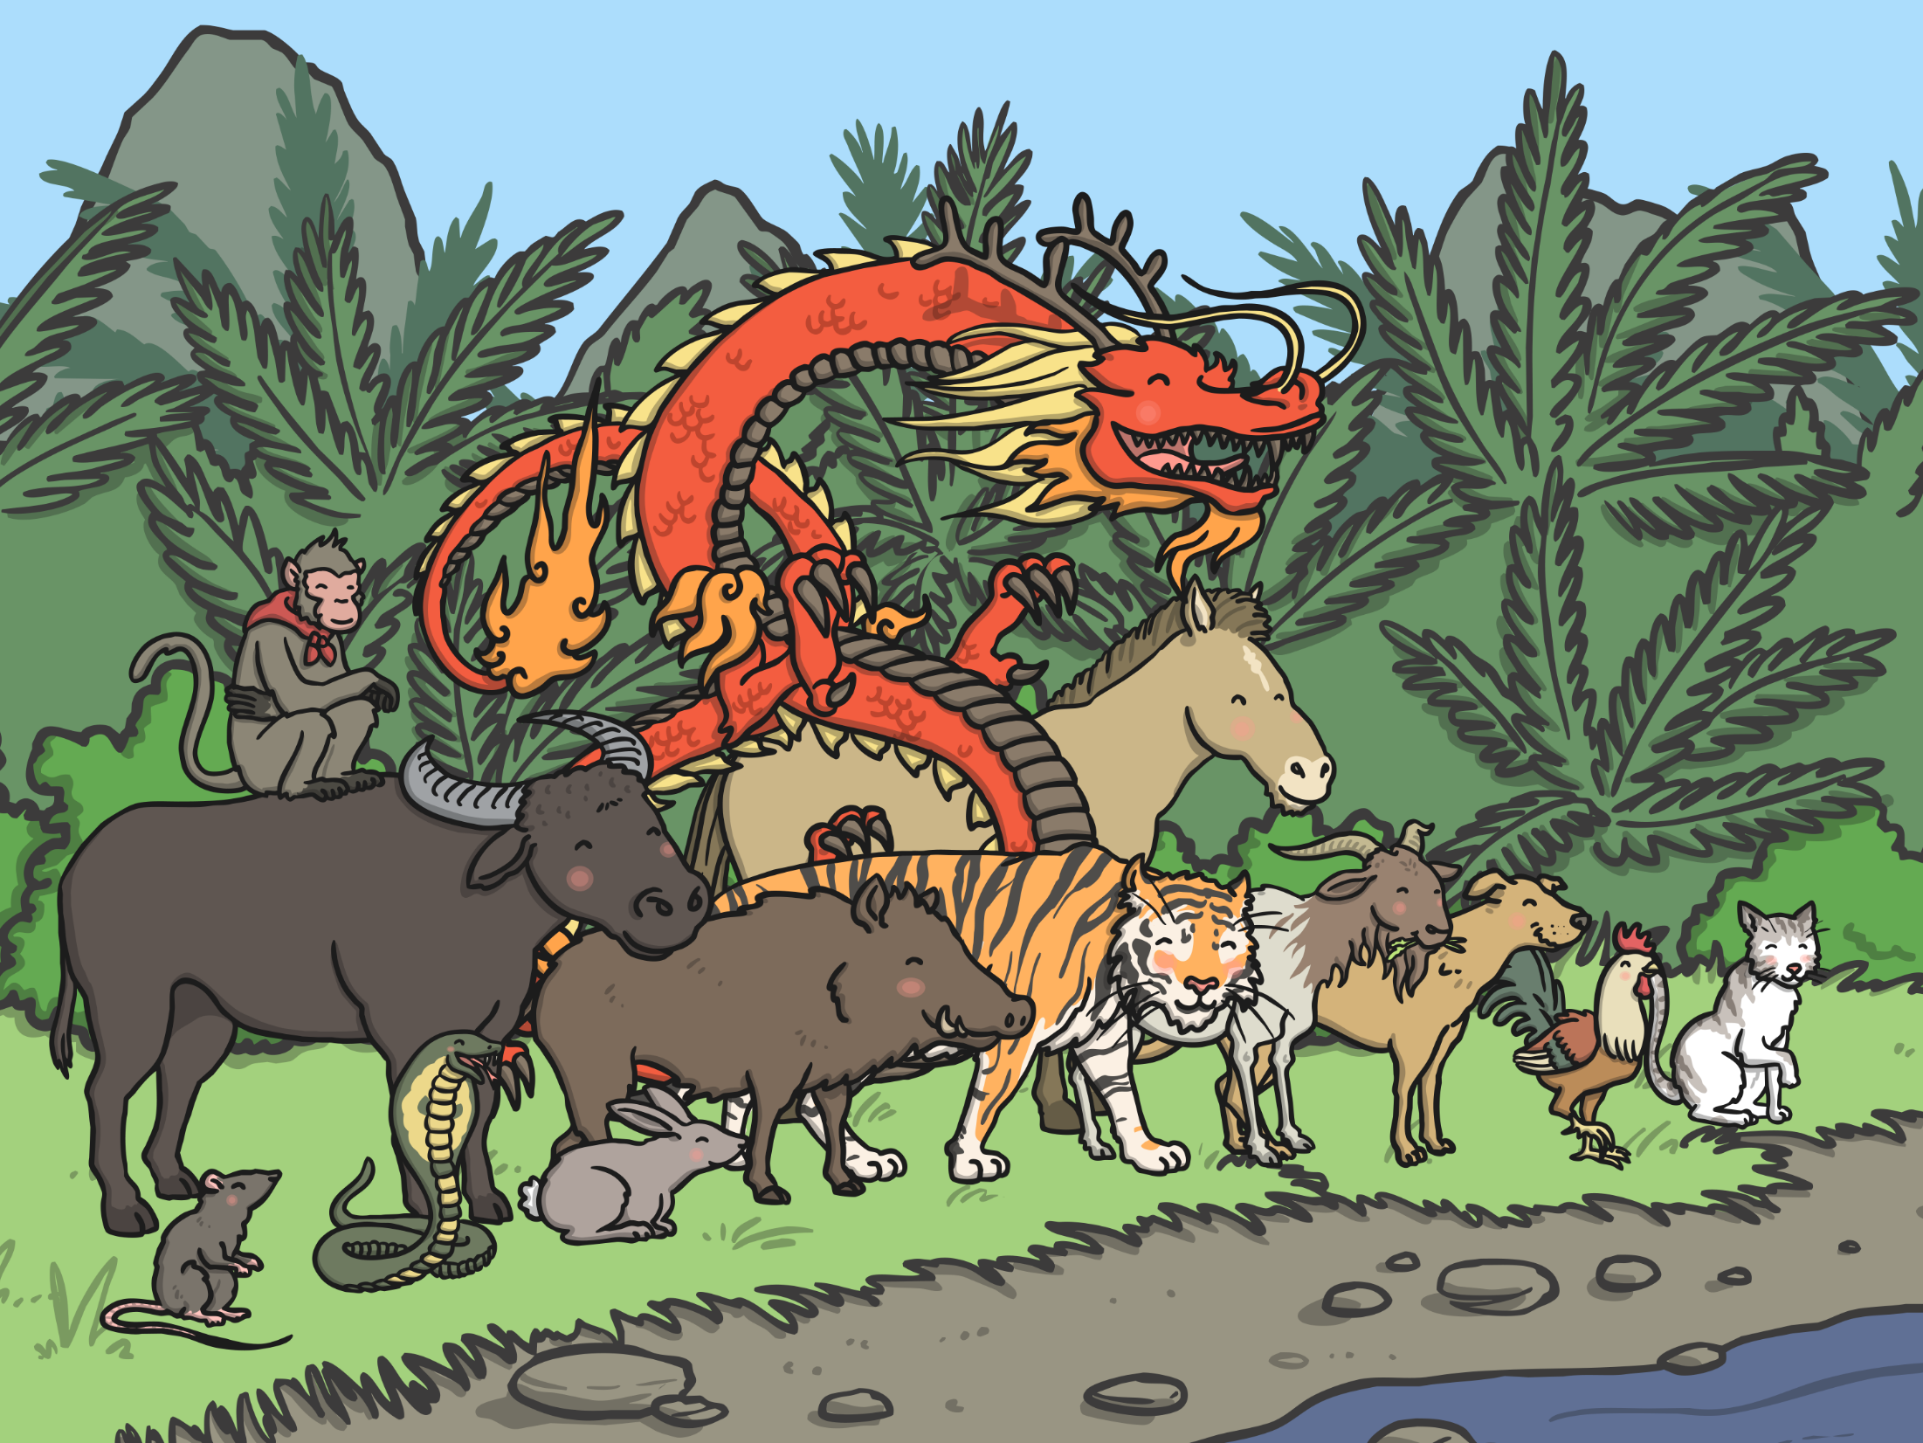
On the day of the race, all the animals lined up beside the river. The rat and the cat, who were good friends, were worried as they were not very good at swimming. They asked the ox if he would carry them across on his back.

Slide 11
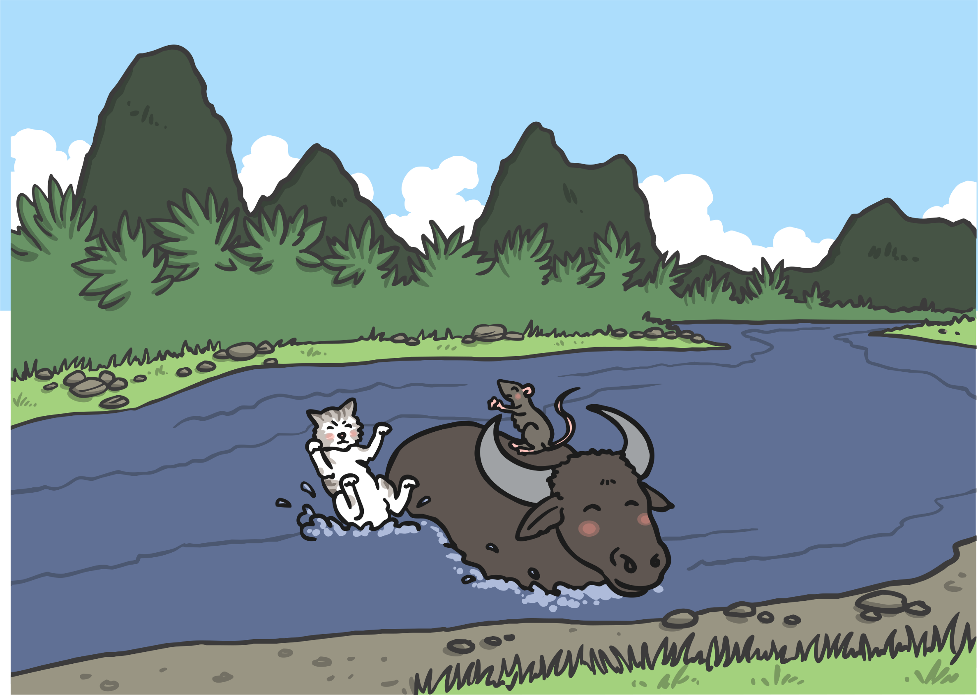
The ox agreed and they jumped on his back. When the race started, the rat and the cat were very pleased that the ox took the lead. They were almost across at the other side when the rat pushed the cat into the water and jumped on the bank to finish first!

Slide 12
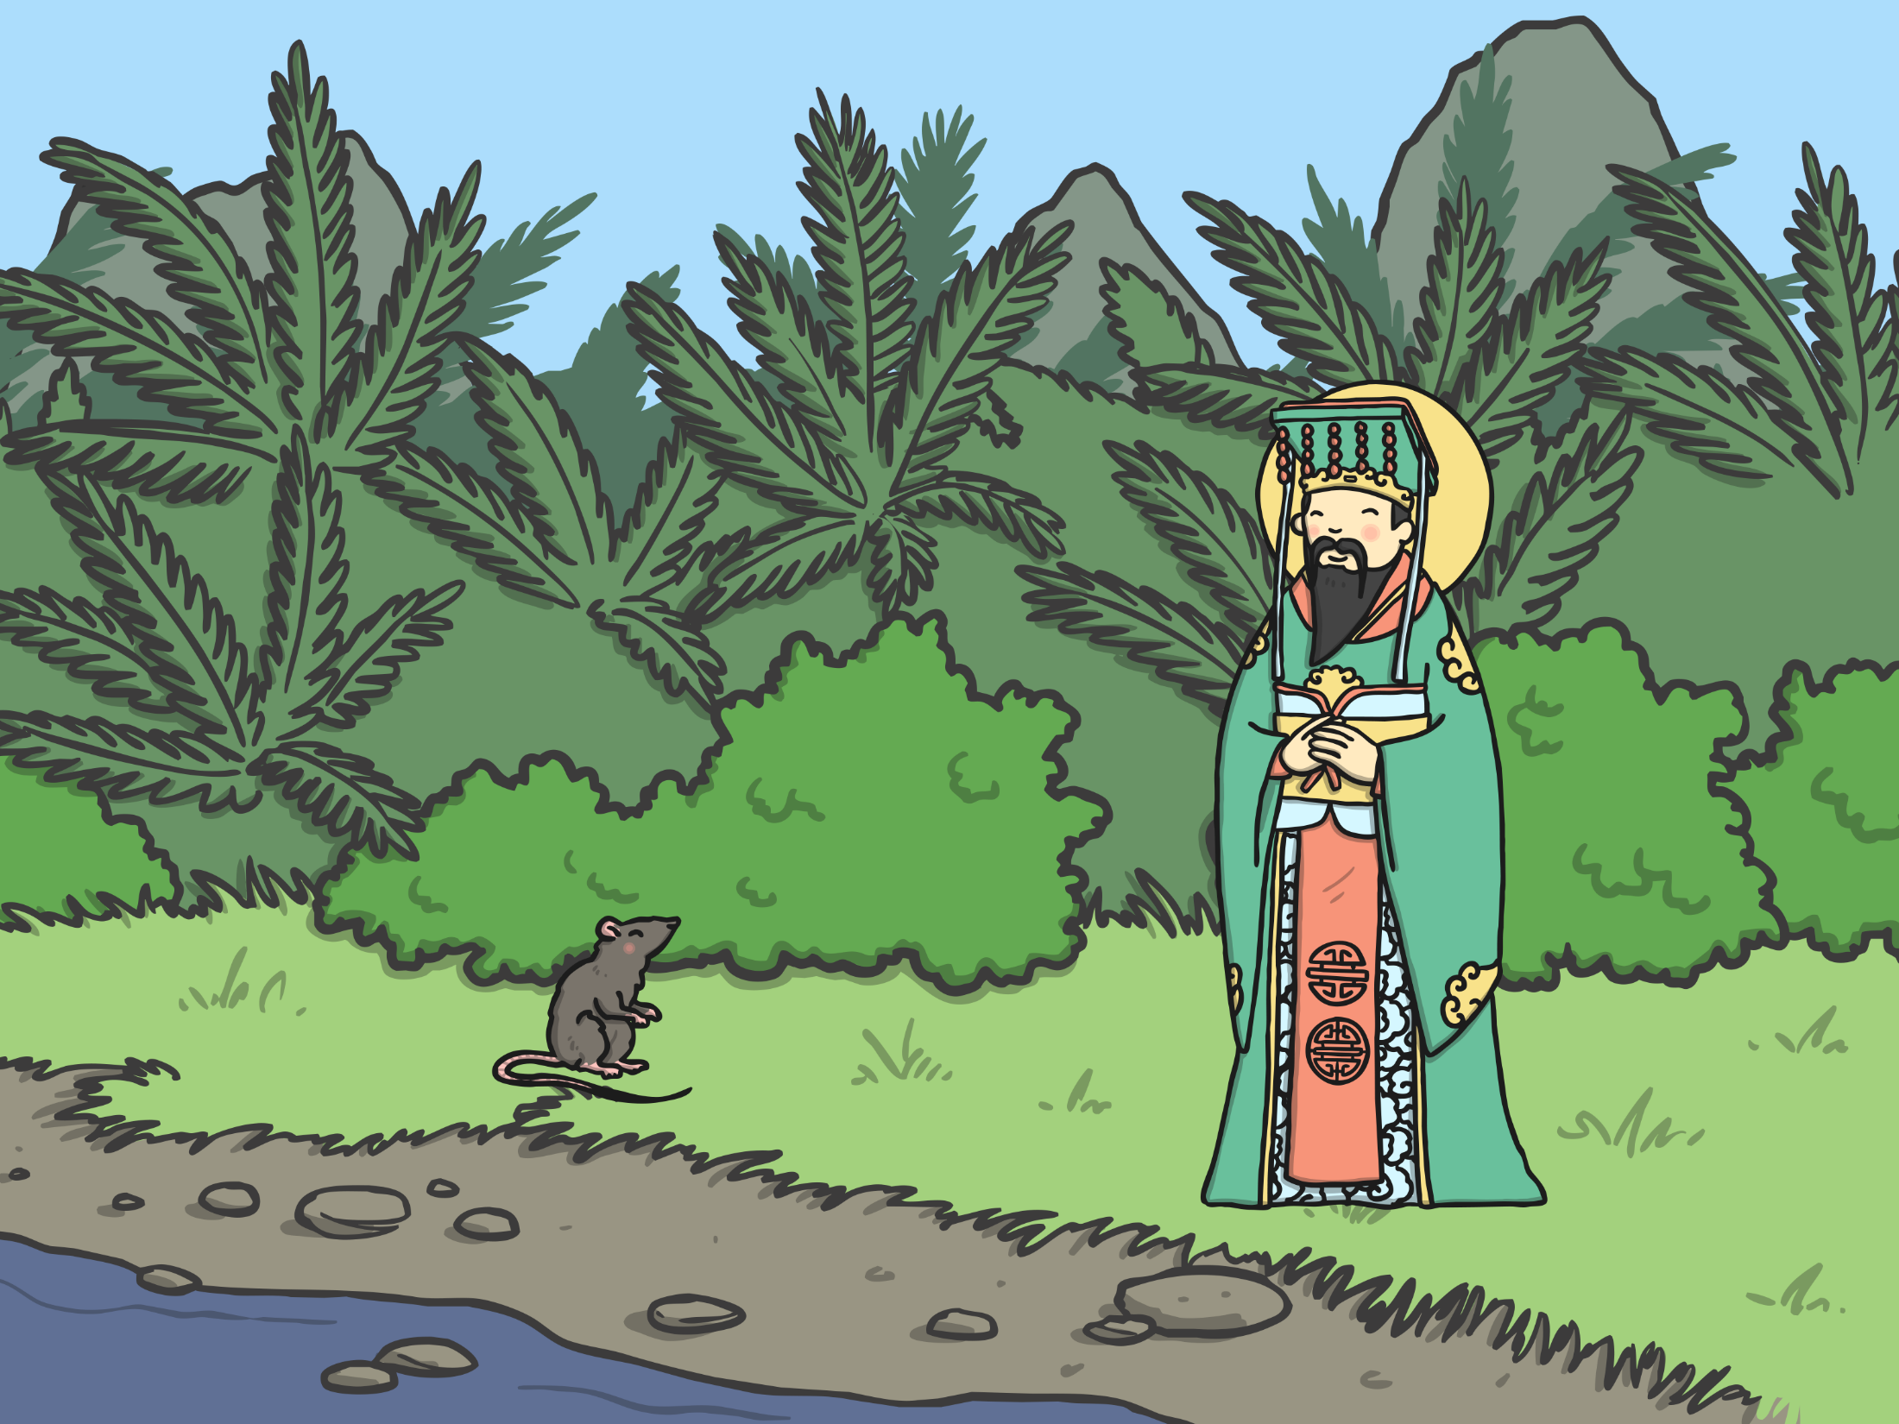
“Well done!” said the Jade Emperor to the rat. “The first year of the Zodiac will be named after you.” The poor ox was tricked into second place and so the second year of the Zodiac was named after him.

Slide 13
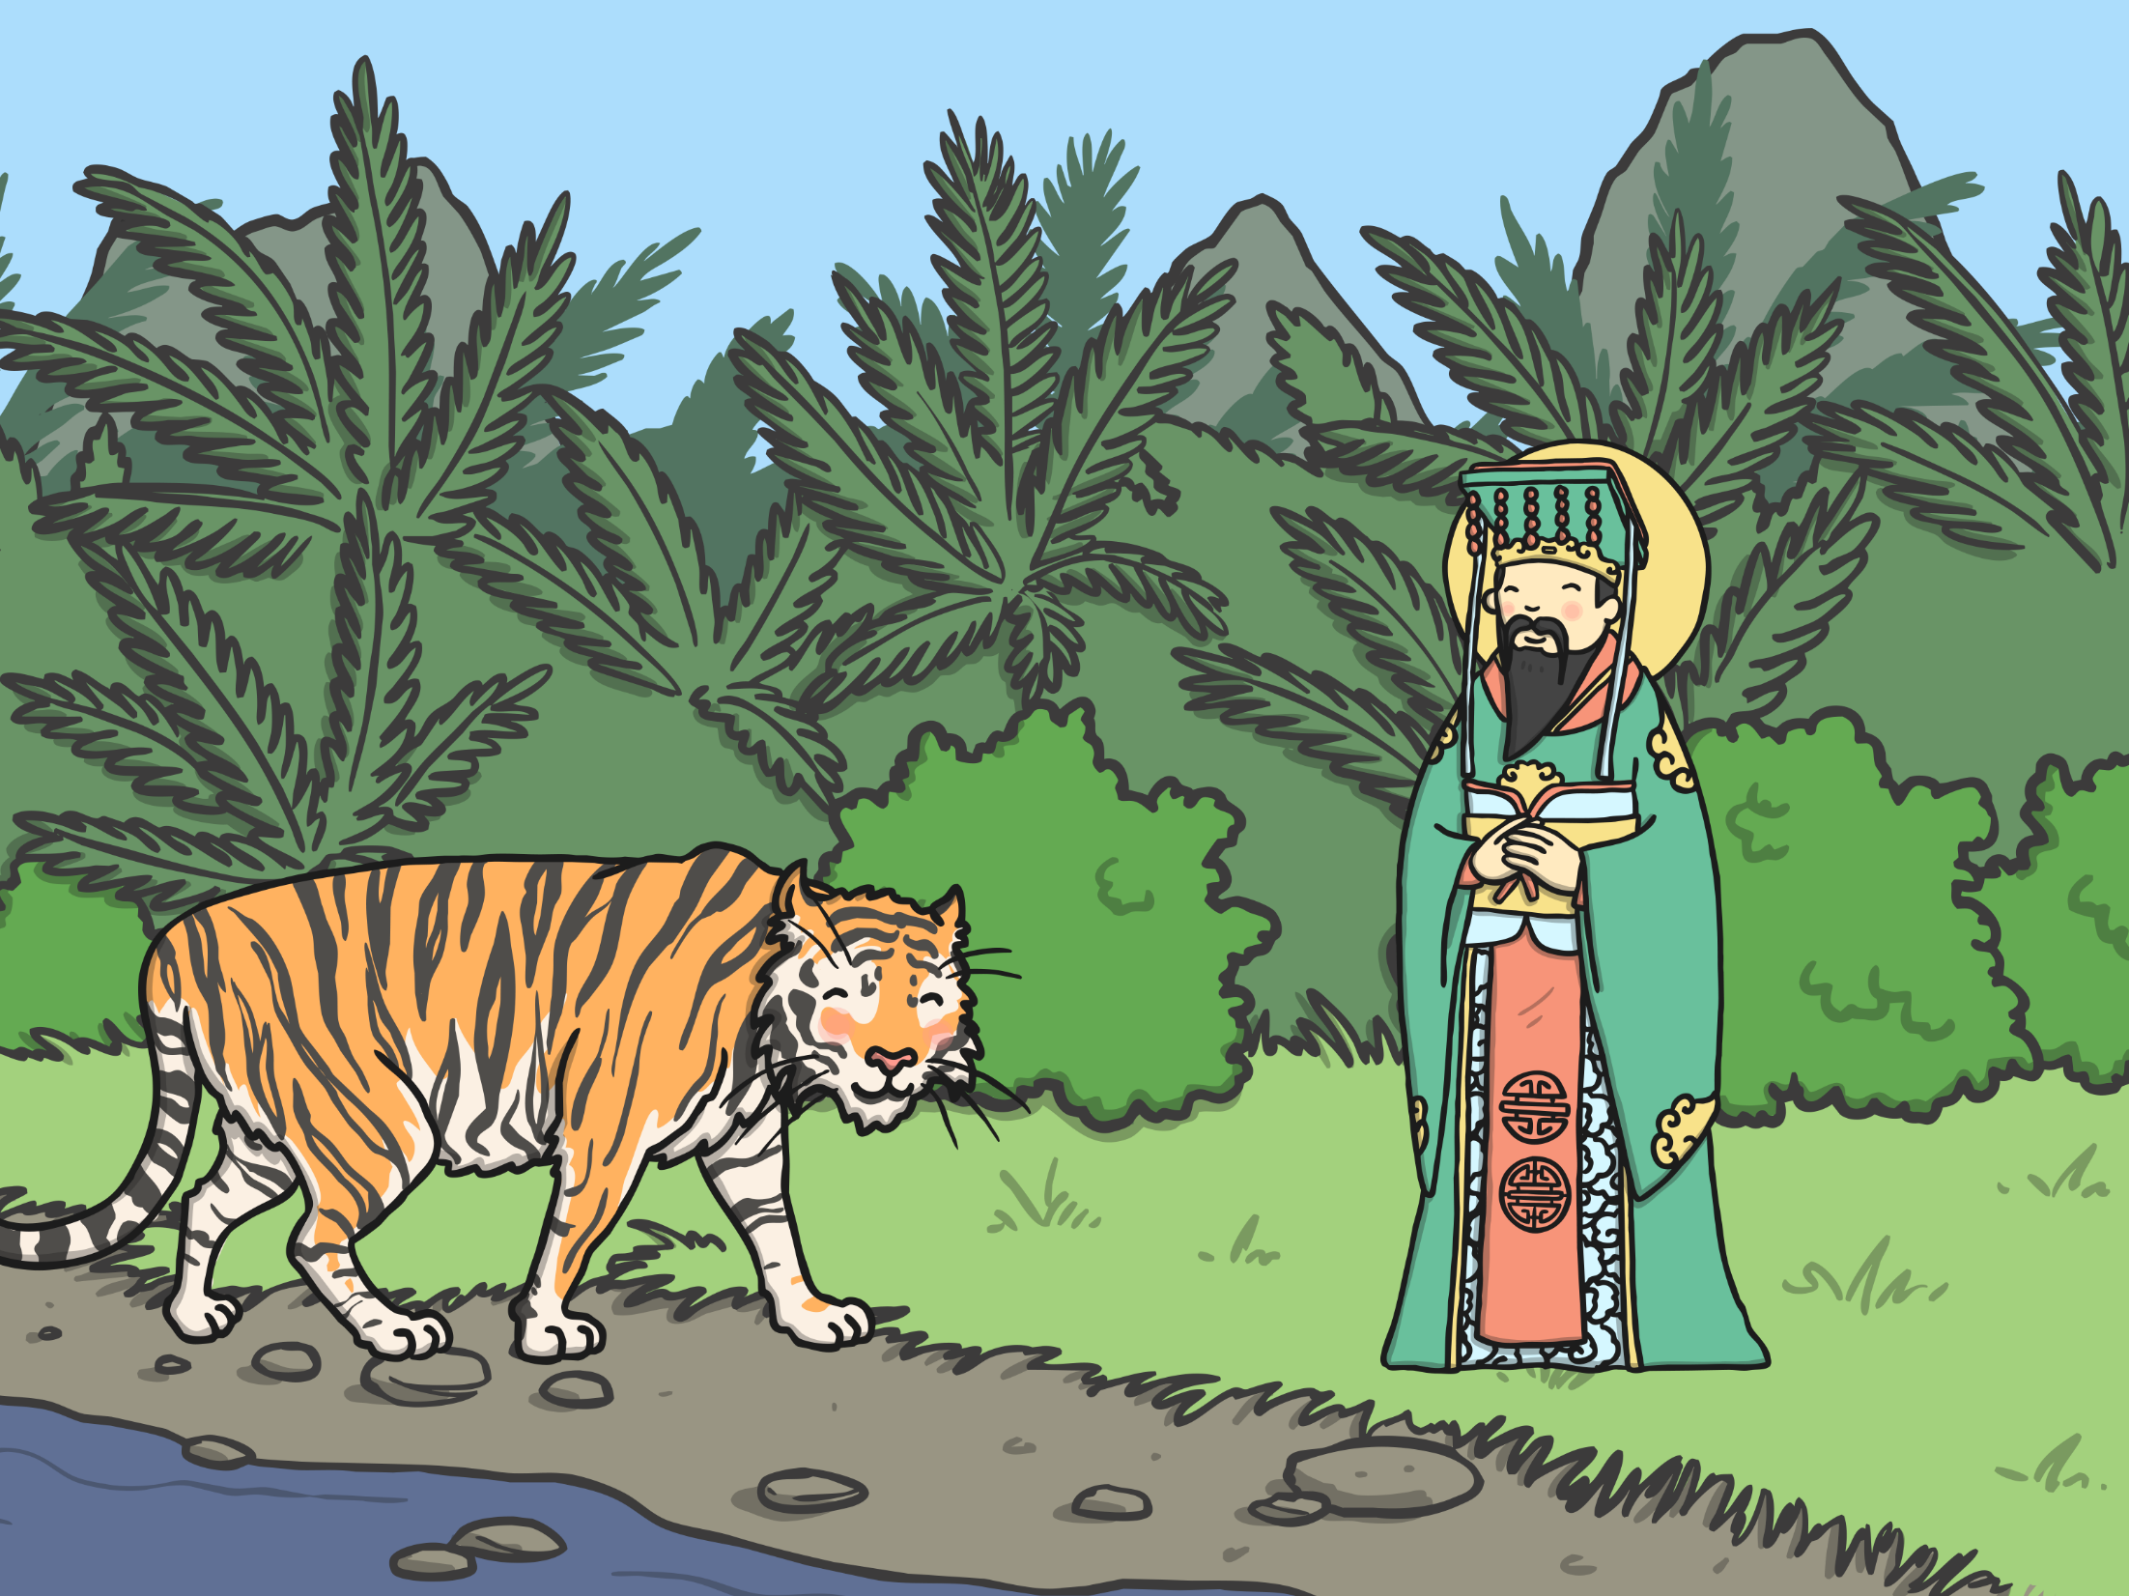
Shortly after, the exhausted tiger arrived on the river bank. Swimming the river had been very difficult, as he had to fight strong currents.

Slide 14
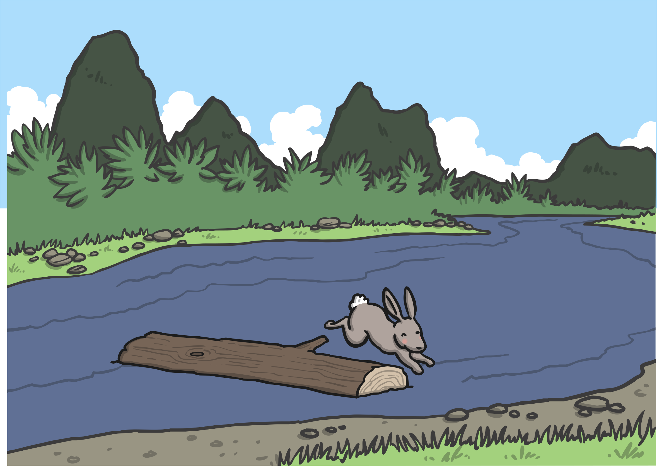
The next to arrive was the rabbit, who hadn’t swum across but hopped across on some stepping stones and then onto a floating log which carried him to the river bank. “I shall call the fourth year after you,” the surprised Jade Emperor said.

Slide 15
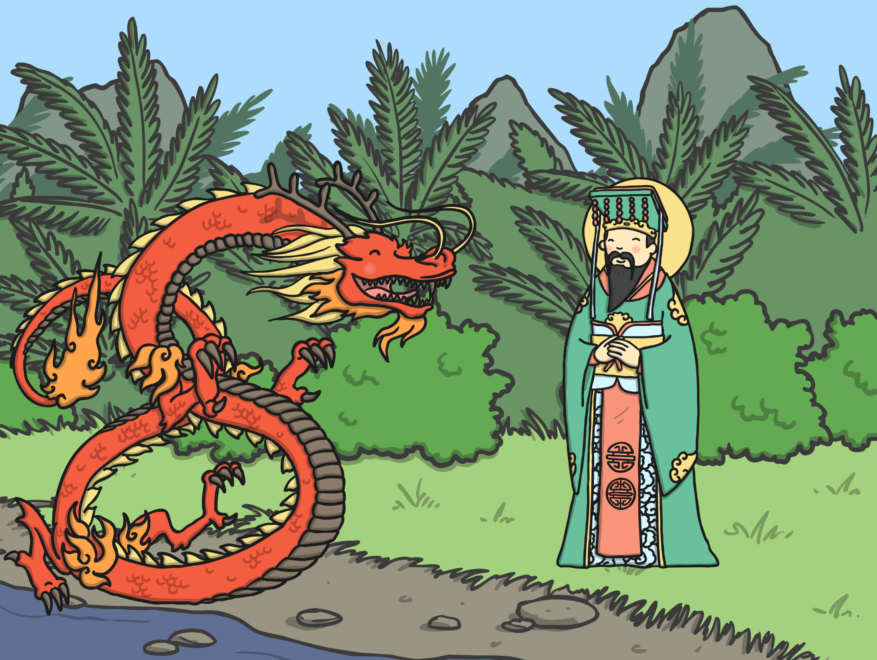
Taking fifth place was the dragon. “How come you didn’t win the race, when you could fly across?” the Emperor asked.
“I stopped to help some animals,” the dragon explained.

Slide 16
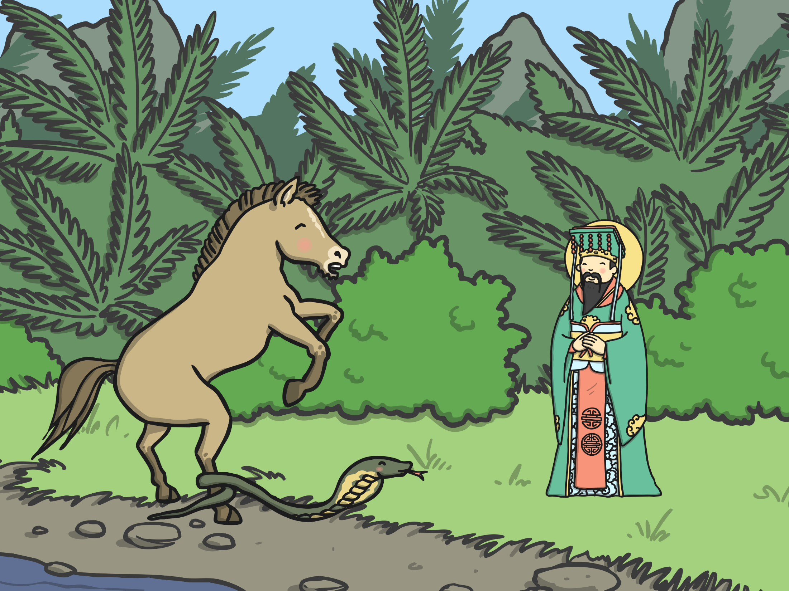
Heading towards the line was the horse. Just as he thought the horse would cross, the sly snake wriggled around one of the horse’s hooves. The horse was so surprised that he jumped backwards, giving the snake a chance to slither forward and take sixth place. The horse made it for seventh place.

Slide 17
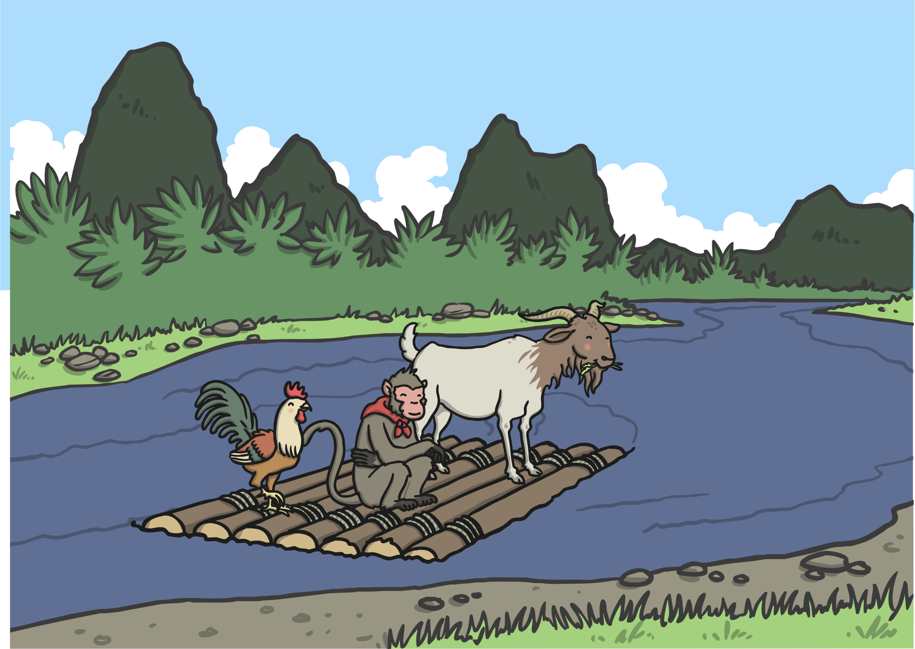
Not long afterwards, a raft arrived carrying the monkey, the rooster and the goat. They explained how they had worked as a team to get across. The
Emperor was very pleased. He said the goat would be the eighth year, the monkey the ninth and the rooster the tenth.

Slide 18
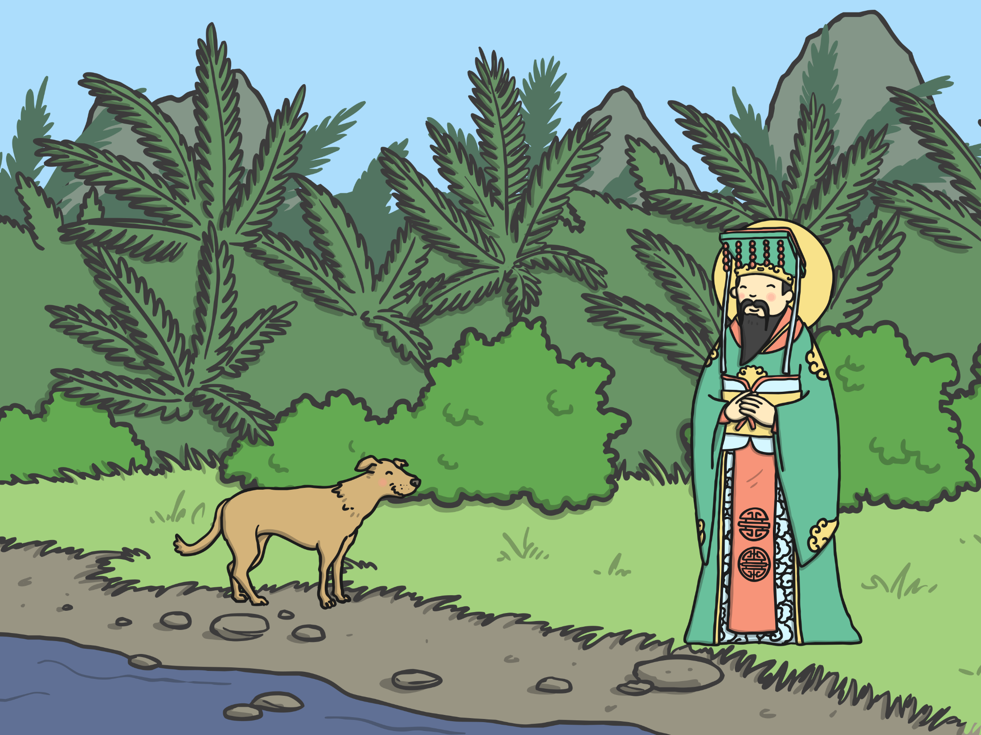
The next animal to arrive was the dog. “What took you so long, when you’re such a good swimmer?” asked the Emperor.
“The river was so clean that I decided to have a bath along the way,” the dog explained. He was rewarded with the eleventh year.

Slide 19
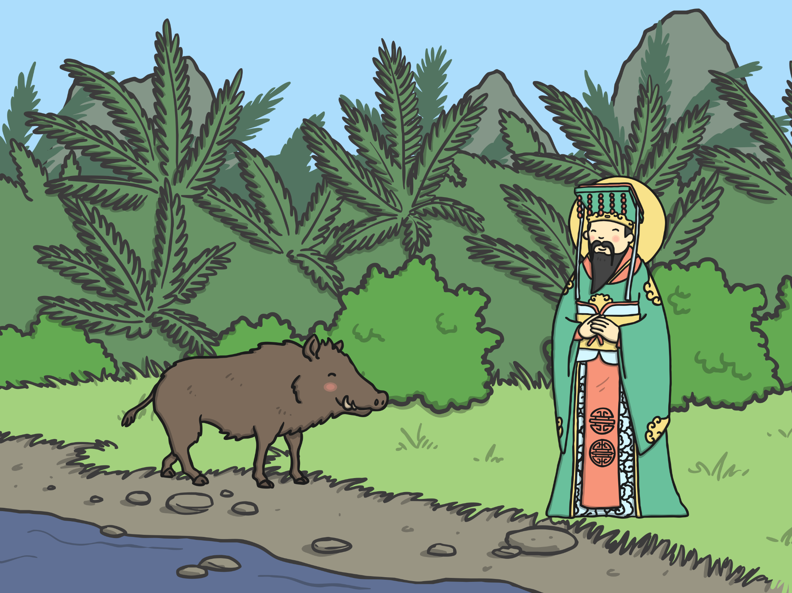
There was one place left in the Zodiac and the Emperor wondered who the last winner would be. All of a sudden, the pig turned up. “You took a long time. What happened?” the Emperor asked.
“I was hungry and stopped to eat, then I fell asleep,” said the pig. The twelfth year was given to the pig.

Slide 20
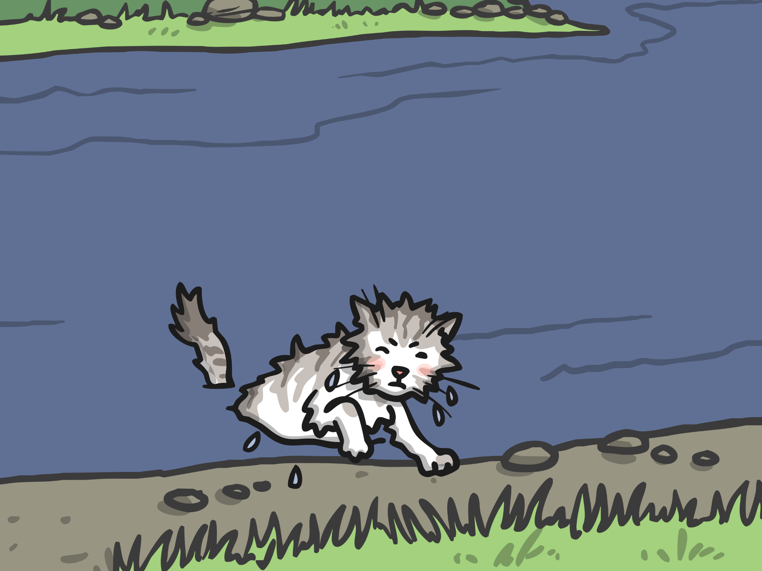
As for the cat, he finally crawled out of the river, but was too late to have a year named after him. He was very angry with the rat for pushing him in and, since then, cats have never been friends with rats!

Slide 21
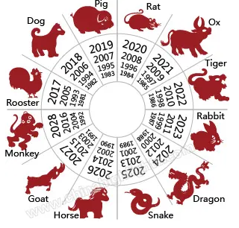
From that day to this, the Chinese Zodiac has followed this cycle of years, named after the twelve animals.

Slide 22
It is not all about winning
The dog enjoyed the clean river and a swim
The monkey, the goat and the rooster worked as a team
The dragon could have won it by flying across, but he stopped to help others instead
The Ox had been helpful
In fact now the Chinese New Years are a circle/cycle – with no beginning or end. No winner or loser

