Slide 1

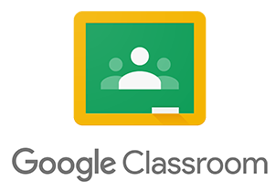

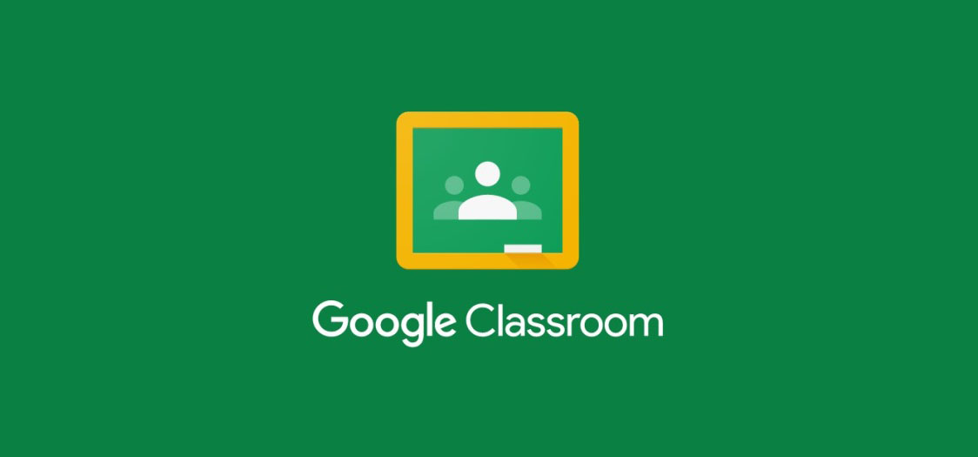
Google Classroom
A Guide for Pupils & Parents
Russell lower school 2020-2021

Slide 2
What is Google Classroom?
Google Classroom is a web service developed by Google for schools that aims to simplify creating, distributing, and grading assignments.
The primary purpose of Google Classroom is to streamline the process of sharing files between teachers and students (Wikipedia).
Russell Lower has joined Google Classroom, as it is known to be an efficient learning platform that will enable children to receive, complete and hand in items of work.
Teachers will be able to set work, conduct live lessons, supply resources, create templates, mark and return children’s work within one smooth, streamlined platform.

Slide 3
What is Google Classroom?
Google Classroom can be useful for setting classwork and homework.
It is widely used in other local school.
So will prepare the children well for that transitions
It will be used if bubbles are required to self isolate or there is a wider lockdown during the coronavirus pandemic.
While it is hoped that we will not need to revert to remote learning, this guide provides full information on using Google Classroom in case anybody does require it.

Slide 4
Which sign in details are used?
Every child at Russell Lower now has their own Google account.
Children will need to use their school email address to sign in. This will be given to them and written in their reading record.
This email address ends with @russell-lower.co.uk
Every child also has a unique password which will be written in their reading record
Children will have a Computing lesson introducing them to Google Classroom, including their sign in details.
Children will only every need to access their own classroom.

Slide 5
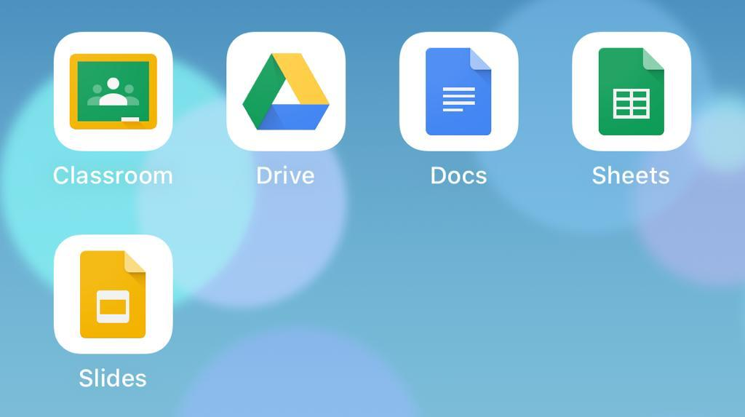
Mobile devices – apps to download
If you are using a mobile device, you may need to download the Google Classroom app.
In order to edit any Google documents on your mobile device, you may also like to install Google Docs, Slides and Sheets.
Google Drive may be useful too. All of which are free and available on iOs and android.

Slide 6
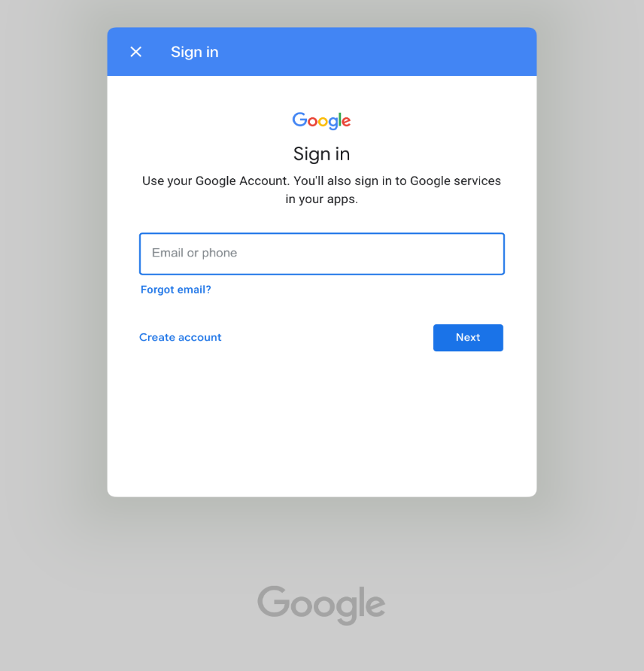
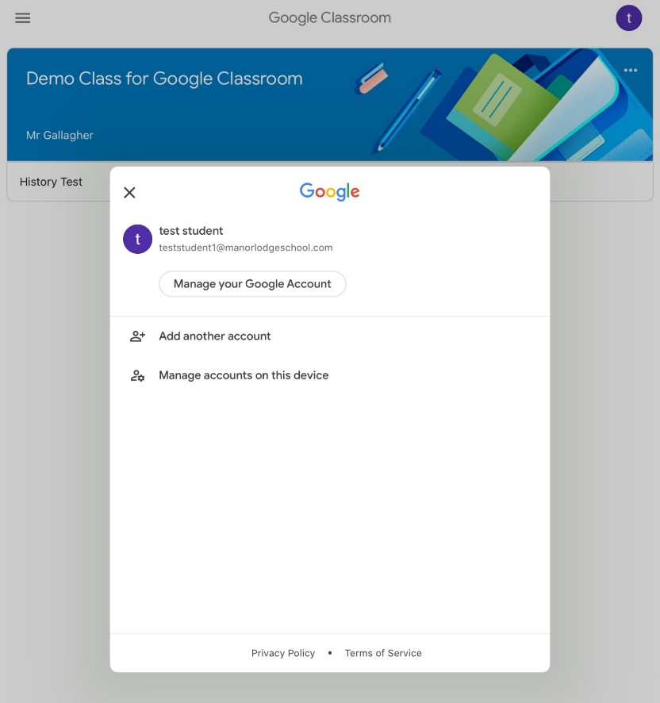
Mobile devices – how to sign in
Once you’ve downloaded the Google Classroom app, open it on your mobile device.
Then sign in here
If you already have another Google account signed in,
click Add another account

Slide 7
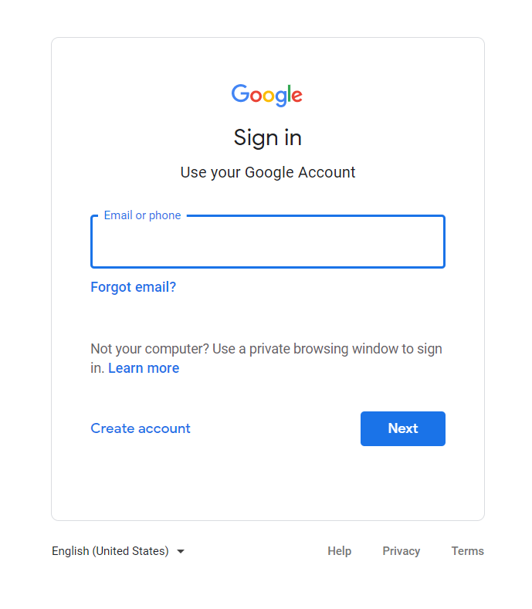
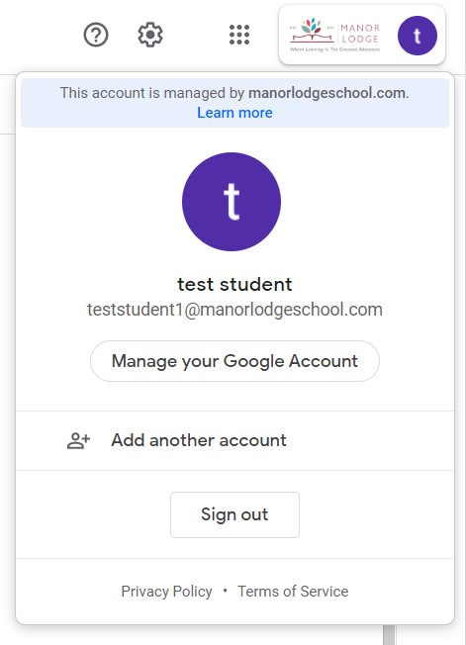
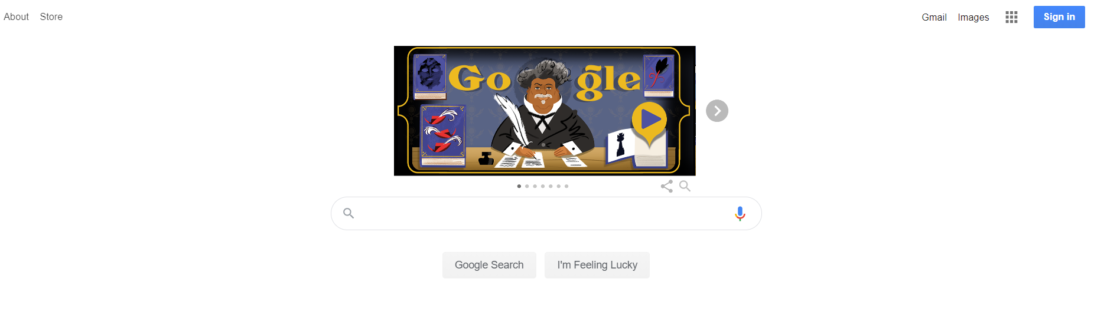
Desktop devices – how to sign in
If you already have another Google account,
click Add another account
On a desktop device, click on the Sign in icon in the top right hand corner of a Goggle home screen
Then sign in here

Slide 8
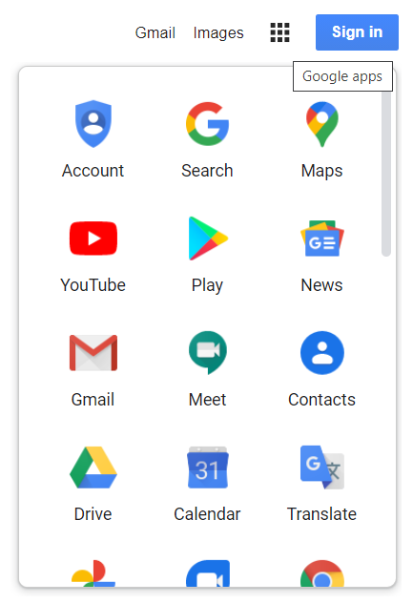
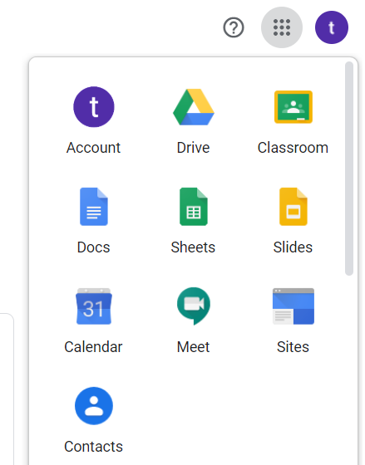
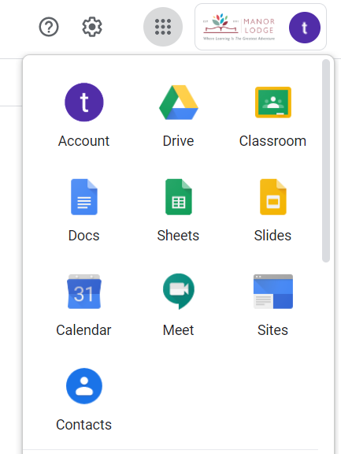
Desktop devices – how to access Google Classroom
Clicking this nine dot matrix displays some Google Applications.
The apps displayed may vary.
If Classroom isn’t displayed, go to Drive first, and then Classroom should be listed.

Slide 9
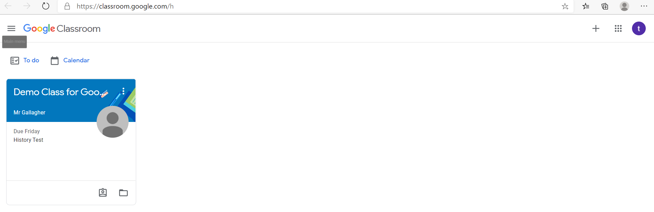
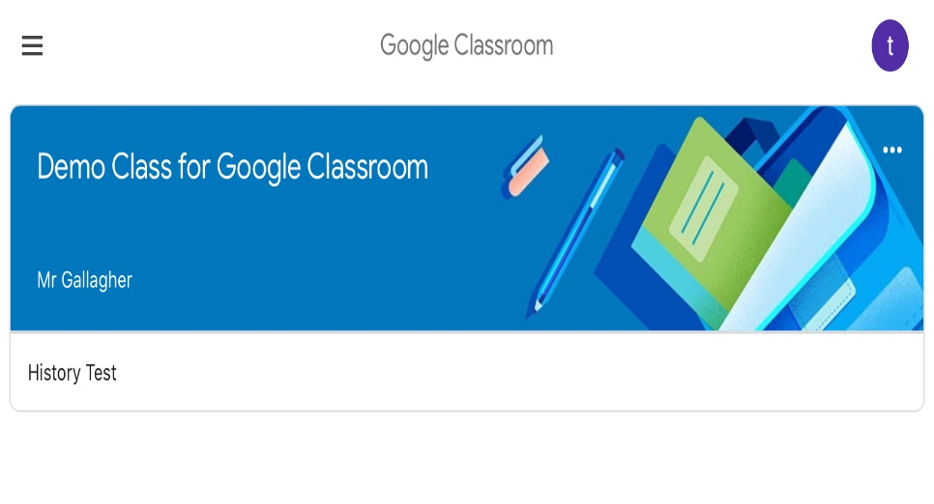
How to access Google Classroom
**This is just a demo class**
This screen shows the class the child has joined.
Click on the class name to enter the classroom.
This will look almost identical on mobile devices too.
DESKTOP DEVICE
MOBILE DEVICE

Slide 10
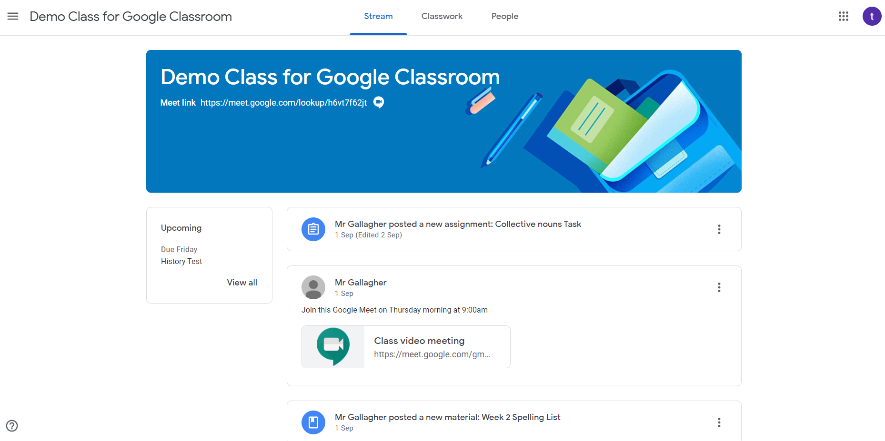
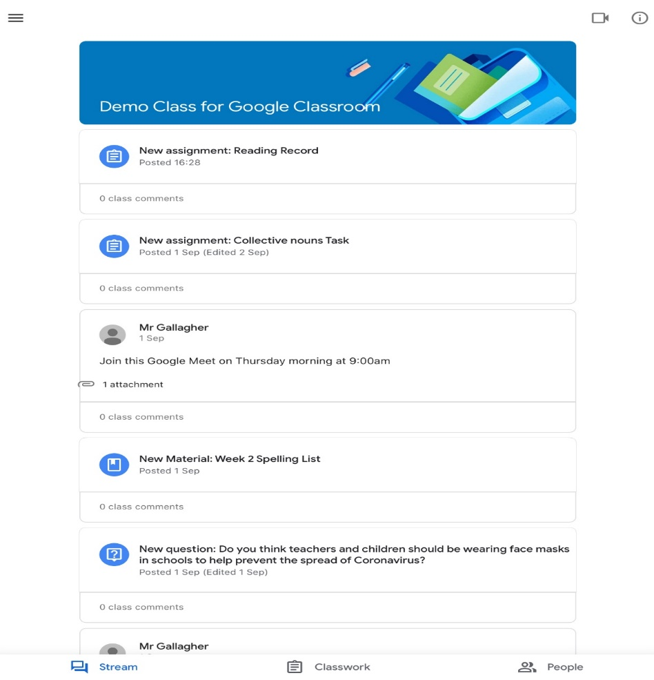
Google Classroom - Stream
**This is just a demo class**
This section of Google Classroom is called the Stream.
This is where children can see a list of all the assignments and comments posted by teachers in chronological order – like a newsfeed. This can get quite full after a while so when looking for work pupils would be best going to classwork.
DESKTOP DEVICE
MOBILE DEVICE

Slide 11
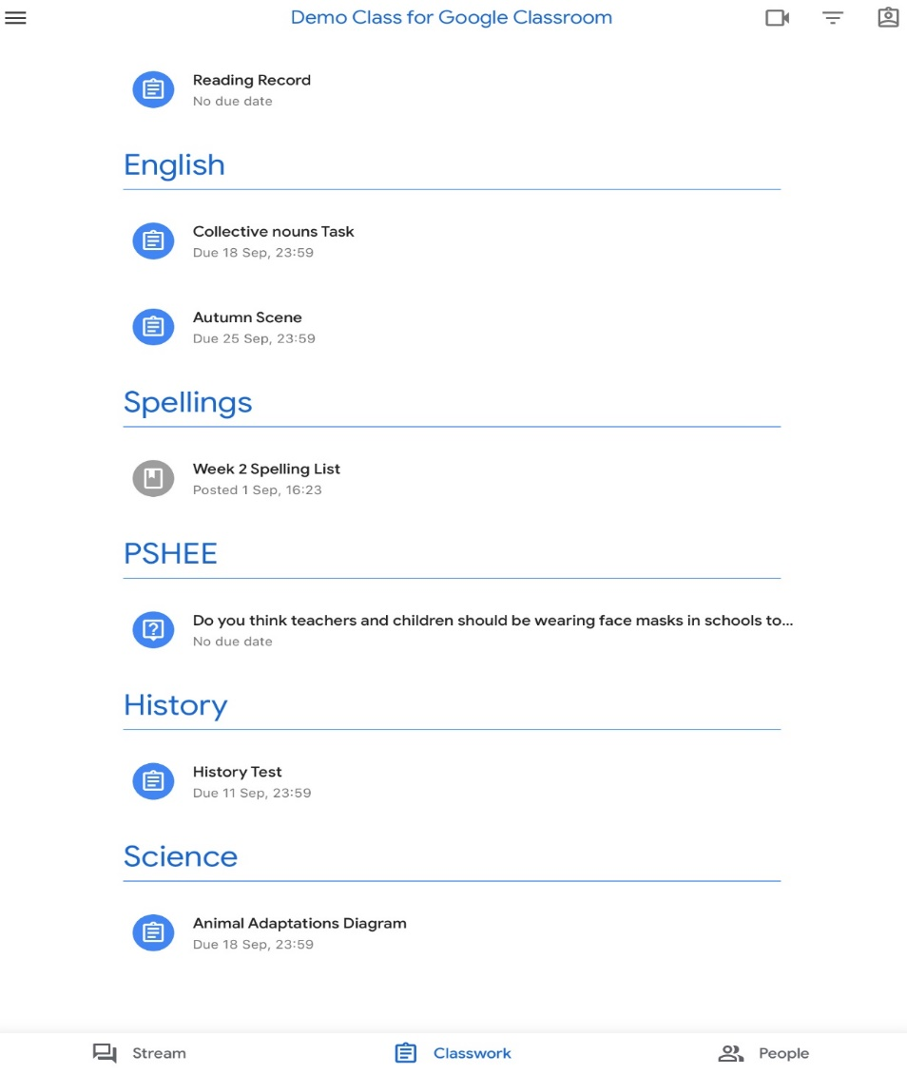
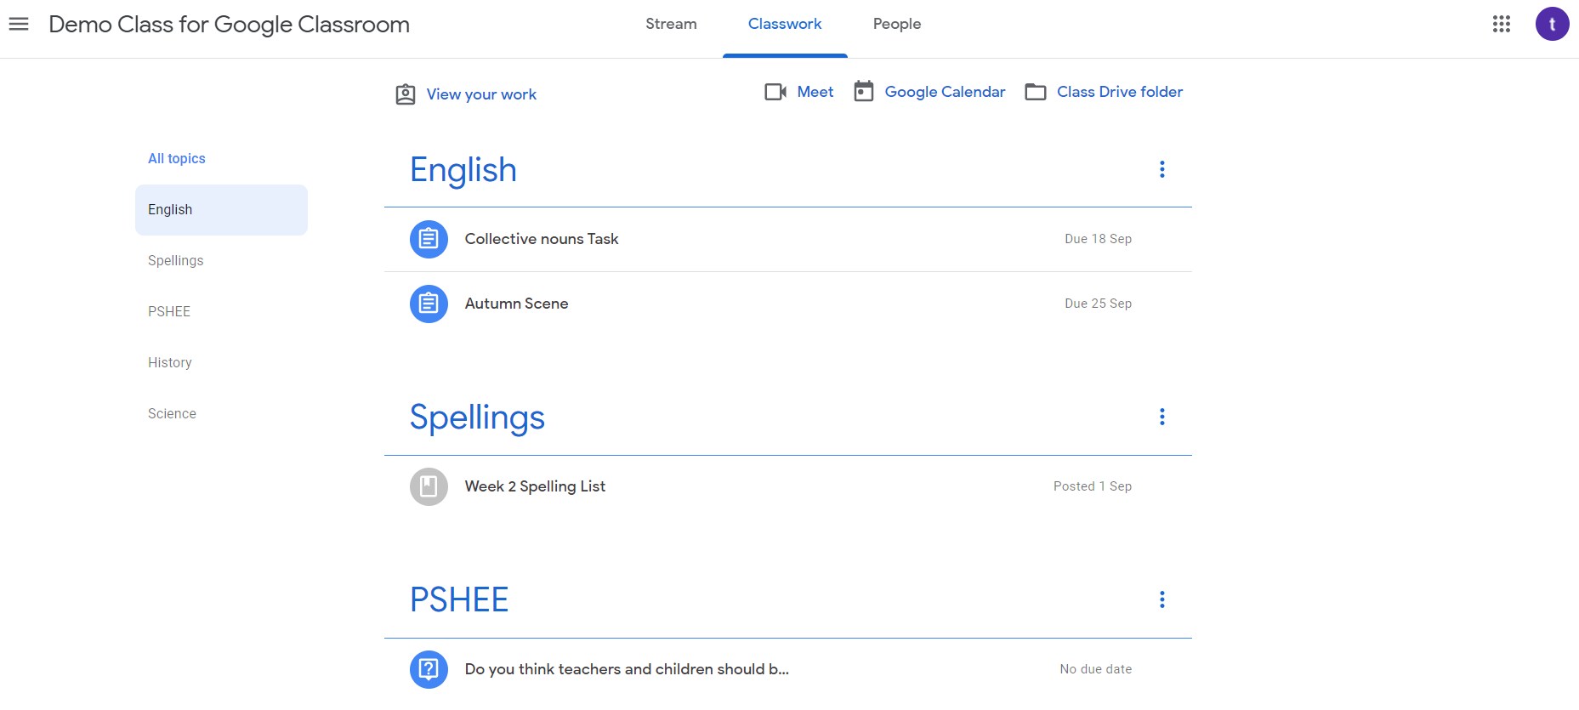
Google Classroom - classwork
**This is just a demo class**
The next section along is called Classwork.
Assignments set by the teachers appear here.
They can be organised into subjects/topics by the teachers to make it easier for pupils to view.
This is the most useful way for students to see their work in an organised way
DESKTOP DEVICE
MOBILE DEVICE

Slide 12
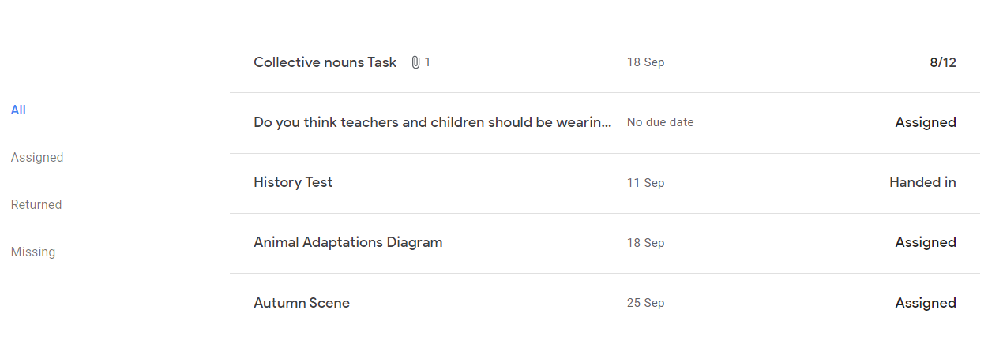
Desktop device - classwork
**This is just a demo class**
Pupils can view the assignments under each topic.
Pupils can also click on View your work.
Once here, pupils can view all their work in other useful categories too.

Slide 13
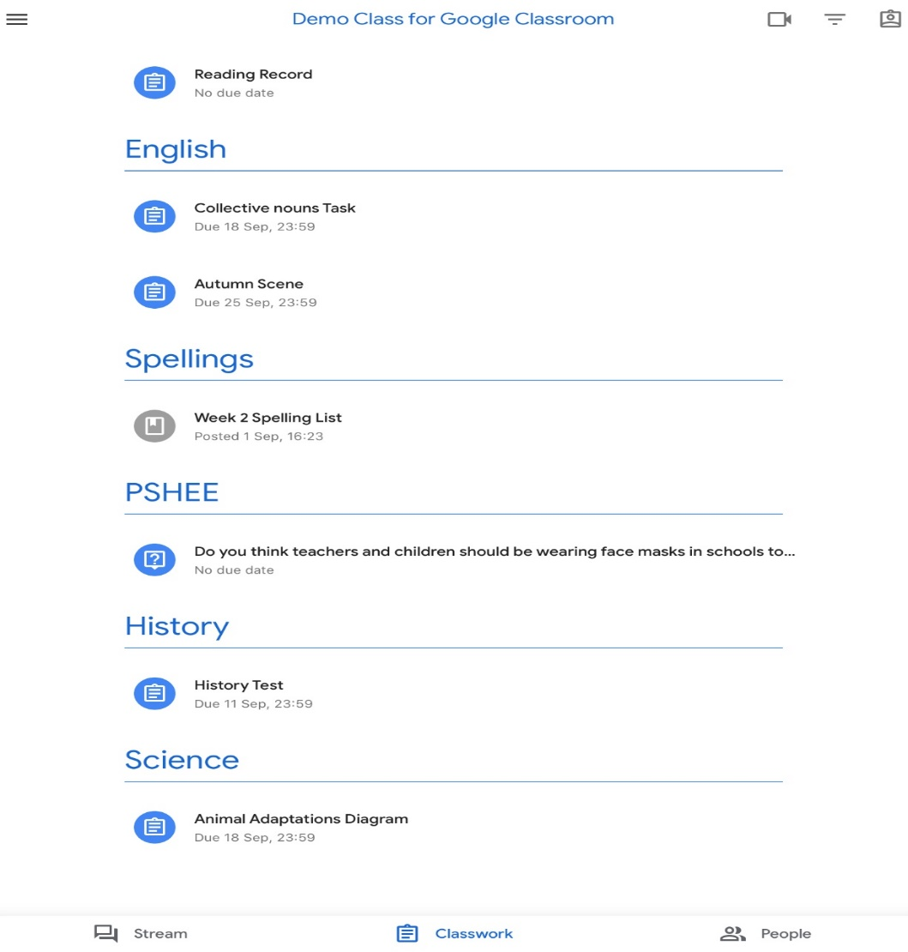
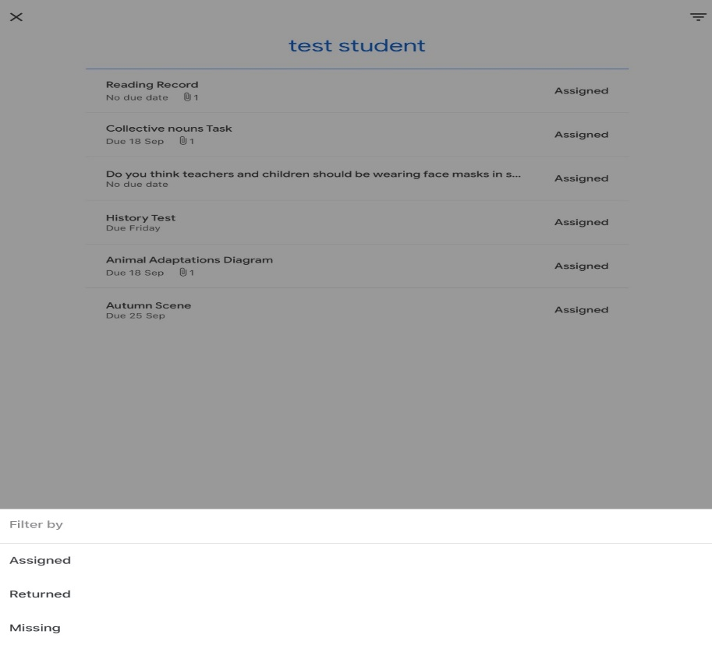
Mobile device - classwork
**This is just a demo class**
Pupils can view the assignments under each topic.
Pupils can also click on the View your work icon.
Once here, pupils can view all their work in filtered categories too.

Slide 14
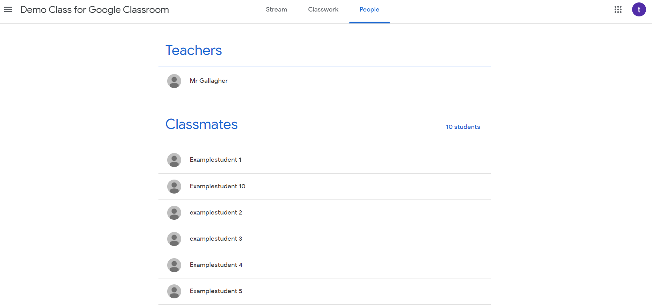
Google Classroom - people
**This is just a demo class**
The last section along is People.
This just shows a list of the members of the class – children and teachers.

Slide 15
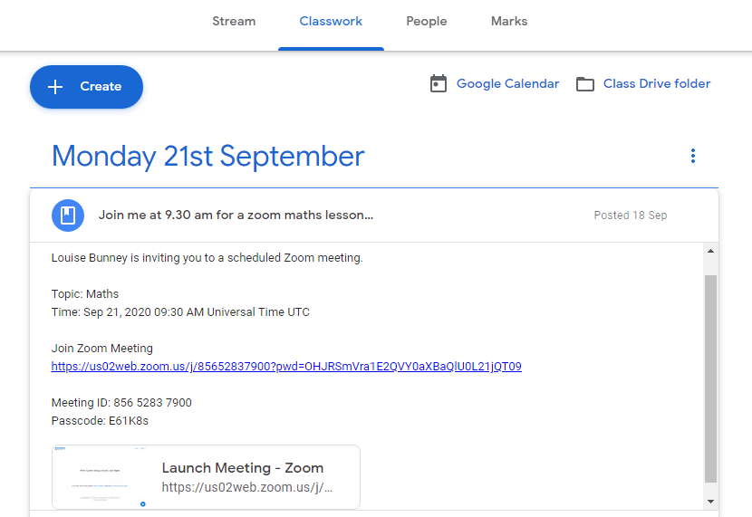
Live lessons – currently through zoom
Within the classwork section teachers will post links to live lessons. NB: This will also appear in the stream but is easier to find the correct one through the classwork section.
The pupil can join these lessons by either clicking the link or the resource to access the live lesson at the right time.

Slide 16
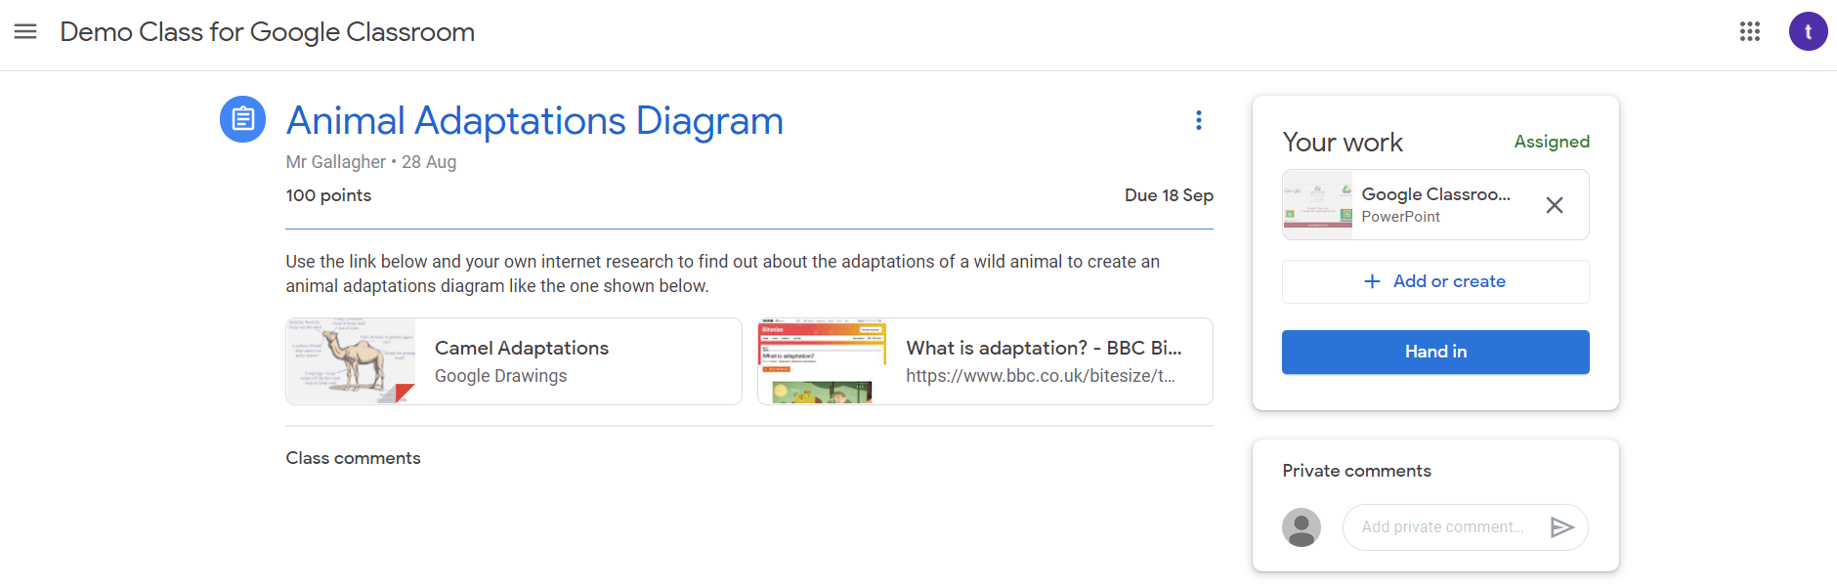
What an assignment might look like
Items of work are called assignments. They can take various forms, but may look like this.
Deadline for the item of work
Assignment title
Grading information
Pupil’s completed work attached.
They can attach more than one piece.
Instructions
Associated resources
Pupil to teacher comments

Slide 17
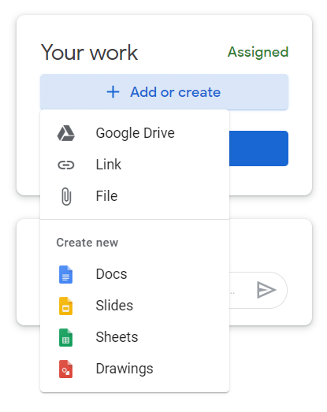
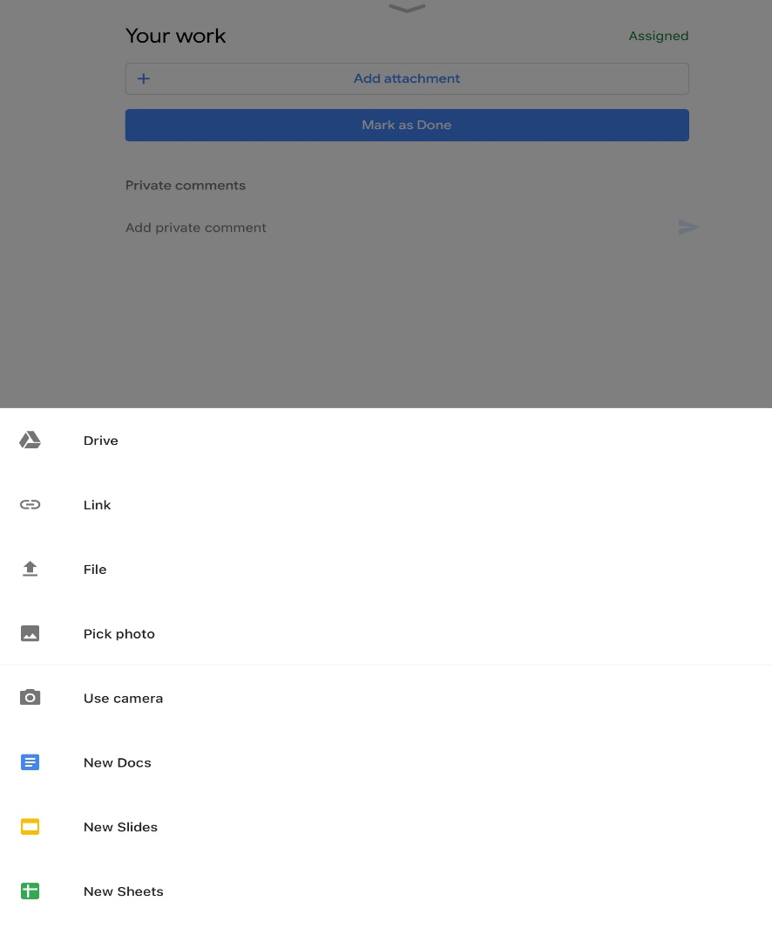
How to complete and hand in work
Assignments can be completed in any format that is appropriate to the task and then attached.
To complete work pupils need to go to the Your work box and click the + Add or create tab or
Add attachment
They will get some drop down options of how to complete the work.
Pupils could upload a link or an existing file on your computer
Pupils could create a new document, slides, sheets or drawings
A picture from your device’s camera roll

Slide 18
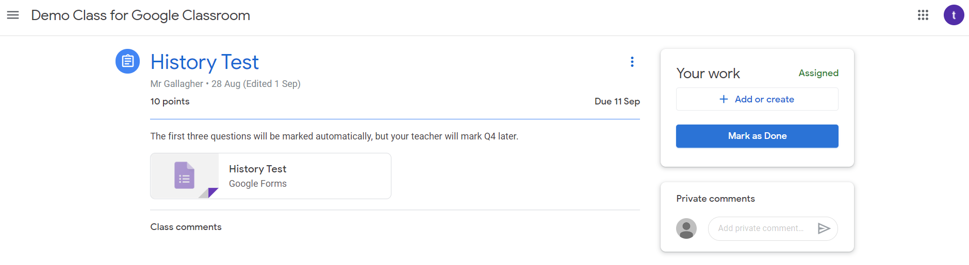
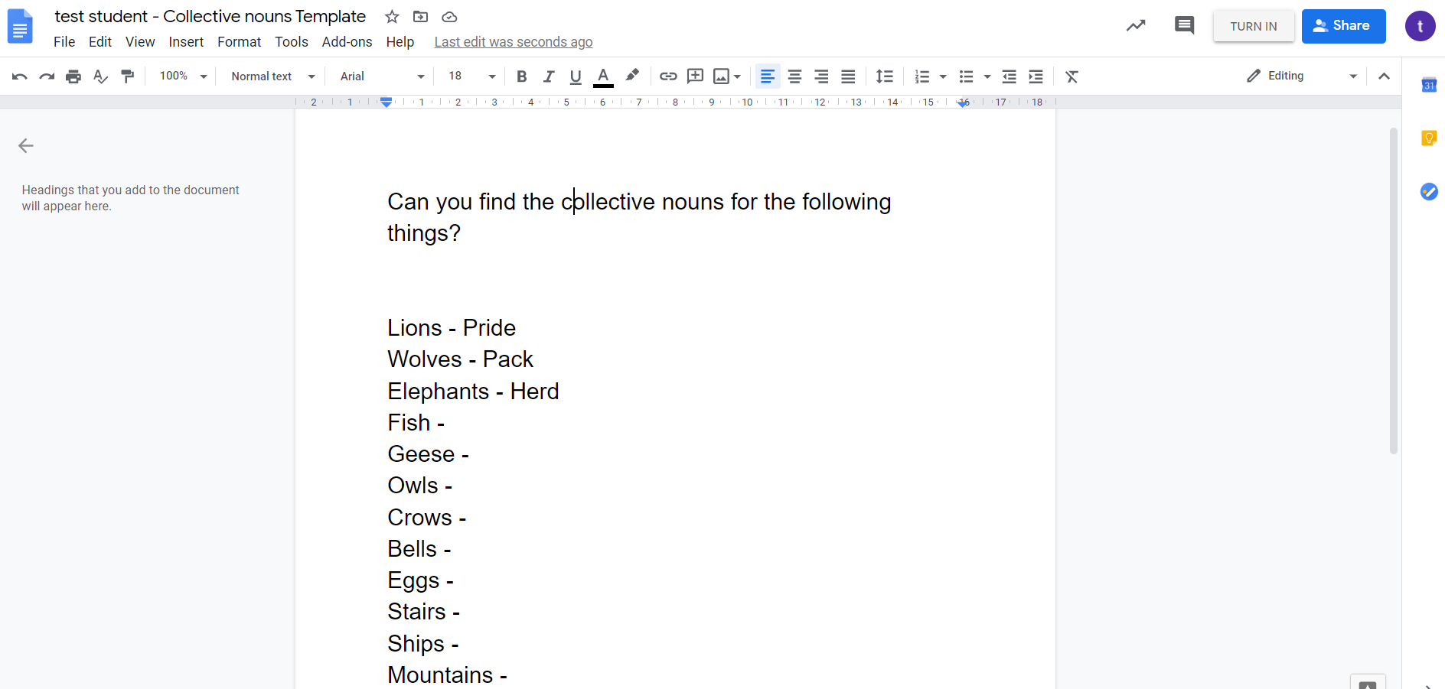
How to hand in work as they go
Depending on the task, pupils can ‘hand in’ work in a few different ways.
Look for the terms:
Hand in
Turn in
Mark as done

Slide 19
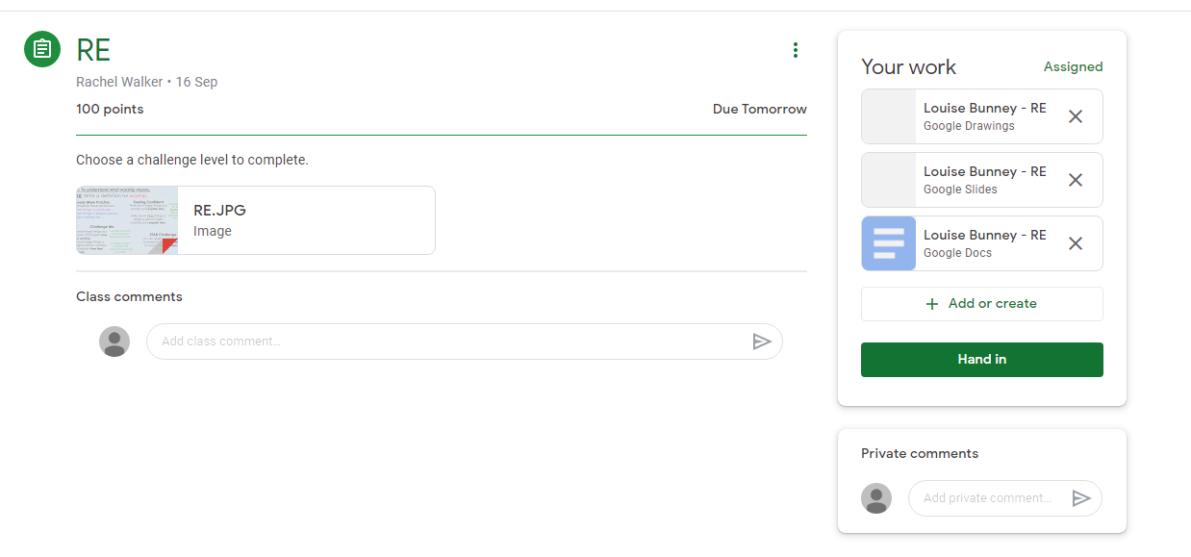
How to hand in work once all work is completed
If pupil’s forget to hand in each piece of work as they go or would prefer to hand it in when all completed Google Classroom will store each piece they have started in their ‘Your work’ box.
They can also delete unwanted piece by clicking the X.
Once they have everything in there they want they can ‘hand in’.

Slide 20
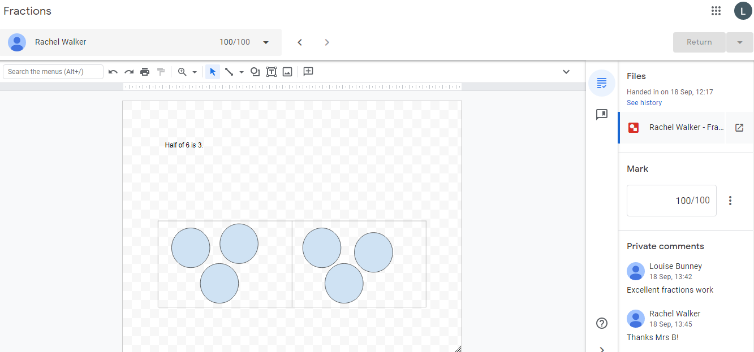
Feedback from the teacher
Once a pupil has handed in their work their teacher will be notified.
Their teacher can then award marks and give feedback. The work will then be returned to the pupil so they can see what the teacher has said.
The pupil can comment on their feedback too.

Slide 21
Questions or problems
If you have any queries, please email:
office@russell-lower.co.uk
Detail any queries within the email and include a telephone number in case it is easier to discuss over the phone.
A member of the school team or our IT team will respond to your query either via email or telephone (whichever is most appropriate) as soon as they can.

