Slide 1
Inclusion Coffee Morning Building Resilience
FRIDAY 24th NOVEMBER 2023
Notes:
What we have noticed both locally and nationally over the past few years and specifically since the pandemic is that an over focus on wellbeing has damaged resilience and mental health amongst our children, and also amongst adults (staff and parents). We need balance.
There is lots of research to support this too.
Carol Dweck – Growth Mindset (we all have both fixed and growth)
Dr Neil Hawkes – importance of values/social beings/community
Marta Pawlika – children learn anxiety from key adults (so it can be unlearnt)
Grotberg – research on crisis inducing events
What we do know is that when it comes to children they are little mirrors and therefore they often learn their anxiety or their response in difficult situations from key adults. Therefore it is our role as adults to help them to learn a more positive, more resilient response.

Slide 2
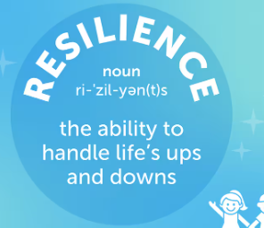
Wellbeing……Resilience
Resilience is a choice – give up or persevere (how do you feel when you give up?)
Notes:
Wellbeing is great…but it is an END PRODUCT, research shows…it has led to a lack of resilience in us all. We need resilience both for good mental health and a sense achievement/self-worth
when parents come to see me…’my child needs to move class because of X.’ ‘No, we need to teach your child strategies to cope with X.’

Slide 3
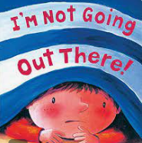
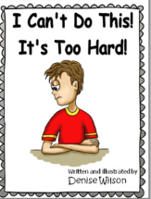
Characteristics of an un-resilient child
Notes:
I can’t
I won’t
I’m not going to school
It’s too hard
It’s too difficult
Meltdown
Disegulation

Slide 4
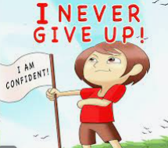
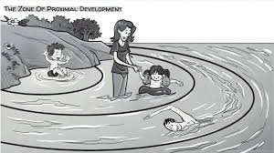
Characteristics of a Resilient Child
A child who responds well to difficulties in life will often have the following characteristics:
A strong sense of independence, autonomy, and self-confidence.
Ability to communicate well with others and express themselves.
Good problem-solving skills.
Strong empathy and respect for others.
Active interest in school activities.
Responds well to instructions and guidance.
Knows how to ask for support.
Open to trying new things.

Slide 5
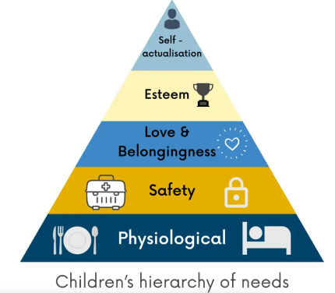
Good foundations for building resilience
To be healthy
To sleep well
To eat well
To get enough exercise
To develop good relationships/friendships
To have balance – rest and activity
To feel loved
To be happy
To be safe

Slide 6
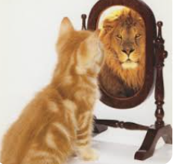
Children see/children do
Children see/children do - little mirrors
Parents and teachers promote children’s resilience through
their actions,
what they say (as long as they match the actions)
by creating a supportive environment.
Fake it til you make it – scientifically proven to rewire the brain.
Notes:
Children see/children do – little mirrors – that’s why what we DO is so much more important than what we SAY

Slide 7
Building Resilience in Children
Encourage healthy risk taking.
Show acceptance of mistakes and losses.
Ask questions to encourage independent thinking.
Praise accomplishments in the right way.
Define and discuss emotions. (Emotion Coaching)
Promote optimism and positive thinking.
Encourage interaction with others.
Show that it’s okay to ask for help.
Notes:
1. Many people make the mistake of preventing children from taking risks, or they jump in too soon to solve a child’s problems. Unless it’s necessary to protect the child from real danger, it could prevent them from developing their self-sufficiency.
So, if the risk of harm is low, resist the temptation to pre-emptively intervene. Let them face the challenge and attempt to problem-solve on their own. You can offer help if they really do need it.
2. Doing so demonstrates that mistakes are not the end of the world and you shouldn’t avoid trying new things due to fear of failure. Call them GREAT MISTAKES! What’s important is reflecting on mistakes and learning from them. This helps children to develop a growth mindset and encourages them to look for solutions, rather than focusing on unhelpful blaming or self-criticism.
3. Whenever children face problems, you may be tempted to simply tell them the answer. But doing this prevents them from practising self-sufficiency. This is why you should actively ask questions if children come to you with an issue. It allows them to think for themselves and gain valuable problem-solving experience. For example, let’s say a child in your class is trying to put away some books, but they can’t fit them on the shelf. “The bookshelf is very full, isn’t it? I think we can do something to create space though. Is there anything we can move on it? What do you think Charlie?” You can give them further nudges if needed, such as: “I think that we could tidy these books up a bit and that pencil box could go somewhere else to free up some space. What do you think we should do with them?” If a child’s climbing high on a climbing frame. Instead of saying “get down, it’s too high, that’s not safe, ask them “how do you feel? Do you feel safe? Do you feel like you can get yourself down?
4. Praise and recognition are critical for building a child’s self-confidence. However, excessively and exclusively praising accomplishments and talents, while failing to praise effort, can send the message to children that they must succeed at everything and be talented to be valued. It can make them afraid of failure and generate feelings of inadequacy, which in turn can lead to poor resilience when they face challenges. This is why it’s crucial to praise children when they do their best and make an effort, even if they don’t achieve the results they wanted.
5. Emotion Coaching
6. Promote optimism and positive thinking.
The best way to do this is by showing rather than telling, as children often learn from the example of others. If you have a positive attitude and respond optimistically to difficulties, observant children will notice and may start adopting this behaviour themselves. if you’re trying to use a laptop and it’s not loading properly, it can be tempting to say something like: “Ah this annoying laptop! Why does technology never work for me? This is just great, now I’m going to have to change everything I had planned” This negative thinking can easily rub off on children if you adopt it all the time.
A better approach would be something like: “Ah, I can’t get the laptop to work right now. Well, I’m sure it’ll start working later or I can get someone to help me fix it. For now, let’s do some reading instead. We can enjoy some stories now sooner than we thought!”
7. Another key characteristic of resilience is being able to draw strength from friends and family. This is why it’s important that children learn how to develop relationships. While some are natural social butterflies, some may need an extra push. So, where possible, you should create the opportunity for children to practice their social skills.
Developing relationships is also important for the next and last tip for building resilience in children.
8. We discussed earlier about encouraging children to take healthy risks and to think through problems on their own. You have to find a balance here too, as you don’t want to imply that they shouldn’t ask others for help. Otherwise, they may feel that they shouldn’t bother others with their problems.
In situations where they’re working through a challenge independently, make it clear that you are still there to help them. In turn, you should also ask them for help with things around the classroom. Actively offering and asking for support demonstrates that no one needs to work in complete isolation, not even authority figures. People are always available and willing to help one another, whether it’s everyday tasks or in times of need.

Slide 8
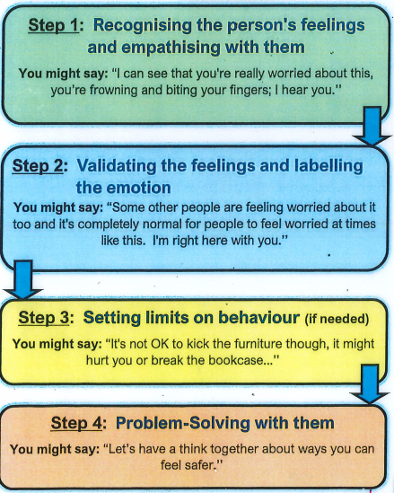
Emotion Coaching
Notes:
Children should learn how to identify and talk about their emotions. It will help to develop the emotional intelligence they need to handle how they’re feeling when things get tough. Otherwise, confusion and frustration can stop them from carrying on. Resilience involves recognising and controlling our emotions, but not permanently eliminating them, as this isn’t realistic.
If a child becomes upset about something, talk to them about how they’re feeling and reassure them that their emotions are normal.
This also helps to develop empathy, which allows us to see situations from others’ points of view and to not dwell on ourselves. Challenges will therefore feel less like personal attacks and more like an opportunity to solve the problem for everyone.

Slide 9
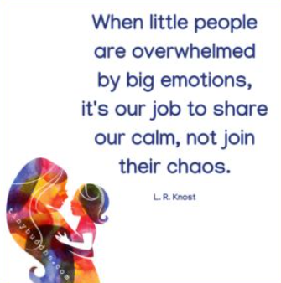
Adult response matters
It’s not just about what we say.
Body language – at their level
Tone of voice - calm
Gestures – arms not waving around
Movement – not running frantically
Facial expression – don’t roll your eyes
What you could say - I-WING
I imagine you must feel quite upset
I wonder if you’d like to come with me to a quiet space
I’ve noticed that you are feeling like throwing everything.
I imagine that must feel scary.
I wonder if you have a fuzzy head and fluttery tummy because you are feeling anxious.
I guess you’re not ready to learn right now. That’s ok!

Slide 10
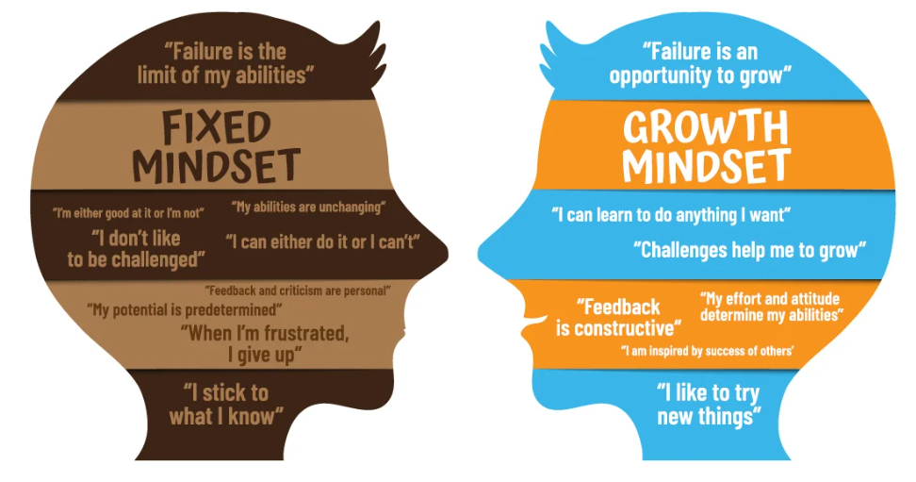
Growth Mindset
Notes:
People with a fixed mindset feel as if they have no control over their abilities, and are helpless in the face of difficulties and setbacks. They begin to feel disheartened if they find something difficult, which can lead to low self-esteem and a developing sense that there is ‘no point’ in trying. Over time, children who feel like this may decrease their efforts and sometimes even engage in disruptive behaviours (anything that will detract from the fact that they are struggling).
Children (and adults!) with a growth mindset think very differently. They believe that they can get better at something by practising, so when they’re faced with a challenge, they become more and more determined to succeed, wanting to persevere and overcome knockbacks. They tend to feel as if they’re in control, and are not threatened by hard work or failure.
Although no one likes failing, children with a growth mindset do not let failure define them; instead, they use setbacks to motivate them. Children encouraged to adopt a growth mindset enjoy challenges and the sense of achievement they get when they succeed.

Slide 11
The Power of Yet!
https://www.youtube.com/watch?v=J-swZaKN2Ic
Notes:
This is another powerful message we use in school when children say “I can’t do this” Our response might be “maybe not YET but if you keep trying as hard as you are now, you will soon be able to”
Learning is a journey…..
What could you do to get better?
What else could you do?
Who else can help?
What else can help?
If you want to know more about this, look into Carol Dweck – there’s a good TEDTalk video that explains growth mindset and the power of yet.

Slide 12
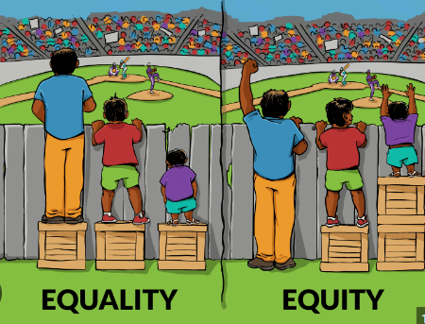
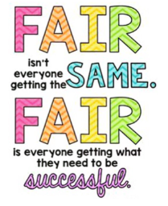
Equality vs Equity
Notes:
We wanted to share this with you, because we use this with children all the time. When you explain this to children they understand that everyone needs help with different things to be the best that they can be. If all of the children have the same size box, it doesn’t mean that they can all see over the fence – each needs something different to make it FAIR
If you give a plaster to every child who is sad or hurt, it will only help the child with the cut. Perhaps the others need ice, a drink, to wash their hands, or a bit of TLC

Slide 13
Learning to problem solve /overcome challenges
Notes:
The tissue box represents a problem, a challenge, a barrier or something difficult to overcome.
As parents/adults our natural reaction to an upset child who says “I can’t…” is to remove the barrier.
An example of this would be “I hate so and so and I want to move class”. If we move the child to a new class all we are teaching them is that grown ups solve problems and I can’t solve problems myself.
Another example…”I don’t like my new teacher (Autumn term)”. They are of course comparing their teacher to the one they had last year who they had a year to get to know, in a year group where perhaps the topics were more appealing to them, and the work in the Summer term not as challenging as Autumn term in a new year group.
Instead, we can say to the child….the problem (the tissue box) isn’t going away, what are you going to do to get around it? Together you can work on strategies or solutions to overcome (not remove) the barrier, making the child more flexible and resilient and giving them the tools/strategies to overcome the barrier next time they meet it.
On the example of “I don’t like my teacher” - If we as adults listen to this and agree with them, we’re not helping them to be prepared for a future where they may have many different teachers (all different) every year. Instead we need to say “no she’s not the same as Mrs ?? for example, but she has high expectations, Mrs Walker says she’s a good teacher and she will help you to be ready for middle school.”

Slide 14
How we teach this to children – The Crow and the Pitcher – a story of resilience
https://www.bbc.co.uk/teach/school-radio/english-ks1--ks2-aesops-fables-the-crow-and-the-pitcher/zkxmwty
Notes:
This is the story used in an assembly for the children to teach them perseverance/resilience

Slide 15
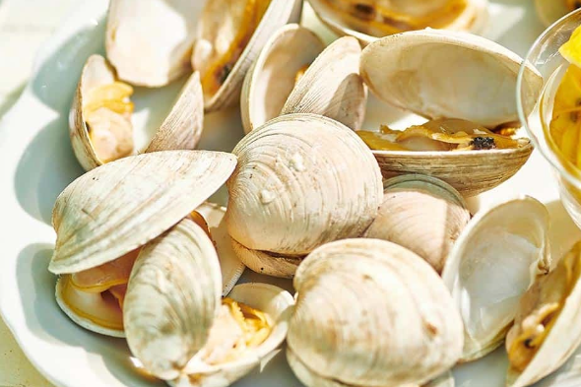
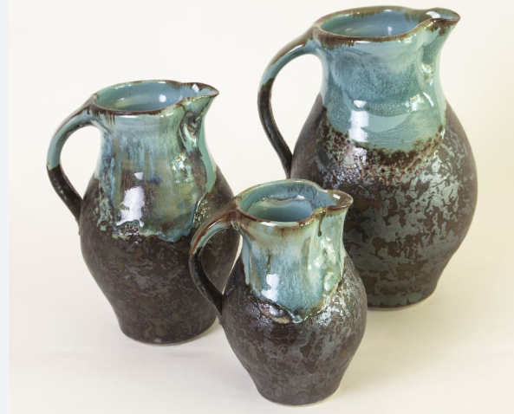
You can fix a problem if you think about it…
Crack a clam?
Crack a walnut?
Reach water at the bottom of a pitcher?

Slide 16
Resilience – can you think what crow would do or say?
Resilient/Resilience - Being able to cope with challenges that life brings and keep calm
I have forgotten my water bottle…
My friend won’t play with me…
I’ve got to leave my mum and dad and go to school…
My work is tricky today…
Because it’s hard I don’t want to do it.

Slide 17
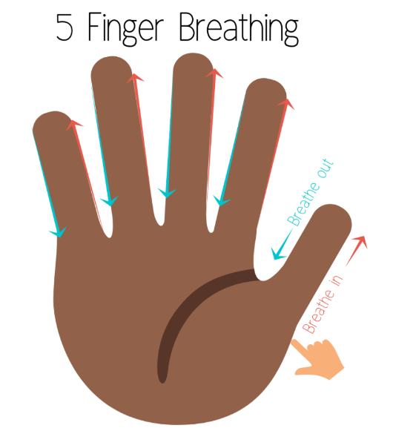
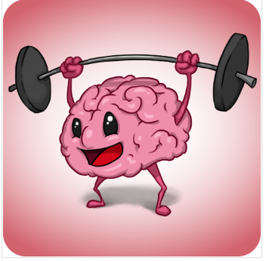
Can you be a Clever Crow next time you face a challenge?
Recognise a challenge
Keep calm
Think…what could I do?
Think…what else could I do?
Think…could anyone or anything help me?
Be patient and calm; it might take a while. That’s okay!
Remember – every problem can be solved if you think about it
Take your brain to the gym to build brain strength.
Notes:
Strengthen neural pathways by practising this way of thinking.

Slide 18
Achieving ‘hard stuff’ feels good and grows your capacity further
Notes:
You expect to work hard to make your muscles stronger.
You should expect to work your brain hard to make it stronger too.

Slide 19
Children see, children do!
Notes:
If children see you get knocked down by every day challenges, they too will face difficulties in overcoming the challenges they face.
Dropping a child to school who is upset and screaming is hard (we know that). But by dropping them quickly, showing trust in the adults at school, they will learn to feel happier about it.
Children see/children do - little mirrors
Parents and teachers promote children’s resilience through
their actions,
what they say (as long as they match the actions)
by creating a supportive environment.
Fake it til you make it – scientifically proven to rewire the brain.

Slide 20
Further information
Russell Website/Safety & Wellbeing/Pastoral Support
www.russell-lower.co.uk
Locality Bulletin
https://www.bbc.co.uk/cbeebies/grownups/help-your-child-try-new-things#:~:text=Although%20no%20one%20likes%20failing,they%20get%20when%20they%20succeed.
Central Beds Local Offer
send@russell-lower.co.uk
pastoralsupport@russell-lower.co.uk
office@russell-lower.co.uk

Slide 21
Support from other parents
Facebook
SEN Parents/Carers of Russell Lower
This is designed as a safe space for parents/carers of children with SEN at Russell Lower School
Notes:
With the agreement of myself and Nicki Walker, a Year 2 parent has set up a Facebook page for parents and carers of pupils with SEND at Russell to support each other.
We are absolutely delighted that it is being supported by 29 families and supportive to parents in all year groups.

