Slide 1

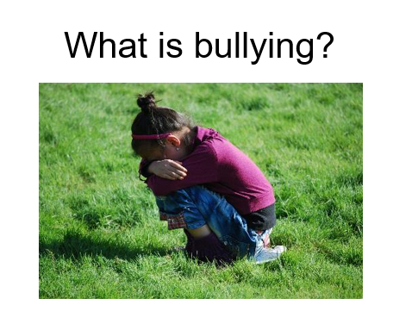



What is bullying?

Slide 2


Is this bullying?
The ABA (Anti-Bullying Alliance) defines bullying as:
The repetitive, intentional hurting of one person or group by another person or group, where the relationship involves an imbalance of power.
Bullying can be physical, verbal or psychological.
It can happen face-to-face or online.
Notes:
ABA definition of bullying. Very important that we have a shared understanding of what bullying is. You might want to replace with your own school’s definition.

Slide 3
Is this bullying?
Someone is mean to you, but they aren’t normally.
Someone bumps into you accidently and doesn’t say sorry.
Someone kicks your leg when they were tackling you in football.
Someone doesn’t like the same football team as you.
Notes:
ABA definition of bullying. Very important that we have a shared understanding of what bullying is. You might want to replace with your own school’s definition.

Slide 4
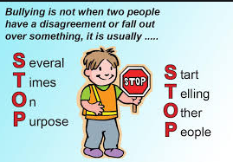


Slide 5
Types of bullying
Verbal
name calling, calling people unkind names, verbal threats of violence
Physical
hitting, kicking, biting, pushing, tripping you up – anything that hurts you by touching you
Indirect
isolating someone, leaving them out, spreading rumours, threatening looks
Cyber / Online
social networking pictures, Whatsaap groups to encourage bullying, nasty text messages, filming people without permission, prank calls

Slide 6
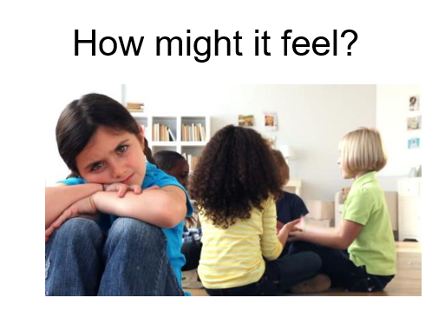

Slide 7
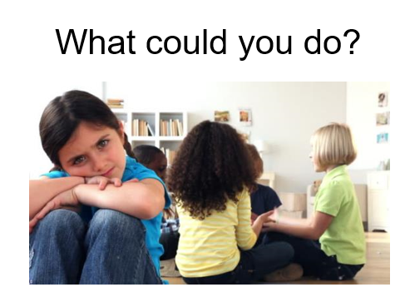

Slide 8
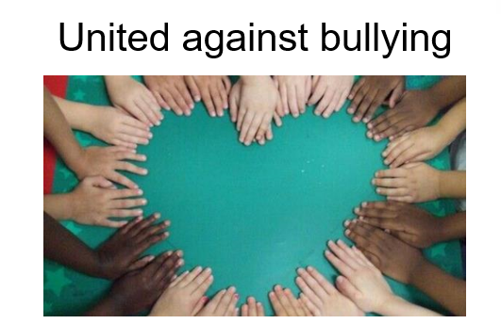

Slide 9


Slide 10
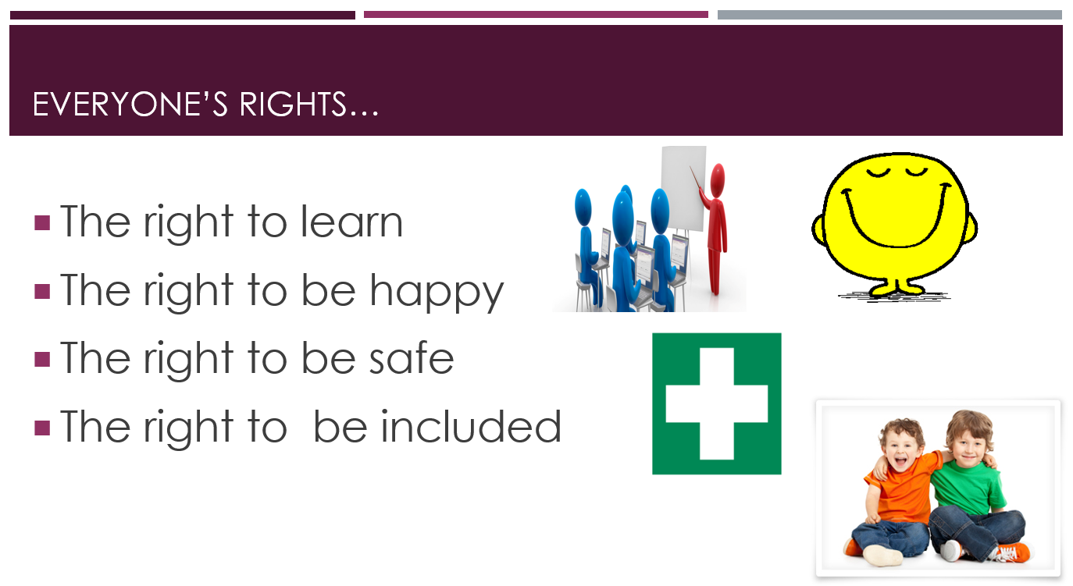

Slide 11
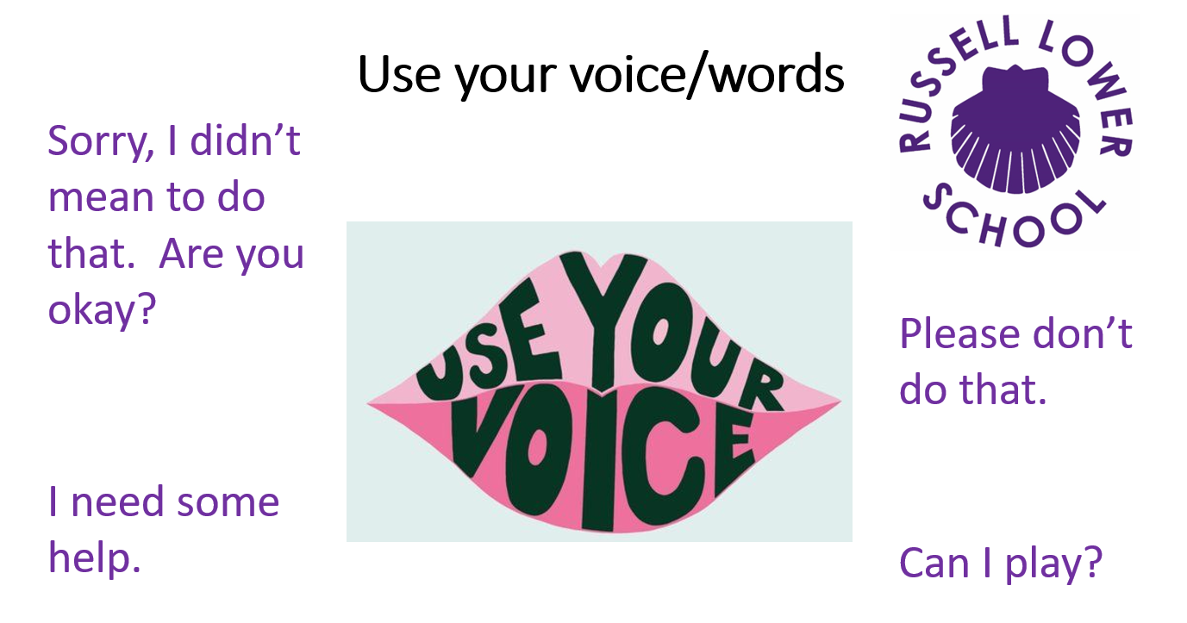

Slide 12

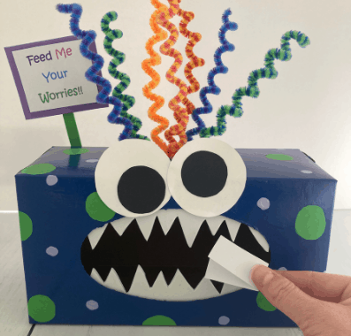

Slide 13
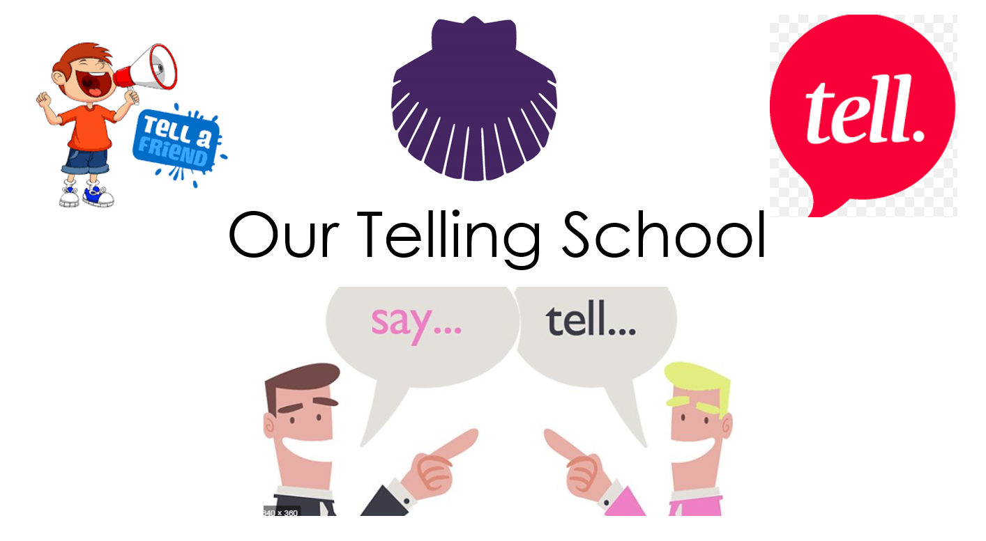

Slide 14

