Slide 1
The power of ‘yet’ – Growth Mindset

Slide 4
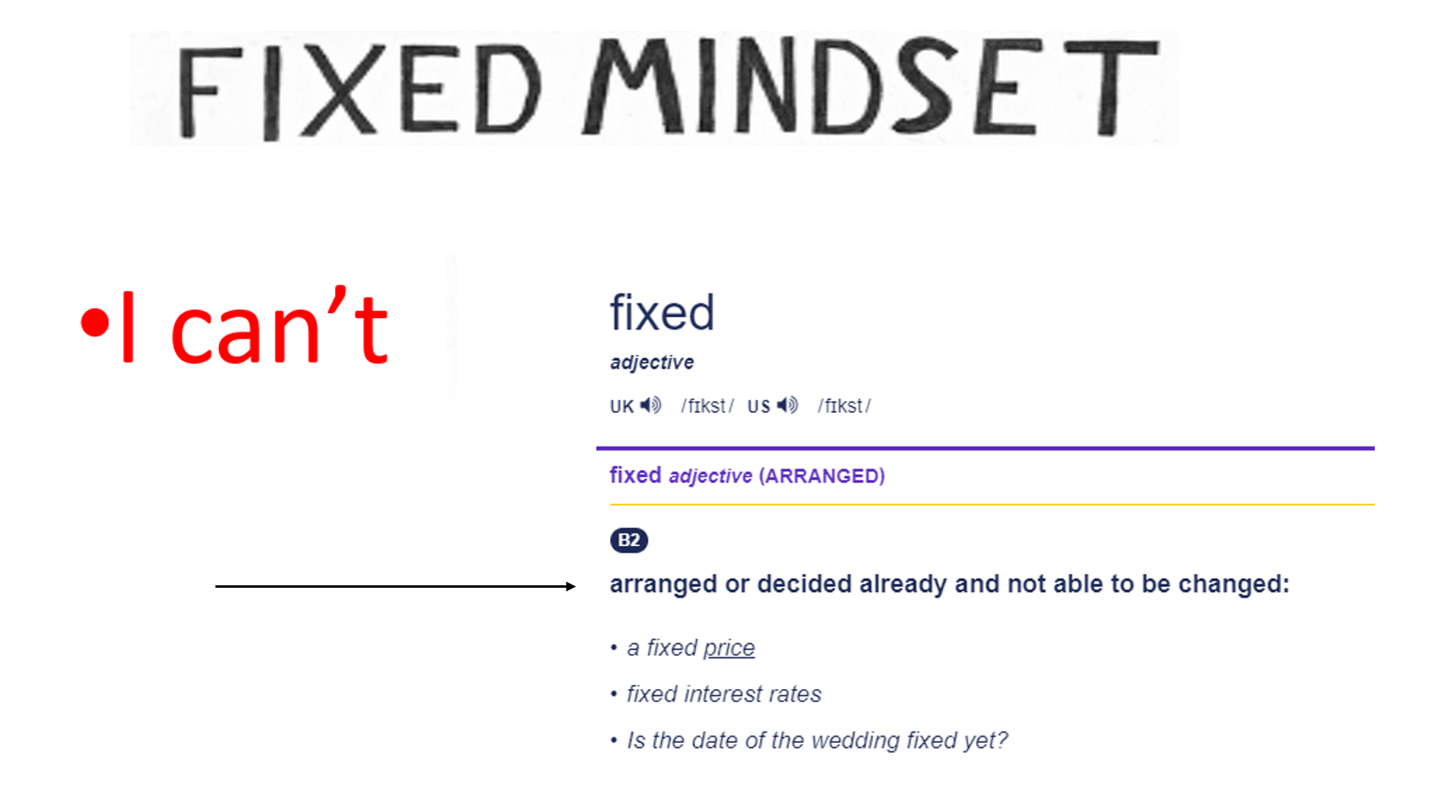

Slide 7
