Slide 1
Bedtime stories – reading workshop for parents – Russell lower School
January 2019

Slide 2
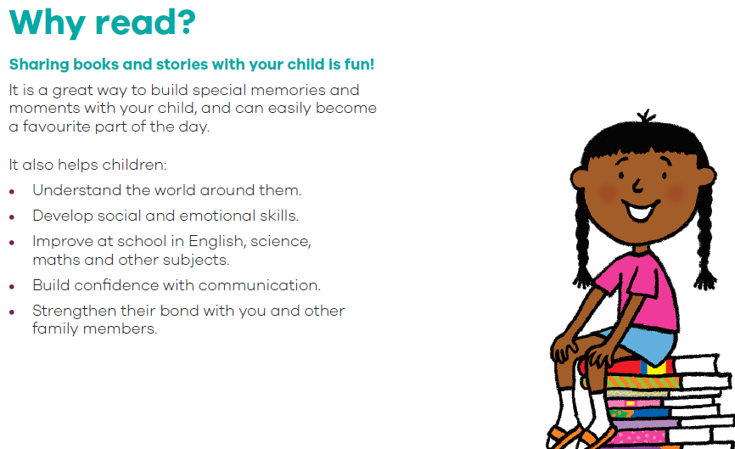
Why reading matters

Slide 3
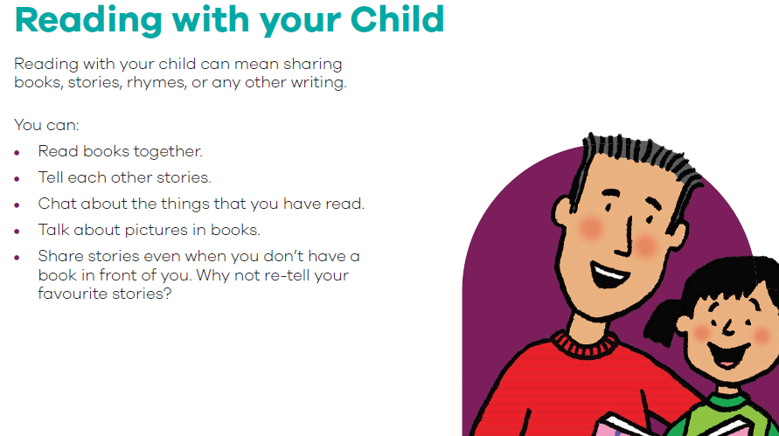
What do you mean by reading with your child?

Slide 4

What we know about the benefits
Reading together helps to create an incredible physical and emotional bond
There’s nothing better than cuddling up and reading a book or a bedtime story together. Spending time with one another, reading, and talking, is crucial. For busy parents, relaxing with your child and simply enjoying each other’s company while reading can be a great way for you both to wind down, relax, and bond. It gives a ‘safe’ space to talk about things…it is amazing what they will ask pretending it is about a character, but is really ‘sounding you out’
Reading supports academic progress like nothing else (this has the added benefit of giving your child confidence at school too!)
It is probably the single most important academic habit you can develop at Lower/Primary School

Slide 5

Even more benefits
It is hugely important to your child’s language acquisition (key to educational success – the more words you ‘know’ in Lower School the better educational success as far ahead as GCSE)
It teaches them about the world (both ‘knowledge’ and tackles issues such as disappointment, friendship issues etc.) in safe ways and gives you opportunities to discuss them
It supports developing concentration for longer periods which helps with all activities
It encourages questions and a thirst for knowledge which becomes self-sustaining (you buy more books, look up more words etc.)
Develops imagination and enjoyment - when we really engage in a book we imagine what the characters are doing. We imagine the setting as reality. Seeing the excitement on a child’s eyes when they know what is going to be on the next page, or having them guess what is going to happen is one of the most amazing things to experience.
When a child can put himself into the story it helps them to develop empathy. They identify with characters, and they feel what they are feeling. Children begin to understand and relate to emotions.

Slide 6
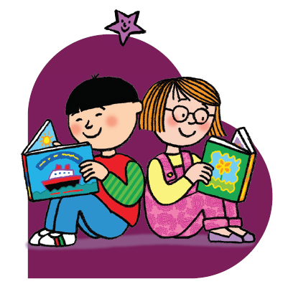
With so many benefits that highlight the importance of reading, we as parents need to prioritise reading in a child’s early years to help them to succeed later in life.

Slide 7
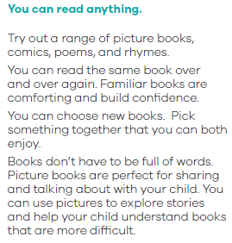
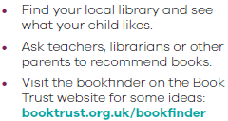

What should we read?
Just enjoy it – so go with what they are interested in!

Slide 8

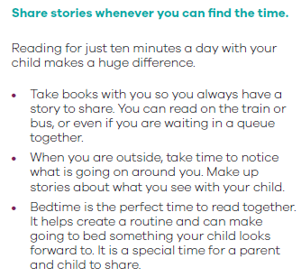
When should we read?
If your child doesn’t want to read…Let’s say bedtime is 7pm. Let your child choose bedtime story or sleep? (No other choices)
It is amazing how they will change their mind
10 minutes either side of bedtime won’t hurt and it will help them relax and sleep better.
Approach it differently…
’Oh my goodness, look at this…’
A parcel arrives…
A special trip to a book shop…

Slide 9
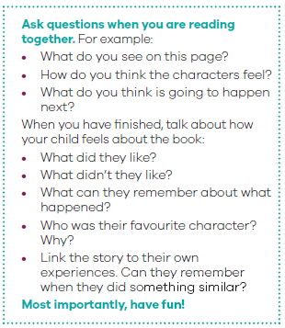
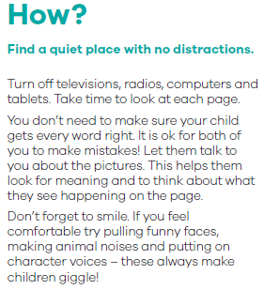
How should we read?

Slide 10
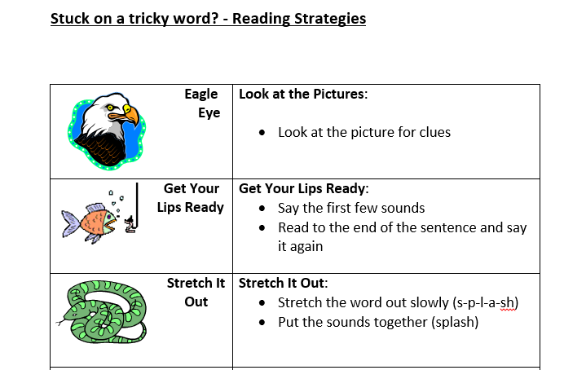
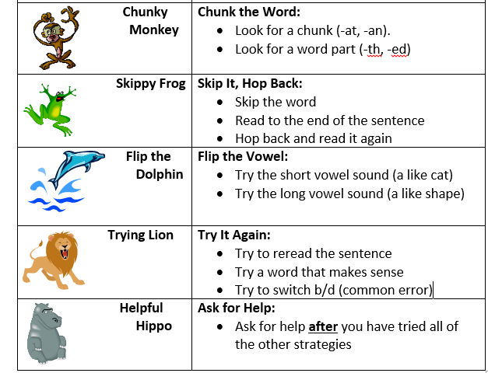
Reading strategies if you are stuck on words

Slide 11
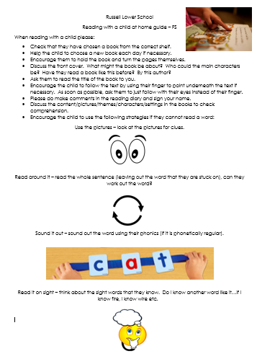
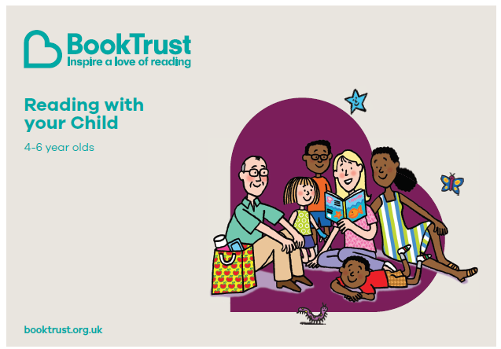
FAQ and resources
Do I still need to read with my child once they can read?
YES! YES! YES! All the same benefits still apply – certainly well into Middle School
Do I have to read everyday?
NO! We aim for at least 4 times a week so we still see the benefits
Do we have to read school books?
NO! You can read anything you enjoy together
Do we have to write in the Reading Diary/Record?
It really helps if you can – and your child will receive Dojos and stickers for doing so
What if my child won’t read?
We rarely find children who don’t like good books…ask…is there an option of something else too exciting stopping them? Is it the wrong time of day? Are the books fun/interesting? Read to them to start with…hook them in with books of their choice; once the habit is established you won’t have to be so creative!

Slide 12
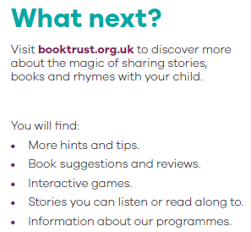
Where can I get more information?

Slide 13
Thank you for coming!
With so many benefits that highlight the importance of reading, we as parents need to prioritise reading in a child’s early years to help them to succeed later in life (and because it is such amazing 1:1 time too!)

