Slide 1
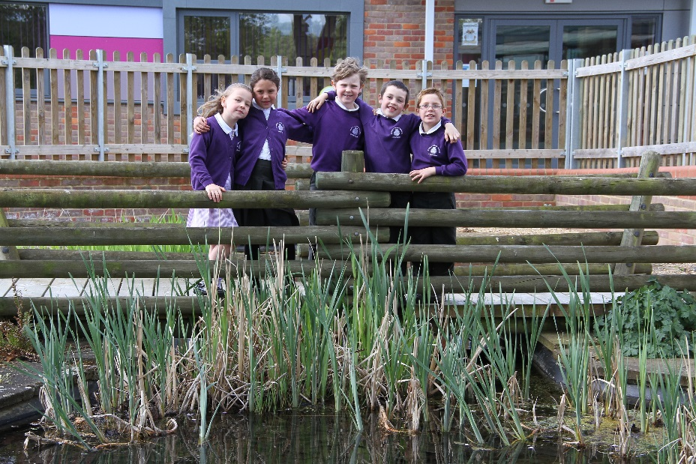
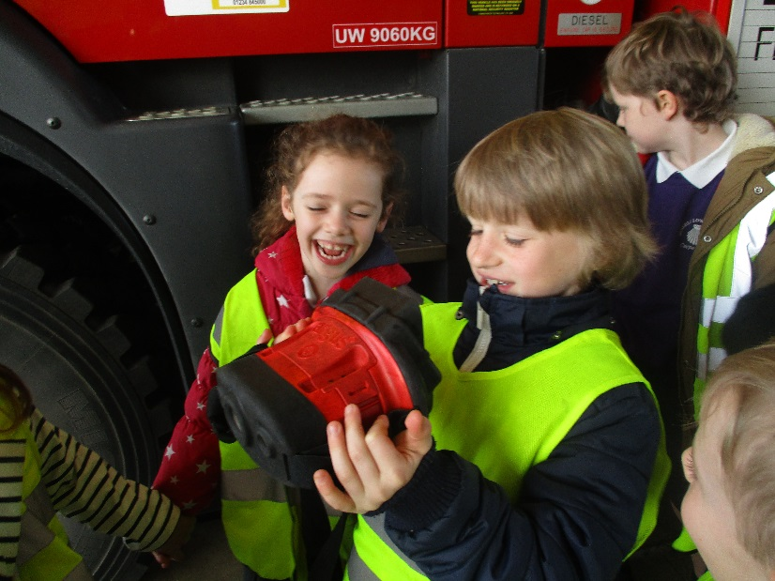
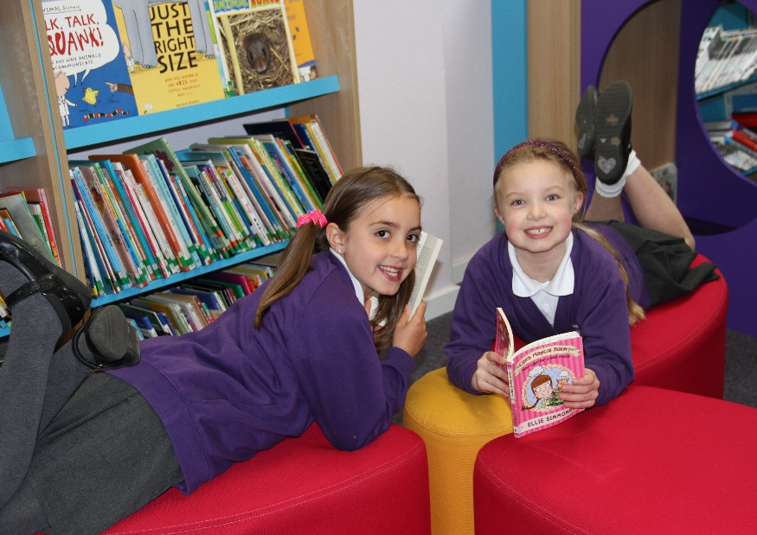
Welcome to Russell lower school thank you for choosing us
New Intake September 2023

Slide 2
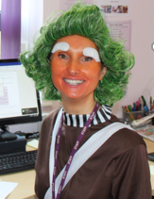
Introductions
Welcome – Fire – Toilets
Mrs Walker – Headteacher
Mrs Bunney – Deputy Headteacher
Mrs Brown – Foundation Stage Leader,(Swans), Ms Leung, (Swifts), Mrs Lyons (currently Miss Cranston but getting married over the summer), (Doves)
Mrs Knight (Inclusion Lead/SENDCo), Mrs Appleby – Finance Manager/Before and After School Club, Mrs Bremner – Office Manager
Representatives from our PTA and food to sample from our kitchen

Slide 3

The agenda
Arrive - Tea/Coffee
Timings – 6:30pm prompt to 7:30pm
Main hall - Introduction and school key Information – Mrs Walker (20 mins)
Main Hall – Mrs Brown – a typical day in FS (10 minutes)
Split in 2 (classrooms and hall time)- two halves – child’s surname A to M first, child’s surname N - Z second (15 minutes and then swap – NW and LB will appear and ask you to follow them back via the outside classroom doors and playgrounds (this is where you will drop off and pick up from)

Slide 4

Welcome to russell…it’s been a busy and Exciting time of change
2015 - Completion of a £3.9 million pound building plan to expand to
become 3 form entry
2015/16 - New Leadership team in school, Refurbishment of all the ‘old’ classrooms
2016/17 – Three form entry achieved in FS/KS1, New ‘Vision’ for the school, Successful Ofsted
2017/18 – Second year running, the most popular lower school choice in Ampthill and Flitwick, Three form entry achieved up to Year 3
2018/19 – Full three-form entry school, third year running: the most popular lower school in Ampthill and Flitwick
2019/20 – A ‘full’ intake in Foundation Stage and, for the forth year running, the most popular school in Ampthill, Flitwick and surrounding villages
2020/21/22/23 – Oversubscribed with a waiting list for September 2023 – yet again, the most popular school in Ampthill, Flitwick and surrounding villages
Covid ‘fun’ Feb 2020 – to now with increased level of illness due to lowered immunity
OFSTED – November 2022 – fantastic report and totally incredible parent view (do go and look!)

Slide 5
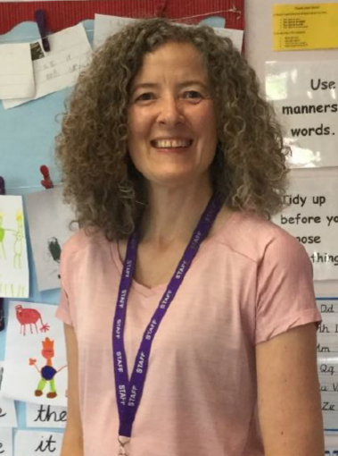
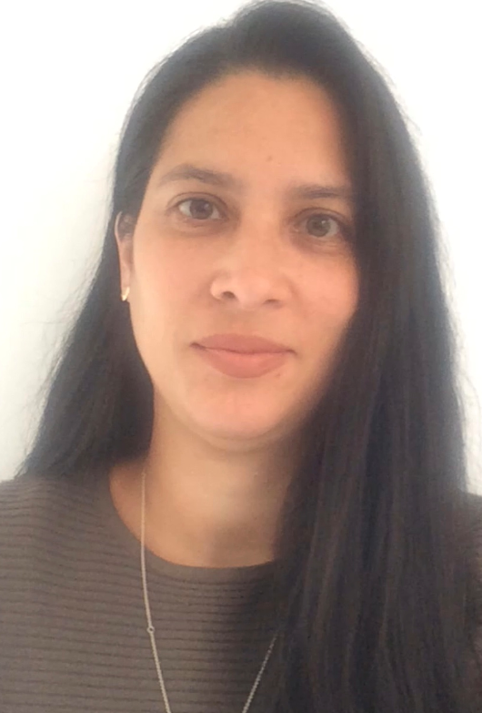
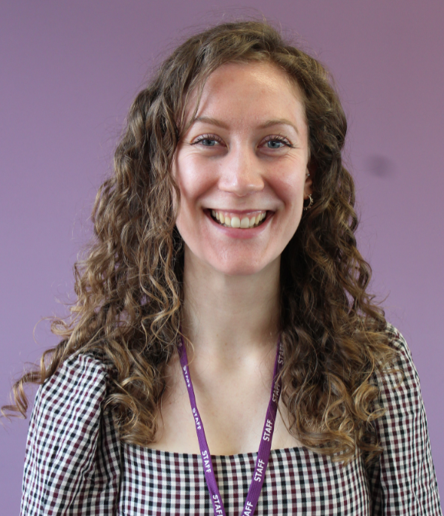
Classes – super experienced teachers
3 classes:
Swans with Mrs Brown
Swifts with Ms Leung
Doves with Mrs Lyons
Class lists are created with the help of pre-schools and nurseries - balance between boys/girls/term of birth/abilities/friendships/medical needs etc. All very tricky but worth it. We want the best start possible.

Slide 6
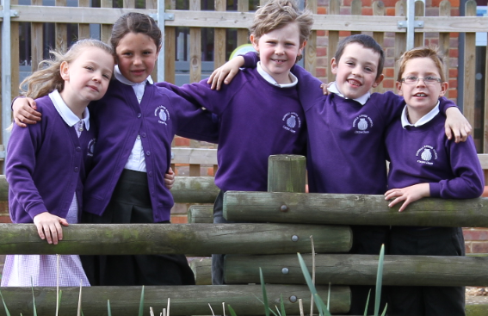
Key information
Uniform – fully uniformed (page in pack and displayed here), including PE kits. Logoed uniform can be bought from Prestige in Flitwick. Please make sure everything is named – biro is fine! Prestige run a booking system: this system to work fantastically over the years and tends to mean less stress and hanging around for the children and adults. These time slots can be booked online via the Prestige website, and appear on the school’s heading. Each time slot is 15 minutes and their staff will assist with the sizing. If you require more time or have two+ children these can be booked together. https://prestigedesignww.co.uk/schools/russell-lower-school/
PE kit – easy to get on and off, beware of tights on PE days, logoed purple top
No Jewellery – exception stud earrings which should be removed on PE days BEFORE coming to school please
New Pupil Form – You should have already completed and returned these. This is your emergency contact information, allergies etc. CANNOT EMPHASISE ENOUGH HOW IMPORTANT IT IS THAT WE ARE KEPT UP TO DATE IN THESE AREAS. PLEASE COMPLETE THIS AND RETURN THEM TO THE SCHOOL OFFICE ASAP IF YOU HAVEN’T ALREADY. Details of your home visit are also in your pack
School day timings (8:40am – 8:53am, registration at 8:55am) and the impact of being late, 3:30pm finish
Open door policy in KS1 – very proud of this but it does mean mornings can be too hectic for calm. In FS parents ‘drop and go’ at the classroom doors as this settles the children best and makes them feel ‘safe’
Parking – Like any school, around drop-off and pick up can be tricky. Please park legally and considerately (not blocking driveways) and not in the ‘Residents Only’ section near A&F Motors please. We want to keep everyone safe and happy (including our neighbours).

Slide 7
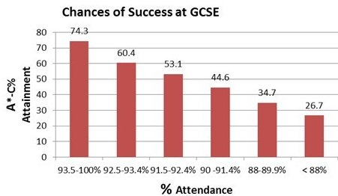
MORE KEY INFORMATION
We are unable to authorise ANY term time holiday the government withdrew the ability of a Headteacher to ‘authorise’ holiday except in the most exceptional of circumstance. For example, a parent returning from a posting abroad with the armed forces for a short period. If you believe you have an exceptional circumstance, please complete a Leave of Absence form in advance (See the website/Office). FS are not statutory until the term after they are 5, however we strongly encourage full attendance to ensure children do not suffer socially, emotionally or fall behind their peers. There is a VERY STRONG PROVEN link between attendance and achievement and attendance and confidence/emotional regulation. Russell’s attendance is historically around 97% which is exceptional and we want to keep it that way please(this year is has been 95% due to increased illness and unauthorised term time holidays. Fines are applied by the LA after 5 day unauthorised absence in any 12 week period.
Really important habits and beliefs are formed in your children now – it really is the ‘foundation’ year and is a crucial one

Slide 8

More key information
Milk and Fruit – milk is free up to the age of 5 and fruit is free to the end of Year 2. Most children will ‘have a go’ when their peers are
Water Bottles – everyday please and it doesn’t have to be a Russell one, named please
Food allergies/Medical Conditions – Information via the New Pupil Form and please keep us updated. We may do food tasting and activities in class. We will then liaise with the school kitchen. Please also return this to the school office ASAP if you haven’t already. PLEASE NOTE: WE ARE AN ALLERGY AWARE and A NUT AND NUT PRODUCT FREE SCHOOL
Head lice – please let us know as soon as possible, we will let other parents know via anonymous letter. Results in everyone checking hair and rarely an issue. Please do not send your child to school unless they have been ‘treated’ and are ‘clear’
Sickness and Diarrhoea – 48 hours from last episode. As with all absence, please email school (dedicated email for absence – pupilabsence@russell-lower.co.uk ) on the first day of absence explaining fully why your child has been absent from school. If we do not hear from you, we will ring to find out why your child is not at school.
Medicines – we can only administer PRESCRIBED medicines (by a doctor). You just need to bring them to the office and sign an indemnity form for us to be able to do this

Slide 9

More key information
School Meals – UIFSM (FS to Year 2). You can ‘chop and change’ between school dinners and packed lunch if you want to – for example Roast Dinner on Wednesday. Meals are provided by Caterlink, meet DfE dietary requirements and the kitchen has a 5 star hygiene rating (May 2023) Display here tonight. Foundation Stage go in first before everyone else and their teachers stay with them for the first 20 minutes or so.
UIFSM not to be confused with Pupil Premium – All children FS to Year 2 entitled to UIFSM but you may also be entitled to Pupil Premium (See Yellow Sheet) YOU HAVE TO APPLY FOR THIS YOURSELF USING THE SHEET PROVIDED-EVEN IF YOUR CHILD IS IN RECEPT OF THE EYPPG – THERE IS NO FORM FILLING,JUST A SIMPLE PHONE CALL -BUT IT CAN GET YOUR CHILD/SCHOOL AN ADDITIONAL £1300+ FUNDING. PLEASE do this if you are in receipt of any benefit such as Universal Credit
The Aviary – HIGHLY popular before and after school club and school holiday clubs – 7:45am to 6pm. Breakfast Club and snack at after school club. There is a charge for this. It is run by our school staff. Holiday Clubs by Premier Sport who lead half of our PE curriculum so the children know the adults. Contact possible via theaviary@russell-lower.co.uk WE CANNOT GUARANTEE YOUR CHILD A PLACE, WE HAVE A MAXIUMUM NUMBER ALLOWABLE FOR FIRE; IT IS STRICTLY ON FIRST COME FIRST SERVED BASIS

Slide 10
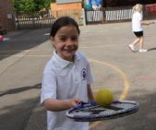
What if my child has special educational needs or disabilities?
We are a fully inclusive school – we already cater full a whole host of needs from Autism, ADHD, ADD, medical needs, physical needs, glue ear, grommets, speech and language, partial sightedness as well as support for children with trauma, attachment, loss and mental health concerns
We begin everything by asking how can each child be included
If your child already has SEND they will have a MAP (My Action Plan) which will be reviewed regularly with you so you can see how they are progressing
If you are concerned about SEND, speak to the class teacher initially
You can also contact our Inclusion Lead/SENDCo, Mrs Sarah Knight (here tonight)
Dedicated SEND/Inclusion email: send@russell-lower.co.uk

Slide 11

What do we really need from you?
A partnership between home and school
Get children to attend school everyday – if in doubt, bring them in and we will ring you
Be punctual – children hate being late and it affects their confidence
Homework – VITAL - READING 4 x week (1:1 time, vocabulary development, reading skills)
Other than this, very little – optional learning log every 2 weeks, show and tell, phonics and common exception words (which become spellings once they can read them)
Ensure children have sufficient rest, sleep and time with you throughout the week/weekend so they can have successful school days
Support the school’s policies – such as dropping quickly and confidently in the morning, sending healthy snacks, providing the correct ‘equipment’, reading etc.
To teach your child to be resilient and be ‘the parent’ – I know this sounds harsh and bossy, but it is so important. Children feel ‘safe’ when the parent/adult has control. Children will WANT control but they NEED you to have it. Giving children too many inappropriate choices will result in a deterioration of their behaviour and wellbeing. E.g. Do you want to go to school today? Do you want to go on the school trip/festival? Is it time for bed? Appropriate choices are great and to be encouraged (healthy lunch box choices, where to go at the weekend etc.)

Slide 12
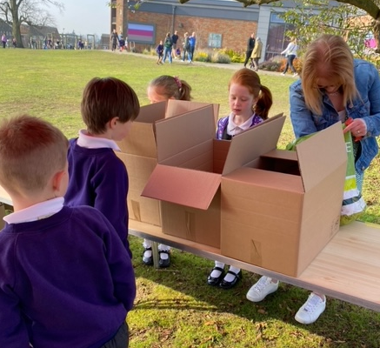
Our strong community ‘feel’ and wonderful PTA
PTA – Parent Teacher Association – an incredible group!
Regularly raise up to £20 000 A YEAR for school
6 Shelters, benches and tables for the school site, Trim-trails for each key stage, Ipads, outdoor gym, astroturf, Chromebooks, Phonics and AR books etc.
Exciting, sociable events such as School Ball (May 23), Quiz nights, Scavenger Hunts , Sunflower Competition, Sustainability days, Circus, Summer Fayre/Inflatable fun days, Halloween and Spring Discos, Sports morning and refreshment, Easter fun, theatre visits etc.
The PTA meet roughly every half term and hold friendly, efficient and enjoyable meetings. We have representatives here tonight – please go and talk to them. We would love you to join!

Slide 13
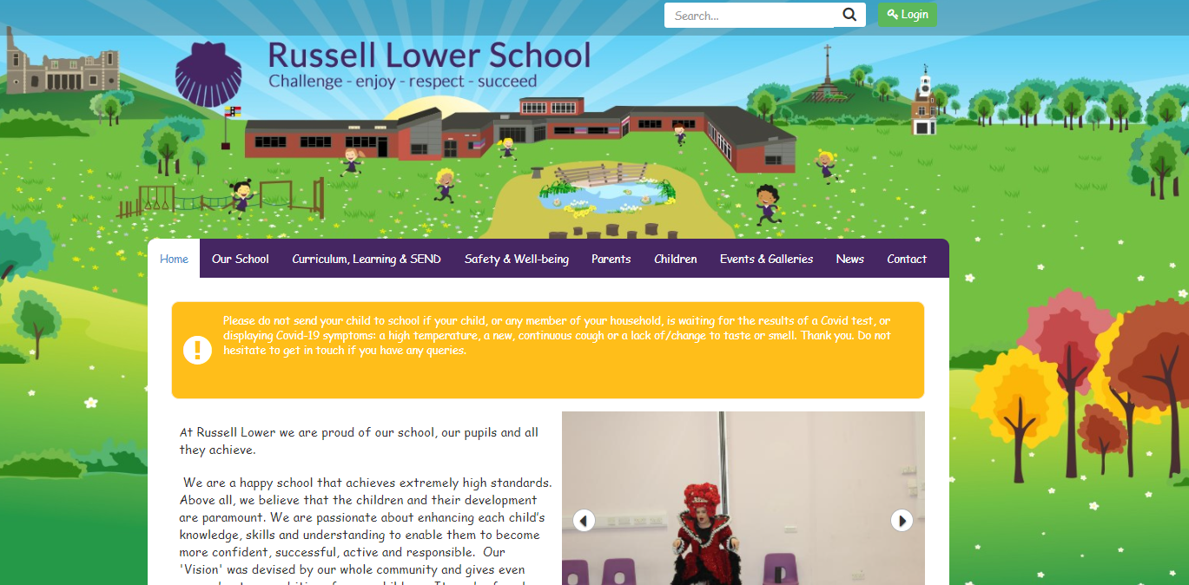
Sources of information
The website: www.russell-lower.co.uk (Curriculum, Policies, Photos, Letters etc.)
Email: office@russell-lower.co.uk Telephone: 01525 755664
Monthly Newsletter – updated calendar
Gate ‘duty’
Classroom doors/Open door in KS1– Class Teacher, Phase Leader (FS/KS1/KS2), Deputy Head Teacher and Headteacher
Class emails – robinclass@russell-lower.co.uk and what it isn’t for (pupil absence, something we need to see urgently that day) as it will not be looked at during the day
Special email contacts: send@russell-lower.co.uk, pastoralsupport@russell-lower.co.uk, theaviary@russell-lower.co.uk pupilabsence@russell-lower.co.uk

Slide 14
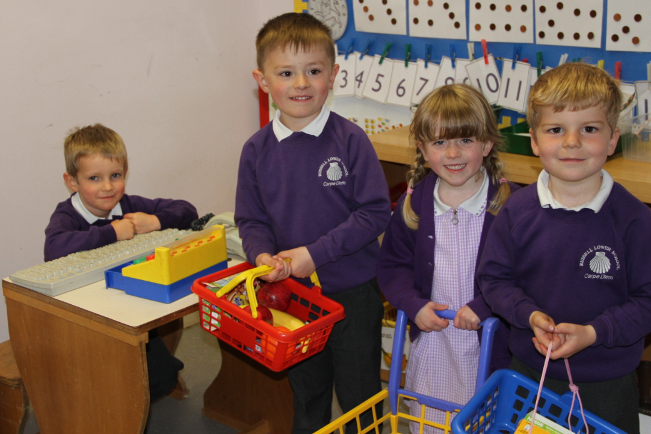
Starting details
The envelope you were handed today tells you the class, teacher, start date and home visit date
Half the children will begin on Wednesday 13th September (youngest: approx. March to August) and then everyone on Thursday 14th September
Home visits will take place between Monday 4th September and Monday 11th September – this information is in your pack – any queries or problems please speak to Mrs Bremner our Office Manager (01525 755 664 or office@russell-lower.co.uk).
Volunteering or helping in school – after October half term (allowing your children to settle), requires a ‘Volunteer session’ and a DBS
Stay and Play sessions – Friday 7th July (9:15 – 10:15 or 10:30 – 11:30) –Sign up for these today – your child does not need to wear school uniform for this, but will need to bring an adult with them! Sorry – it is the only day we can do as it is transition day (so Y4 are at middle school and it is the only day we have room to do it!)

Slide 15

questions
Can you cope with all allergies and intolerances? Yes, let us know and we will work with you to cater for anything
Can we ask for a specific class with specific friends? No, I am afraid not, but as I said earlier we have spoken to pre-school to find out friendships that work (and don’t) and want to ensure your child is happy. They will VERY QUICKLY make lots of new friends and there will be lots of ‘settling activities’ and opportunities to play across all 3 classes with all children
Do you encourage full-time from the beginning? Yes, 110%. Evidence (national) shows that children thrive socially and emotionally in this way. In addition, the children will miss valuable learning experiences if they are not here and gaps will grow between them and their peers
Can we have a phased start and who do we arrange it with? Yes, but we encourage this to only last as long as absolutely necessary as experience tells us gaps, social issues and emotional anxieties will develop. ‘Certainty is safe’ for all of us! – even when it is something we may not want to do ☺, it is better than inconsistency/unpredictability
What does before and after school club cost and how do I apply? It costs £3.80 per hour which includes snack or breakfast. We charge by the half hour after school (from 4:30pm), but not for the breakfast club which is a flat rate of £3.80 per session. See Mrs Appleby tonight or at any time in the school office to register for a place. PLEASE REMEMBER WE CANNOT GUARANTEE YOUR CHILD A PLACE AND THEY MAY HAVE TO GO ON A WAITING LIST
Will children get to meet the staff before they start? Yes, via stay and play, stay and lunch, home visits and pre-school visits (where local and possible)and what we will do if we cannot. This transition is tried and tested (even during really tricky Covid times) and works really well
Number of children in each class? Approximately 30 – as I said, we are full and in fact over-subscribed
Will you be taking part in the government’s baseline testing in 2023 and are you be using the new EYFS curriculum? Yes to both which are now statutory

Slide 16
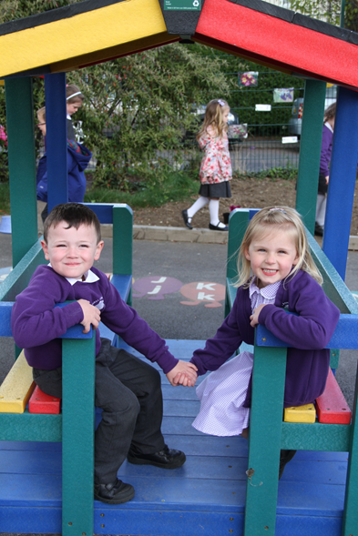
We hope you and your child will be really happy here…
The information from this presentation will be available on the school website under the Parent Workshop Tab
We hope you and your child will be really happy here.
We want children to love coming to school and aim to create ‘irresistible learning’ and a strong partnership with home
We are here to help – no question is a silly question!
Teaching staff, SLT out on ‘the gate’ and in doorways - and the school office are invaluable.
I look forward to meeting you and your children more over the coming months.
Please feel free to approach any of us later with questions.
Hand over to Mrs Brown – FS Leader – a typical day!

