Slide 1
Inclusion Coffee Morning
Behaviour as Communication
Friday 25th November

Slide 2
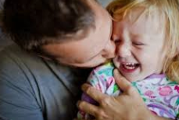

Being a parent…isn’t easy
Being a parent is at times:
Rewarding
Enjoyable
Demanding
Frustrating
Exhausting
Parents:
Learn through trial and error
Have their own approach
Should take one step at a time
Haven’t been in this exact situation before
Don’t have a handbook

Slide 3
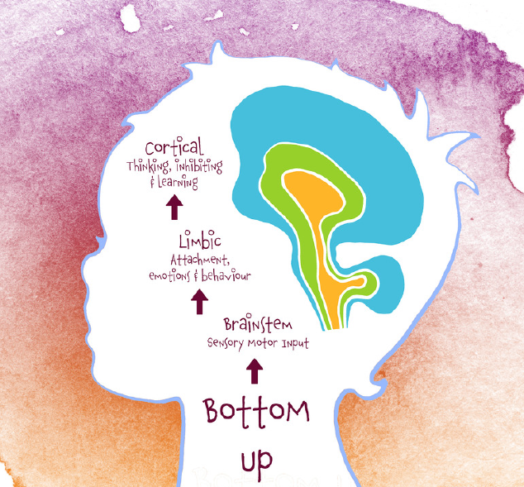
Child Development
Children’s brains develop slowly. The Amygdala or “survival/fight/flight or freeze” part of the brain develops before the Pre-frontal cortex or “thinking” part of the brain which is one of the last to develop and takes until early adulthood.
Children need to learn emotional regulation. Adults serve as an external regulator until children can regulate their own emotions. When children feel stressed, adults can help to reduce this.
Positive, enriching environments provide opportunities for children to learn emotional regulation in order to become emotionally regulated adults.
Some undesirable behaviour is normal (child’s development) – pushing boundaries, trying new things out.
Boundaries and consistent responses are important and make children feel safe
Managing everyday behaviour (even small issues) can prevent more serious behaviour problems
It’s not about being the perfect adult, it’s about tipping the scales towards positive outcomes.

Slide 4

The Hand Brain Model
https://www.youtube.com/watch?v=lRmnVmELMn8

Slide 5
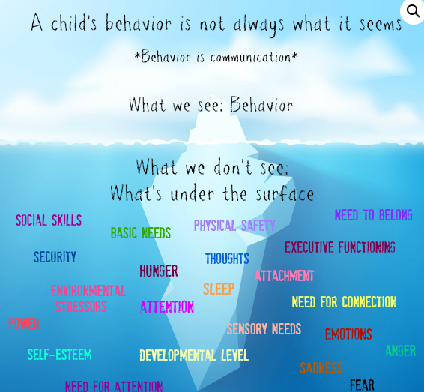
Behaviour is communication

Slide 6
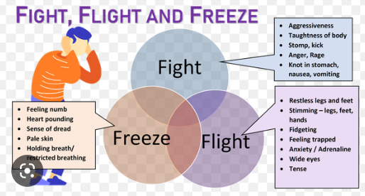
Meltdown or Panic Attack?

Slide 7
The role of adults
Building strong, nurturing relationships, Make your family a priority – spending time with your children
Create a warm, loving and safe environment.
Good communication – how do children know what you want them to do? Set an example and tell them. How you tell them is really important. Set expectations and communicate well
Plan ahead to prevent problems as well as supporting children to learn and do their best at an age appropriate level – communicate the expectation and behaviour, prepare in advance and have specific rules.
Focussing on the behaviour you want to see rather than that which you don’t. Positive attention. Still address the negative but focus on the positive.
Help child take responsibility for their behaviours and teach them to recognise and manage their emotions– don’t ignore the small things or they become big! Reasonable expectations for self and each other. Some misbehaviour is normal.
Take care of yourself – look after your own needs, balance work and family, talk back to negative thinking and work as a team!

Slide 8
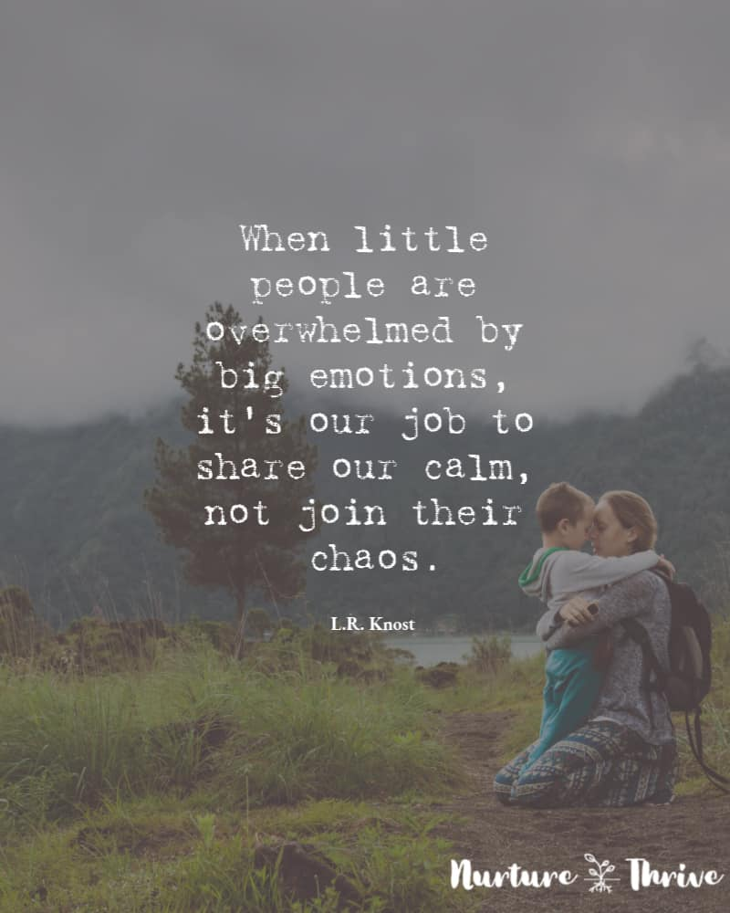
Emotional regulation
Support and teach children to recognise and name their emotions
Teach children to understand how emotions affect our bodies
Find alternative ways to express and regulate emotions
Co-regulate
Model self-regulation

Slide 9
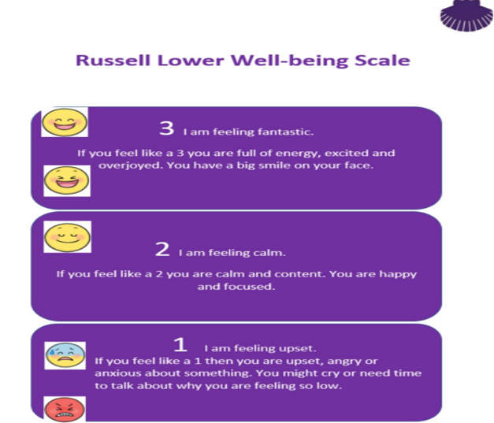
Wellbeing scale

Slide 10
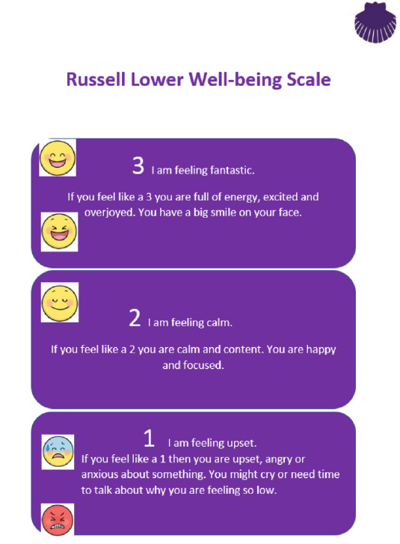
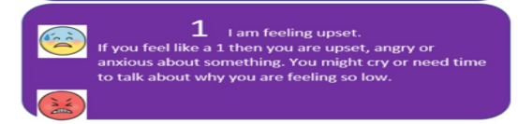
Feeling upset, angry or frustrated? We all do sometimes and that’s okay…it is what we do that matters

Slide 11

Use our emotion coaching and calm brain to protect our Russell Rights

Slide 12
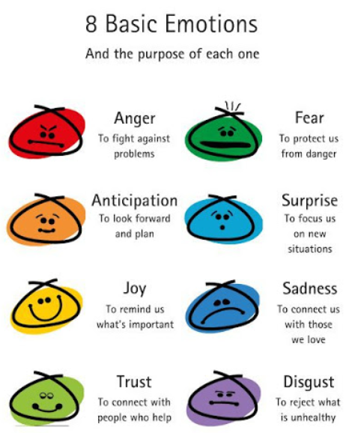

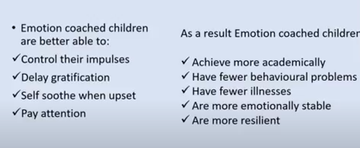
Emotion coaching – get control

Slide 13
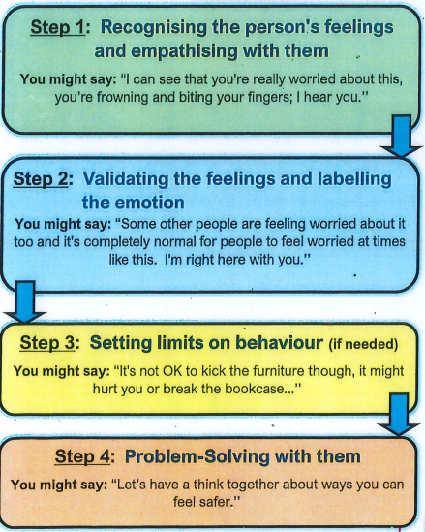
Emotion Coaching

Slide 14
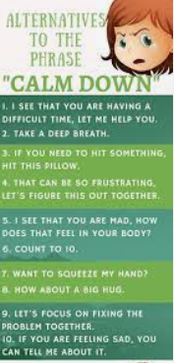

Recognise the feeling and empathise with them
I can see that you’re really worried about this, you’re frowning and biting your fingers; I hear you.

Slide 15
Validate the feeling and name the emotion
We separate the emotion (which is always fine to have), from the behaviour (which isn’t always fine)

Slide 16

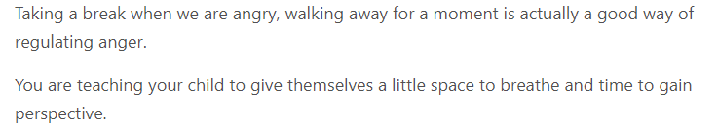
Setting limits on behaviour
We separate the emotion (which is always fine to have), from the behaviour (which isn’t always fine)

Slide 17
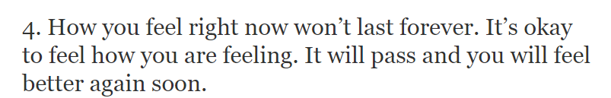

Problem Solving
Let’s have a think together about ways you can feel safer/happier/calmer.

Slide 18




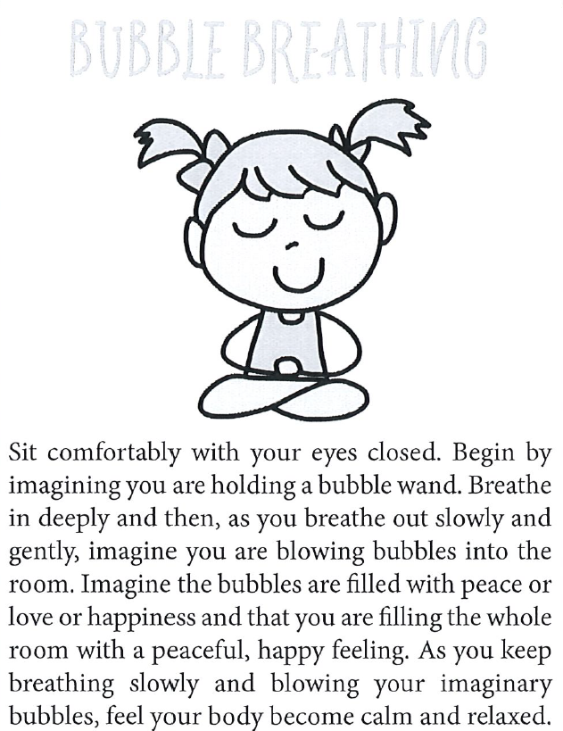
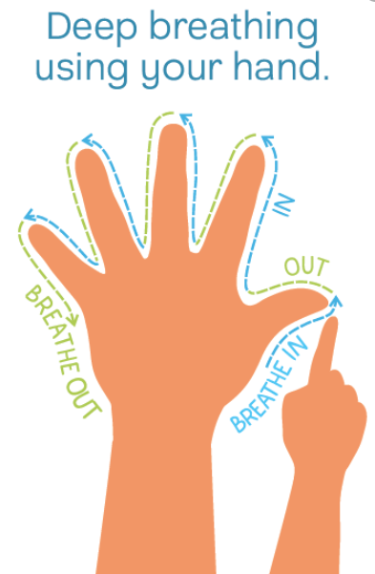
Time to let our brain make better choices
Calm Starts With Me

Slide 19
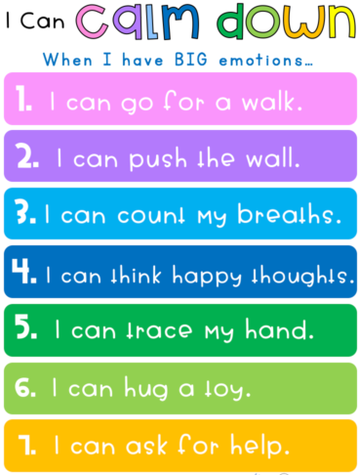
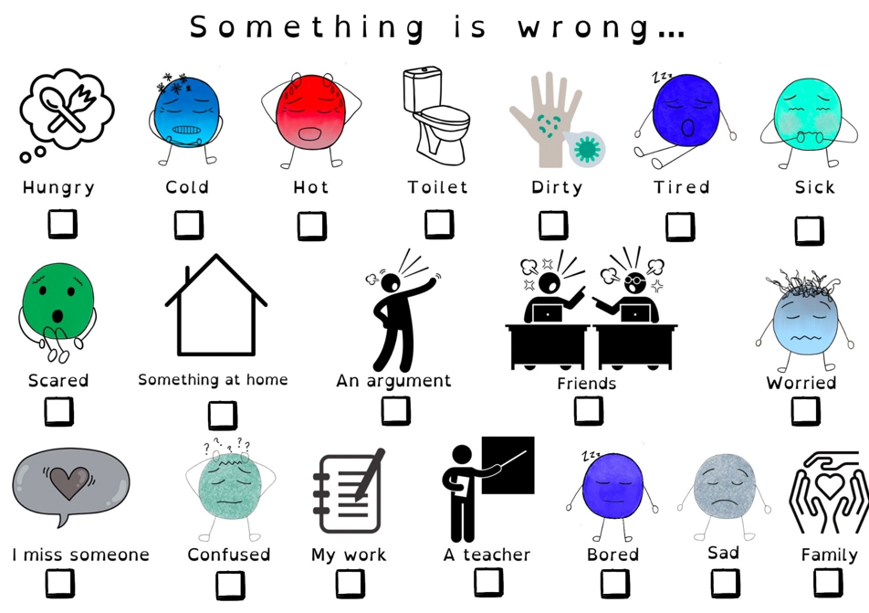
We could also:
Talk about what is upsetting us – use our Network hand
Do something to relax, like bubble breathing with your eyes closed
Do Mindful Colouring for 5 minutes, then try again
Count slowly to 10
Listen to calm music
Go for a walk
Blow bubbles
Distract/Divert
Change of face

Slide 20
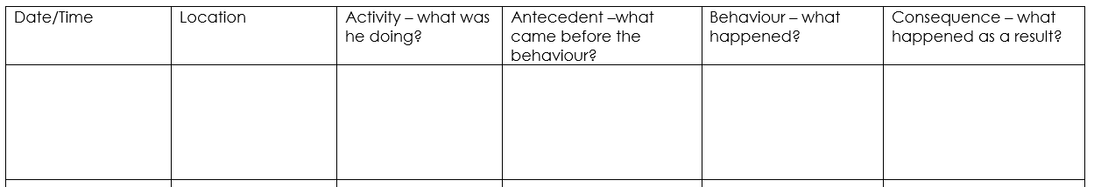
Is there a pattern to the behaviour? ABC

Slide 21
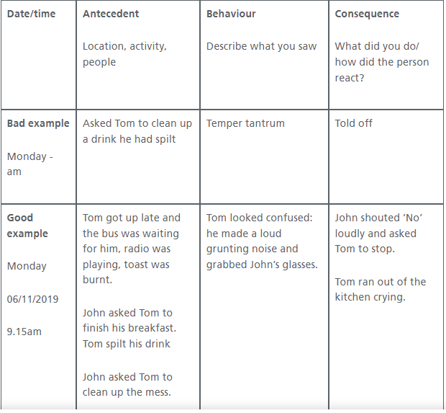
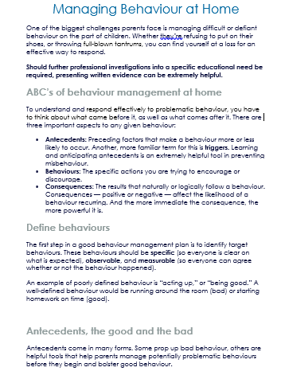
Find the trigger

Slide 22
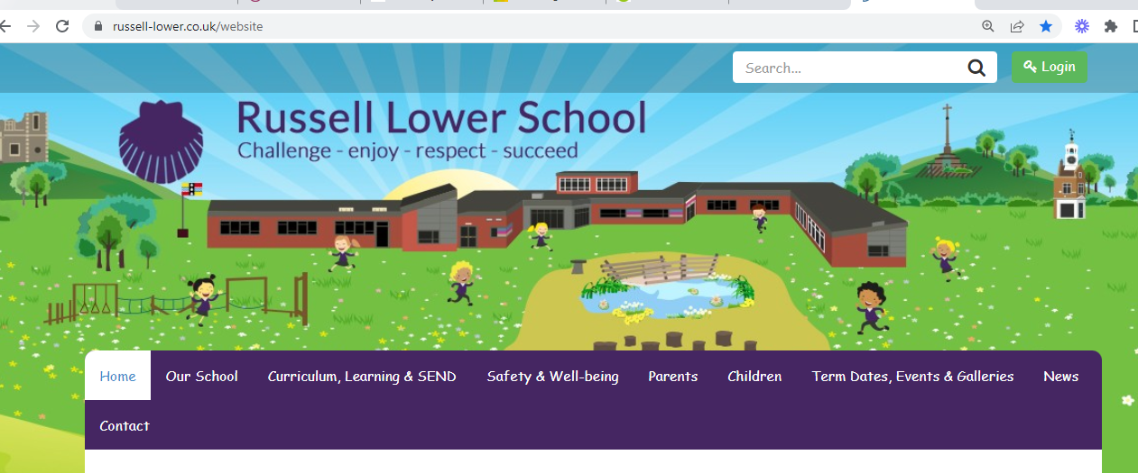


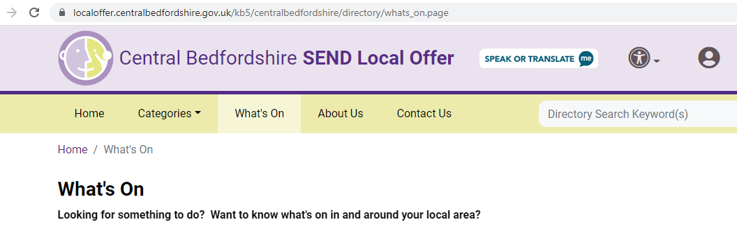
More information
Russell Website/Safety & Wellbeing/Pastoral Support
Locality Bulletin
Central Beds Local Offer
Books

Slide 23
Future Events
Friday 20th January at 2.30pm - suggestions for theme welcomed!
Wednesday 7th June 9.00am –
Smooth Transitions

Slide 24
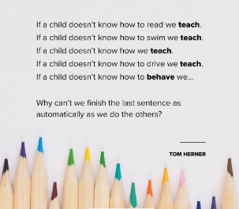
russell-lower.co.uk
office@russell-lower.co.uk
send@russell-lower.co.uk
pastoralsupport@russell-lower.co.uk

