Slide 1


Friendship
Summer 1 2024

Slide 2
Welcome to our ‘Values’ assembly
A value is a principle that guides our thinking and behaviour

Slide 3

This half term we will be exploring the value of:

Slide 4

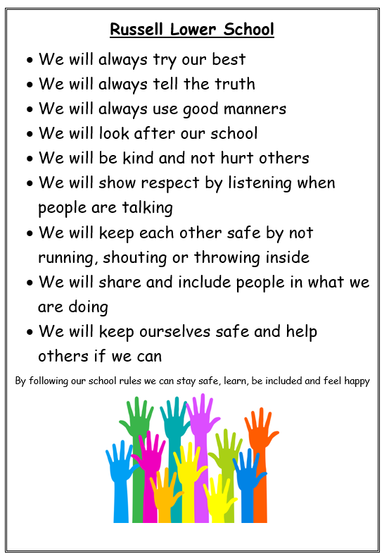
We are a team at Russell Lower School
We use the Russell Rights to help us.

Slide 5
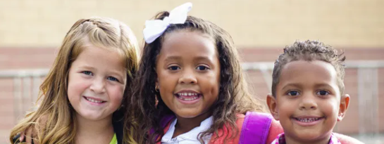
Every class is a team too. We need to be good friends.
We are all friends
We let anyone play
We can be friends with everyone. Just because I choose to play with someone else for a day/lunchtime/playtime does not mean that I am not friends with you any more
No child is ‘the boss’ of others and tells other children what to do. The adults are in charge. We ask others what they want to do too
We share everything – including whose turn it is to choose the game
We can have lots of friends
No one is left out
No one is laughed at
We always use kind hands and kind words

Slide 6
What are the qualities of a good friend?
A friend should be:
Honest
A good listener
Trustworthy
Encouraging
Caring
Gives you compliments and makes you feel good about yourself

Slide 7
Being there through thick and thin
Being a good friend is supporting them in the good times and the bad times.
The good times could be:
-Going to birthday parties
-Playing/ spending time with each other
The bad times could be:
Supporting them when they feel down
Remaining loyal when other people turn their back on them
Being there for them when they need support

Slide 8

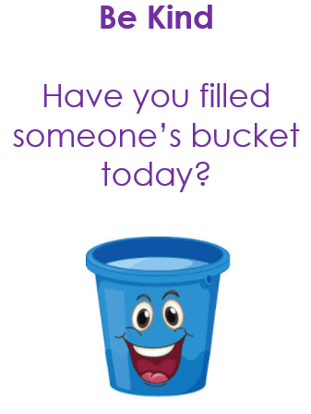
By being a good friend we are bucket fillers
When we are kind, helpful, honest, caring, respectful, tolerant, thoughtful (using ALL our values), it makes other people feel good AND we feel good too!
It’s a ‘win/win’!

Slide 9
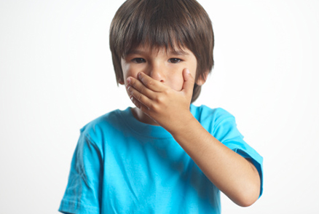
If I can’t say anything kind…

Slide 10
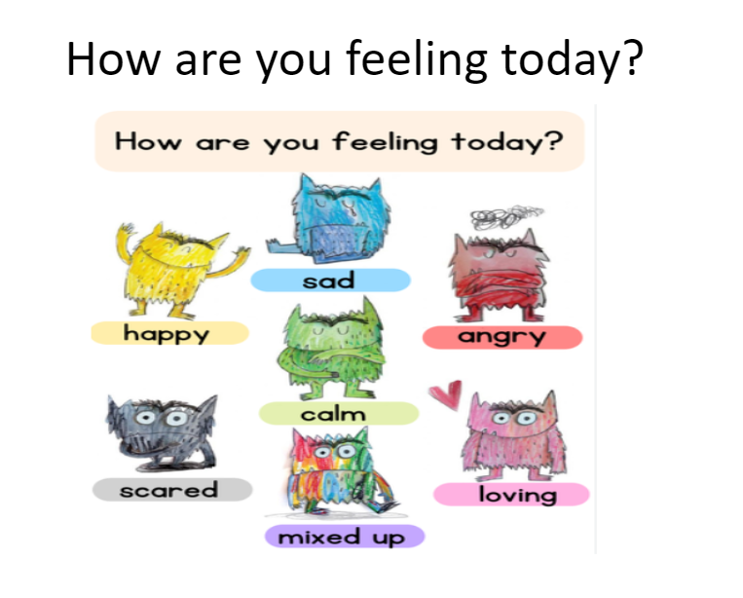
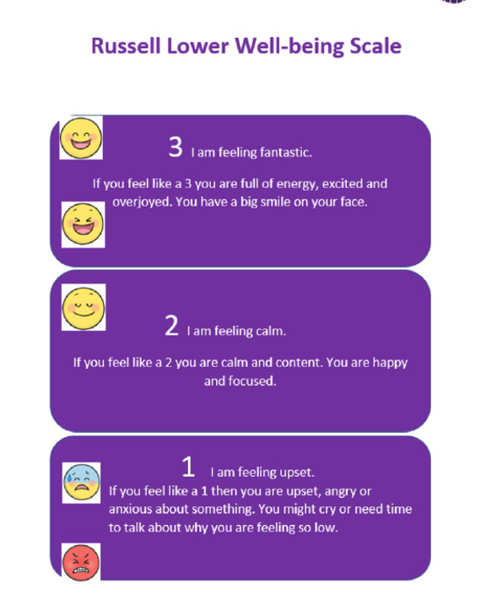
What can we do if things feel a little too much?

Slide 11
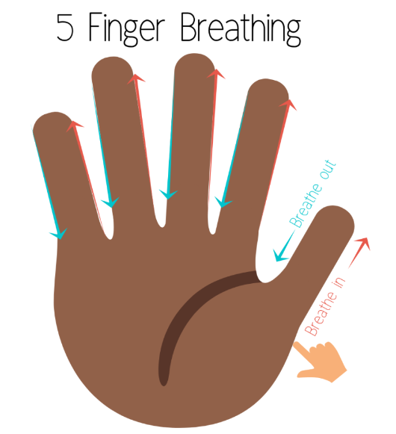
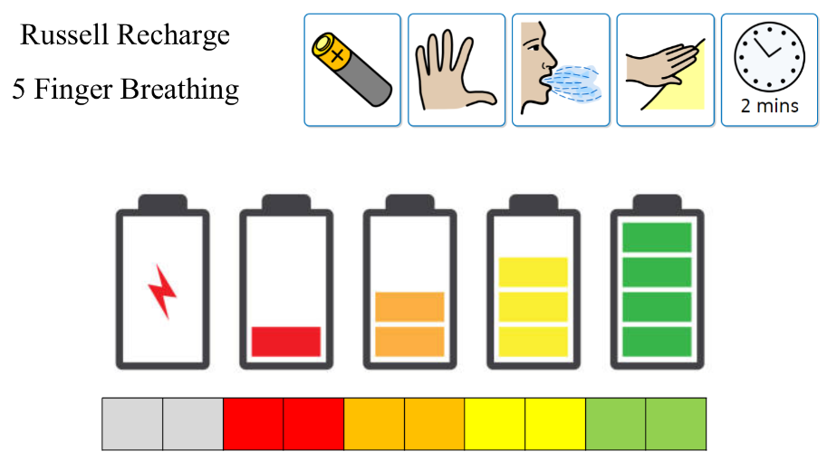
The Russell Recharge

Slide 12
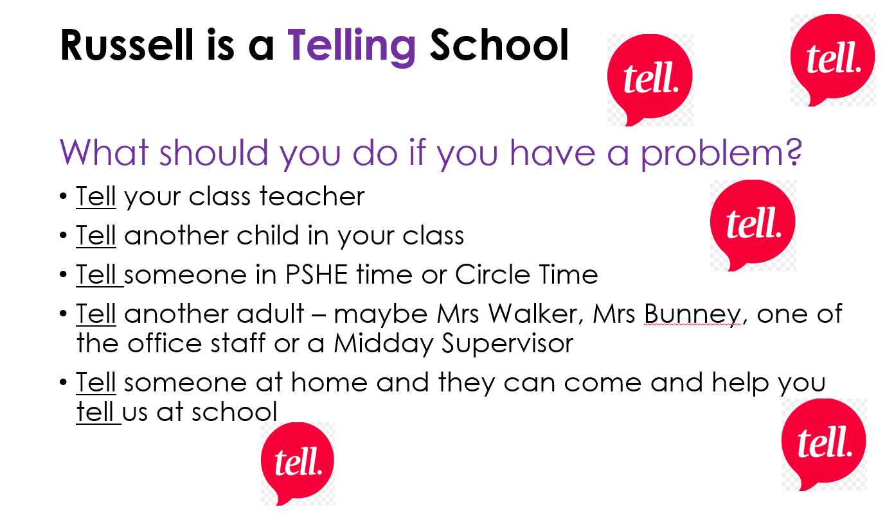
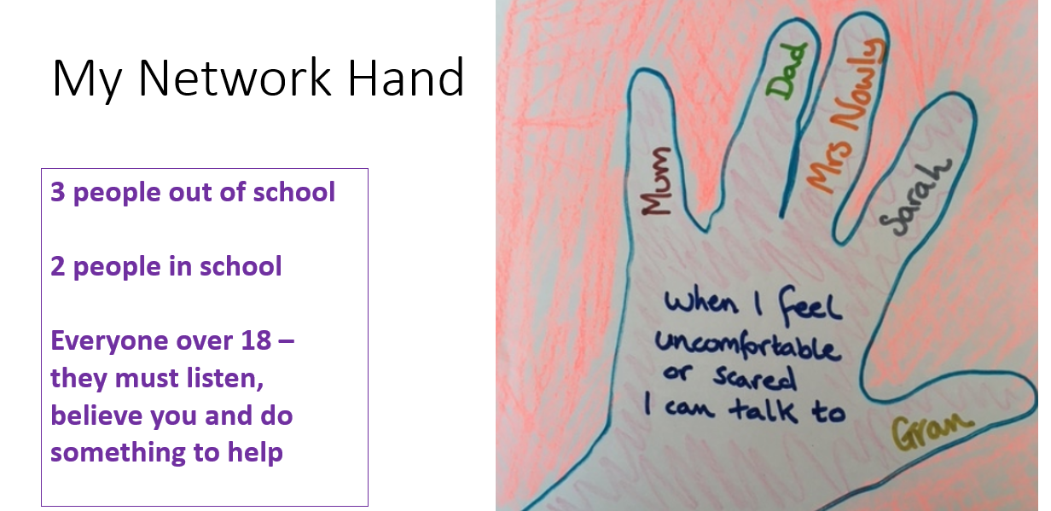
We are a telling school and can use our voice.
Notes:
‹#›

Slide 13
Reflect on how you can show to friendship to others
Here in our school
Let us be peaceful at all times.
Let our rooms be full of happiness
And respect for each other.
Let love be in our hearts
With kindness and compassion for all.
Let us remember
In learning together,
We grow together
And succeed together.

