Slide 1
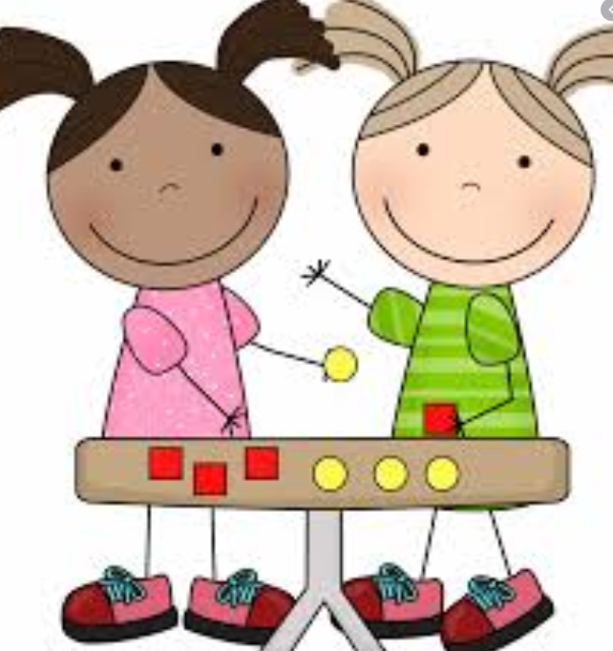
Responsibility and Cooperation
SPRING 2 2024
Responsibility song

Slide 2
Welcome to our ‘Values’ assembly
A value is a principle that guides our thinking and behaviour

Slide 4
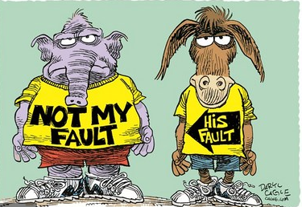
This half term we will be exploring the values of:
Responsibility
&
Cooperation

Slide 5
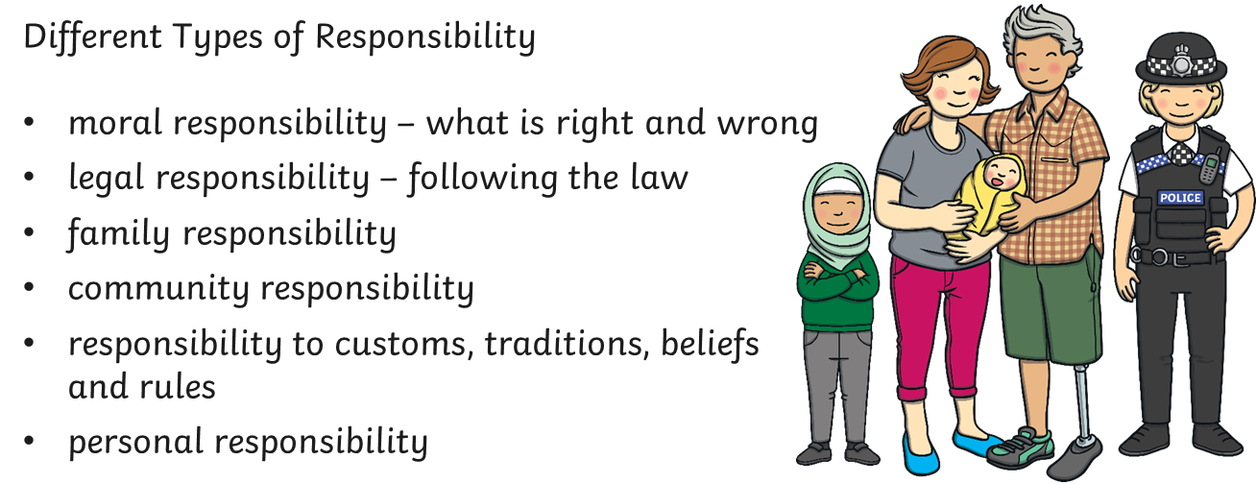
What Does Responsibility Mean?

Slide 6
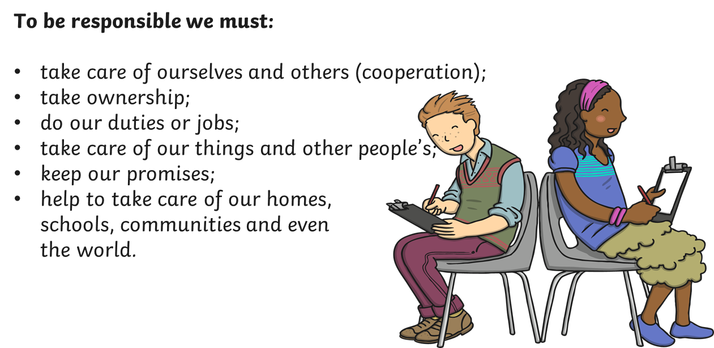
How Can We Be Responsible?

Slide 7
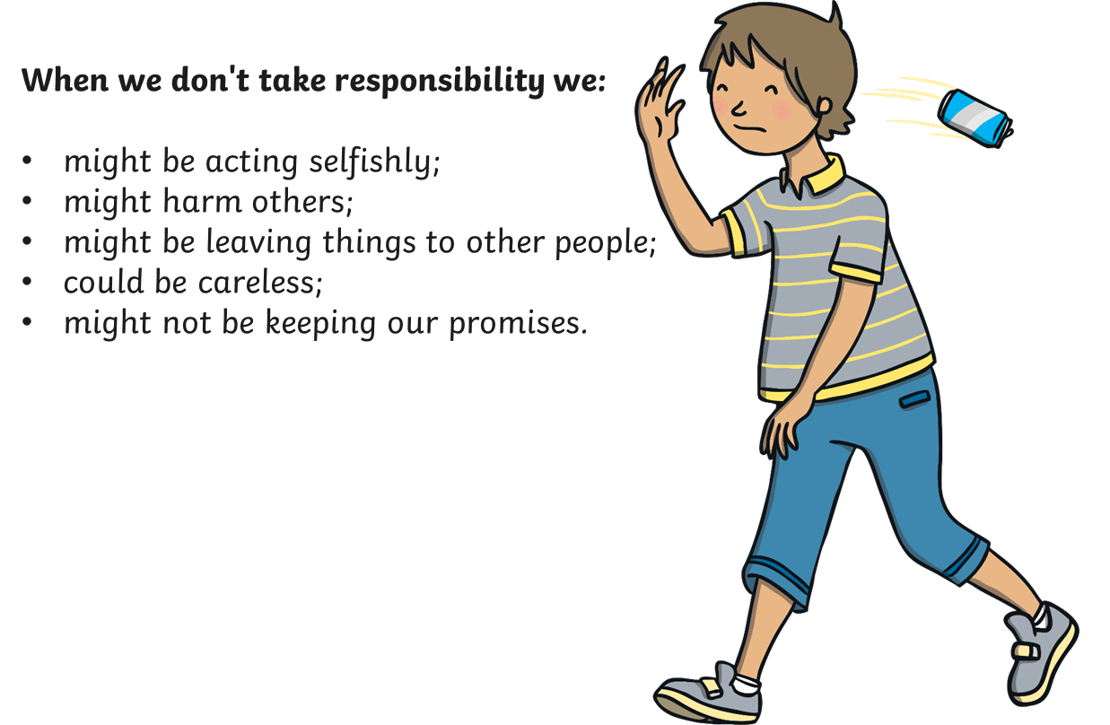
What Happens When We Are Not?

Slide 8
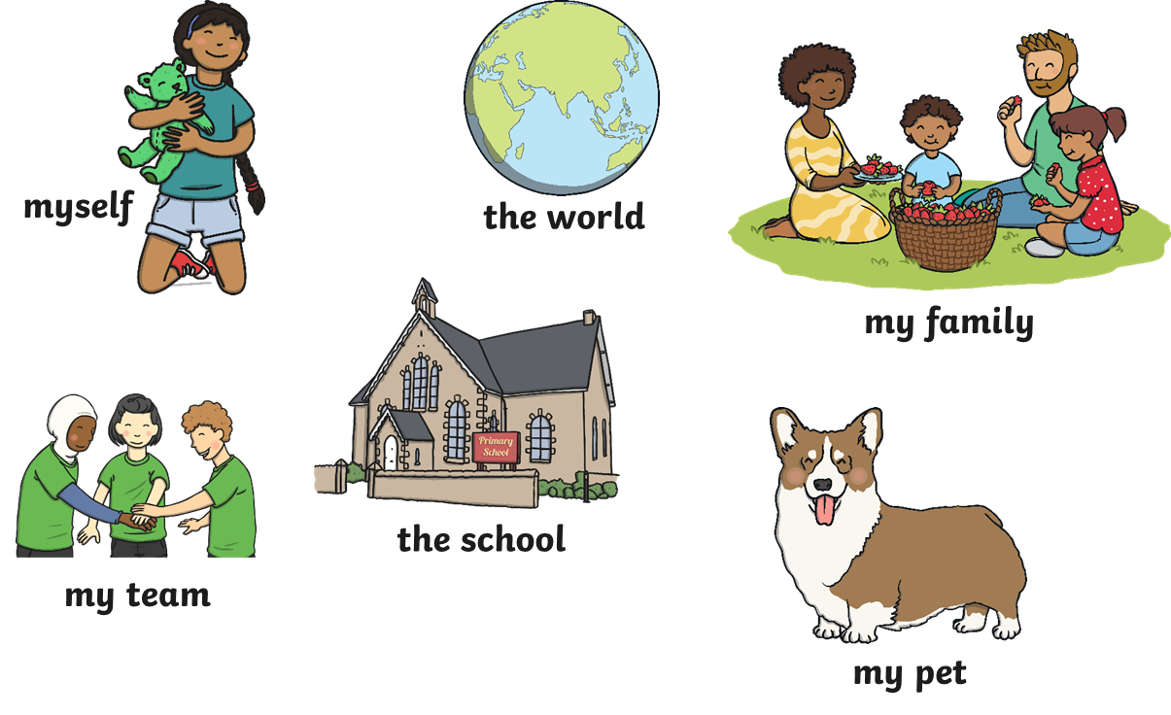
Which of These Are You Responsible For?

Slide 9
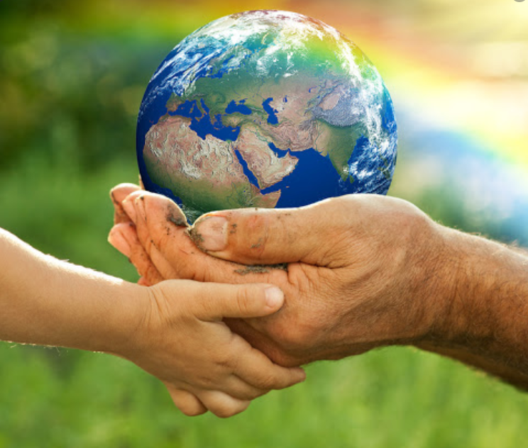
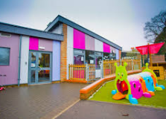
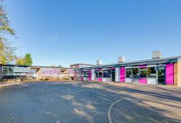
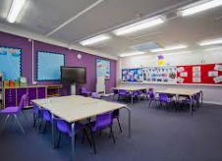
Our Focus
Personal and Moral Responsibility (Earth, animals and people)
Community Responsibility (Russell Lower School and Ampthill)
Notes:
‹#›

Slide 10
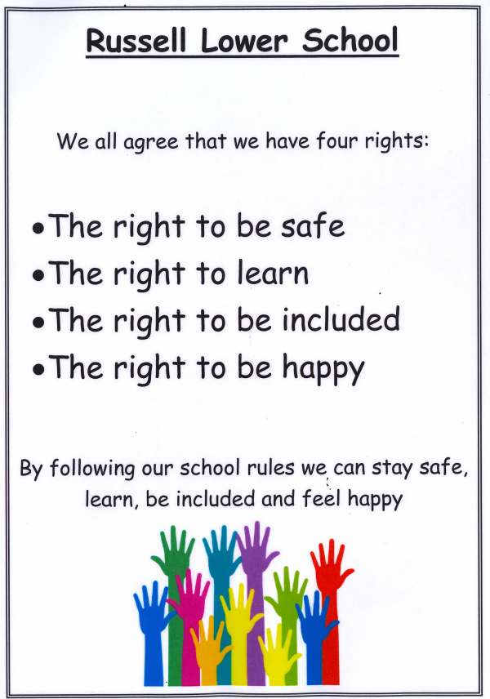
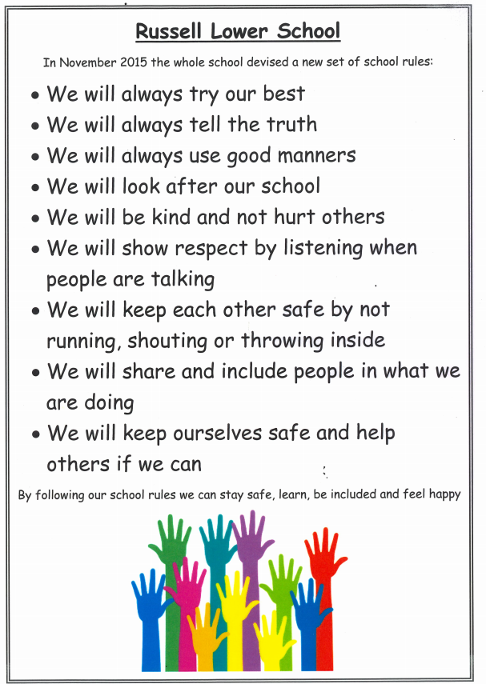
Personal, moral and community responsibility – looking after ourselves and each other

Slide 11
Looking after the Earth
Earth is a beautiful planet
It gives us what we need:
Food, Shelter, Air and Water

Slide 12
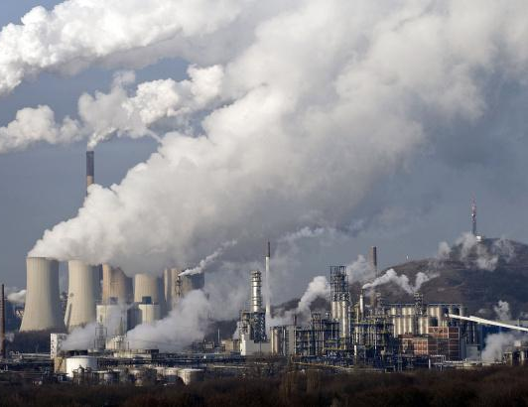
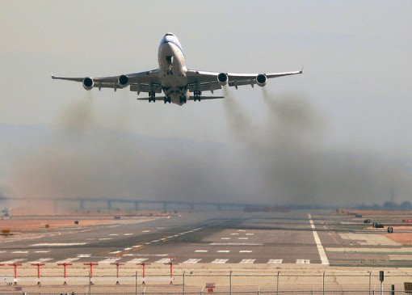
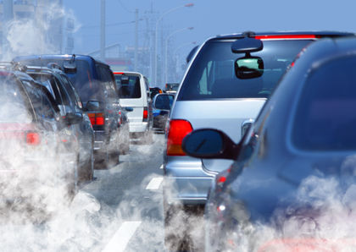
How do we treat the Earth?
Pollute it (air and water)
Air pollution is causing the Earth to heat up causing climate change. Air pollution comes from cars, aeroplanes and factories producing CO₂.

Slide 13
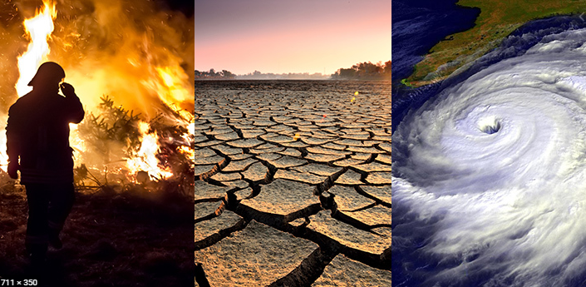
How climate change is impacting Earth

Slide 14
What can we do?
Try to walk/cycle/scoot more to school
Only travel in the car when you need to
Q: How did you travel to school today? How could you travel tomorrow?
Not throwing litter into water sources
Only use what we need
Recycle unused paper etc.
Turn the lights and water off when not using them
Energy monitor (check lights/ computer switched off)

Slide 15
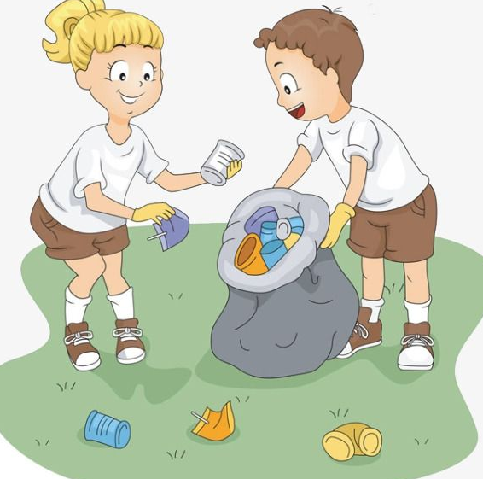
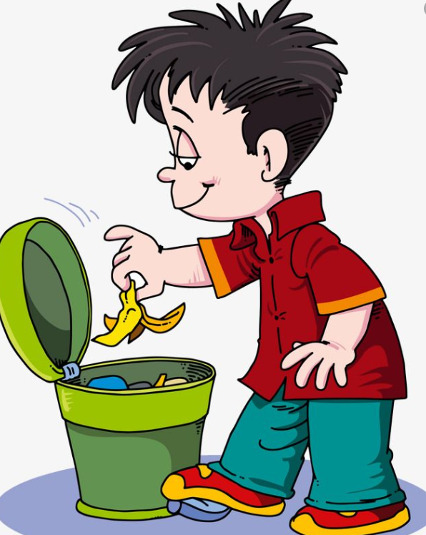
Whose Responsibility is it?

