Slide 1
Happy New Year!
SPRING 1

Slide 2
Sharing and Caring
SPRING 1

Slide 3
Welcome to our ‘Values’ assembly
A value is a principle that guides our thinking and behaviour

Slide 4
Values so far…
Can you remember which values we have already covered this year?
Respect Thoughtfulness

Slide 5
Sharing and Caring
What is sharing?
When have you experienced sharing in school?
What can we share?

Slide 6
What is sharing?
Sharing is when you let others use something that is yours.
Sharing is when you all use something together and take turns.
When we share everyone feels happy.

Slide 7
What is sharing?

Slide 8
What is sharing?

Slide 9
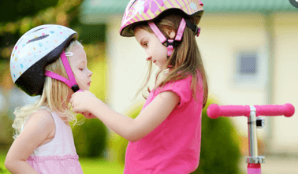
How can we share and show that we care?
Taking turns with classroom equipment
Playing together with toys on the playground
Being understanding and patient
Thinking about the needs of other people
Noticing and asking if your friend or teacher needs help

