Slide 1
https://www.jca-adventure.co.uk/activity-centres/condover-hall/
Condover Hall 2025
Adventure Centre for educational activities

Slide 2
https://www.youtube.com/watch?v=wsxwx5Lknzw
Let the adventure begin!
Adventure Centre for educational activities

Slide 3
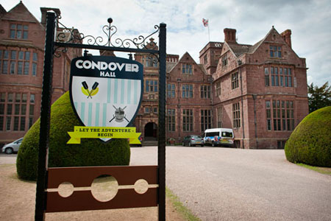
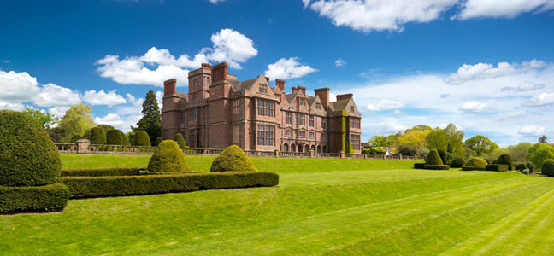
Condover Hall
Built in 1586, Condover Hall is a grade I Elizabethan Mansion. Set in 78 acres of fantastic countryside and gardens your students will experience history, beautiful surroundings and state of the art activities during their stay.

Slide 4
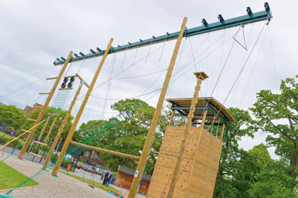
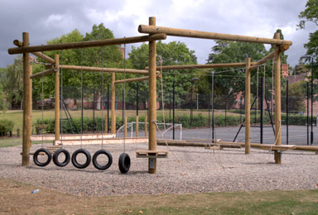
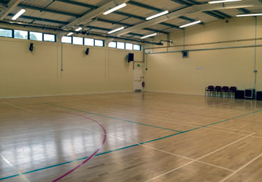
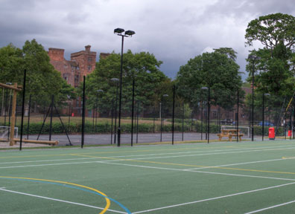
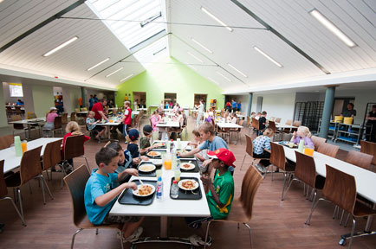
Facilities
High Ropes
Low Ropes
Sports Hall
Sports Courts
Restaurant

Slide 5
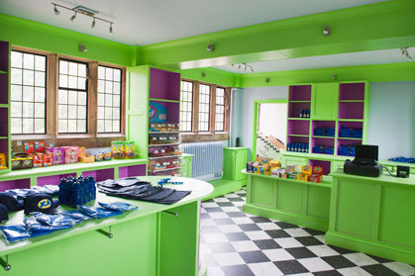
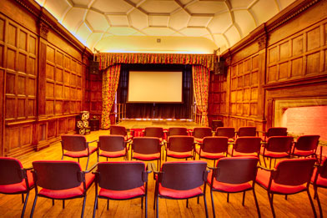
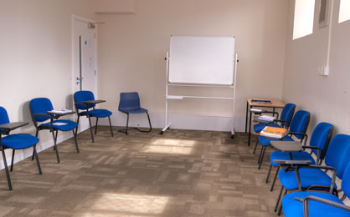
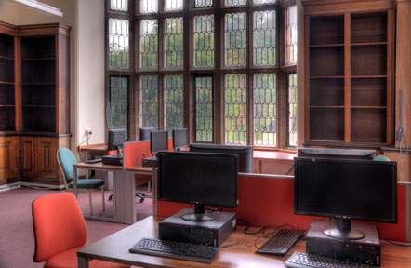
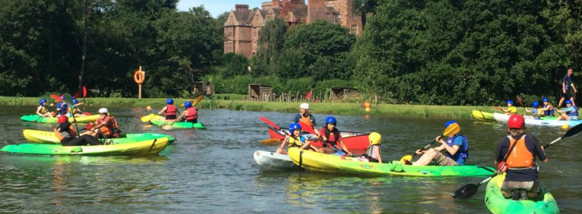
Facilities
Cinema Room
Classroom
Tuck Shop/Gift Shop
Water Sports on a man made lake
IT Suite

Slide 6
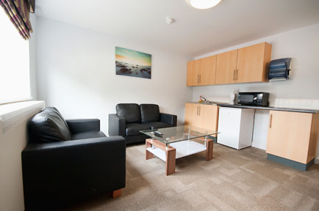
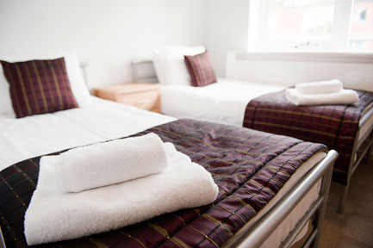
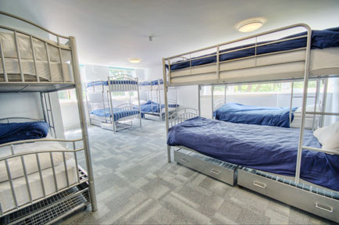
Accommodation
Accommodation comprises several blocks, all of which are completely refurbished. A member of JCA staff is on call 24 hours a day. In the evening Senior Staff are on duty until 11pm and night security patrol between 11pm and 7am.
Teacher’s Lounges
Teacher’s Rooms
Spacious Dormitories

Slide 7
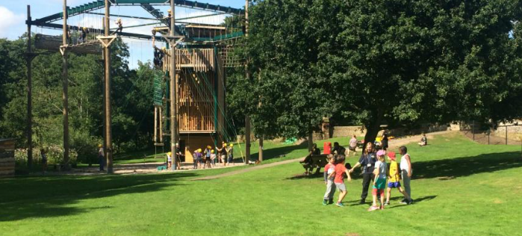
Activities
^{Activities include:}
Run Around Quiz
Survival
Team Challenge
Tunnelling
Wet and Wacky
Wide Games
Zipwire
Abseiling
Archery
Buggy Building
Camp Fire
Climbing
Fencing
High Ropes
Mini Olympics
Orienteering

Slide 8
Kit list:
Sleeping bag (named)
NO JEANS
Day bag - packed lunch and drinks for day of departure (no glass, fizz, nuts or chocolate), reading book, mini games for the coach
Night clothes
Underwear
Pairs of socks
Trousers and Leggings
T-shirts
Jumper/sweatshirt/Fleece
Waterproof Jacket
Trainers or other substantial footwear
Swimwear
Washbag
Toothbrush/paste
Flannel/soap/shower gel
Towel – large bath towel
Book
Sun hat
Sun cream
ALL NAMED
PLEASE!

Slide 9
All medication should be clearly labelled and handed directly to staff on the medication table in the hall ( Do not pack this!)
No mobile phones, smart watches
No electronic gaming equipment
No disposable camera or normal cameras
Your child must be able to carry their own luggage to the coach and from the coach to the accommodation!

Slide 10
Mrs Tuck (Group Leader)
Mrs Knight (Pocket Money / SEND Support)
Mrs Walker (Medicines)
Mrs Wolfe ( Asthmatics)
Mrs Beirne (First Aider)
Mrs Moffat
Miss Jones
Mrs Stringer
Mrs Roberts
Miss Dunham
Miss Church
Staffing

Slide 12
On the day: The journey will take 2.00 – 2.40 hours
Drop off in the main hall
Drop off luggage, medicines, spending money (£10 max), packed lunch for the day and drinks
Say goodbye to the children as they will not be leaving school until 10am.Children go into normal classrooms to register and prepare for the trip
We will leave at approximately 10am from the Fire Station. We will send updates back to school who will update the Website/Facebook when we arrive.

Slide 13
Questions:
What time will we get back? We will be leaving about 12:30, so all being well we should be back by 3:30pm. We will update the Website and Facebook
Do they get to call home? No
What is the food like, I have a fussy eater! Good, we have taken fussy eaters before with no problems
Who do I speak to about additional needs such as dietary or medical? Mrs Tuck
What do we need to take? Kit list + sensible amount of ‘snacks’, reading book, teddy, £10 pocket money (max) in change in a named envelope, packed lunch and drinks for day of departure (no glass, fizz, nuts or chocolate please)

Slide 14
Questions:
What about contact while they are away? Updates via website and Facebook. If you need to contact us, ring school and they will get hold of us
Dormitories and allocation – up to 10, all boys/girls, friendship groups
Do you have to do all the activities? No, but we will really encourage it
Do you have to be able to swim? No
Can they cater for food intolerance and allergies? Yes
Toilet and shower arrangements and going to the loo at night? Well lit corridors and often rooms have own toilet / shower.
ANY OTHER QUESTIONS?

Slide 15
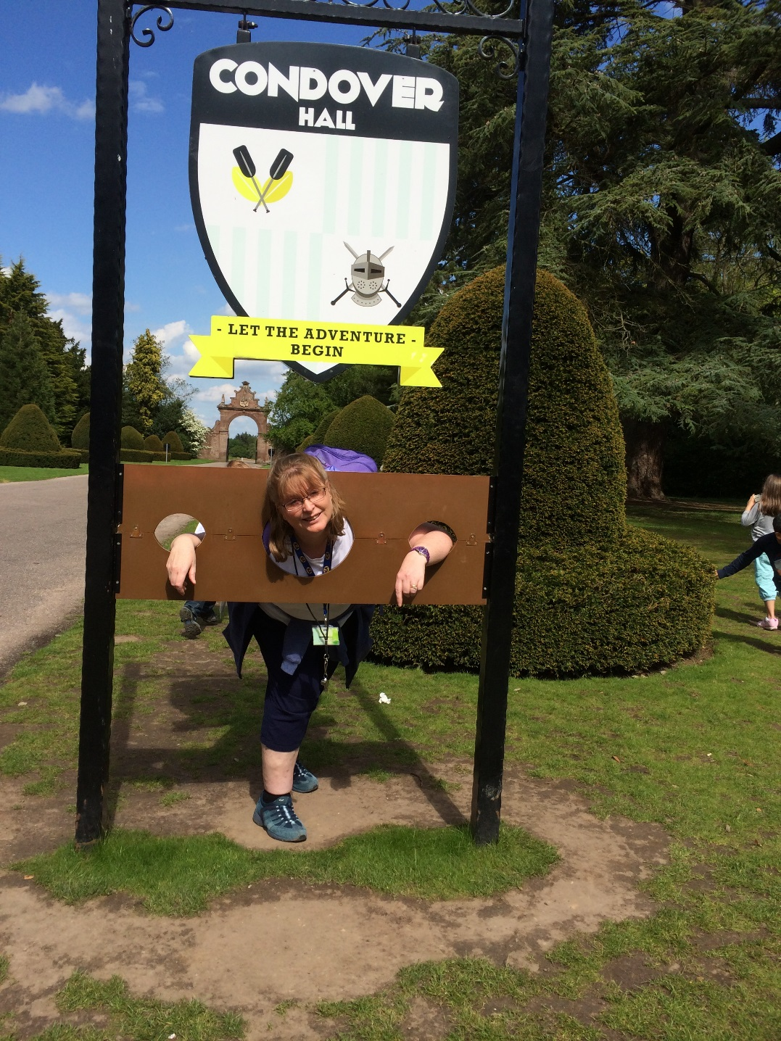
ANY OTHER QUESTIONS?

