Slide 1
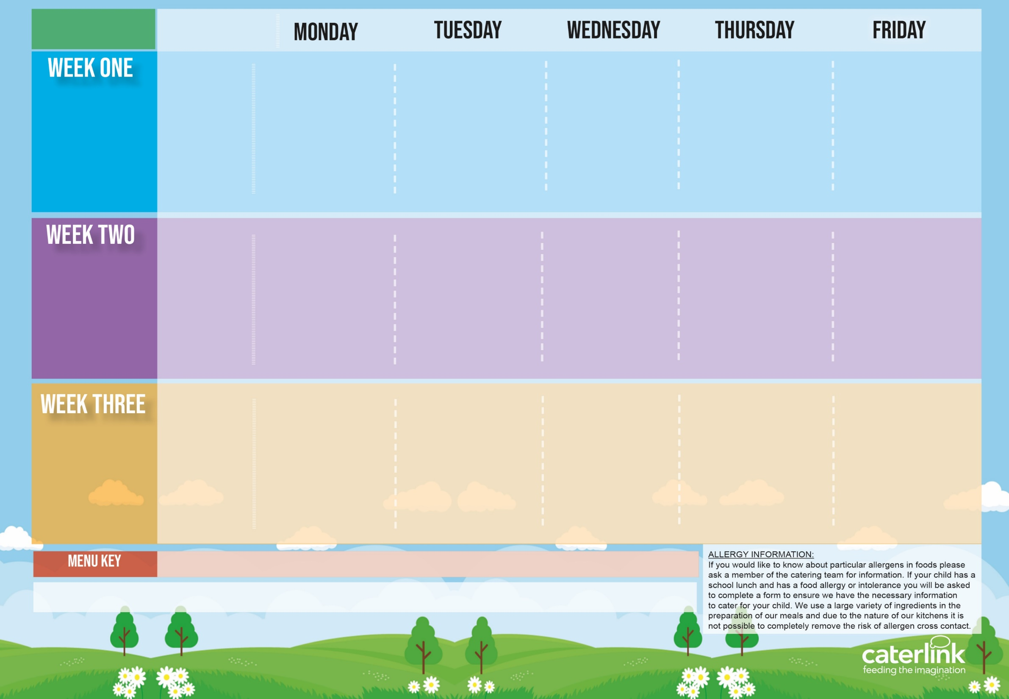








Autumn Winter
2025 2026
Option One
Option Two
Vegetables
Dessert
Plant Balls in Tomato Sauce with Rice | Beef Lasagne with Garlic Bread | Roast Chicken, Stuffing, Roast Potatoes and Gravy | NEW Chicken Biryani | Fishfingers or Salmon Fishfingers with Chips & Tomato Sauce
Autumn Vegetable Lasagne | Beetroot and Lentil Burger in a Bun with Potato Wedges | Vegetarian Wellington with Roast Potatoes and Gravy | NEW BBQ Sausage Pasta with Garlic Bread | Cheese and Bean Pasty with Chips and Tomato Sauce
Vegetables of the Day | Vegetables of the Day | Vegetables of the Day | Vegetables of the Day | Vegetables of the Day
Cheese and Crackers | NEW Apple Crumb Cake with Custard | Fruit Medley | Jelly with Mandarins | Syrup Sponge with Custard
03/11/25
24/11/25
15/12/25
19/01/26
09/02/26
09/03/26
Option One
Option Two
Vegetables
Dessert
Classic Cheese and Tomato Pizza with Wedges | Spaghetti Bolognaise | BBQ Chicken with Seasoned Potatoes and Sweetcorn Salsa | Meatballs in Tomato Sauce with Rice | Breaded Fish or Fishfingers with Chips & Tomato Sauce
Mild Mexican Chilli with Rice | Vegan Spaghetti Bolognaise | BBQ Quorn with Seasoned Potatoes and Sweetcorn Salsa | Creamy Chickpea and Coconut Curry with Rice | Cheese Whirl with Chips and Tomato Sauce
Vegetables of the Day | Vegetables of the Day | Vegetables of the Day | Vegetables of the Day | Vegetables of the Day
NEW Gingerbread Cookie | Chocolate and Beetroot Brownie with Chocolate Sauce | Fruit Salad | Sticky Toffee Apple Crumble with Custard | Vanilla Shortbread
10/11/25
01/12/25
05/01/26
26/01/26
23/02/26
16/03/26
Option One
Option Two
Vegetables
Dessert
Macaroni Cheese | NEW Chicken 50% Enchilada Bake with Paprika Wedges | Sausage with Roast Potatoes and Gravy | Mild Caribbean Chicken with Golden Rice Caribbean Stew with Golden Rice | Fishfingers with Chips & Tomato Sauce
NEW Chefs Special Lentil Curry with Rice | Tomato Pasta | Vegan Sausage and Roast Potatoes and Gravy |  | Red Pepper Frittata with Chips & Tomato Sauce
Vegetables of the Day | Vegetables of the Day | Vegetables of the Day | Vegetables of the Day | Vegetables of the Day
Oaty Cookie | Pear Crumble with Custard | Fruit Salad | NEW Jamaican Ginger Cake with Custard | Cornflake Tart
17/11/25
08/12/25
12/01/26
03/02/26
02/03/26
23/03/26
Added Plant Protein
Wholemeal
Vegan
Chef’s Special
Lowest CO₂ Footprint Option
Available Daily: - Freshly cooked jacket potatoes with a choice of fillings - Bread freshly baked on site daily- Daily salad selection – Fresh Fruit and Yoghurt

