Slide 1
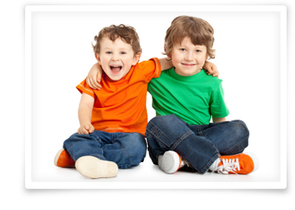
Why do we need to behave in school?

Slide 2
Why do we need to behave in school?
To keep us all safe
So we are all happy at school
So that we can learn
So we can all be included

Slide 3
Everyone’s rights…
The right to learn
The right to be happy
The right to be safe
The right to be included

Slide 4
We choose how we behave
I can make good choices
OR
I can make bad choices
BUT – one thing is for sure…
WE make the choice so WE are responsible for our behaviour and have to take the CONSEQUENCES

Slide 5
If an adult has to give a warning
A reminder ‘We all have the right to be safe, do not push children on the playground or they might get hurt’
A second reminder with a future choice or consequence ‘You must play nicely. We all have the right to be safe. If you push again you will have to have 5 minutes time out walking with me.’
The consequence – WILL HAPPEN – You have your time out

Slide 6
What if I still don’t make a good choice?
You might be asked to leave the classroom and go to a different one for a short while until your behaviour gets better
You will have your behaviour written down on the computer
You might go and see Mrs Bunney or Mrs Walker
You might have a meeting with your parents and Mrs Walker or Mrs Bunney
Mrs Walker might then check there is an improvement in your behaviour a little while later

Slide 7
Do we all agree to our ‘rights’ and to behave in school?
Think about why we need Rights and Rules

Slide 8
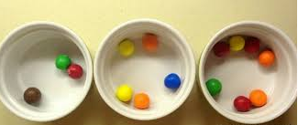
To be fair on everyone!
No one wants to come to school to be UNHAPPY, to be UNSAFE, to be EXCLUDED or to NOT LEARN. If you do, you are in the WRONG place.
We have to be fair on all the other children in the school and respect and follow our Rights and Rules

