Slide 1
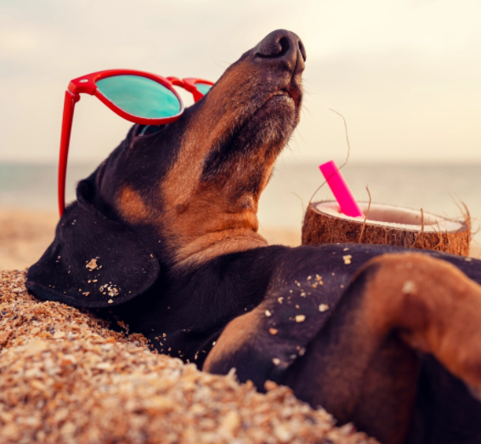

Welcome back to school! We hope you had a wonderful summer holiday.

Slide 2
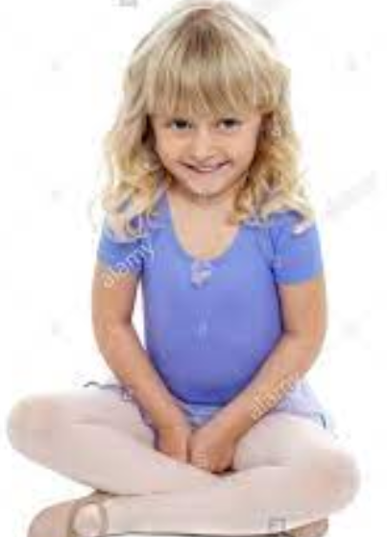
Some assemblies will be in the hall. Can we remember the rules?
Come in one behind the other in a line without talking
Sit in your class line
Sit with your legs crossed
Sit with your hands in your lap
No talking in assembly
Eyes on the board or on the grown up

Slide 3

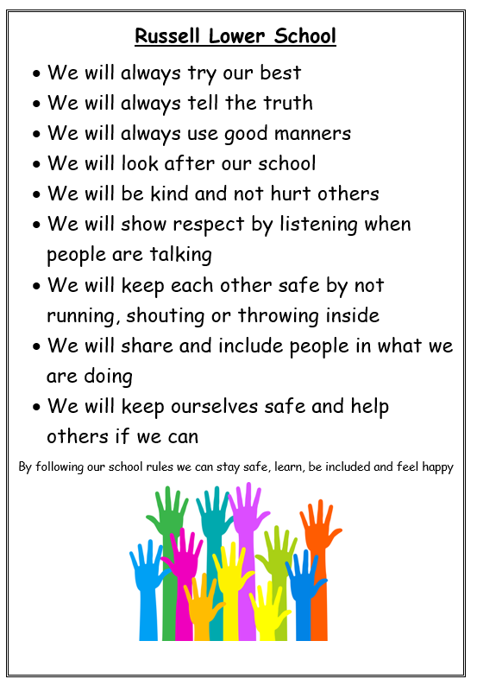
What is the same at school? Expectations!

Slide 4
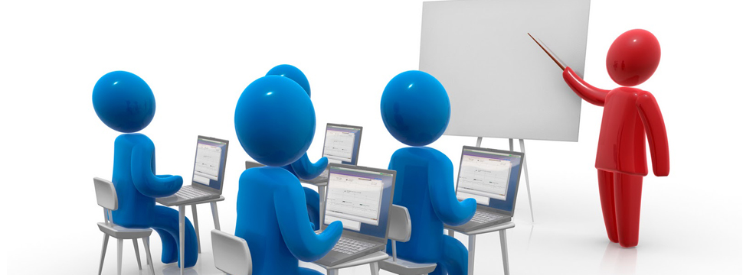


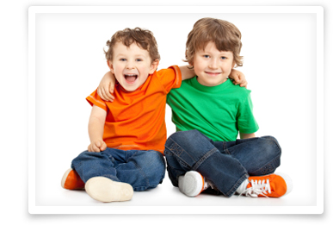
Everyone’s rights…
The right to learn
The right to be happy
The right to be safe
The right to be included

Slide 5
The right to be safe

Slide 6
The right to be safe
We are a ‘Telling School’

Slide 7
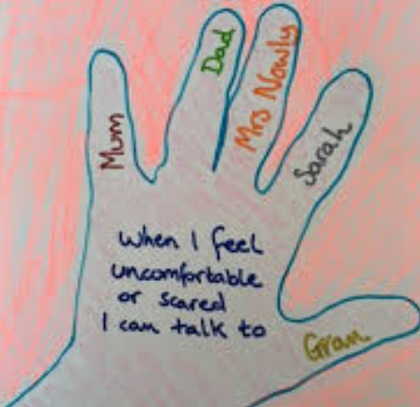


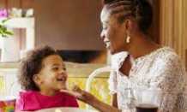

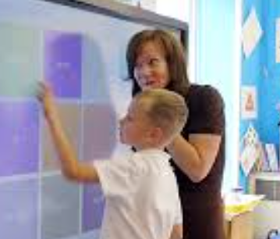
What do I do when I don’t feel safe?

Slide 8
Everyone’s rights…
The right to learn
The right to be happy
The right to be safe
The right to be included

Slide 9
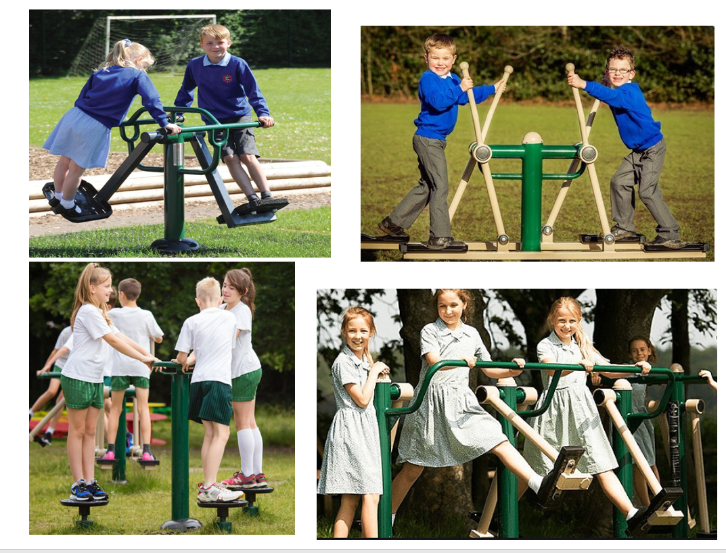

Slide 10
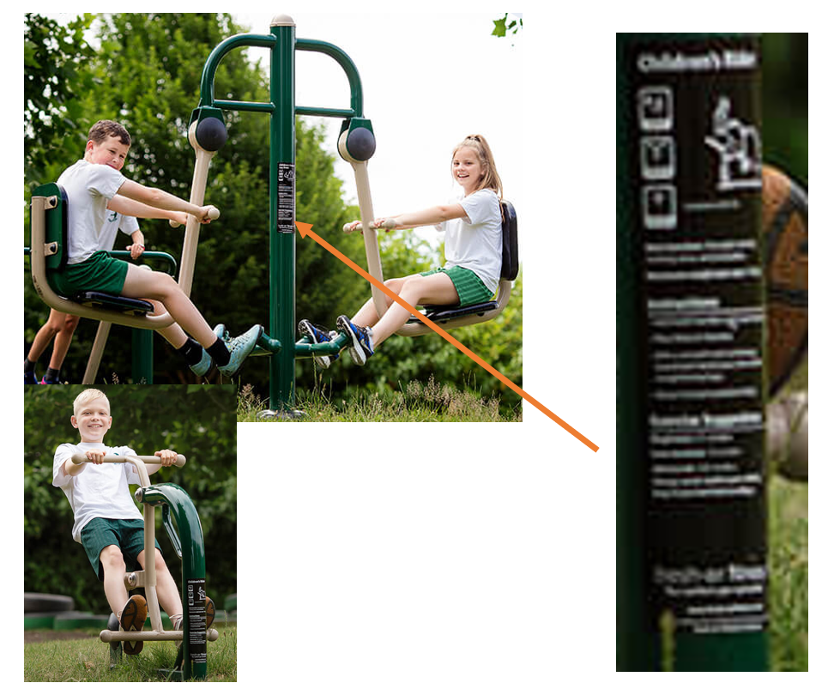

Slide 11
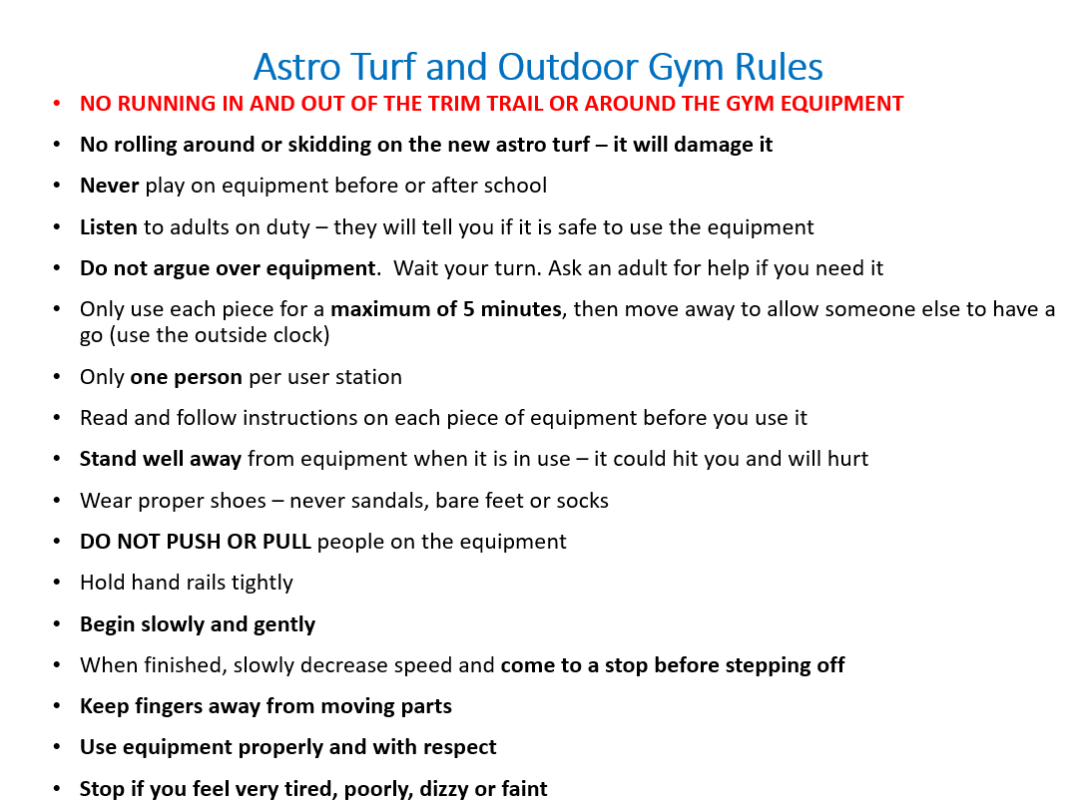

Slide 12
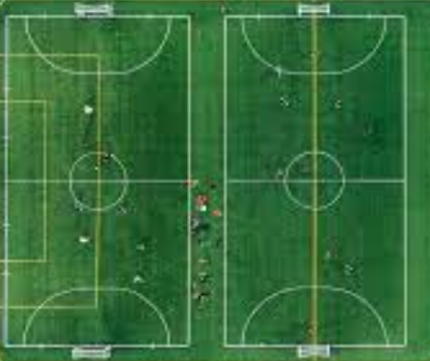
Football in KS2
There are only 2 classes at a time
Classes do not mix on the pitches
There is a rota
There are marked out goals
It is only 5 a side (bibs and non-bibs) – you use substitutes fairly if there are too many to play. You can play penalties if there are not enough people to play 5 a side
You cannot play football (or even kick a ball) anywhere else except these two pitches
If you don’t stick to the rules you miss the next time it is your class’s turn. You could be banned from football
When it rains, we cannot use the field and we cannot play football – it uses up too much space and people get hurt
The adults are in charge and they have the final say on everything

Slide 13

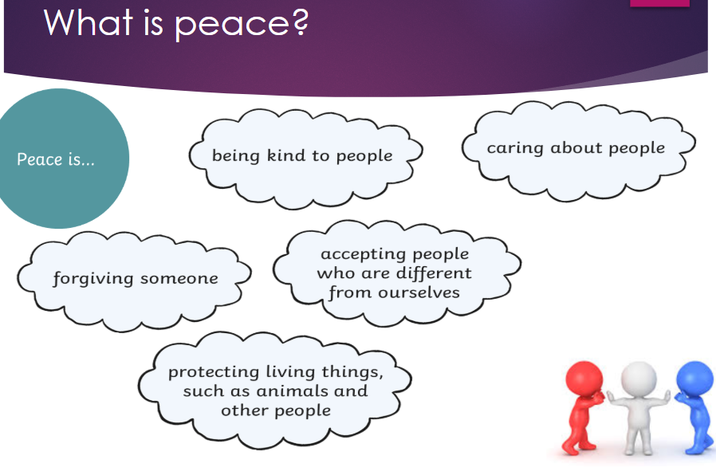

Slide 14
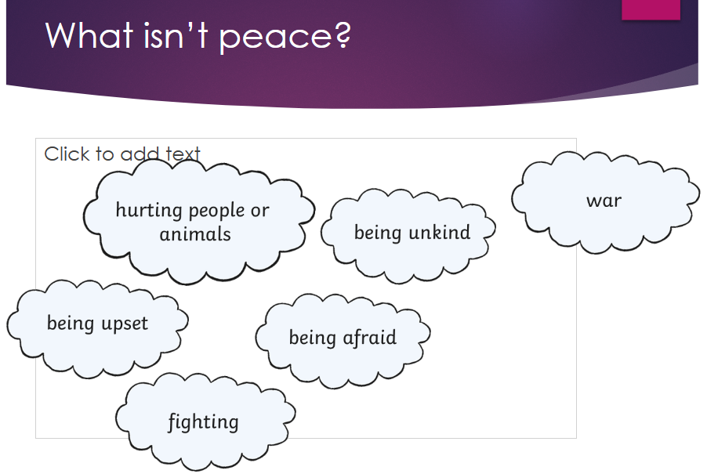

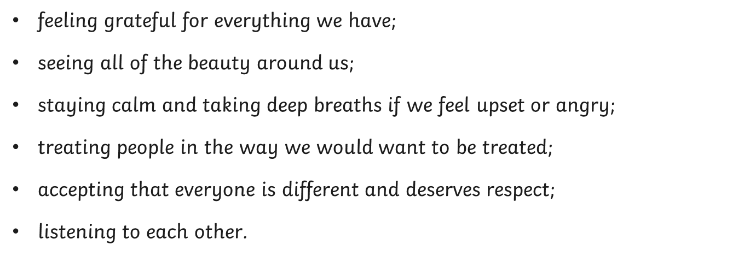

Slide 15
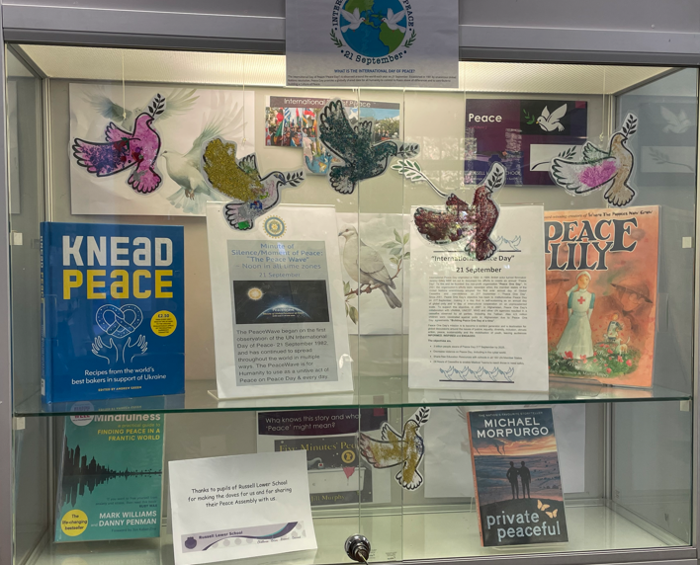
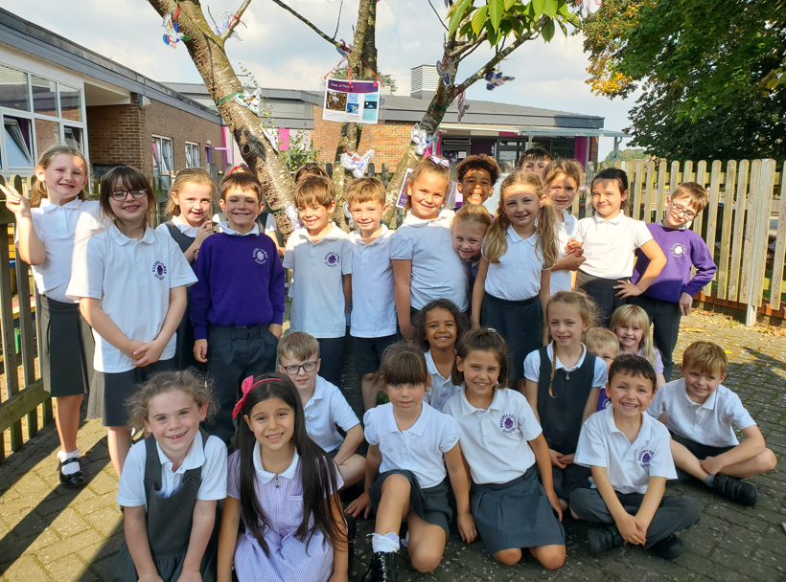

Slide 16
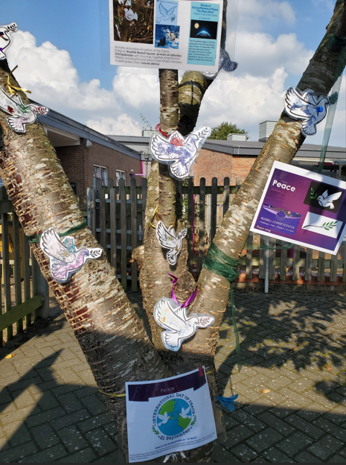
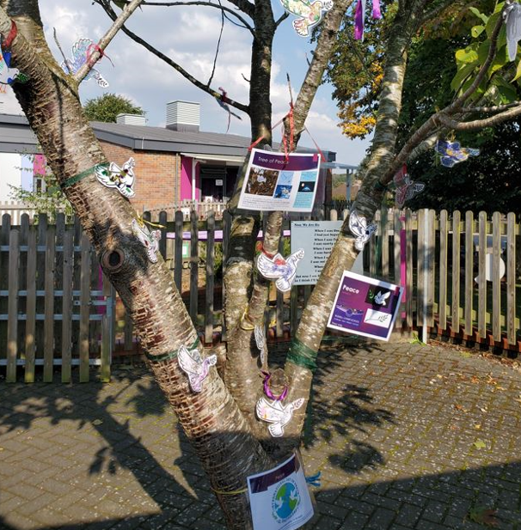

Slide 17


Peace Pond 2025 challenge
Club children
KS2 children

