Slide 1




Everyone’s rights…
The right to learn
The right to be happy
The right to be safe
The right to be included

Slide 2
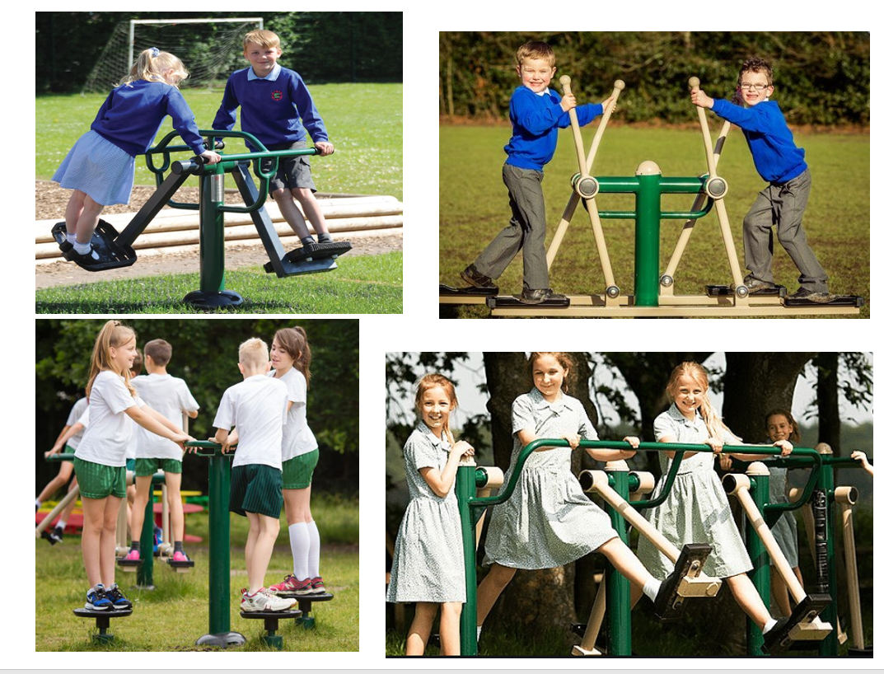

Slide 3
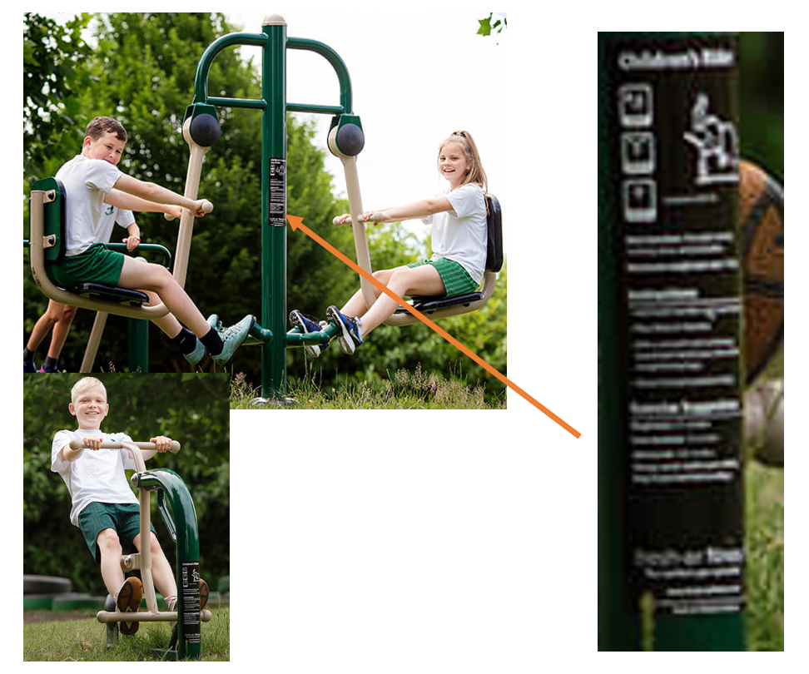

Slide 4
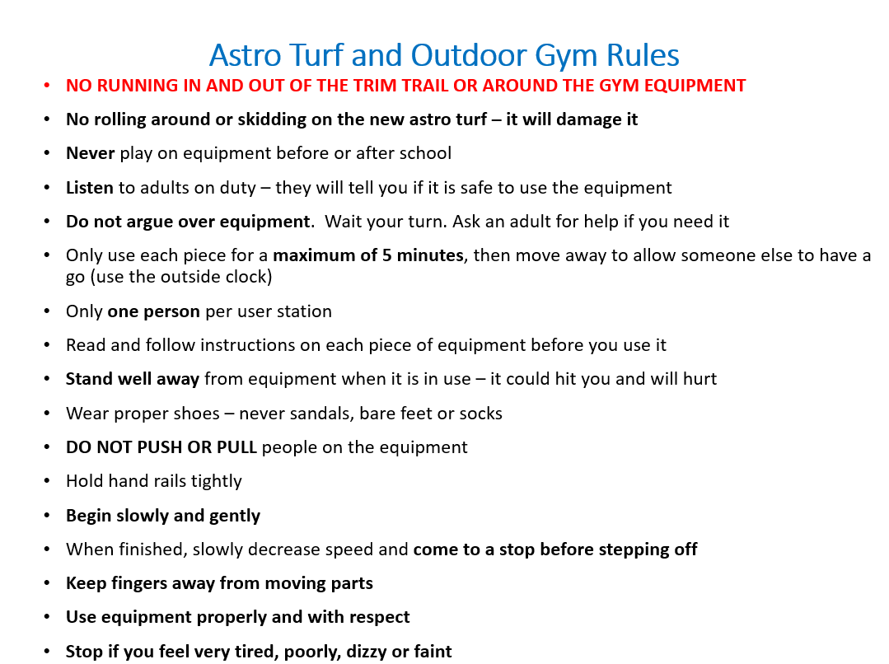

Slide 5

Playground Rules
Keep all our Russell Rights
Walk calmly until you are on the playground - Only run on the tarmac playground – not on ramps, steps and astro turf areas
Stay safe - Do not climb trees – it is not safe
Kind hands and words - No play fighting
Use equipment the way it is intended to be used. For example – skipping ropes are for skipping with, hoops are for rolling and hula-hooping with
Gentle tags
No pulling hoods and clothes
Hood up when it is raining
Rubbish in the right bin

Slide 6
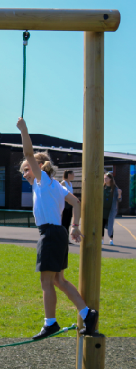
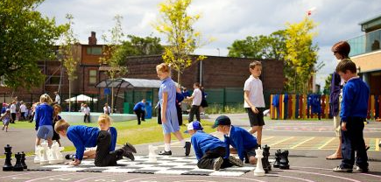
Safe games – Unsafe games
Safe | Unsafe
Tennis Trim Trail used properly Tag – gentle tag Basketball Skipping Giant Polydron What’s the time Mr Wolf? | Tennis where the ball is wacked as hard as possible Trim Trail – when we run in and out of it and play tag around it Rugby tackling Pulling over/wrestling/play fighting Tag where you hit Uses a skipping rope wrongly – tug of war etc.

Slide 7
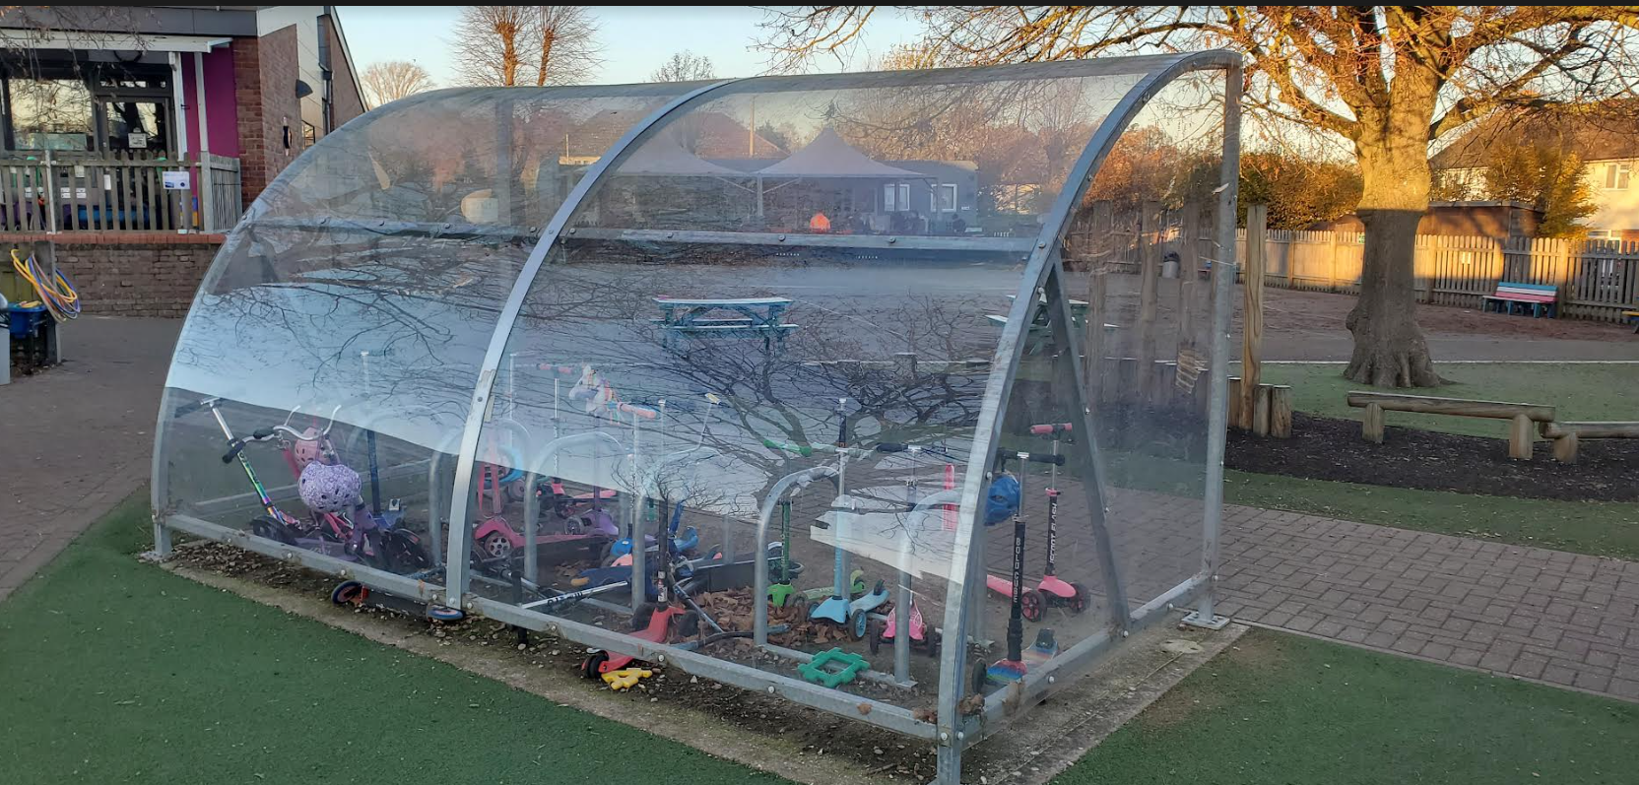
Sensible behaviour – respectful behaviour – we do not bang into the shelters

Slide 8
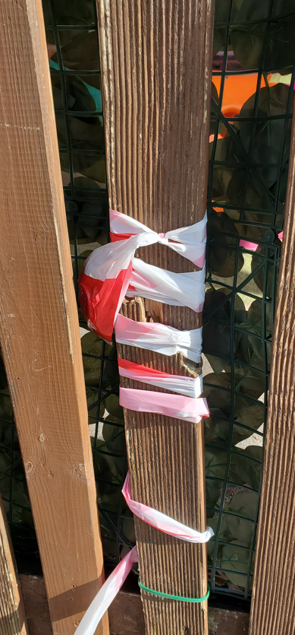
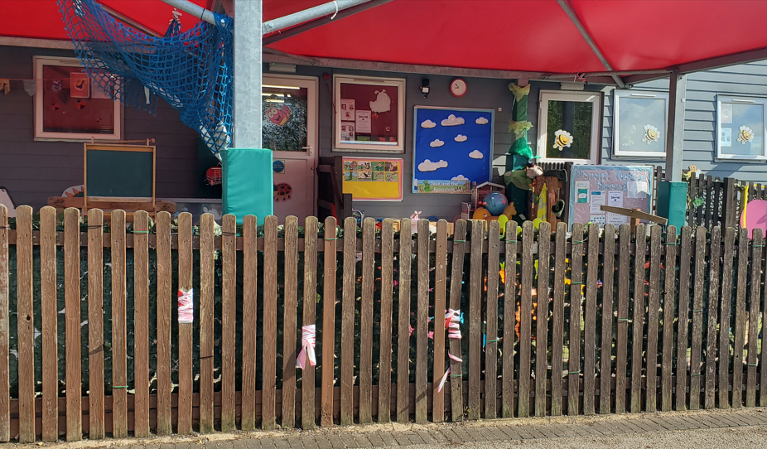
Playing safely – do not run into our fences

Slide 9
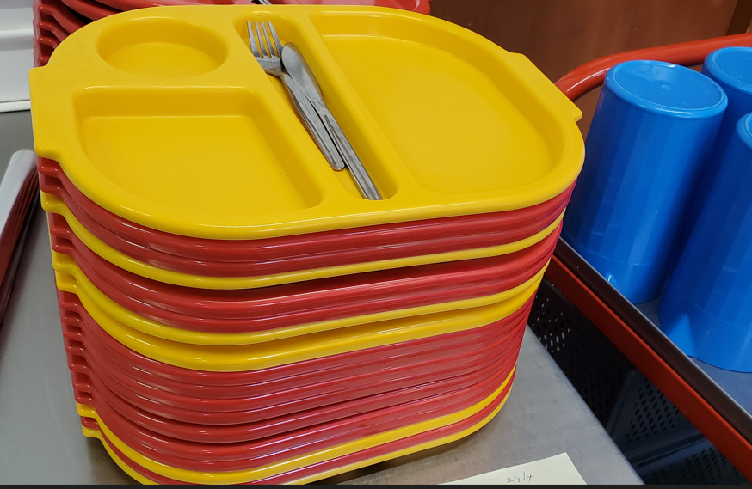
Leaving the environment safe for others – shape matching and food behaviour

Slide 10
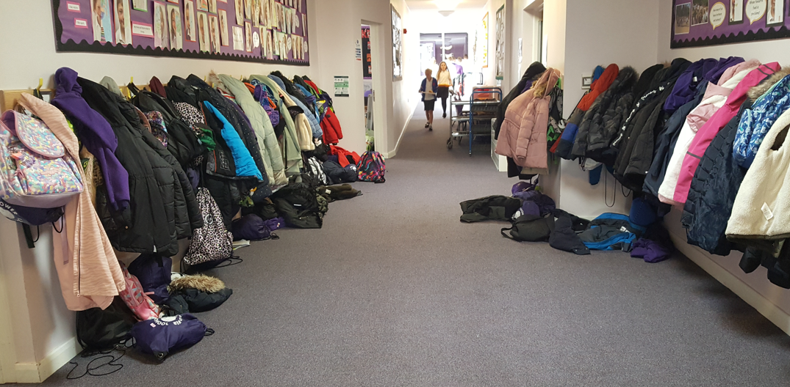
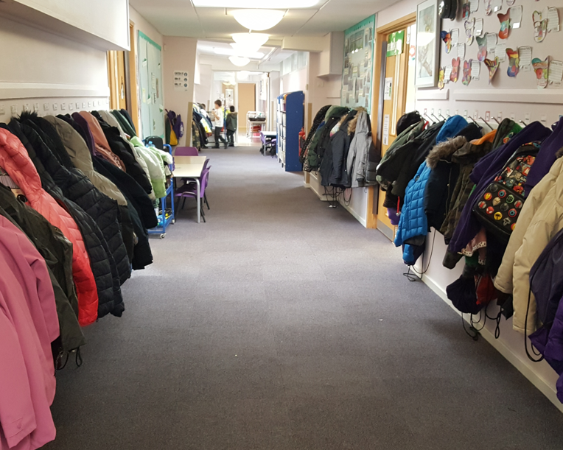
Leaving the environment safe for others – coats and bags on pegs. Safe walking

Slide 11
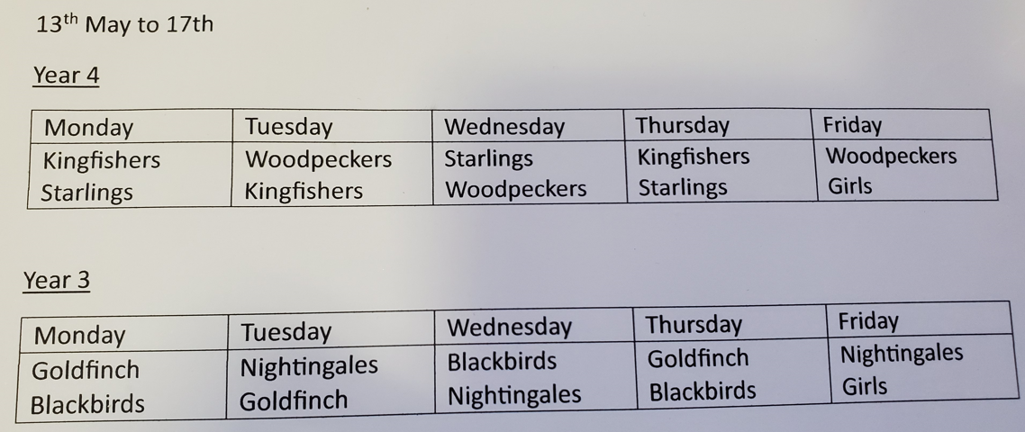
Sharing with others – for example, the field

Slide 12

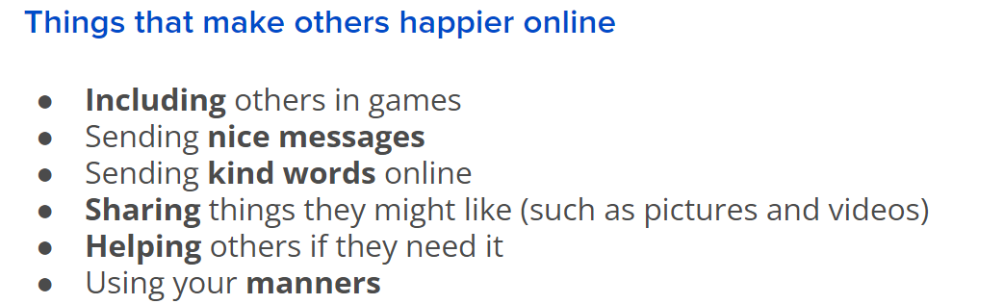
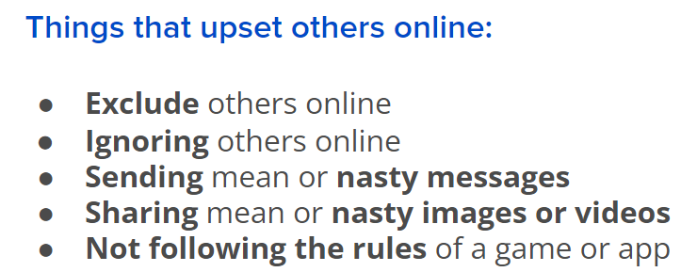

Being Positive – in person and on-line relationships. They are the same!

