Slide 1
Anti-Bullying Week 2020
Notes:
The speech will cover:
the national picture of cyberbullying in England,
what are the key issues for young people,
how can schools support young people to address cyerbullying
what resources / tools are available for schools and young people
the picture for cyberbullying and disabled young people and those with SEN
There will be a question put to you at the end of the presentation and a chance for questions.

Slide 2
What is bullying?

Slide 3
Is this bullying?
The ABA (Anti-Bullying Alliance) defines bullying as:
The repetitive, intentional hurting of one person or group by another person or group, where the relationship involves an imbalance of power.
Bullying can be physical, verbal or psychological.
It can happen face-to-face or online.
Notes:
ABA definition of bullying. Very important that we have a shared understanding of what bullying is. You might want to replace with your own school’s definition.

Slide 4
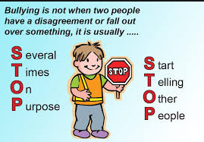

Slide 5
Types of bullying
Verbal
name calling, calling people unkind names, verbal threats of violence
Physical
hitting, kicking, biting, pushing, tripping you up – anything that hurts you by touching you
Indirect
isolating someone, leaving them out, spreading rumours, threatening looks
Cyber / Online
social networking pictures, Whatsaap groups to encourage bullying, nasty text messages, filming people without permission, prank calls

Slide 9
Definition of ‘united’
The Cambridge English Dictionary definition of ‘united’:
UNITED
1
2
Joined together as a group “Factions previously at war with one another are now united against the common enemy.”
If people are united, they all agree about something: “On that issue, we're united.”
Notes:
Reference: https://dictionary.cambridge.org/dictionary/english/united

