Slide 1
Needs More Practice
Each jump is worth 100.
Each jump is worth 50.
Each jump is worth 100.

Slide 2
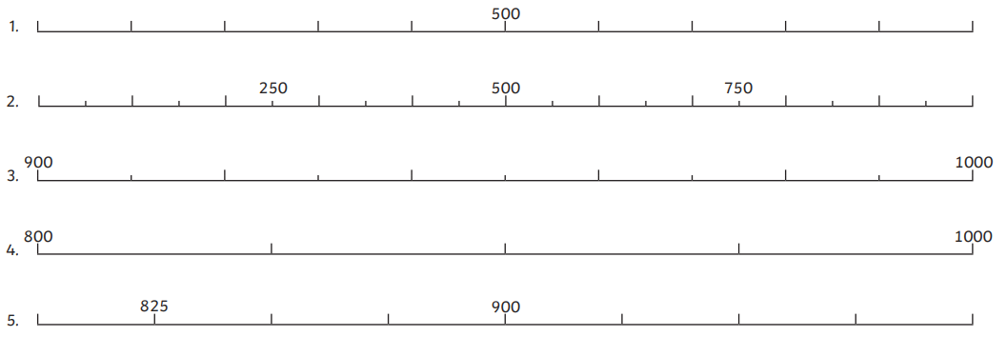
Feeling Confident
Each jump is worth 100
Each jump is worth 50
Each jump is worth ___________
Each jump is worth ___________
Each jump is worth 25

Slide 3
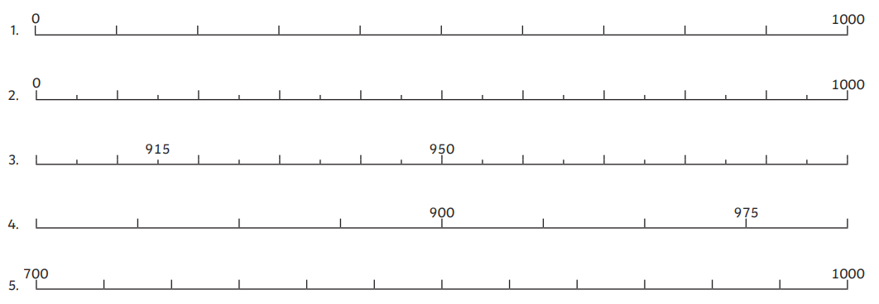
Challenge Me
Each jump is worth ___________
Each jump is worth 50
Each jump is worth 5
Each jump is worth 25
Each jump is worth ___________

Slide 4
STAR Challenge

