Slide 1
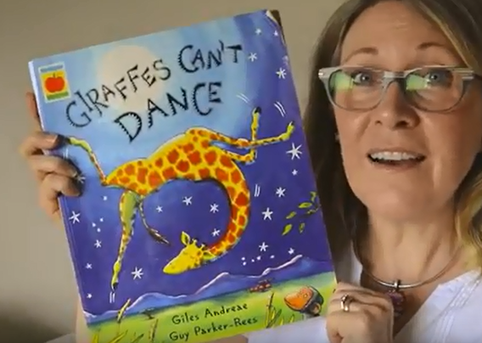
Giraffes can’t dance Having a helpful attitude

Slide 2
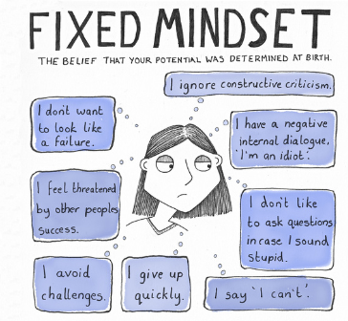
Having an unhelpful attitude
I can’t

Slide 3
Having a helpful attitude – The power of YET
I can’t yet
I can try
I can do my best
I can learn from my mistakes

Slide 4
How does Gerald’s attitude change through the story? What helps him change? Who is the only person who can change you?
https://www.youtube.com/watch?v=m6QJK2oiF0M

