Slide 1
Children’s Mental Health Week
4 – 10 February 2019
Healthy: Inside and Out
Assembly slides for Primary Schools

Slide 2
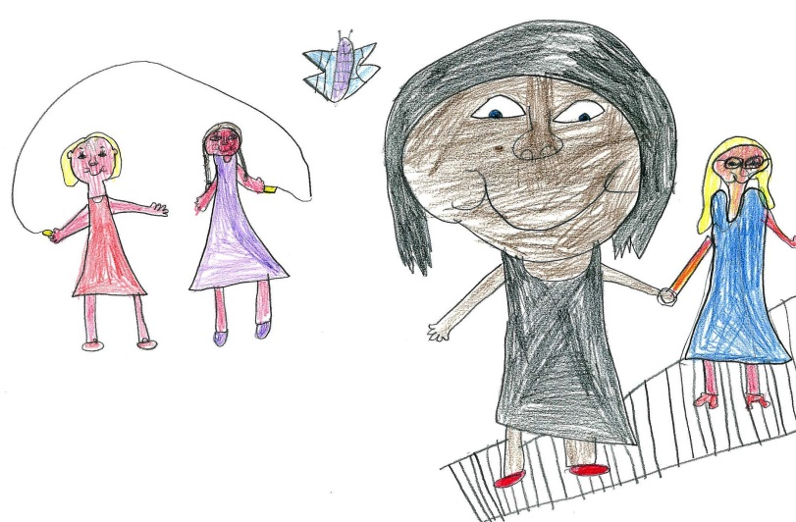
Being healthy
How do we stay healthy?
Food
Being active
Sleep
Slide 2

Slide 3
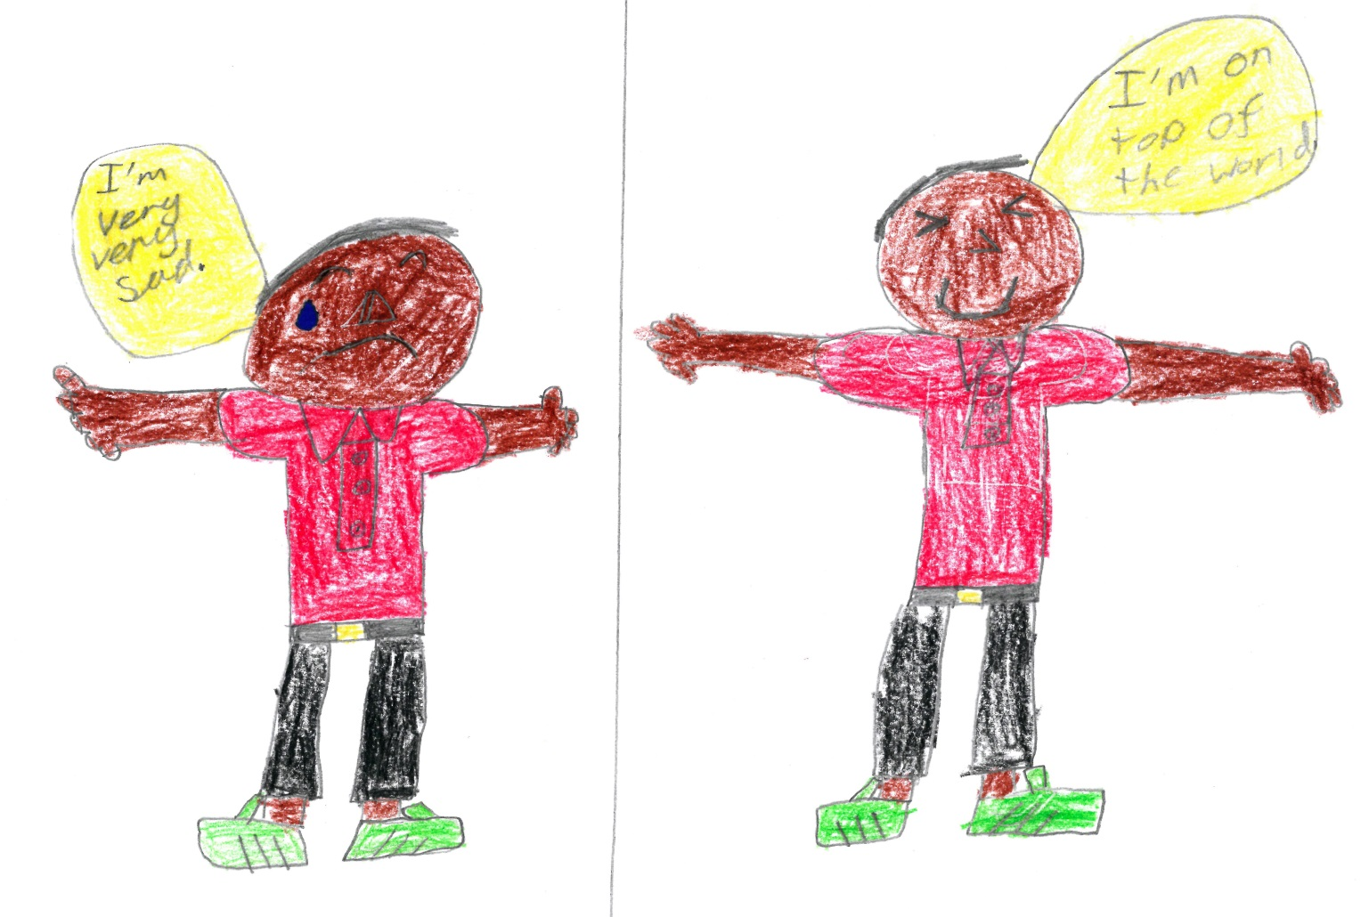
Being healthy
Go outside and play
How do you cheer yourself up when you feel sad?
Talk to someone
Play happy music
Watch TV
Have a sleep
Have a healthy snack
Get a cuddle from someone, a pet or a toy
Do something you enjoy
Slide 3

Slide 4
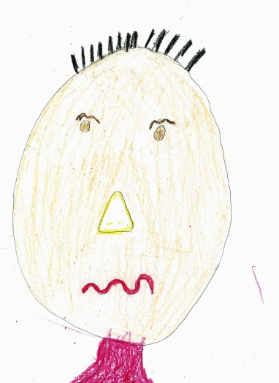
Bodies and minds
What do you feel in your body when you’re…
Nervous?
Angry?
Happy?
Fizzy tummy
Distracted
A bit poorly
Unsure
Frightened – but not sure what of
Hot
Tight muscles
Want people to go away
Unhappy
Like I will burst
Warm
Relaxed
Sociable
Happy
Slide 4

Slide 5
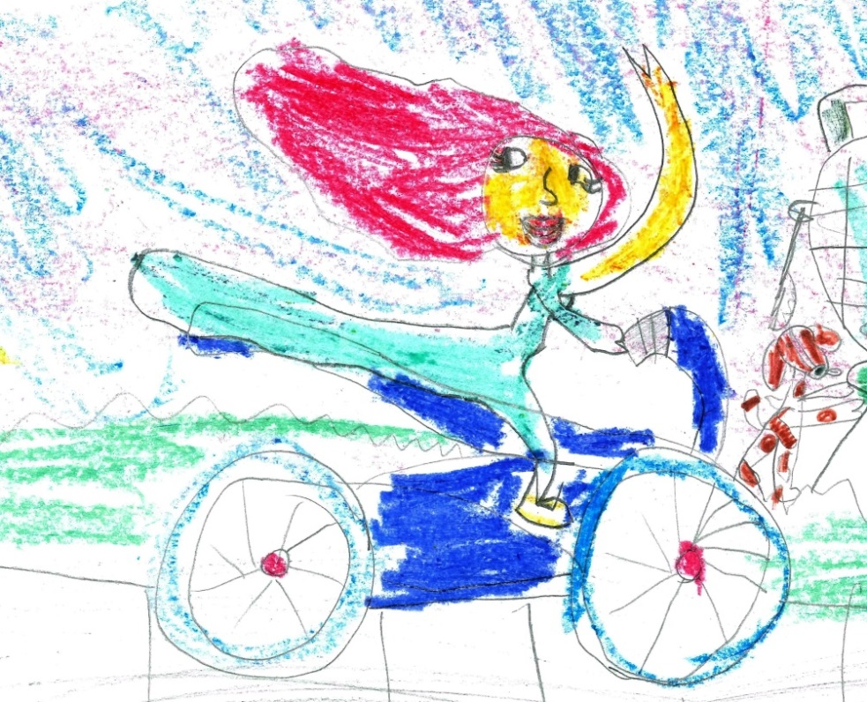
Bodies and minds
Our bodies and minds are connected!
Looking after our bodies helps our minds too.
Infants
Exercise: tinyurl.com/yc4c7bwd
Play this section: 1m03-2m48
Sleep: tinyurl.com/ybwo8hq5
Play this section: 2m35 - 3m30
Juniors
Food: tinyurl.com/zwj8pzr
Play this section: 0m12-3m01
Sleep: tinyurl.com/yc3hwa89
Play the whole video. Duration: 1m21
Slide 5

Slide 6
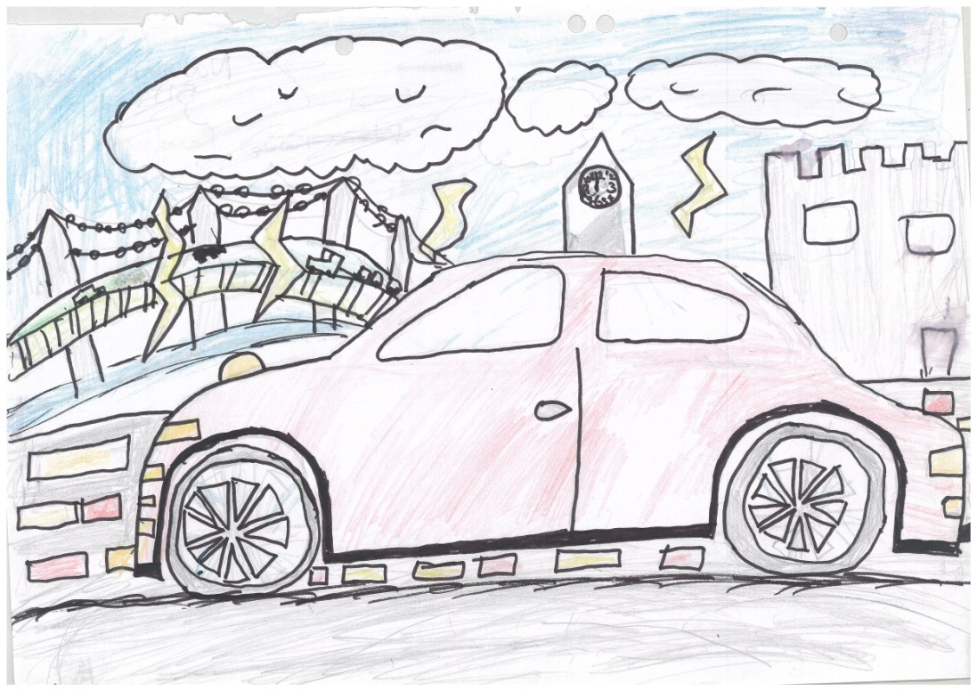
Healthy: Inside and Out
You’re like a car – you need working parts AND a good driver!
Infants
Exercise: tinyurl.com/gv7hbzn
Play the whole video. Duration: 1m26
Sleep: tinyurl.com/ybwo8hq5
Play this section: 4m53 - 6m10
Juniors
Food: tinyurl.com/yd85pnhk
Play the whole video. Duration: 2m13
Slide 6

Slide 7
What steps are WE taking to be ‘Healthy: Inside and Out’?
Eating healthy snacks and lunches
Getting a good nights sleep and turning off screens one hour before bed
Walking/Biking or Scooting to school
Drinking water through the day
At least 5 minutes of calm breathing in the day
Getting outside for fresh air
Don’t forget if you’re worried about something, you can always speak to your teachers, Miss Watton or Mrs Walker
Slide 7

Slide 8
Credits:
Slide 5
Lion Family Fitness for Children Cartoon for Kids - VexTrex: tinyurl.com/yc4c7bwd
Why Do You Need A Good Night's Sleep? - Get Well Soon: tinyurl.com/ybwo8hq5
The 5 Fabulous Food Groups – SciShow Kids: tinyurl.com/zwj8pzr
Good Sleep in Kids and Teens – Adiaha Franklin: tinyurl.com/yc3hwa89
Slide 6
Shake Break Exercise Song for Kids | Pancake Manor: tinyurl.com/gv7hbzn
Why Do You Need A Good Night's Sleep? - Get Well Soon: tinyurl.com/ybwo8hq5
3 out of 5 Healthy Breakfast Lesson Plan: Nutrition Made Fun! – Dairy Council of California: tinyurl.com/yd85pnhk
Slide 8

